Slide 1
                By: Marc R. Lamb, Aviation & Community Services Manager
Q2 2020 COMMUNICATIONS REPORT

Slide 2


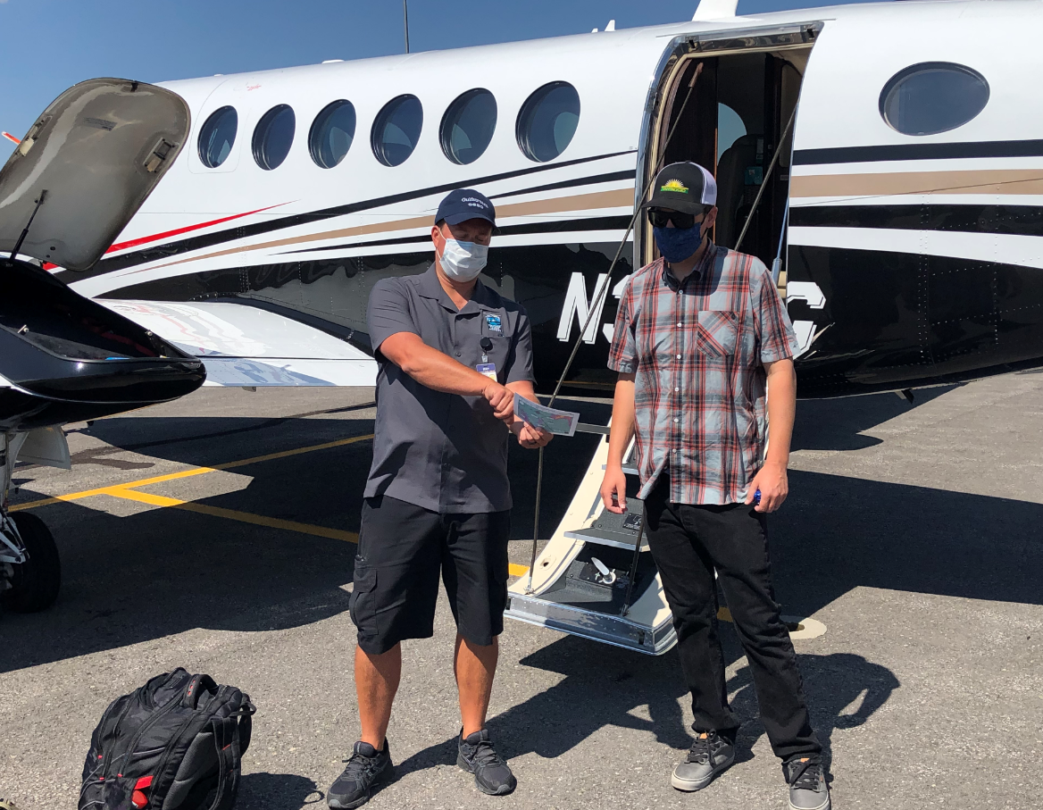
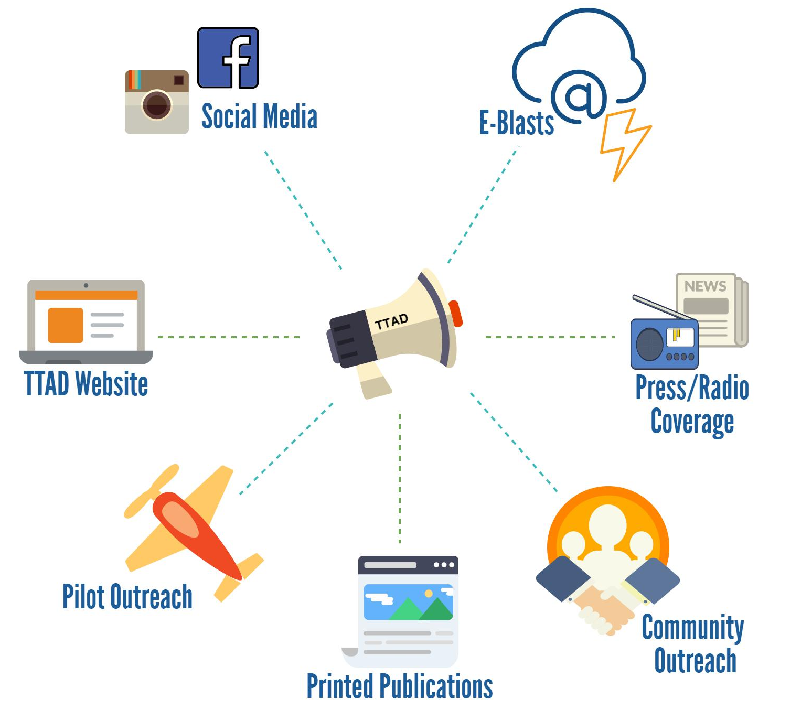

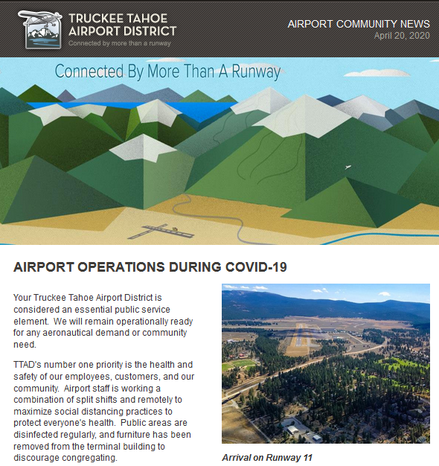
  Q2 2020
  DISTRICT COMMUNICATION METHODS

Slide 3
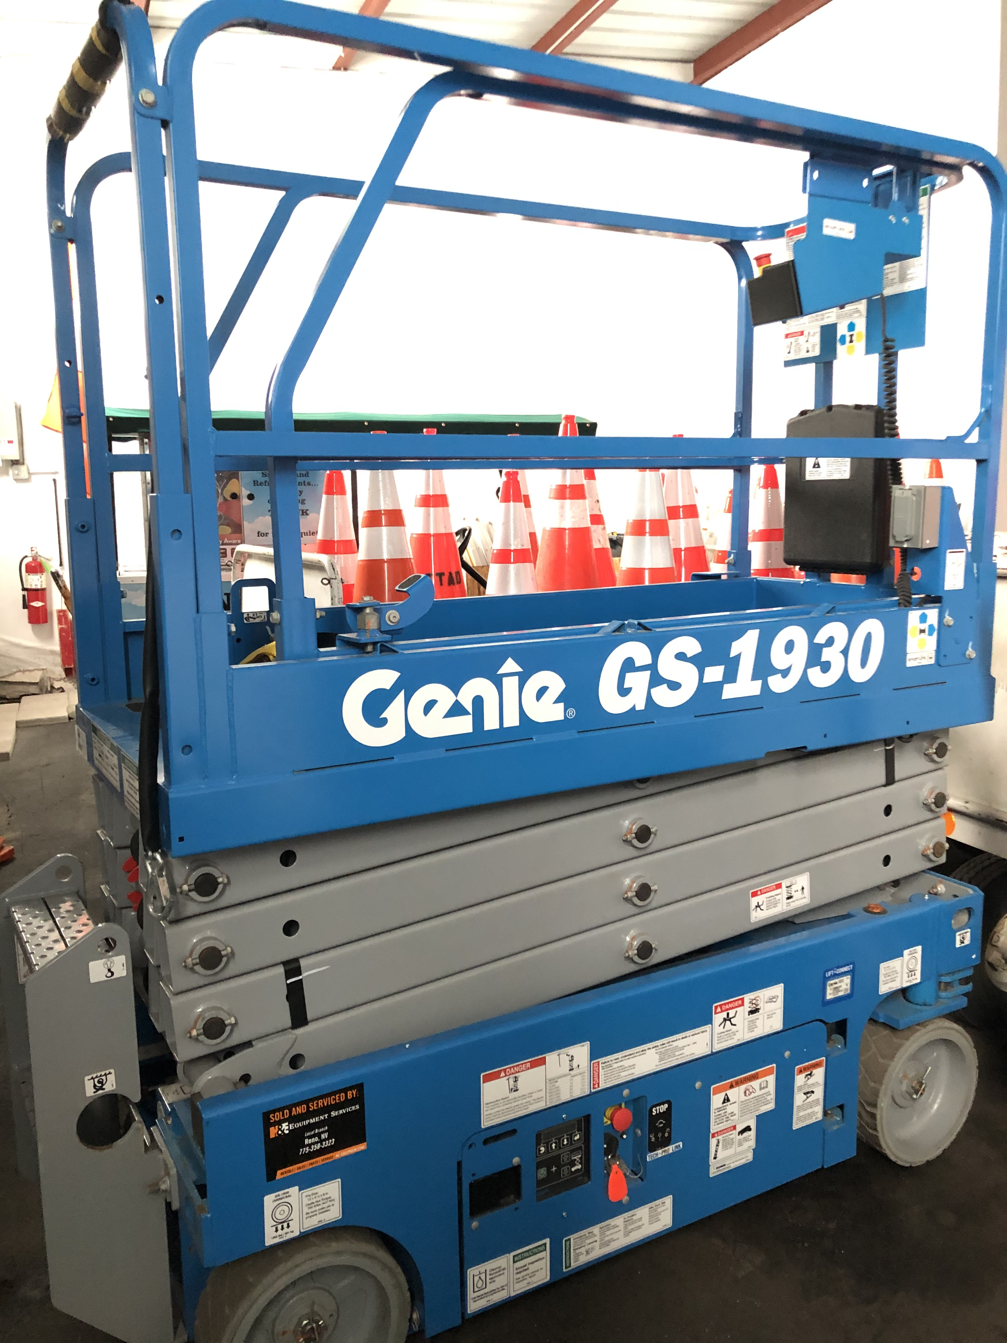
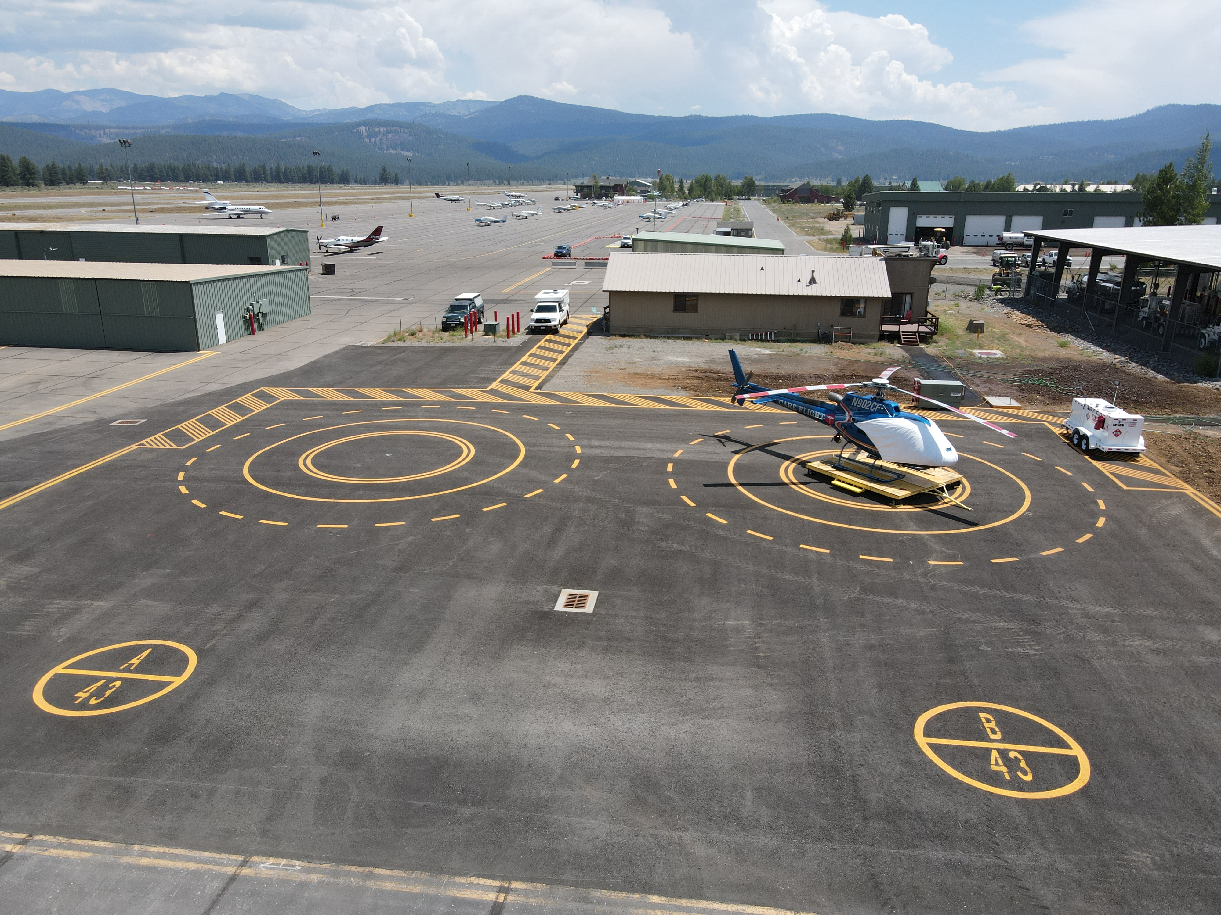
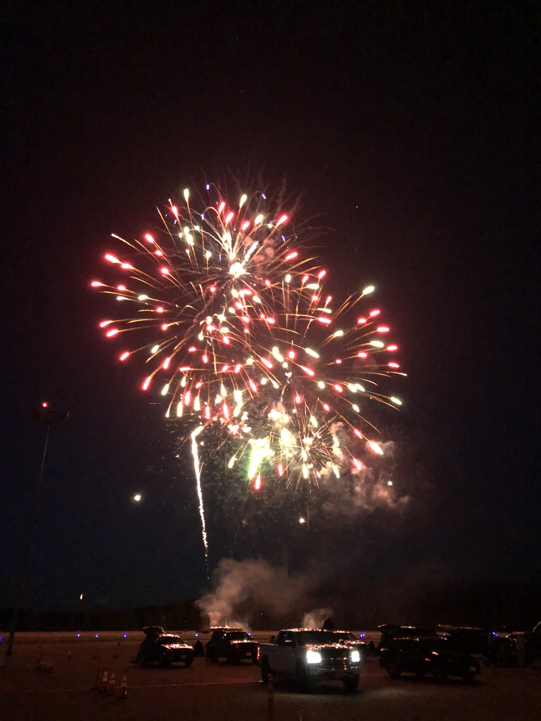
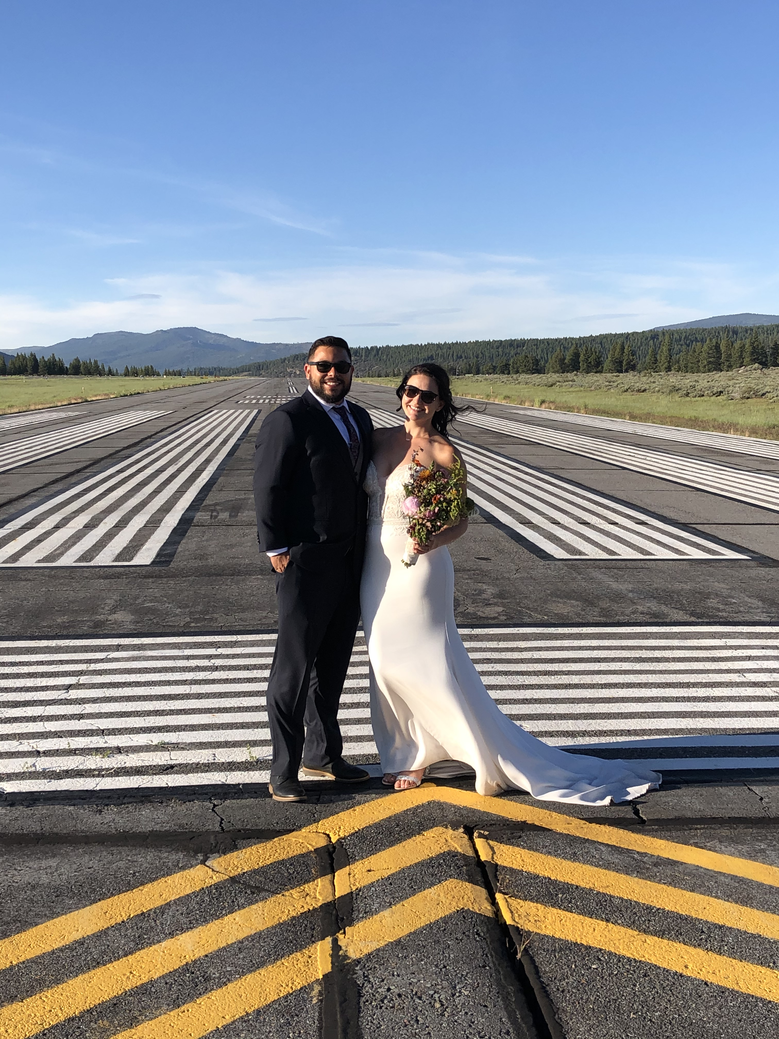
Q2 2020
AIRPORT EVENTS & HIGHLIGHTS
Air Traffic Control Tower expands Spring and Summer hours (4/01 & 6/01)
TTAD staff manages ongoing COVID pandemic protocols at the airport (Q2)
Flight Simulator opens to the public, Mtn Lion Aviation assumes schedule mgmt (Q2)
TTAD takes delivery of new LaRue Snowblower and Scissor Lift with Trailer (Q2)
U.S. Forest Service Summer Fire Fighting Helicopter Crew based at KTRK (Q2)
Pilot Outreach ZOOM - KTRK & NWS Virtual Intermountain West, Aviation Weather and Safety Workshop 75 attendees (5/30)
TTAD Going Green - Dry Lake Beacon Goes Solar and power poles pulled from Waddle Ranch (6/03)
Project Graduation KTRK Hosts 2020 Graduating Class Fireworks Show (6/13)
Pilot Outreach ZOOM - AVCOM hosts Pilot Roadshow “Flying In & Out of KTRK” 80 private and Corporate attendees across the U.S. (6/13)
Runway photo shoot for Alaskan Airlines Flight Attendants (6/20)
Runway 29 Blast pad reconstruction completed (6/30)
Aircraft wash rack construction completed (6/30)
Heliport construction project completed (6/30)

Slide 4
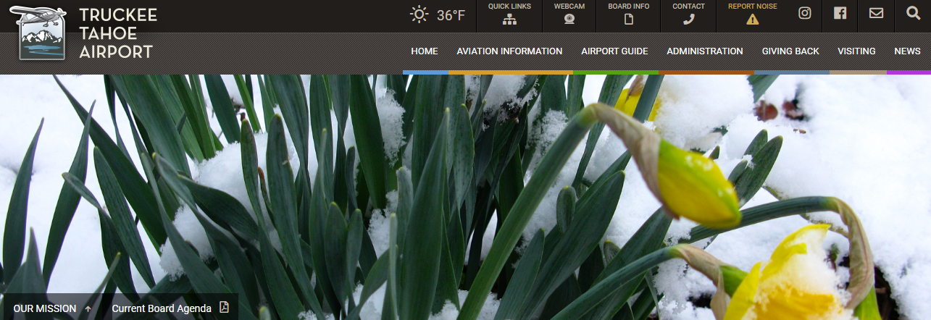
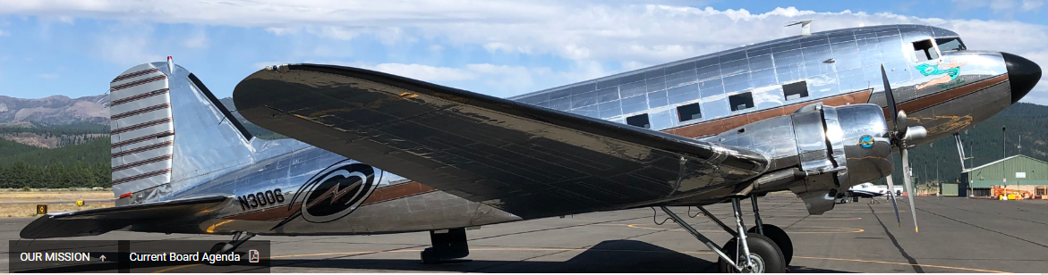
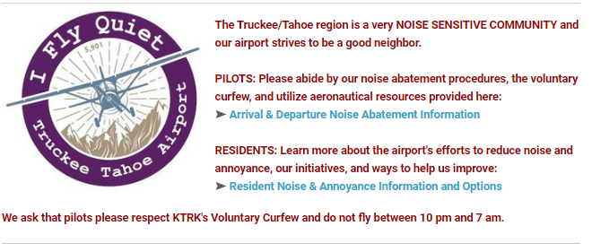

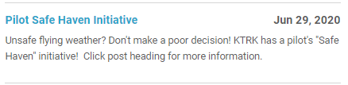
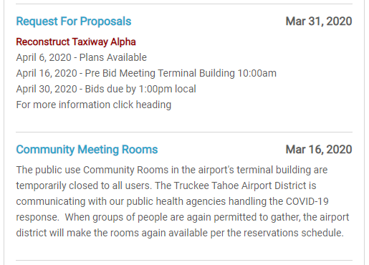
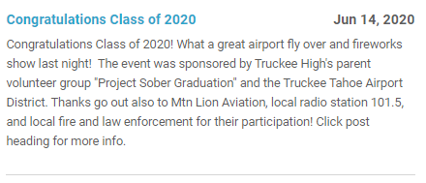
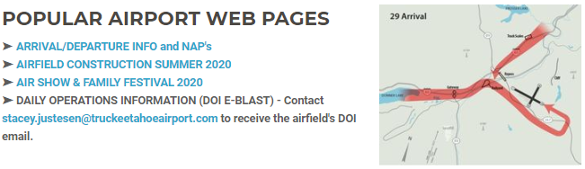
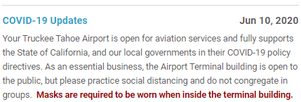
  Q2 2020
  KTRK WEBSITE STATS
Audience Overview
In Q2 we had 14,377 website users, who completed
37,779 sessions and 59,031 page views.
Website traffic “users” were down 1% from Q2 2019
Where do our website users live? US 12,301
  California 7,635
  Nevada 1,358
  Oregon 337
  Washington 279
  Texas 273
What web pages do visitors view?
  Webcam 31,665
  Home Page & Community News 10,527
  Aviation Flt Procedures & Planning 1,569
  Admin - Board meetings 804
  Aviation - Hangars 540
  Admin - Doing Business/Construction 461

Slide 5
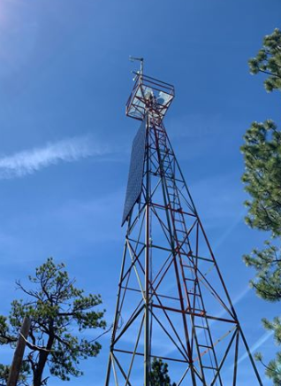
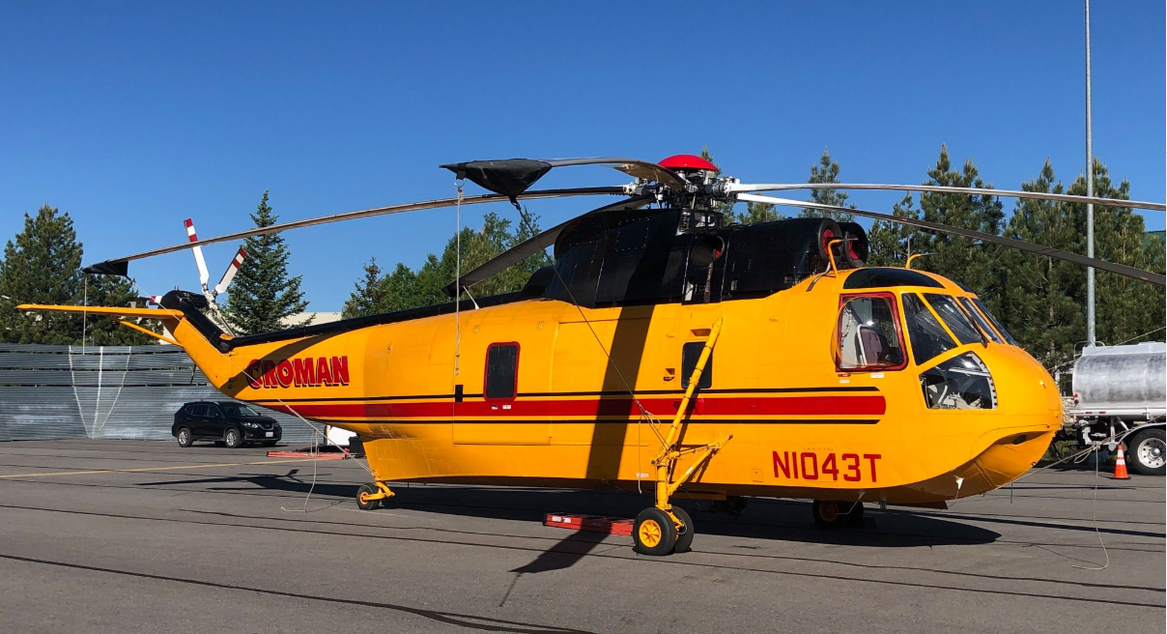
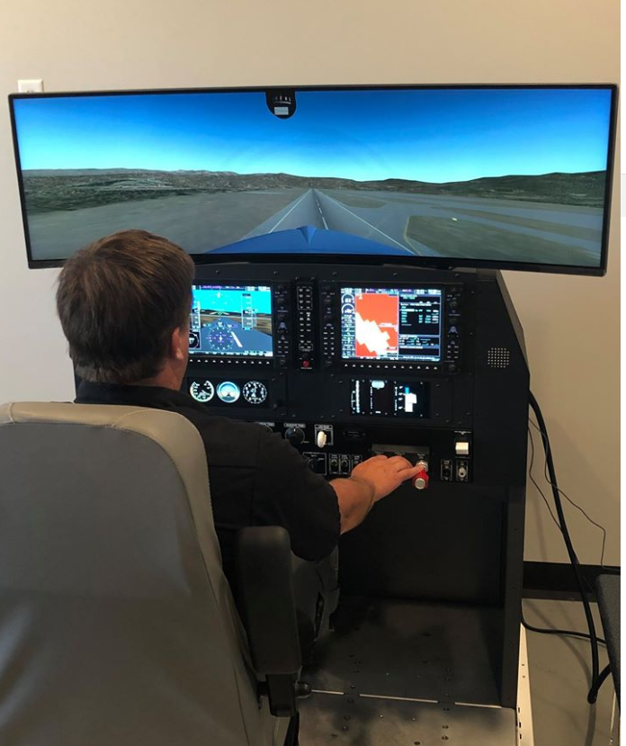
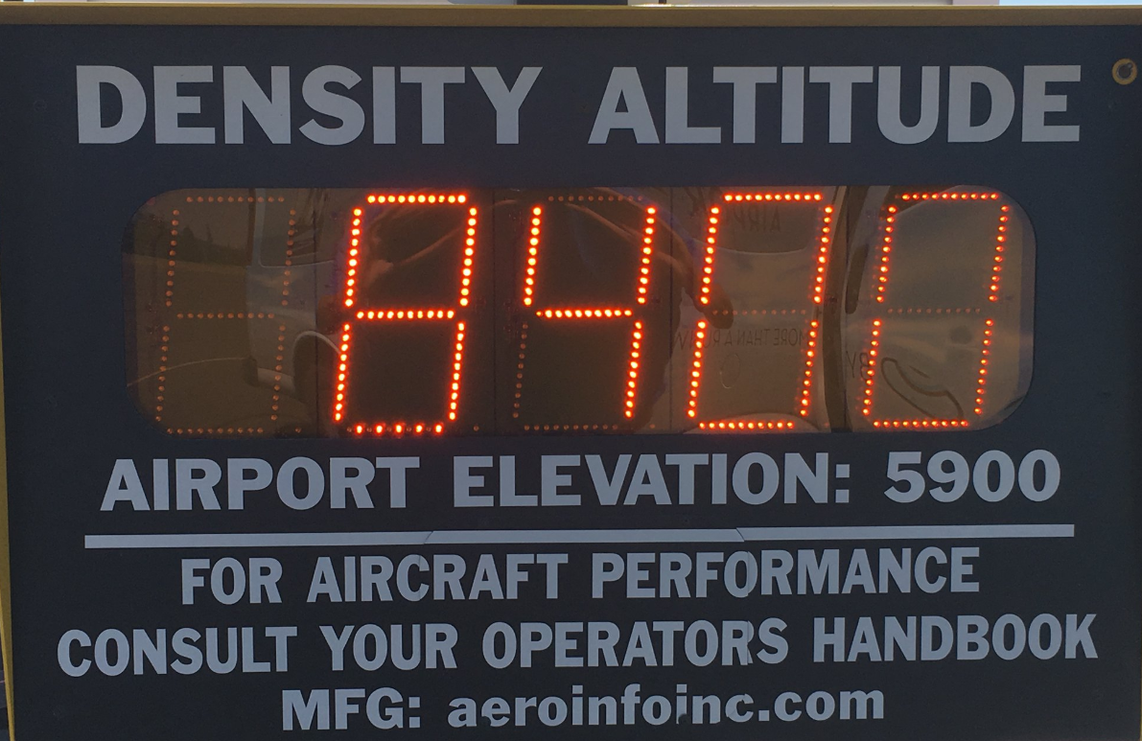
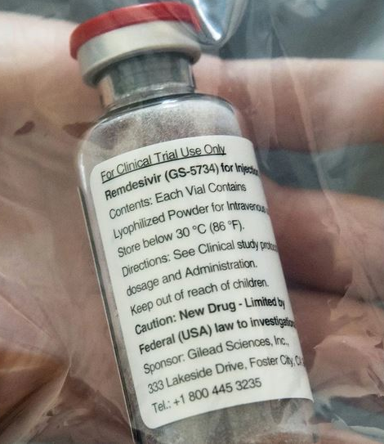
  Q2 2020
  SOCIAL MEDIA
INSTAGRAM
Launched 02/01/2016
1,390 Followers as of 06/30/2020
Followers up 32% over Q2 2019
Average 1 post per week
FACEBOOK
Launched 06/01/2015
2,699 Followers as of 06/30/2020
Followers up 14% over Q2 2019
Airport Facebook Page Rating: 3.7 out of 5.0
Average 2 posts per week
Highest FB Post Views Q2 2020: (Top 5)
13,620 - TFHD Remdesivir drug delivery
5,358 - D-Day Squadron Honor Flyover
1,396 - Density Altitude
972 - National Guard High-Rollers Flyover
881 - Karin Hardiman Tower Manager Retires

Slide 6

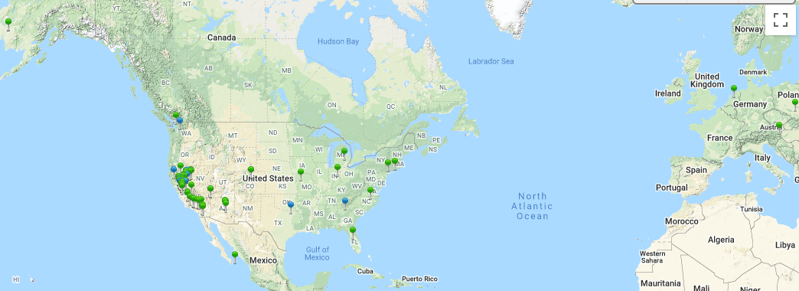
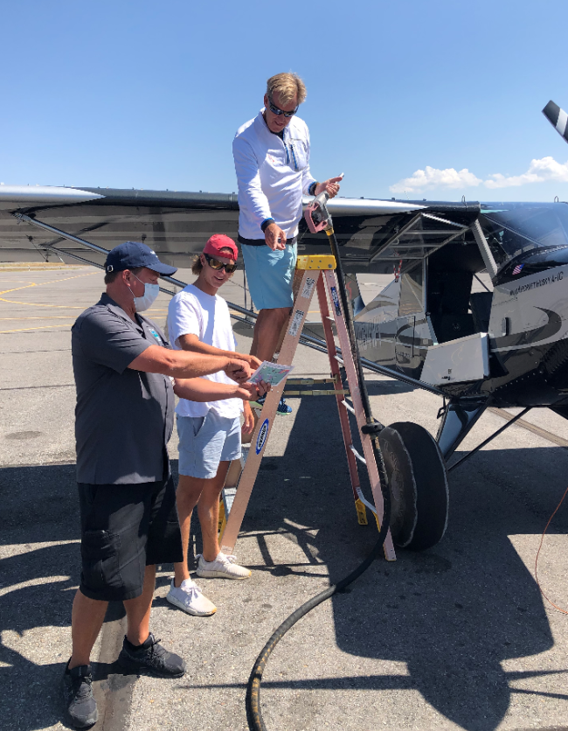
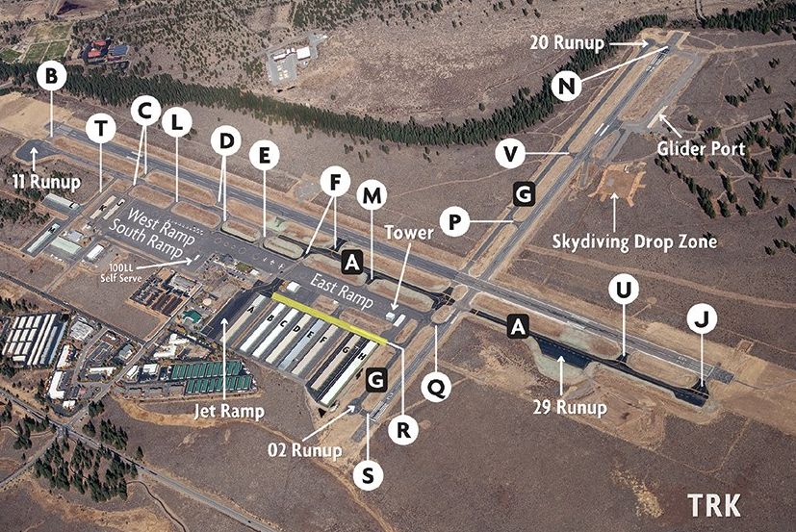
  Q2 2020
  KTRK PILOT & COMMUNITY OUTREACH EFFORTS
    E-BLAST RECIPIENTS OPENED DATE
    April Community Outreach 965 54% 04/20/2020
    April Tenant Rent Deferral 557 60% 04/29/2020
    May Community Outreach 964 49% 05/25/2020
    KTRK FAMILIARIZATION PROGRAM # FLOWN DATE
    Local Instructor Familiarization Flights 1 Q2
  PUBLICATIONS IN-HOUSE # PRINTED DATE
  Pilot News Summer 2020 Edition 600 copies Mailed Q3
  PILOT OUTREACH DATE
  - Airfield Construction 2020 (web page) Daily
- ZOOM - KTRK & NWS Virtual Intermountain West, Aviation 05/30/2020
Weather and Safety Workshop 75 attendees
- ZOOM - AVCOM hosts Pilot Roadshow “Flying In & Out 06/13/2020
of KTRK” 80 private and Corporate attendees across the U.S.
- Pilot & Pax Outreach on ramp, NAP & Curfew Compliance Daily
- DOI’s (Daily Operating Info) 62 E-blasts to airport users Daily
- FICON (Field Condition) and NOTAMS posted As Needed
- Partnered with Solairus Aviation - Flt Procedures & NAPS On Going
- Contacted Artie Clark Net Jets Flt Ops Compliance Mgr 04/24 & 6/30

Slide 7
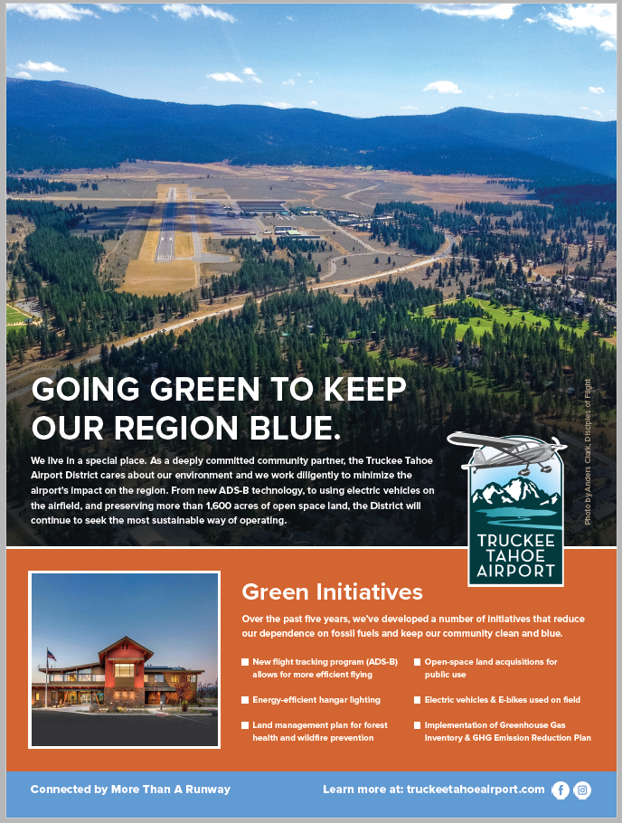
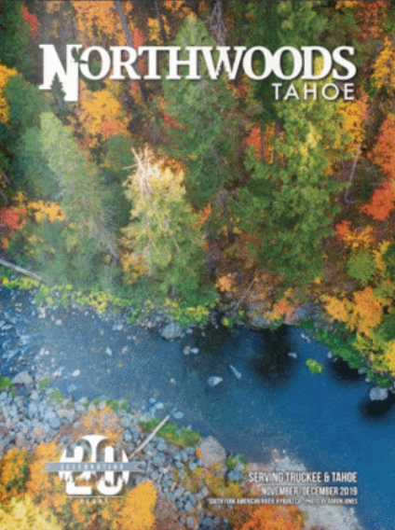
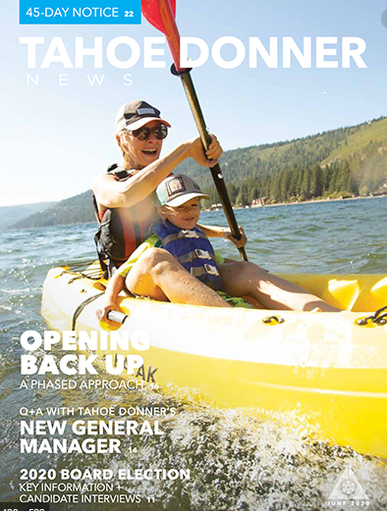
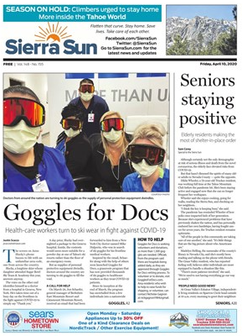
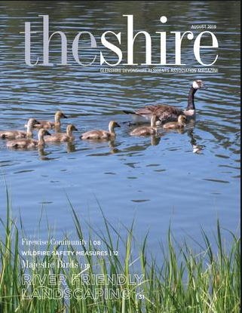


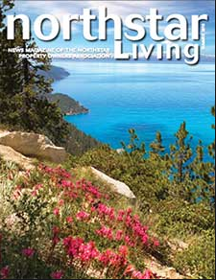

  Q2 2020
  SCHEDULED SUMMER “GOING GREEN” AD CAMPAIGN

Slide 8
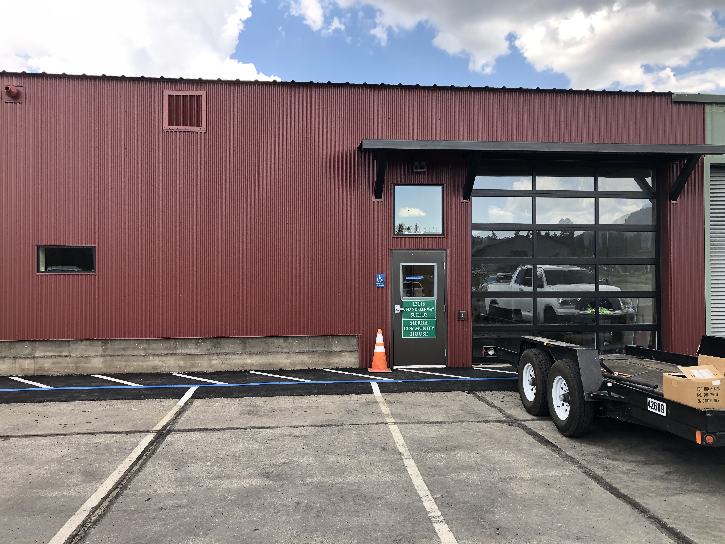
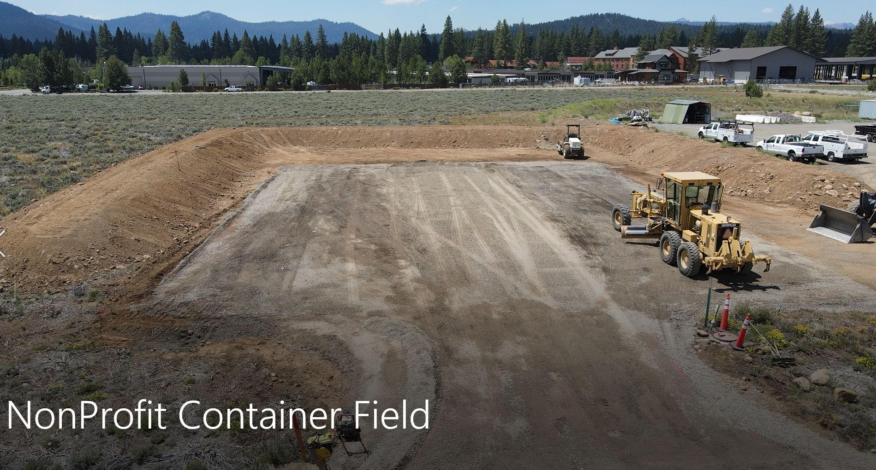
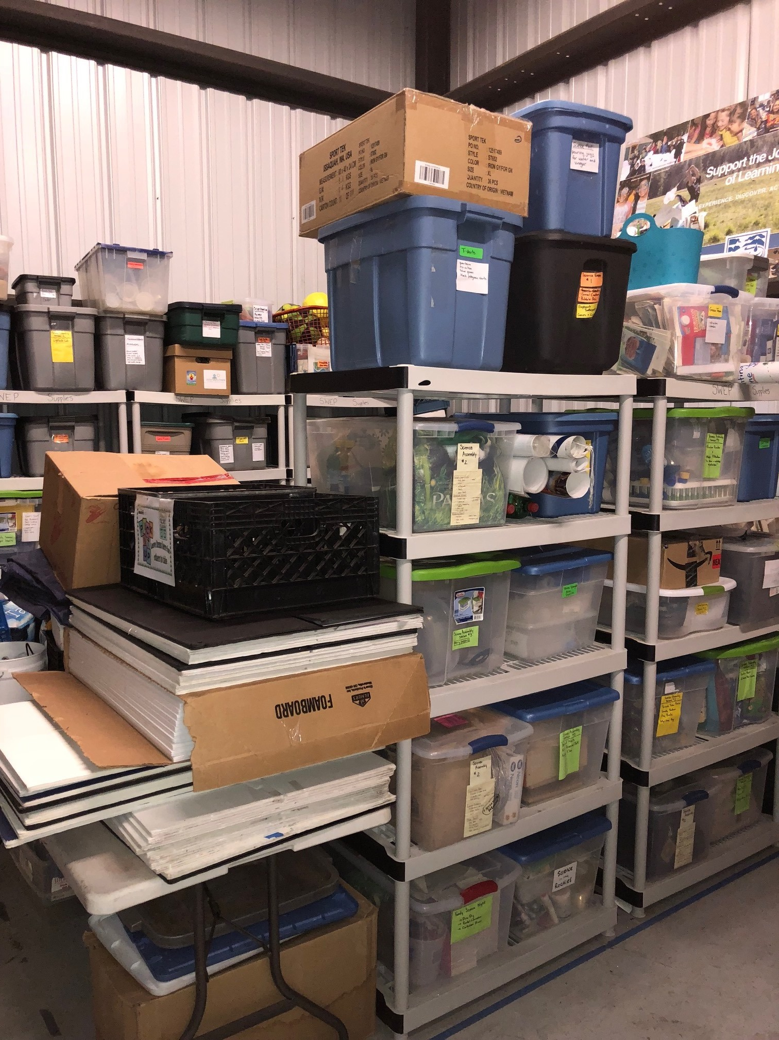
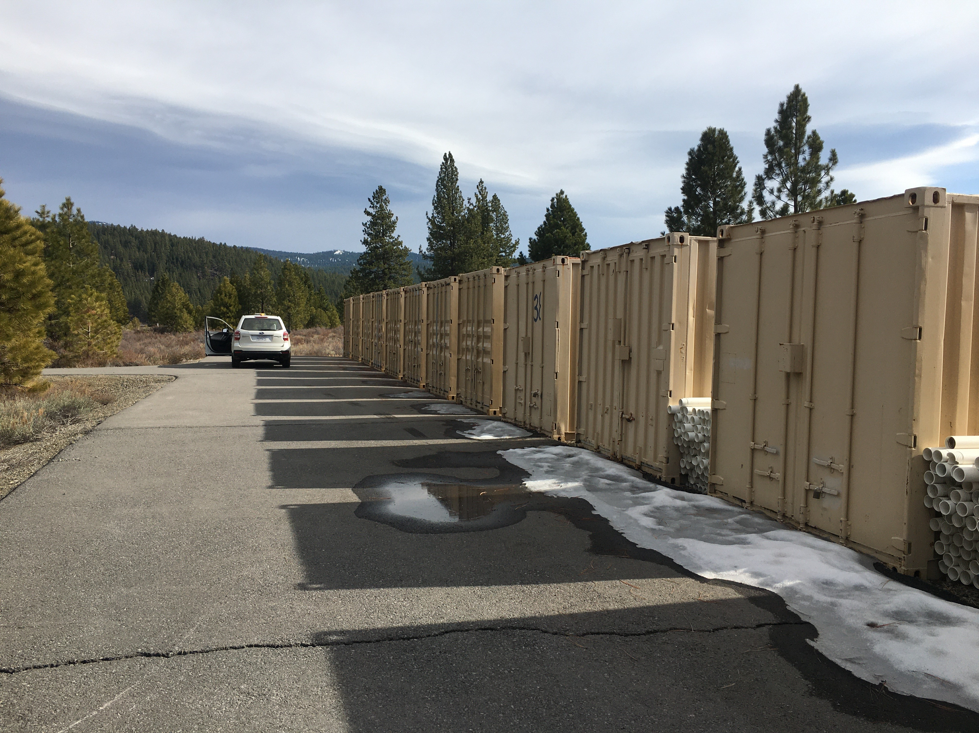
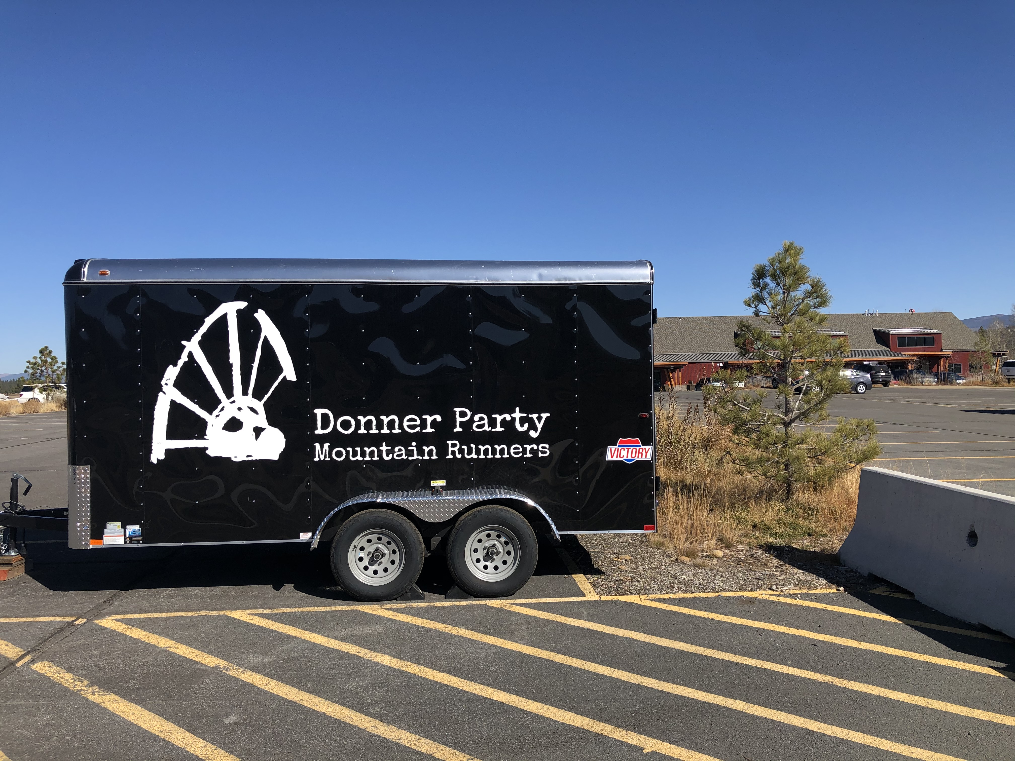
Q2 2020
AIRPORT SPACE PROVIDED FOR NON-PROFITS (17)
American Red Cross
Civil Air Patrol
Donner Party Mountain Runners
Experimental Aircraft Association
Foster the Sierra
Friends of the Truckee Library
KidZone Museum
Little Gems Pre-School
Sierra Watershed Education Partnerships (SWEP)
Tahoe Forest Hospital EMS
Tahoe Nordic Search + Rescue
TCPUD - Lake Tahoe Music Festival
TNT Junior Development Cycling
Trails & Vistas
Truckee Donner Land Trust
Truckee Optimist
Truckee River Watershed Council
* TTAD offers reduced rent spaces to some non-profits that are not included in the above list

Slide 9
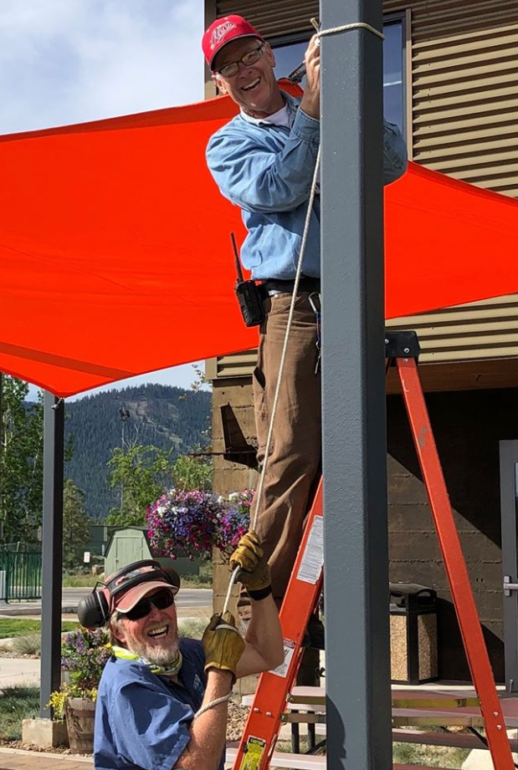
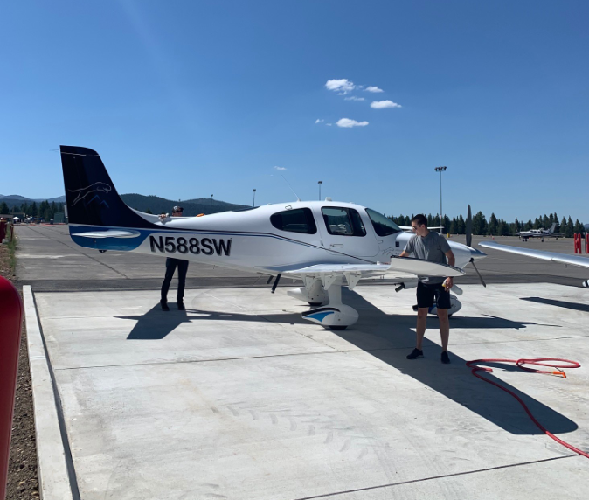
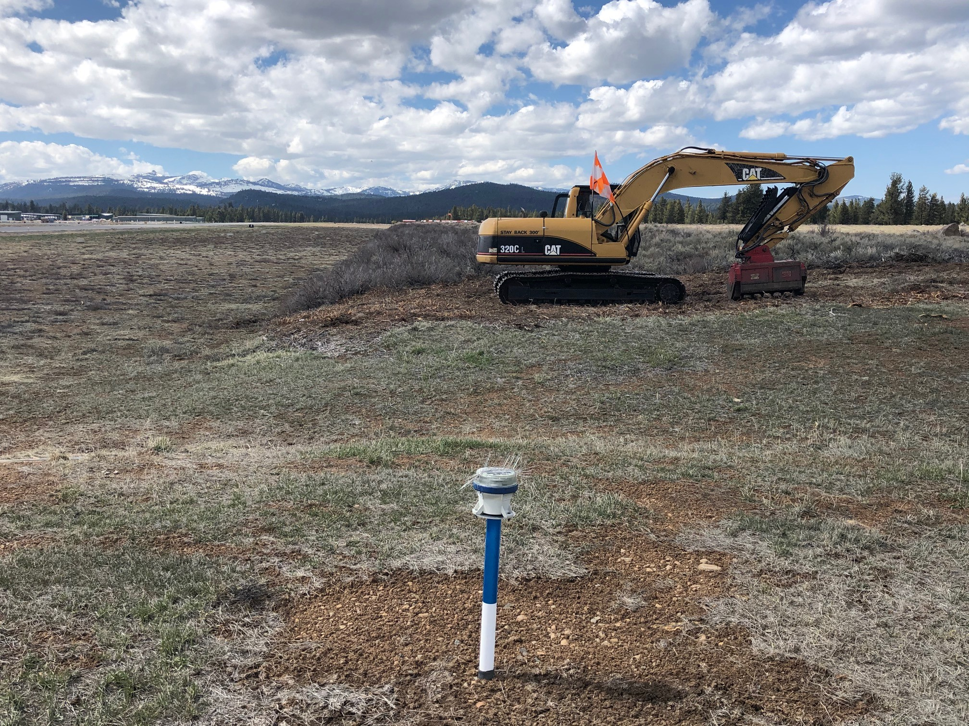
  Q2 2020
  AIRFIELD CONSTRUCTION & MAINTENANCE PROJECTS
Completed
REMSA Care Flight Heliport FAA AIP & TTAD Funding
Runway 29 Blast Pad FAA AIP & TTAD Funding
Aircraft Wash Rack FAA AIP & TTAD Funding
Runway 29 RSZ widening mastication TTAD Funding
Fire Protection break 2 miles long by 200- TTAD Funding
400’ wide Joerger Rd. to Martis Dam Rd.
Terminal Patio Area Sun-Shade Structure TTAD Funding
On-Going 2020
Fuel Farm Asphalt Reconstruction TTAD Funding
Maintenance Shop Asphalt Reconstruction TTAD Funding
Air Show Way / Gate 5 Road Reconstruction TTAD Funding
Non-Profit Container Farm TTAD Funding
Truckee Tahoe Airport Rd. Sidewalk Project TTAD Funding
Tahoe City on-site Helipad Sign TTAD Funding
Scheduled (Spring/Summer/Fall 2021)
Taxiway Alpha Reconstruction FAA AIP & TTAD Funding
Ramp Side terminal bldg entry hydronic pad TTAD Funding

Slide 10
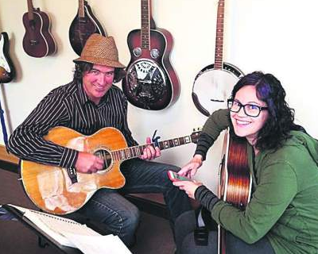
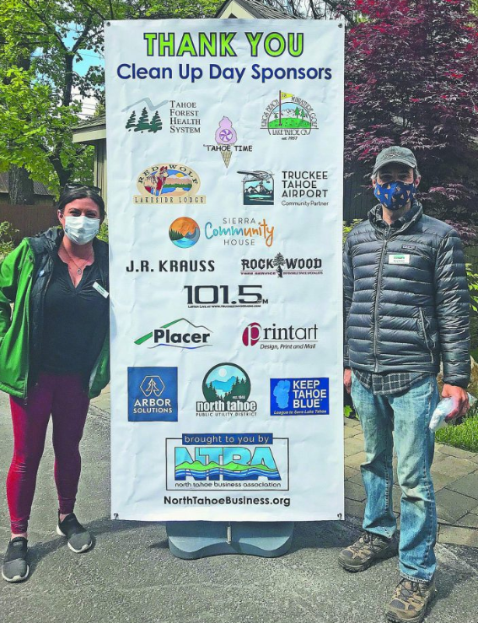
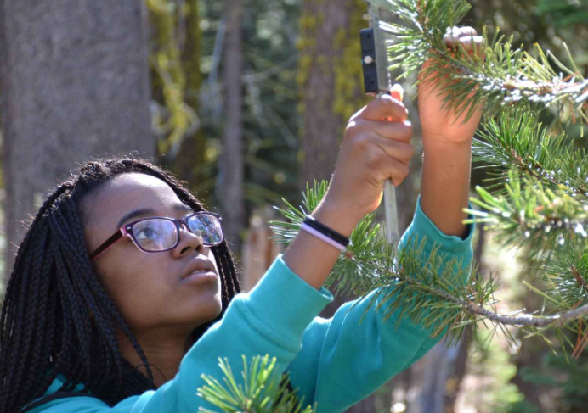
  Q2 2020
  COMMUNITY SPONSORSHIP RECIPIENTS (12) / AGENCY PARTNERSHIPS (0)
Big Brothers Big Sisters $ 1,000
Headwaters Science Institute $ 750
Lake Tahoe Snowmobilers - Avalanche Safety $ 750
North Tahoe Business Assoc - Street Clean Up $ 500
North Tahoe Business Assoc - Virtual Vibes $ 500
Pathways to Aviation $ 3,000
Tahoe City Downtown Association $ 500
Tahoe Truckee School of Music $ 1,000
Truckee Community Theater $ 1,000
Truckee Football Foundation $ 750
Truckee North Tahoe Jr. Cycling Team $ 500
Truckee Wolverines Booster Project Graduation $ 3,000
TOTAL Q2 2020 Community Sponsorships (12) $ 13,250
Year to Date 2020 Community Sponsorships $ 30,000
Community Sponsorship Budget for 2020 $ 70,000
Total Q2 2019 Community Sponsorships (28) $ 28,865
TOTAL Q2 2020 Agency Partnerships (0) $ 0
Year to Date 2020 Agency Partnerships $ 0
Agency Partnership Budget for 2020 $367,000
Total Q2 2019 Agency Partnerships (0) $ 0

Slide 11

Q2 2020
LETTERS OF THANKS & APPRECIATION
Aim High (AP)
Big Brothers Big Sisters (CS)
Church of the Mountains – Warming Hut (CS)
Girls on the Run (CS)
Lake Tahoe Snowmobilers – Avalanche Safety (CS)
North Tahoe Business Association – Street Clean Up (CS)
Pathways to Aviation (CS)
Project Graduation – Fireworks Event (CS)
Tahoe City Downtown Association (CS)
Tahoe Truckee School of Music (CS)
Truckee Community Theater (CS)
Truckee North Tahoe Jr. Cycling Team (CS) & Trailer Storage
U.C. Davis Tahoe Environmental Research Center (CS)
* Community Sponsorship Program Recipient (CS)
* Agency Partnerships / Service Agreement Contracts (AP)

