Slide 1
                By: Marc R. Lamb, Aviation & Community Services Manager
Q1 2020 COMMUNICATIONS REPORT

Slide 2
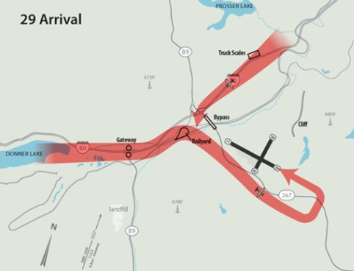

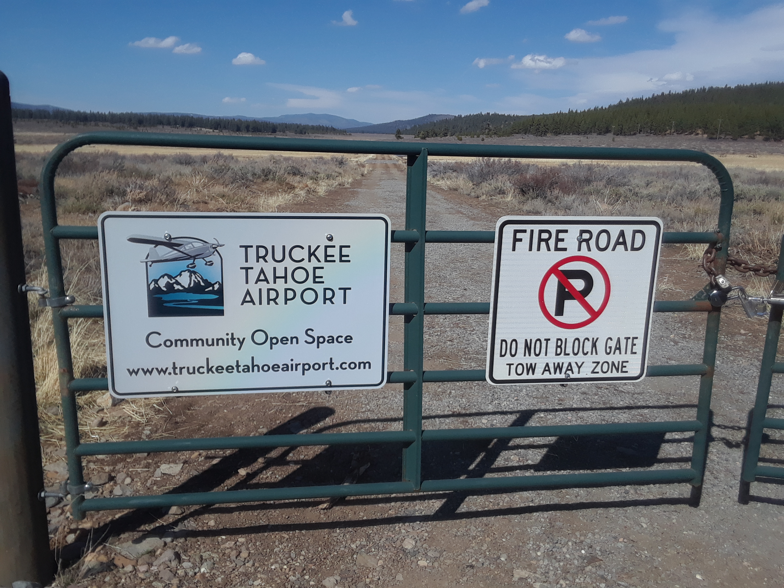

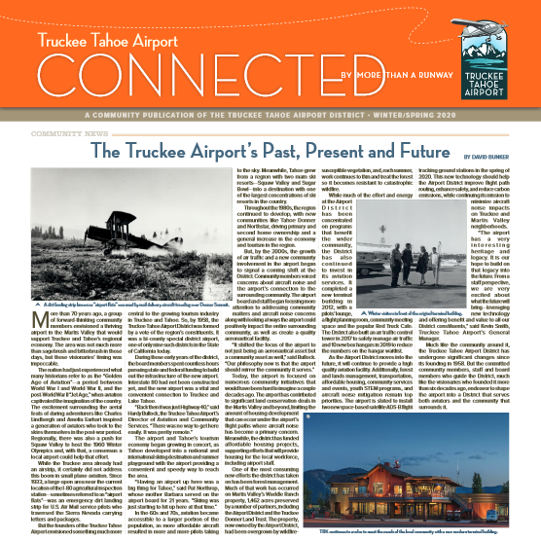
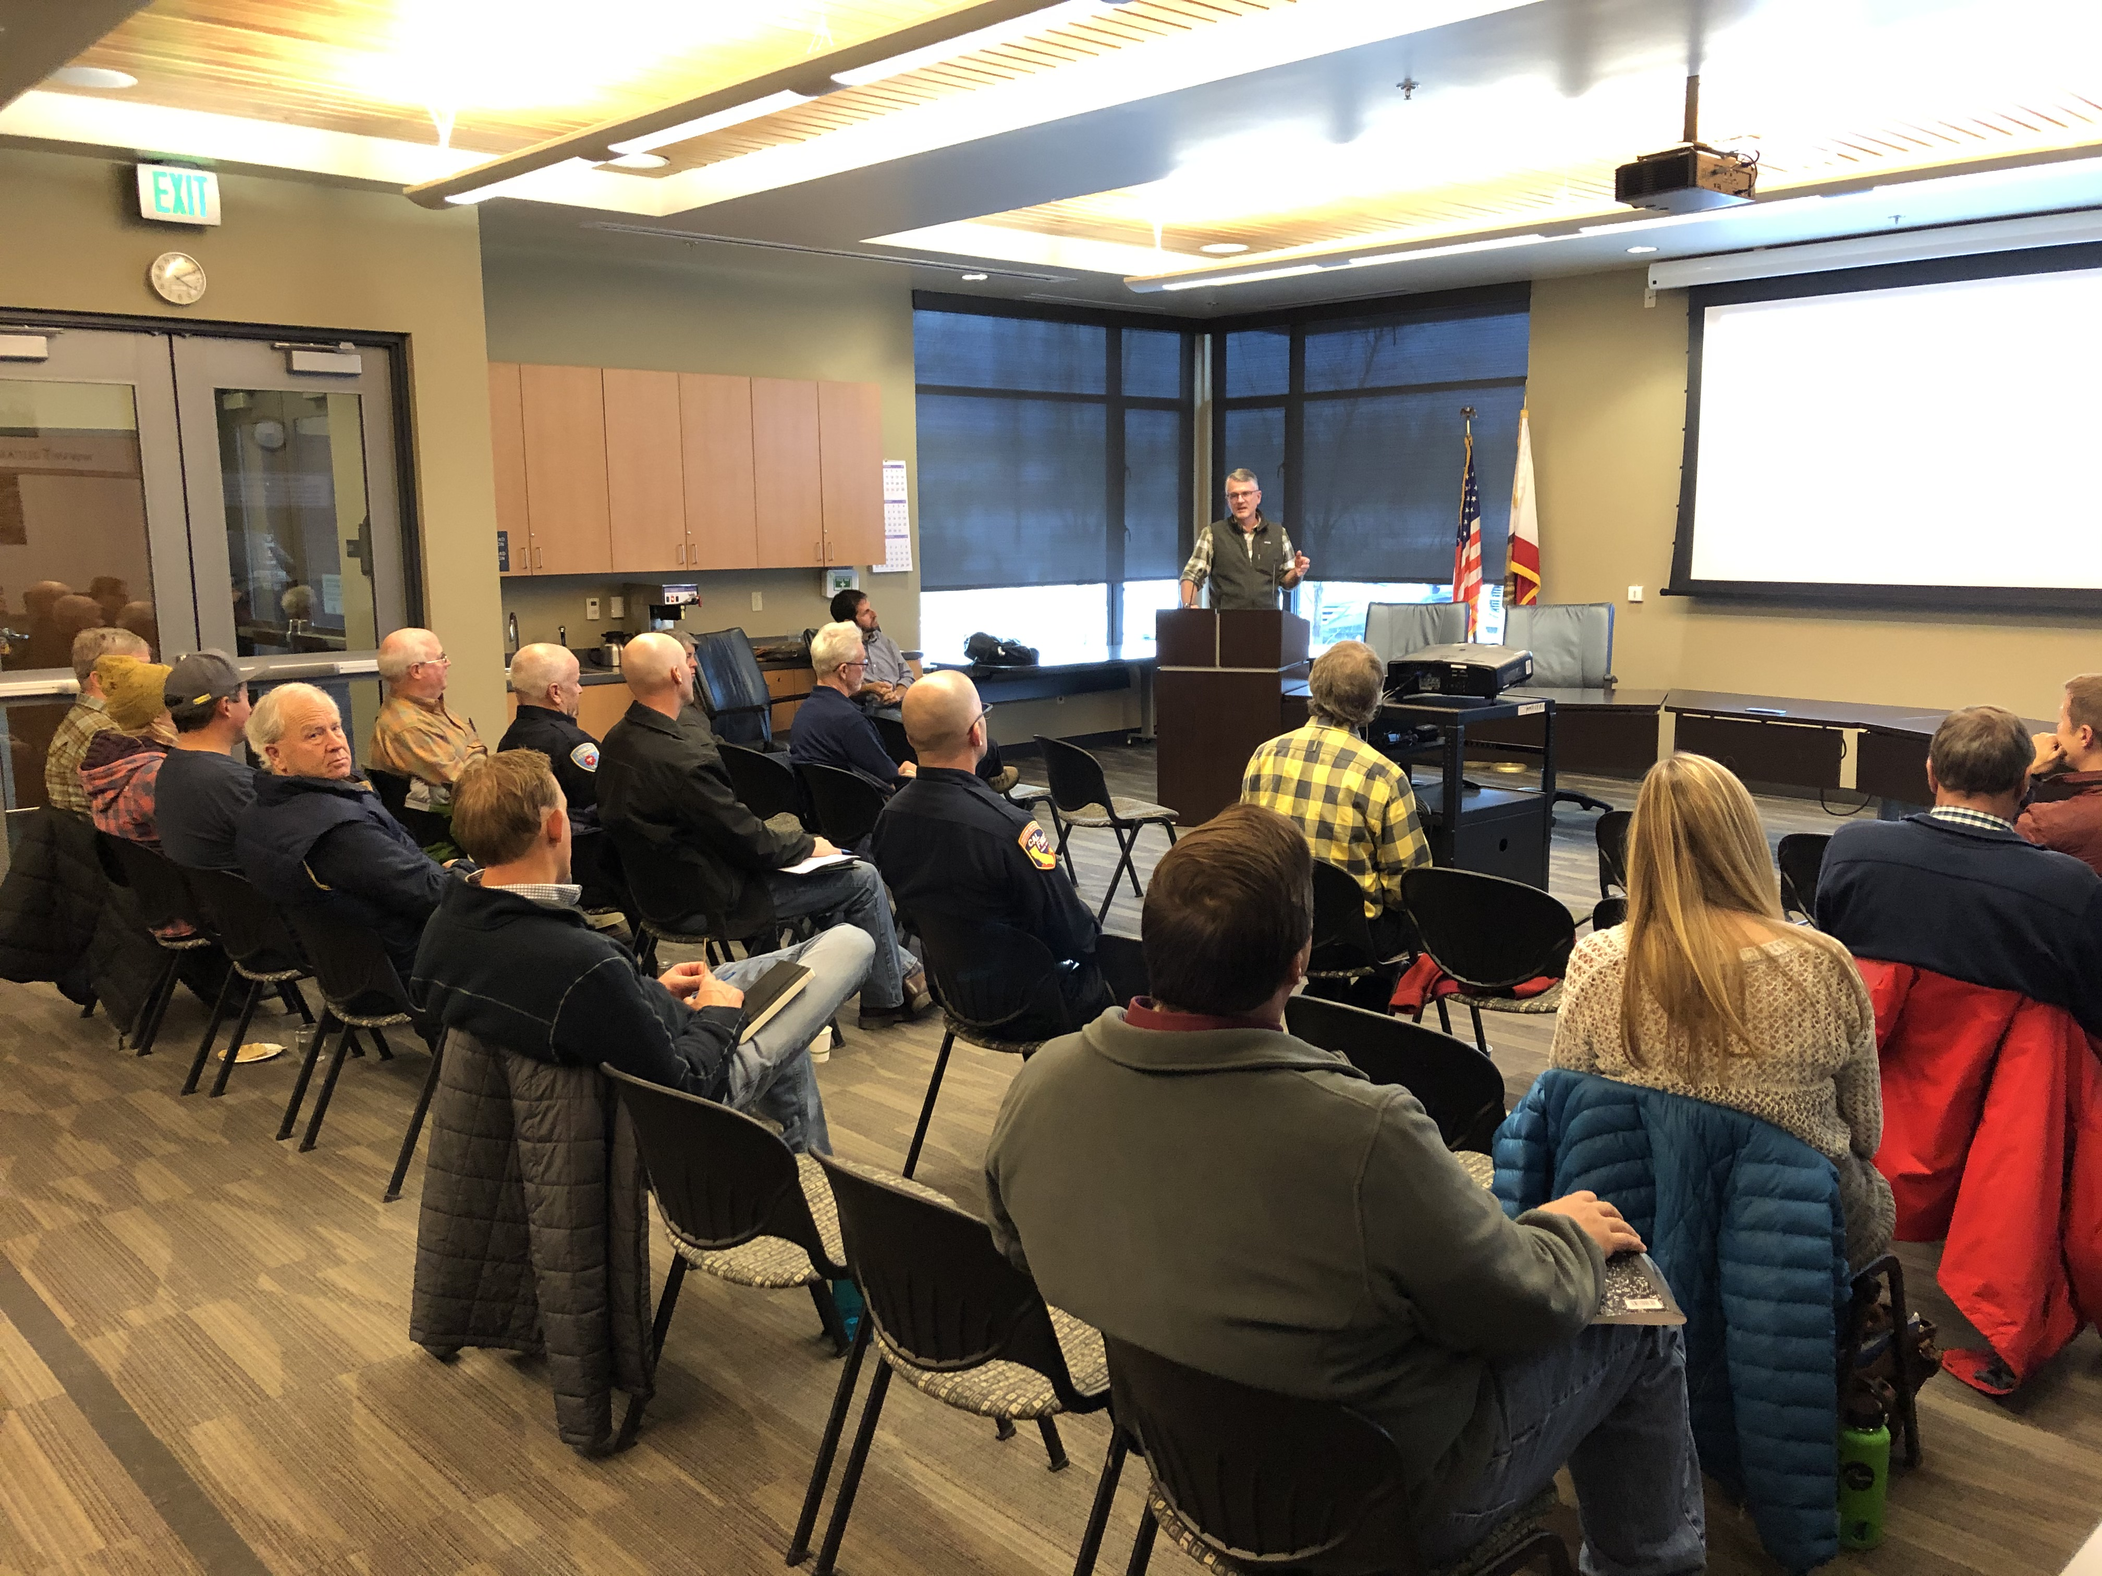
  Q1 2020
  DISTRICT COMMUNICATION METHODS

Slide 3
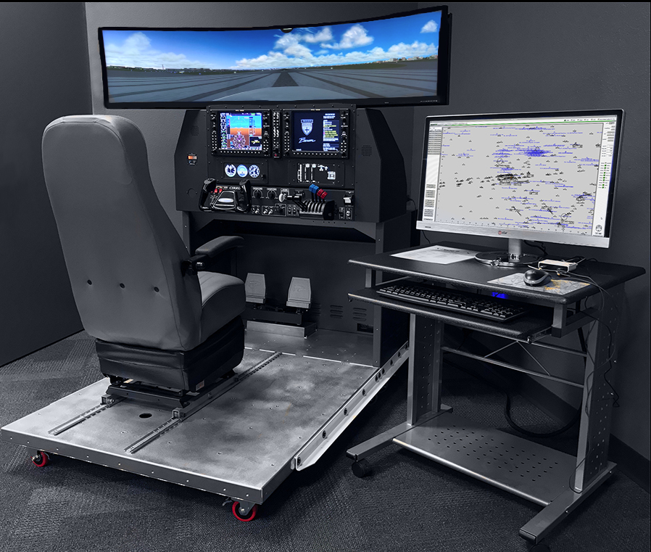
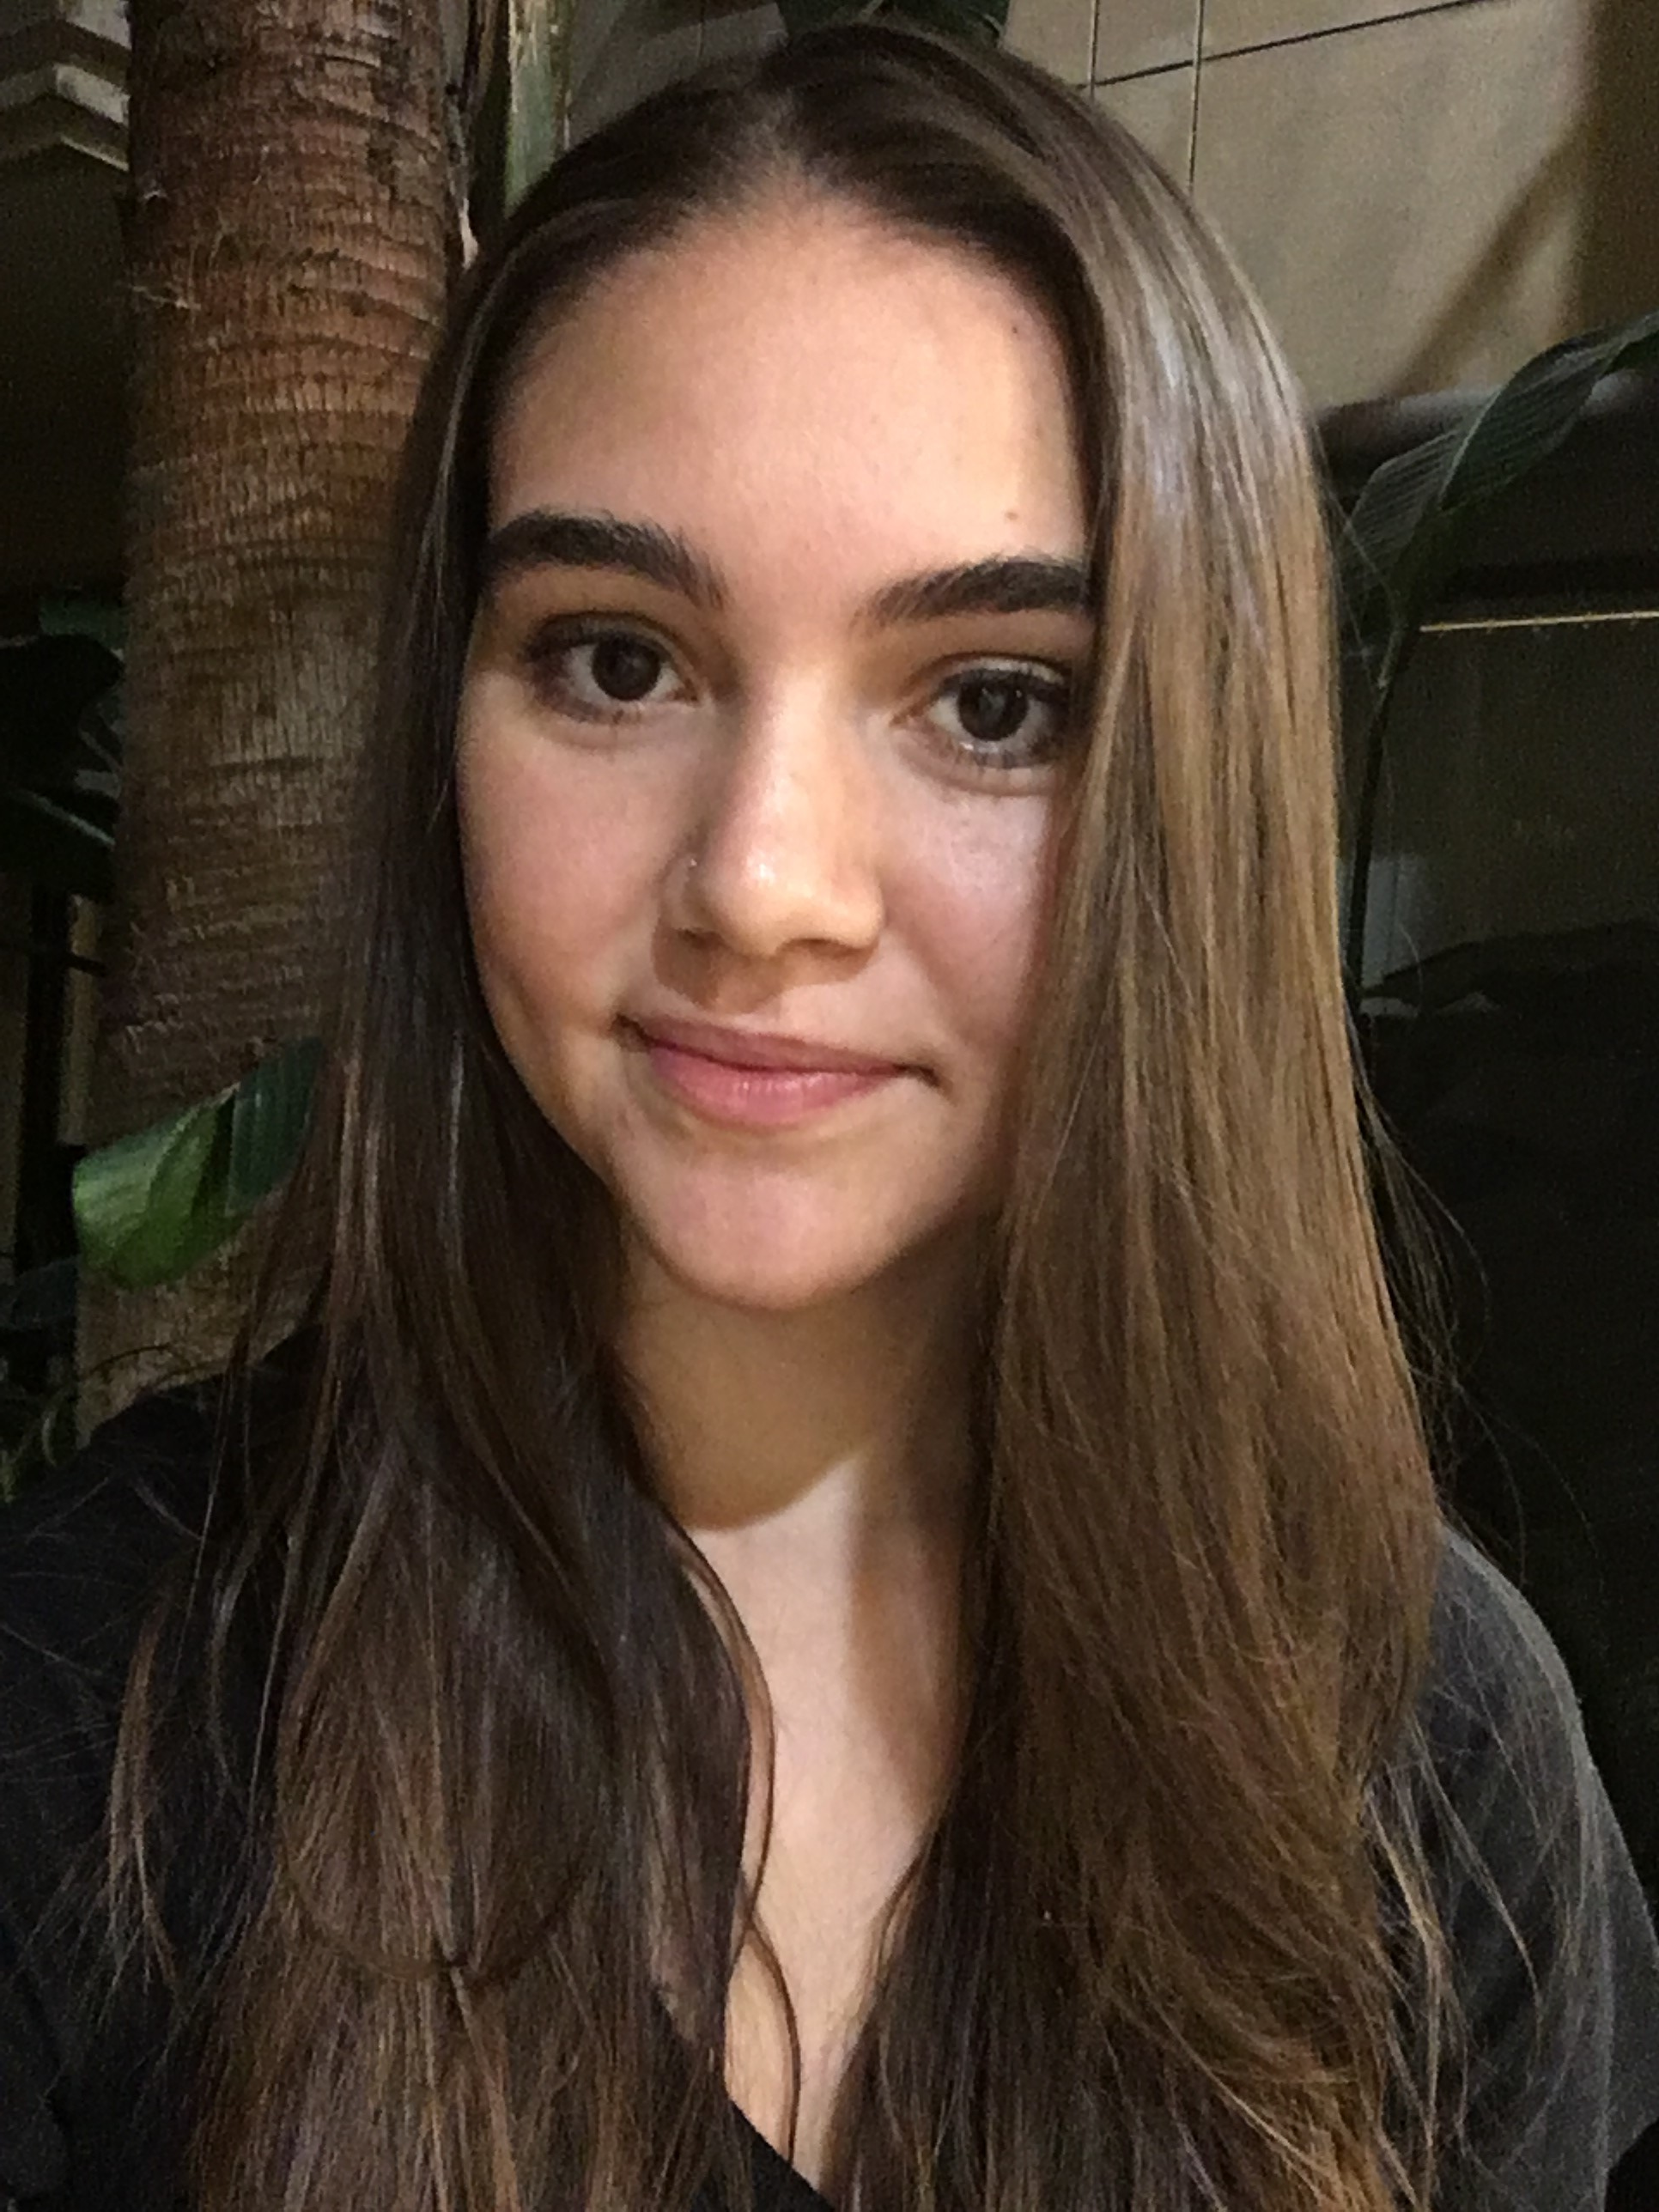
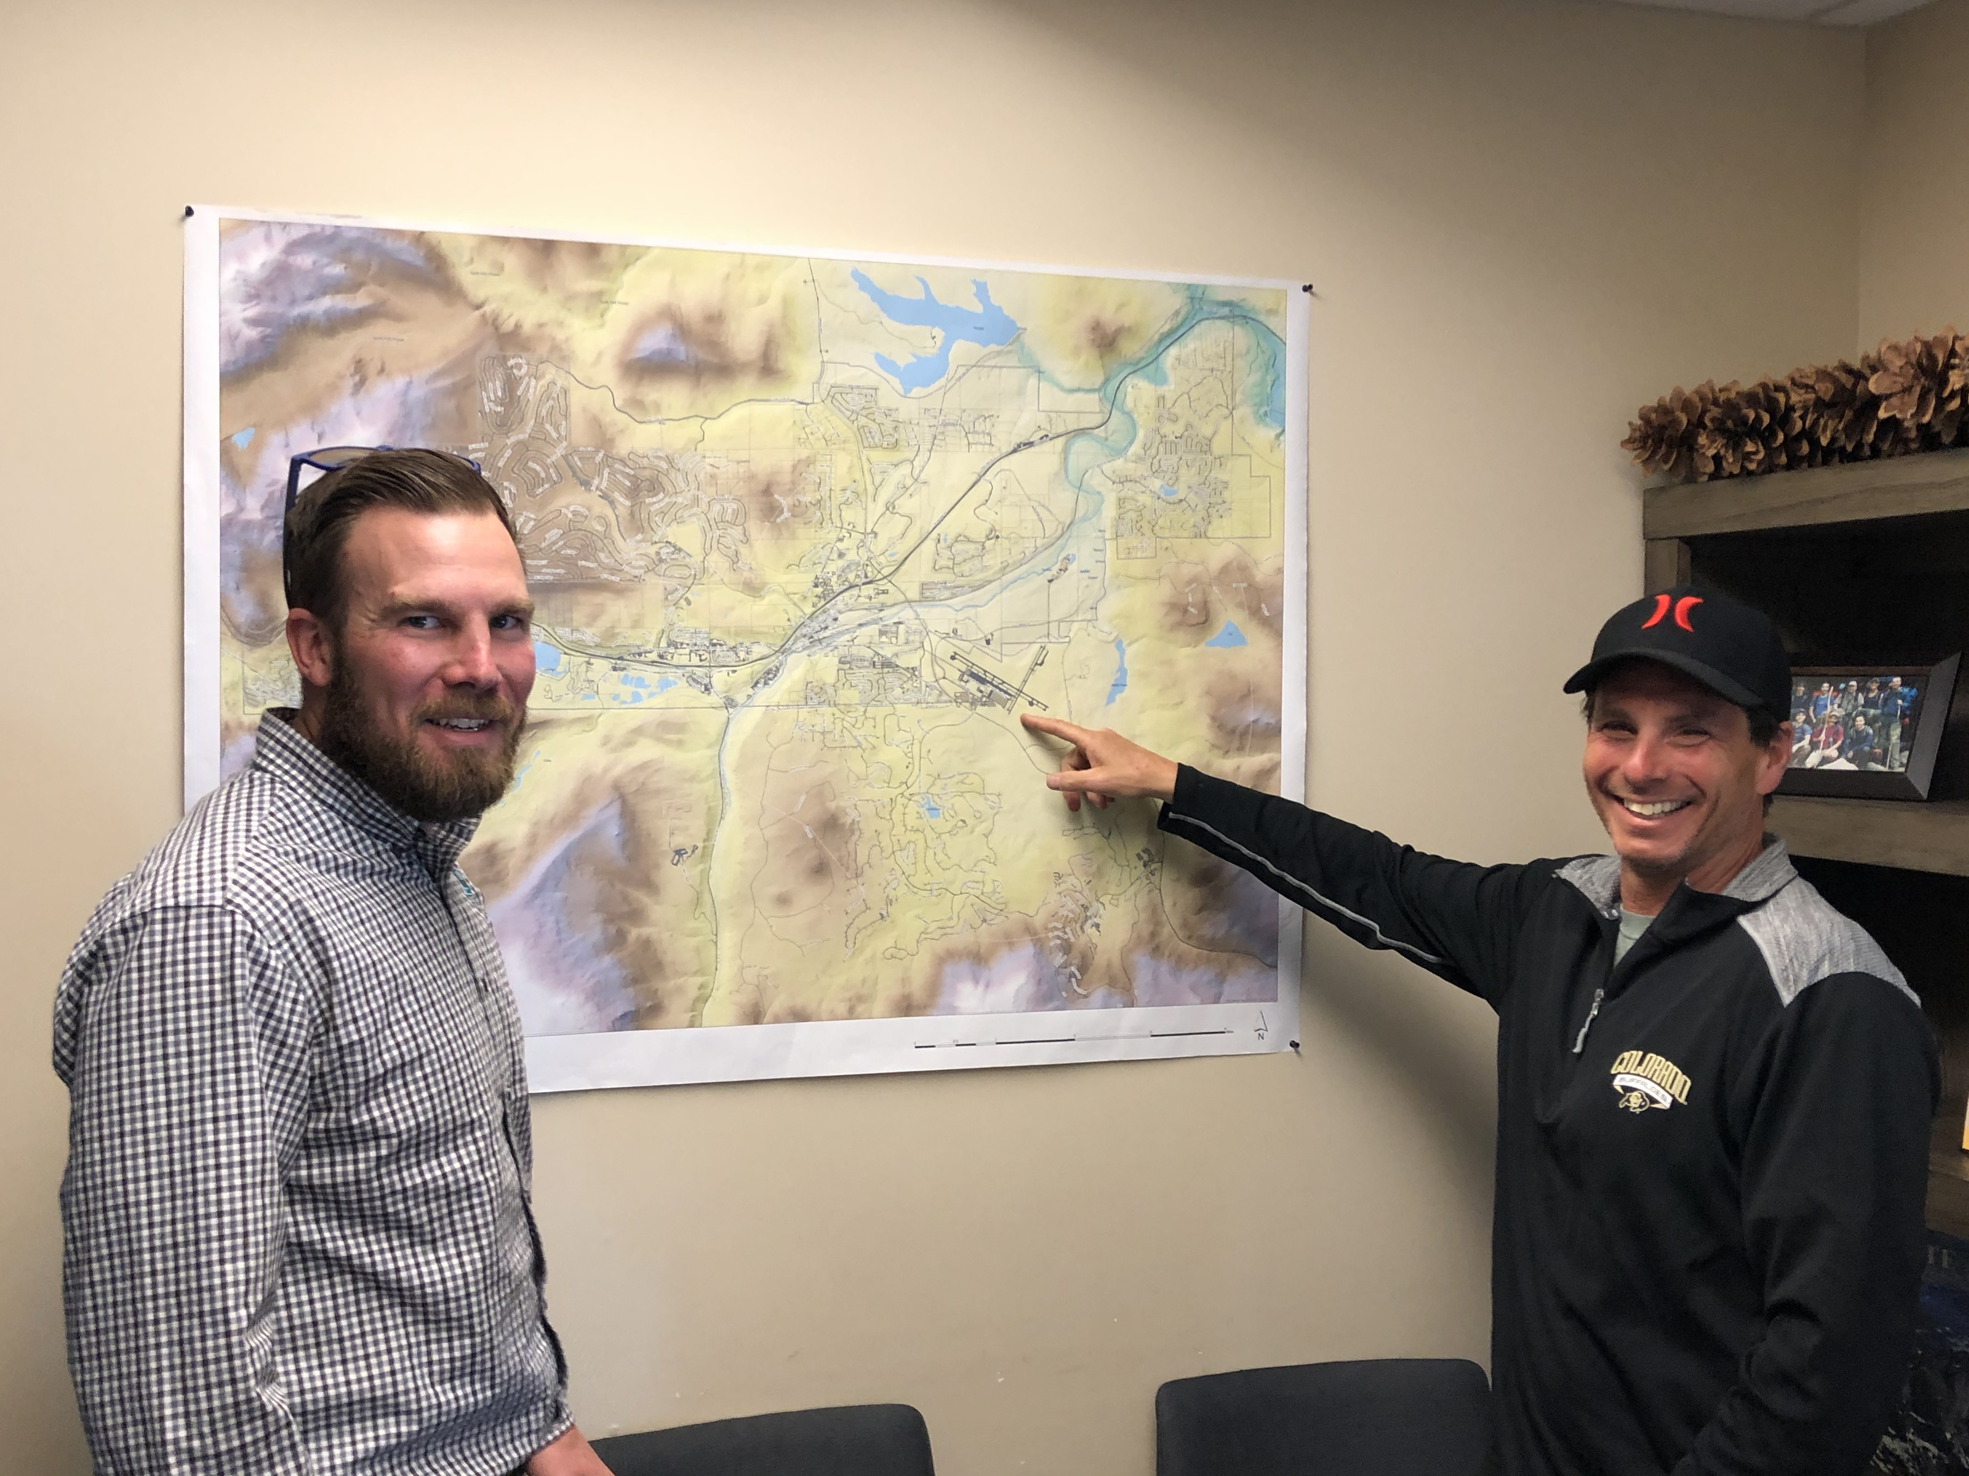
Q1 2020
AIRPORT EVENTS & HIGHLIGHTS
AVCOM’s Jill McClendon’s maternity leave, Keely Hoyt temp 2/18 & 3/6
Boys & Girls Club - Airport tour 24 kids 3/6
Connected mass mailer 20,000 copies mailed 2/20
COVID-19 Pandemic
Forest Charter School – Airport STEM event and airfield tour 18 kids 2/11
Hangar 1 office space removed for more aircraft maintenance space 2/15
Noise & Environment Office moves to terminal bldg breezeway location 2/10
Pathways to Aviation youth STEM events 1/30, 2/13, 3/12
Sierra Aero & Mtn Lion Aviation move into new Hangar 1 office bldg 2/1
TTAD closes public use of Board rooms, social distancing practices start 3/16
TTAD holds first ever teleconference board meeting 3/25
TTAD Going Green campaign -purchase E-Bikes for District
TTAD purchase new GTX, G1000 AATD flight simulator

Slide 4
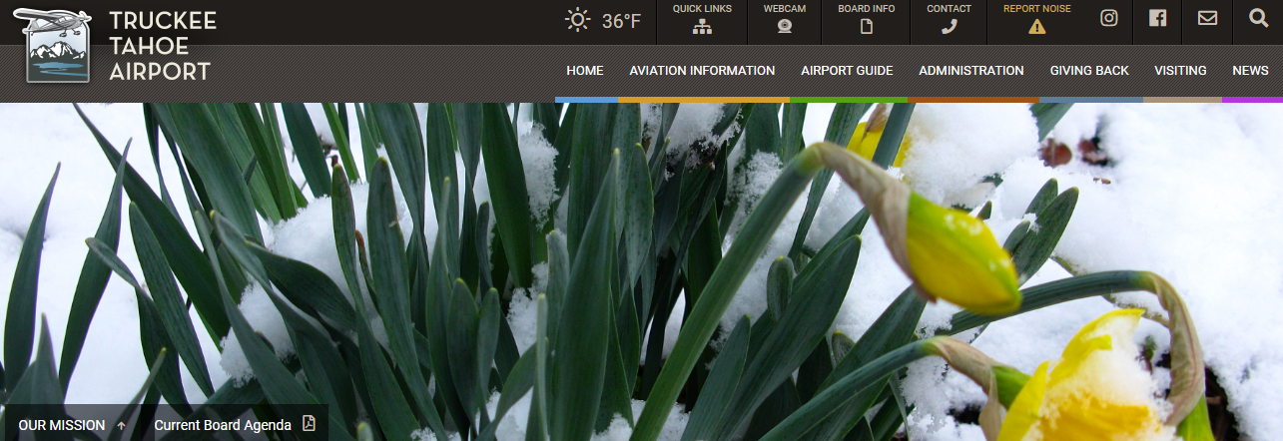
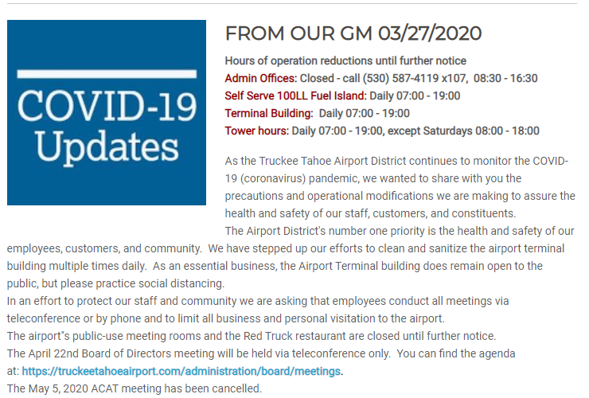

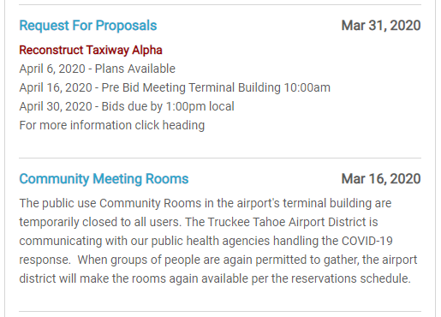

  Q1 2020
  KTRK WEBSITE STATS
Audience Overview
In Q1 we had 18,088 website users, who completed
49,778 sessions and 75,006 page views.
Website traffic “users” were down 36% from Q1 2019
Where do our website users live? (US 16,065)
  California 9,843
  Nevada 1,528
  Washington 647
  Texas 433
  Florida 420
What web pages do visitors view?
  Webcam 45,230
  Home Page & Community News 11,727
  Aviation Flt Procedures & Planning 2,784
  Board/Staff/Admin 1,792
  Snow Day 783
  Doing Business 500

Slide 5
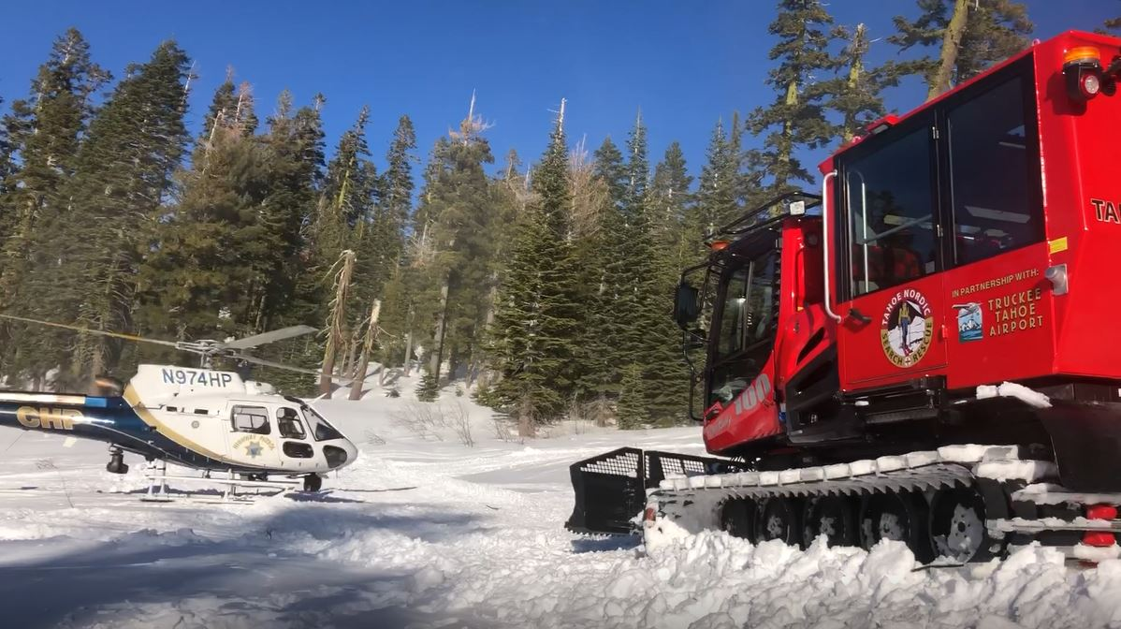
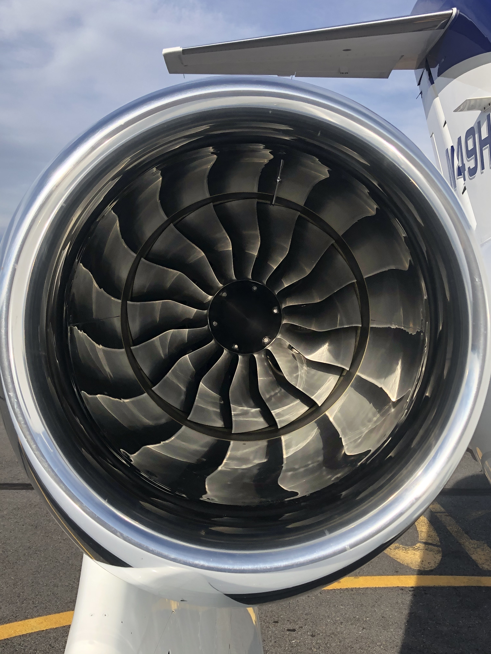
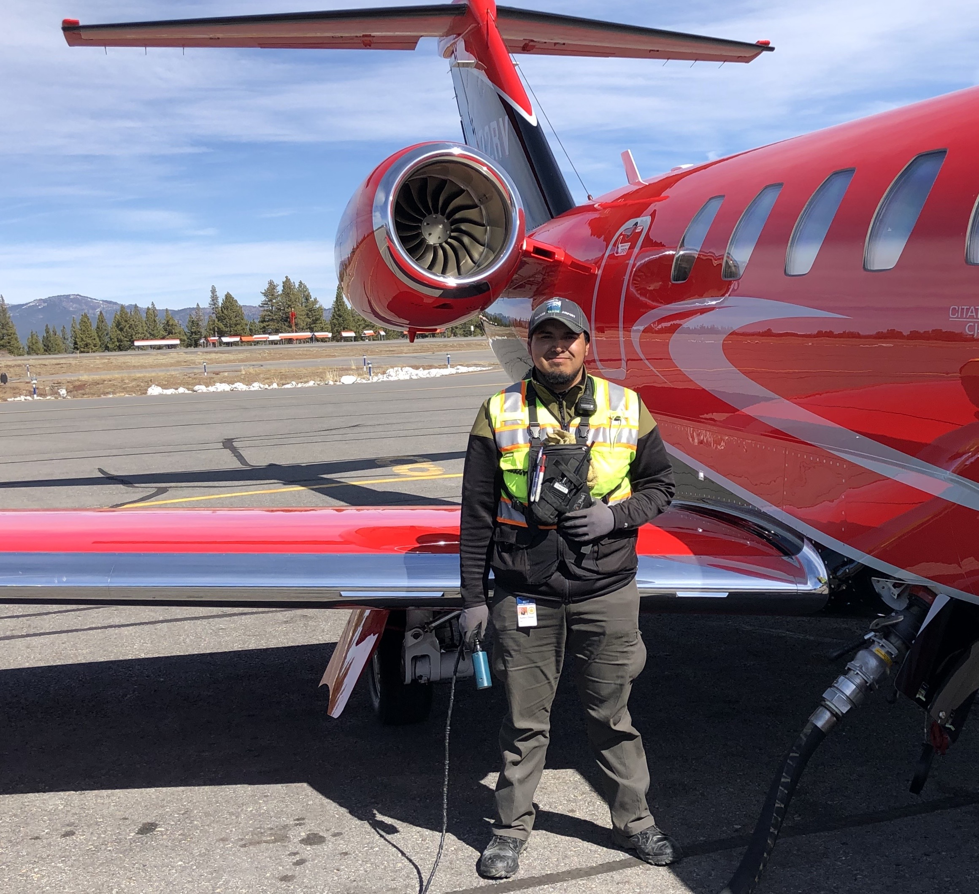
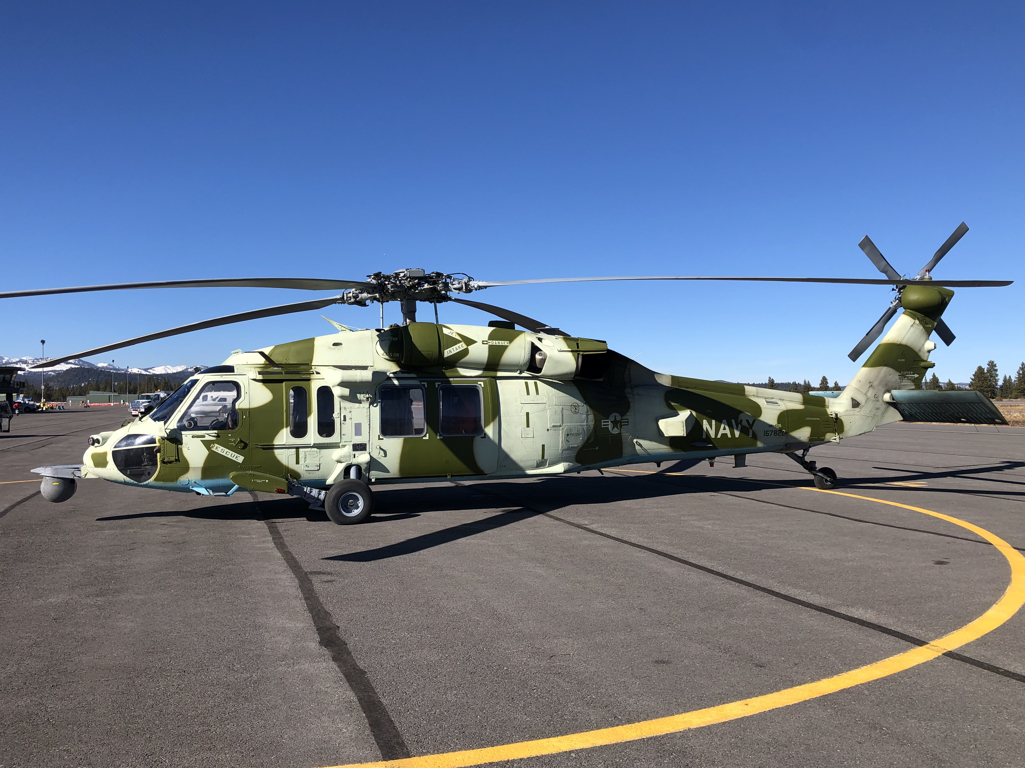
  Q1 2020
  SOCIAL MEDIA
INSTAGRAM
Launched 02/01/2016
1,269 Followers as of 03/31/2020
Followers up 27% over Q1 2019
Average 1 post per week
FACEBOOK
Launched 06/01/2015
2,566 Followers as of 03/31/2020
Followers up 13% over Q1 2019
Facebook Page Rating: 4.0 out of 5.0
Average 2 posts per week
Highest FB Post Reaches Q1 2020: (Top 5)
6,098 - TNSAR helicopter rescue exercise
2,249 - SOTR Go Navy SH-60 Seahawk
2,187 - SOTR Global Express
1,902 - SOTR Honda Jet
1,823 - Office of Noise & Environment

Slide 6

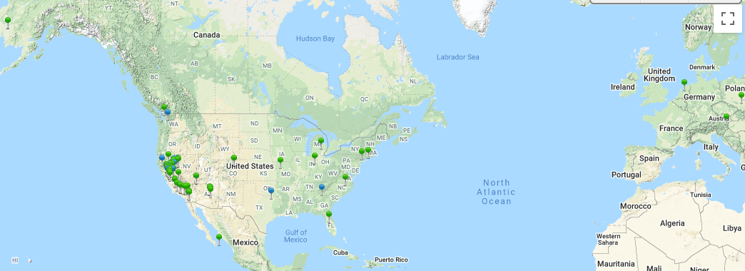
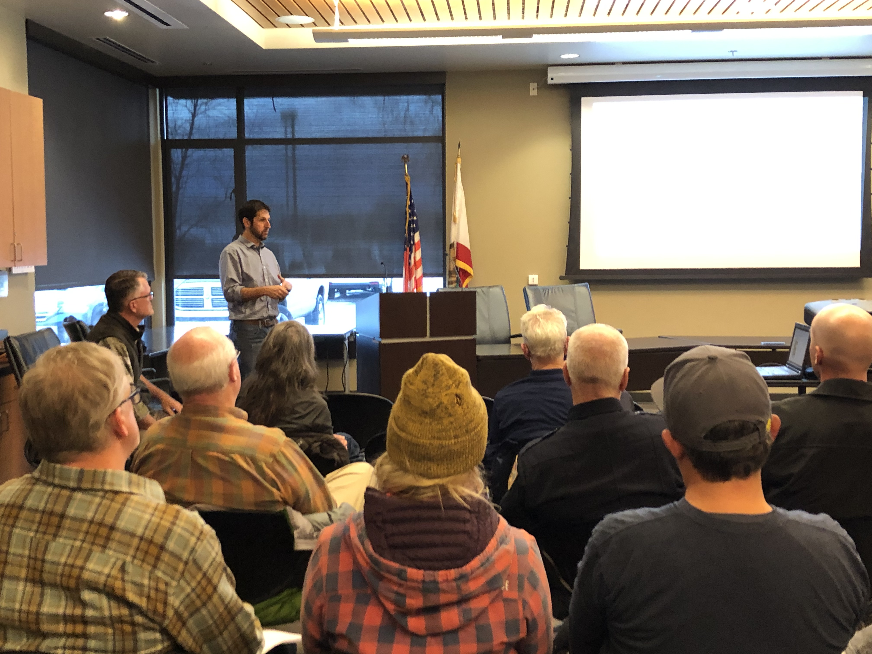
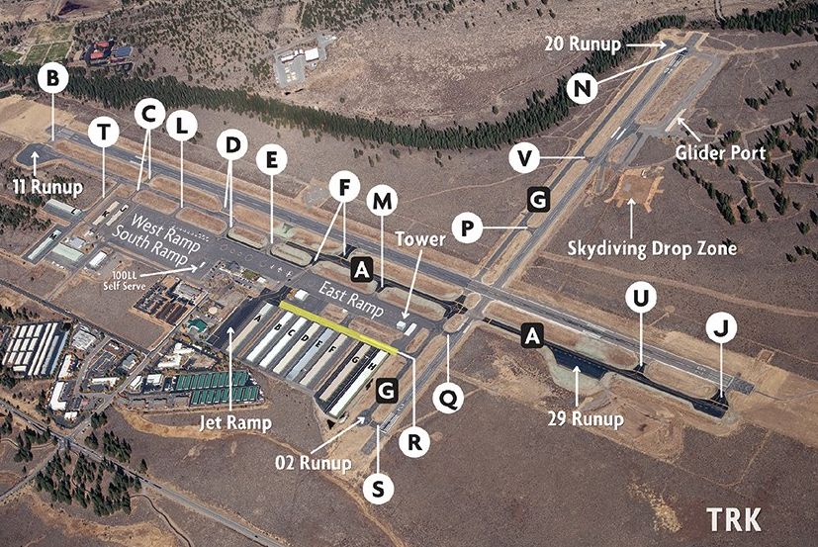
  Q1 2020
  KTRK PILOT & COMMUNITY OUTREACH EFFORTS
    E-BLAST RECIPIENTS OPENED DATE
    March Community Outreach 963 50% 03/23/2020
    January Community Outreach 961 48% 01/21/2020
    KTRK FAMILIARIZATION PROGRAM # FLOWN DATE
    Local Instructor Familiarization Flights 2 Q4
  SPEAKER EVENT(S) # ATTENTED DATE
Boys & Girls Club NLT (Youth STEM) 24 03/06/2020
Forest Charter School 18 02/11/2020
Pathways To Aviation (Youth STEM) 14 1/30, 2/13, 3/12
PUBLICATIONS IN-HOUSE # PRINTED DATE
“Connected” Winter/Spring 2020 20,000 copies 02/24/2020
PILOT OUTREACH DATE
Airfield Construction 2020 (web page) Daily
Snow Day Winter 2019-2020 (web page) Daily
Pilot & Pax Outreach on ramp, NAP & Curfew Compliance Daily
55 – DOI (Daily Operating Info) E-blasts to airport users Daily
Regular FICON (Field Condition) and NOTAMS posted As Needed
  Partnered with Solarius Aviation - Flt Procedures & NAPS 02/02/2020

Slide 7
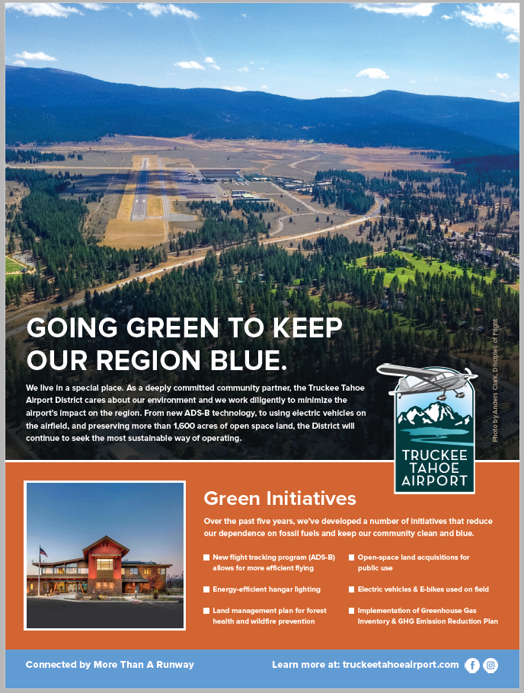
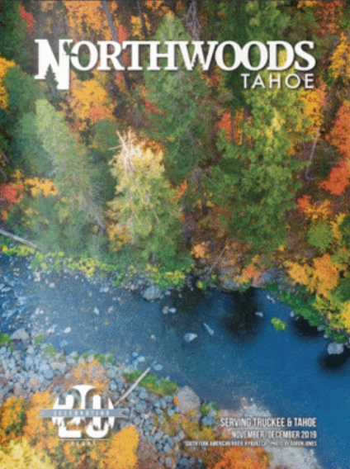

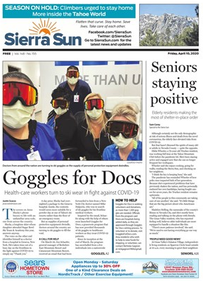
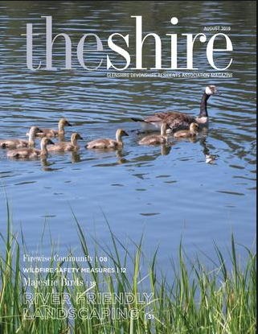


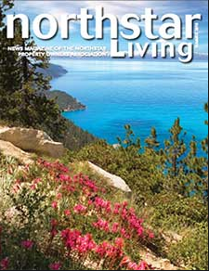

  Q1 2020
  SCHEDULED SUMMER “GOING GREEN” AD CAMPAIGN

Slide 8
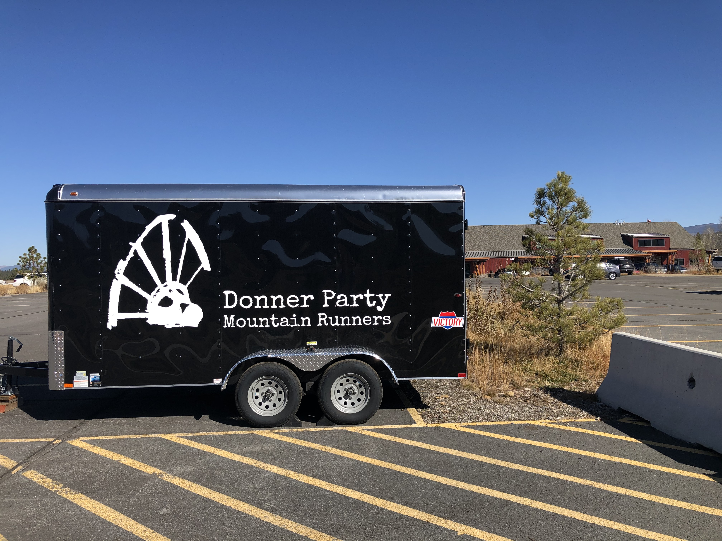
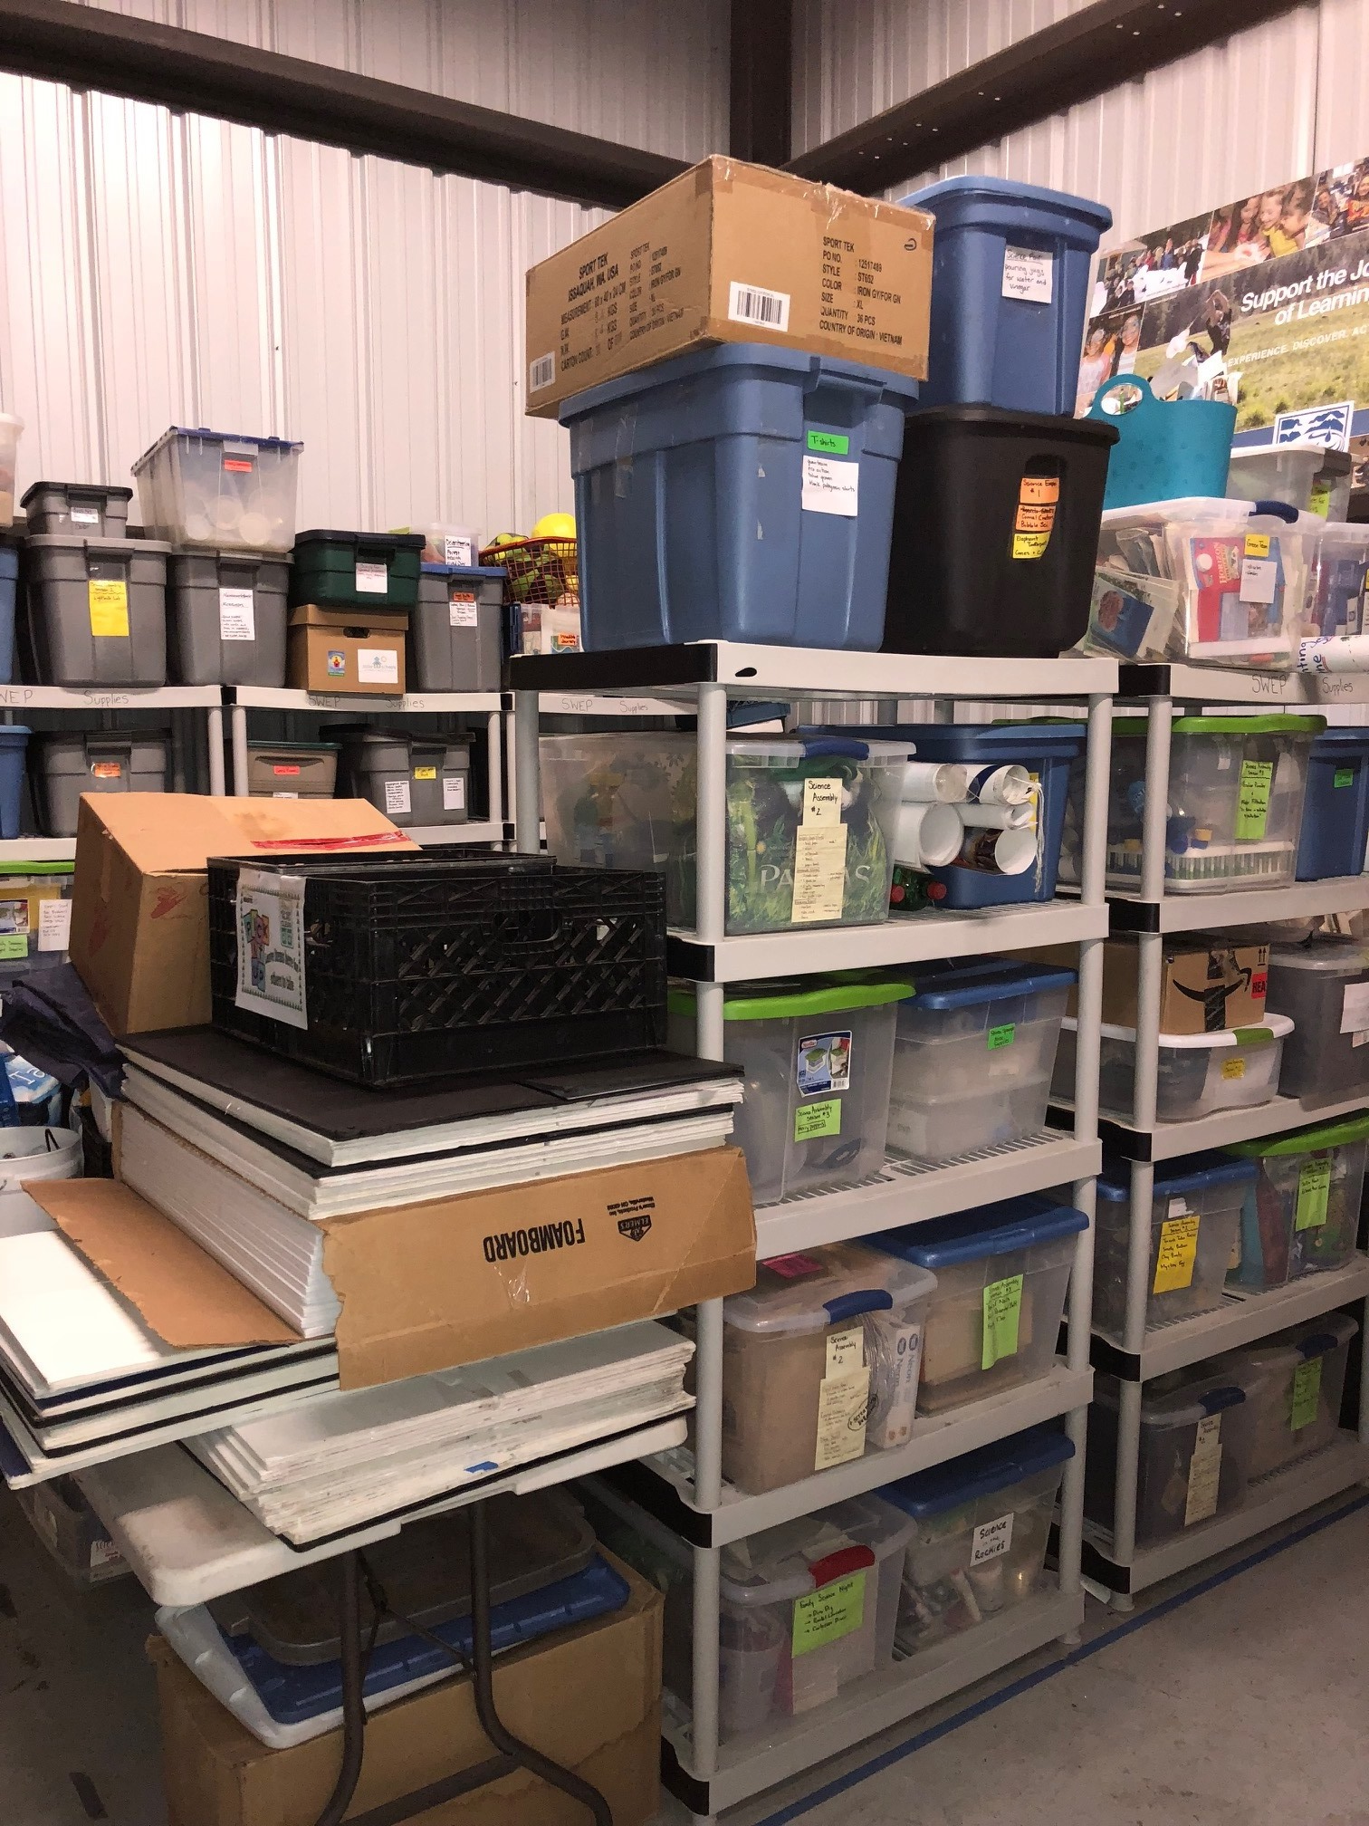
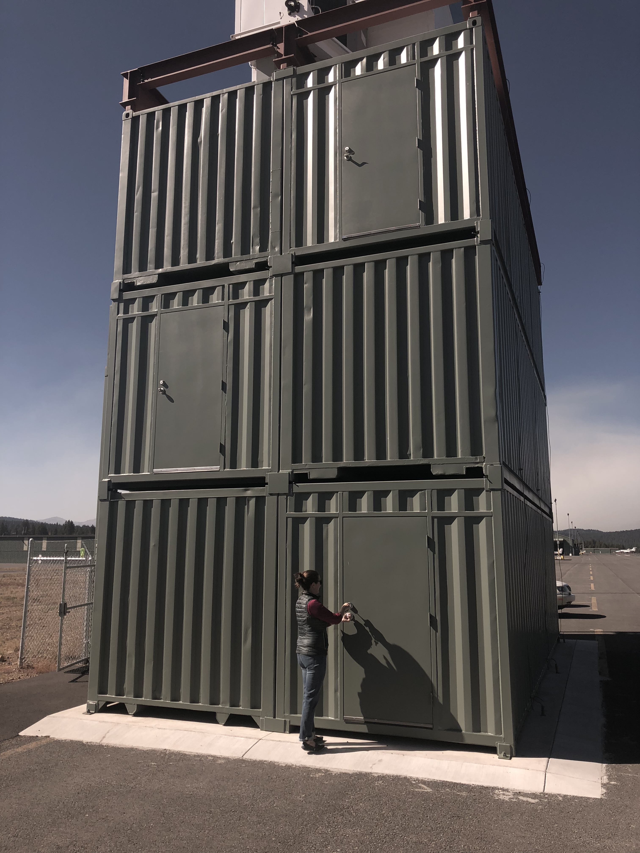
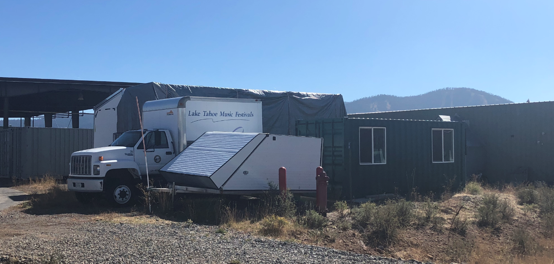
Q1 2020
AIRPORT SPACE PROVIDED FOR NON-PROFITS (16)
American Red Cross
Civil Air Patrol
Donner Party Mountain Runners
Experimental Aircraft Association
Foster the Sierra
Friends of the Truckee Library
KidZone Museum
Sierra Watershed Education Partnerships (SWEP)
Tahoe Forest Hospital EMS
Tahoe Nordic Search + Rescue
TCPUD - Lake Tahoe Music Festival
TNT Junior Development Cycling
Trails & Vistas
Truckee Donner Land Trust
Truckee Optimist
Truckee River Watershed Council
* TTAD offers reduced rent spaces to some non-profits that are not included in the above list

Slide 9
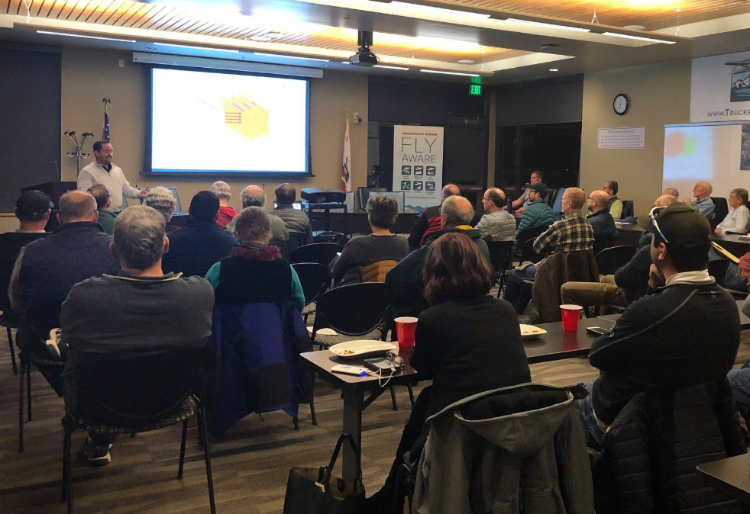
  Q1 2020
  USE OF AIRPORT COMMUNITY ROOMS
Adventure Risk Challenge
American Red Cross
Check Ride – David Diamond
Check Ride – Kevin Sloane
Citizens Climate Lobby
Forest Charter School
Jibboom Street Toastmasters
Mountain Belles
Midwest ATC Training
Pathways to Aviation
Pine Forest HOA
Sierra Avalanche Center
Sierra Community Services
Sierra Expeditionary Academy
Sierra Senior Services
Sugar Bowl Academy
SWEP
Tahoe Backcountry Ski Patrol
Tahoe Expedition Academy (TEA)
Tahoe Regional Arts Foundation
Tahoe Truckee FWDD
Tahoe Expeditionary Academy
TNT TMA Regional Transportation
TNT Jr. Development Cycling
Trails and Vistas
Truckee Baseball Foundation
Truckee Chamber of Commerce
Truckee Fire Protection District
Truckee Little League
Truckee Optimist Club
Truckee River United FC Soccer
Truckee Tahoe Airport District
ACAT, Board & Staff meetings,
Airshow Committee, Community
Events, Construction Projects,
Safety Meetings
Truckee Tahoe Housing JPA
Winter Creek HOA
34 organizations held 91 meetings in TTAD Boardrooms in Q1 2020
(Q1 2019 36 organizations held 106 meetings)
BOARD ROOMS CLOSED TO PUBLIC USE DUE TO COVID-19 PANDEMIC STARTING MARCH 16, 2020

Slide 10
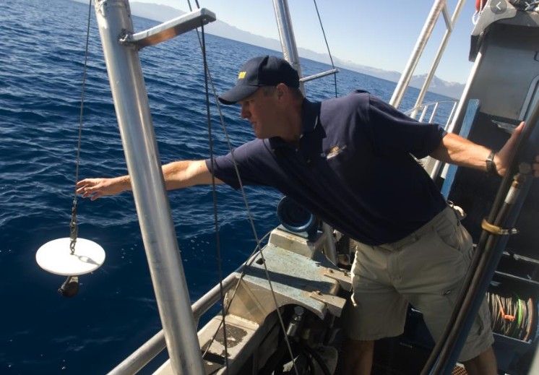
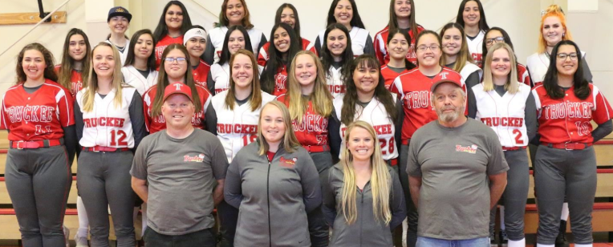
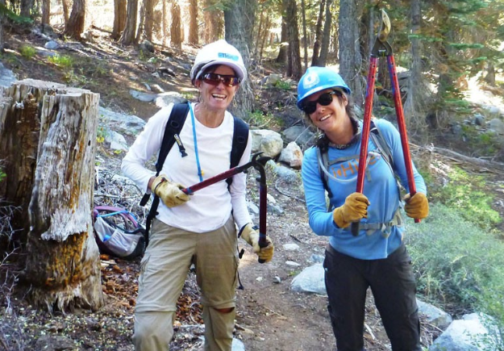
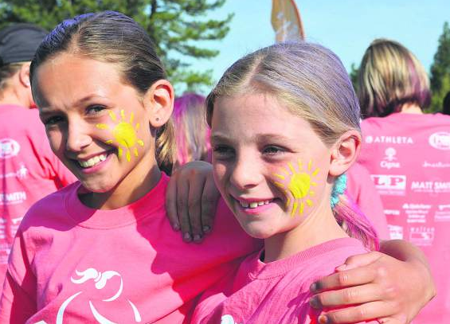
  Q1 2020
  COMMUNITY SPONSORSHIP RECIPIENTS (20) / AGENCY PARTNERSHIPS (0)
American Association of Univ Women NLT $ 1,000
Civil Air Patrol Mission to Mars Summer Camps $ 1,500
Truckee High - Girls Softball $ 1,000
Tahoe Expeditionary Academy $ 500
Tahoe Community Nursery School $ 1,000
Snowfest of North Lake Tahoe $ 1,000
Sierra Continuation High School $ 500
Truckee Little League $ 750
Creekside PTO $ 500
Tahoe Rim Trail $ 500
Sierra States Parks Foundation $ 500
Truckee High - Boys & Girls Track & Field $ 1,000
Truckee Baseball Foundation $ 1,000
Tahoe Silicon Mountain $ 500
Girls on the Run - Sierras $ 750
Truckee Donner Horsemen $ 1,000
UC Davis Tahoe Environmental Research Center $ 750
North Tahoe High - Swim Team $ 1,000
North Tahoe High - Athletics $ 1,000
Soroptimist International $ 1,000
TOTAL Q1 2020 Community Sponsorships (20) $ 16,750
Community Sponsorship Budget for 2020 $ 70,000
Total Q1 2019 Community Sponsorships (18) $ 18,500
TOTAL Q1 2020 Agency Partnership (0) $ 0
Agency Partnership Budget for 2020 $367,000
Total Q1 2019 Agency Partnerships (2) $425,000

Slide 11

Q1 2020
LETTERS OF THANKS & APPRECIATION
American Association of University Women North Tahoe (CS)
Big Brothers Big Sisters (CS)
Boys & Girls Club of North Lake Tahoe (CS)
Civil Air Patrol – Mission to Mars (CS)
Excellence in Education – Challenger Series
Friends of Tahoe Truckee Waldorf (CS)
Glenshire Elementary PTO (CS)
North Tahoe FAN Club (CS)
Sierra Senior Serves (CS)
Sierra State Parks Foundation (CS)
Soroptimist International of Truckee Donner (CS)
Tahoe Expeditionary Academy (TEA) (CS)
Tahoe Film Festival (CS)
Tahoe Rim Trail (CS)
Tahoe Truckee Community Foundation (AAUWNT) (CS)
Tahoe Truckee Unified School District x3 (CS)
Trails & Vistas (CS)
Truckee High Softball (CS)
Truckee Little League (CS)
* Community Sponsorship Program Recipient (CS)
* Agency Partnerships / Service Agreement Contracts (AP)

