Slide 1
Board Workshop
4.2.15

Slide 2
Agenda
Welcome | Purpose of Session
    Review previous Workshop Notes
    Goal of this session + future workshops
    Agenda review/meeting agreements
Topic 1: How| does TTAD define “community”
Topic 2: Managed Growth: Working Towards a Policy Directive
Close | Next steps

Slide 3
Community
WHO is THIS?

Slide 4
Goal of this Section of Workshop
Discuss
  What we mean by “community”
  Who is this?
  Implications to work, policy
Decide
  What language do we want to use to define TTAD community?

Slide 5
Clarification on “Community”
Helps drive managed growth conversation
Drives work: WHO are we working for, accountable to?
In our mission:
TTAD is a community airport that provides high quality aviation facilities and services to meet local needs. We strive for low impact on our neighbors while enhancing the benefits to the community-at-large.

Slide 6
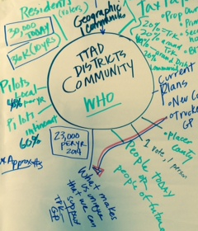
Per Last Session
WHO is defined by “the community?”
What does it mean to be consistent with community need?
Define by:
  Housing Units in District
  By those impacted by District
  Visitors
  Local pilots
  Itinerant pilots
  Business community
  Property owners (local + 2nd home owners)

Slide 7
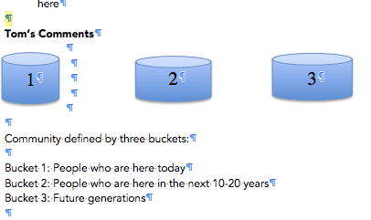
Community Defined…

Slide 8
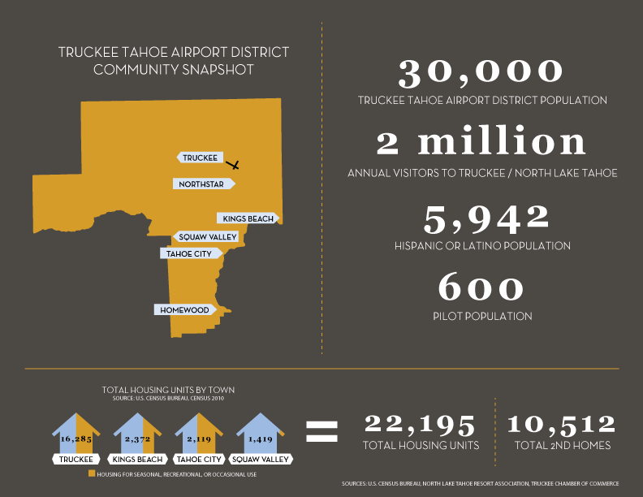

Slide 9
Topic 1: Managed growth
Policy Directive

Slide 10
Goal of this Section of Workshop
Discuss
Information from last workshop (Mead & Hunt)
Notes from discussion
Decide
  What language do we want to use to define managed growth?

Slide 11
Notes from Last Session
Guiding Documents
Other Impacts
Population growth trends in the Region
National aviation forecasts
Part 150161
Negotiation of Night Operations
20 year FAA grant assurances
Tower
Technology
Demand Driver Study
Master Plan
Strategic Plan
Godbe Survey
Public Input
CLUP

Slide 12
Current TTAD Growth Language
The Airport manages growth to be consistent with the community needs
  Comments from Board:
    What are community needs?
    Based on what metric?
    Do we want to grow as fast as projects as Town of Truckee General Plan (2% per year)
    What are economic benefits of growth?
    Need to look at how our growth strategy impacts local community
    We don’t have to respond to regional growth—we can set out own pace
    No matter what our growth policy---some won’t agree---have to deal with this issue via mitigation—public benefits
    Growth is about providing true benefits to community to offset inevitable
    Growth that we can’t control

Slide 13
Managed Growth on a Continuum
No growth
Managed growth
Aggressive Growth

Slide 14
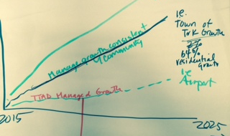
TTAD Growth Rate Below “community-need”

Slide 15
Discussion

