Slide 1
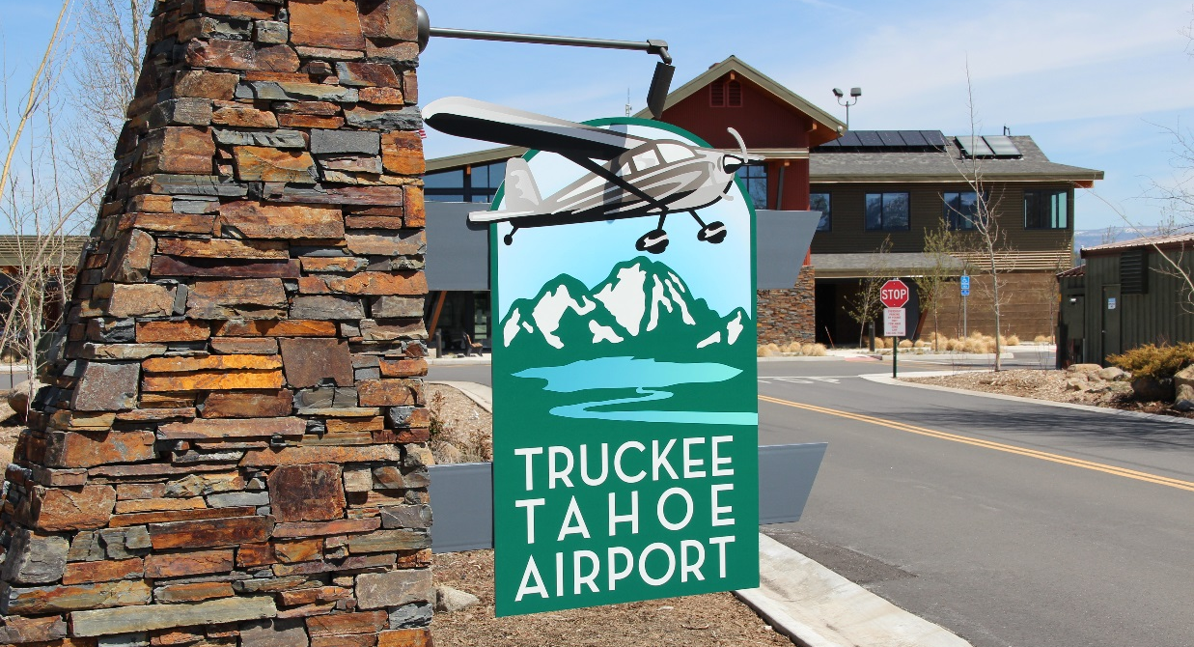

WELCOME
Demand Drivers Study
November 12, 2015
Notes:
Mitch – welcome, intros to team.
M&H on project management, study coordination, results analysis, and document assembly
AMCG on Aviation side, pilots interviews and surveys, statistical analysis,
Seana and Mark Wasley on non-aviation side: non-av. stakeholder interviews, data collection, local perspectice

Slide 2
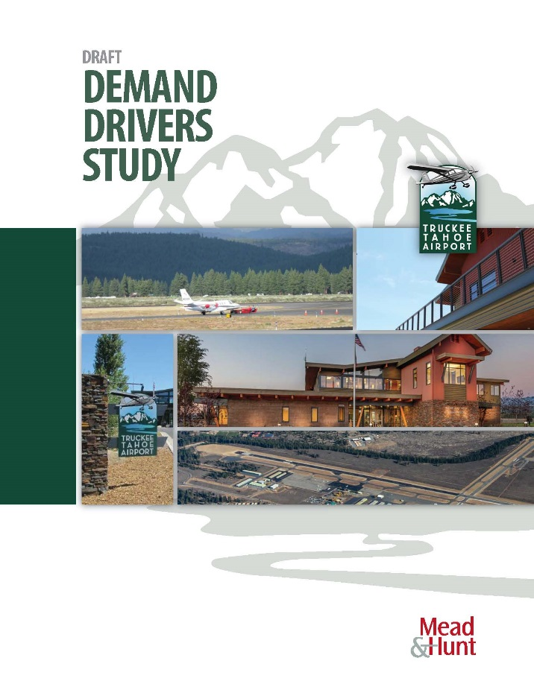
Demand Drivers Study
Aviation Demand Drivers
Interviews & Pilot’s Survey
Correlation Analysis
Market Assessment
Non-Aviation Demand Drivers
Interviews
Correlation Analysis
Market Assessment
Notes:
Core data gathering elements
- Primary sources: interviews and survey
- Secondary sources: Airport records (activity levels), databases (government and third party),
- Tertiary sources: market intelligence

Slide 3
Demand Drivers Study
Appendices
Aviation Demand Background
Aviation Interview Questionnaire
Aviation Survey Results
Non-aviation Market Assessment
Notes:
Information that supports report findings and data collection results are included in appendices.

Slide 4
Demand Influencers and Demand Drivers
Influencers: Indirectly cause changes in demand
(ex. Aircraft Deliveries, Pilot Age, Stock Market)
Drivers: directly cause changes in demand
(ex. Home Sales, Snow Removal and Deicing)
May or may not be under the control of TTAD
Notes:
“Influencers” and “drivers” appear throughout.

Slide 5
Summary of Findings
Activity in the region is not spread evenly
Activity at TRK in line with national trends
Pricing and services may influence usage
Primary demand driver for TRK is proximity
Notes:
Aviation activity in the region is not spread evenly across the airports, and TRK sees less traffic than five of the seven airports studied.
The most important reason for using TRK is proximity to where the pilots and passengers want to go, be it recreational or residential.
Aviation operations at TRK perform in line with national trends, suggesting that demand is driven by factors impacting the region and the County, not only the local level.
Survey responses show that there are changes to pricing and service availability that could make users more or less likely to use TRK.

Slide 6
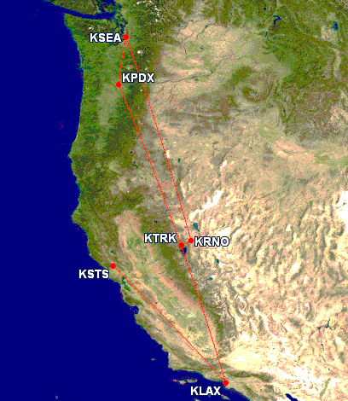
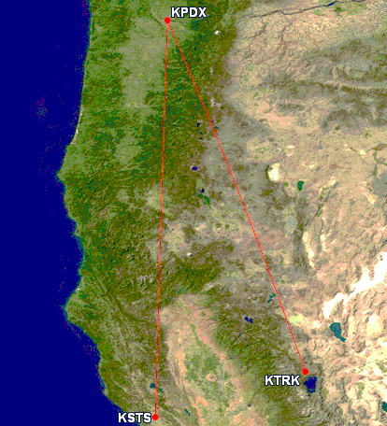
Summary of Findings
Primary demand driver for TRK is proximity
Notes:
My trip – 6am to 1am, 2,000 miles, 4 flights, 45 minute drive
GA trip – 11am to 5pm, 2 flights, 940 miles

Slide 7
Summary of Findings - Aviation
Based Aircraft and Itinerant Operations Correlation
Aircraft Deliveries
  Single Engine and Jet
Active Pilots
  California and the U.S.
General Aviation and On-Demand Activity
  Active Aircraft and Hours Flown
Notes:
Single Engine Piston New Aircraft Deliveries
Business Jet New Aircraft Deliveries
California and United States Active Pilots
General Aviation and On-Demand 14 CFR Part 135 Active Aircraft (California and United States)
General Aviation and On-Demand 14 CFR Part 135 Hours Flown (California and United States)

Slide 8
Summary of Findings - Aviation
Aviation Interviews
Common driver for operating at TRK
  Proximity to users homes and business
Users driven to area for local characteristics
  Recreational areas, resorts
Notes:
Primary reason for basing (or operating) at TRK is the proximity to aircraft owners (or passengers) homes and business.
Proximity to recreational areas and resorts in the Truckee-Tahoe region drives TRK activity.

Slide 9
Summary of Findings - Aviation
Aviation Survey
Location of an airport is a demand driver
17 of 76 based respondents are on hangar wait list
  13 of 17 waiting for box hangar
Activities that may increase traffic
  instrument procedures, deicing, cheaper fuel
Notes:
The survey found that 17 of the based aircraft respondents are on the TTAD-maintained wait list
for aircraft storage and 13 of the 17 are waiting for a box hangar. This may indicate that current
users of TRK will operate here, even when their preferred type of aircraft storage is not available.
This is evidence that there are draws outside of airport facilities driving users to the region.

Slide 10
Summary of Findings – Non-Aviation
Based Aircraft and Itinerant Operations Correlation
Community Growth
  Income, Housing Supply, Population
Local Economic Growth
  Visitor Spending, Total Tax Revenue
National Economic Growth
  Oil Price, Gross Domestic Product, Stock Market
Notes:
Total Residential Housing Units
Number of Households
Population
Median Age
Average Household Income
Median Household Income
Visitor Spending
Total Revenue
Average Crude Oil Spot Price
U. S. Gross Domestic Product (GDP)
S&P 500 Average Close

Slide 11
Summary of Findings – Non-Aviation
Non-Aviation Market Assessment
Primarily Affluent Bay Area Residents
Coming for recreational activities and proximity to primary and secondary home
Affluent people have chosen to build homes here, and have the means to utilize TRK, if they choose to.
Notes:
Customer Base: Generally affluent, second homeowners, from the Bay Area. Ages range from young families to retirees.
Visitor Demand: Recreation activities associated with the mountains and the Lake, plus easy access from the Bay Area.
Area Access: Interviewees described an increase in Airport use by their constituents. This includes some resorts and associations seeing 25 percent of constituents using TRK.
Affluent people have chosen to build homes here, and have the means to utilize TRK, if they choose to.

Slide 12
Aviation Demand Drivers
Research Approach and Methodology
Correlation Analysis
Aviation Market Assessment
Aviation Interview
Aviation Survey
Notes:
Jeff / AMCG

Slide 13
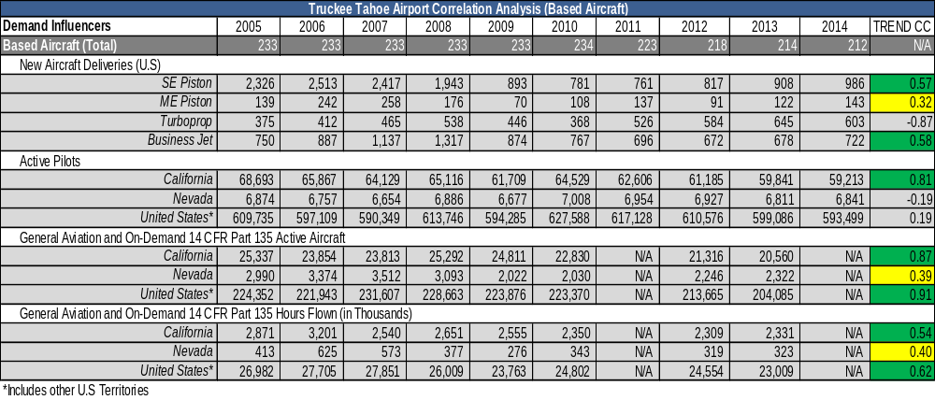
Aviation Demand Drivers
Correlation Analysis: Based Aircraft
Notes:
Jeff / AMCG

Slide 14
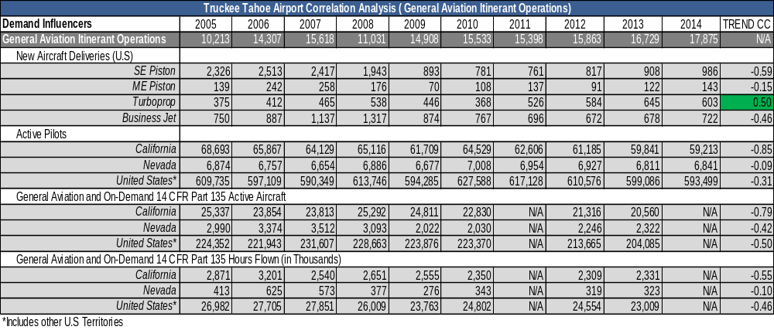
Aviation Demand Drivers
Correlation Analysis: Itinerant Operations
Notes:
Jeff / AMCG

Slide 15
Aviation Demand Drivers
Aviation Market Assessment
Looked at 7 competitive airports within a 60 minute driving distance from TRK.
While TRK ranked 6th in itinerant operations*, TRK ranked 4th in fuel volumes and 1st in based aircraft.
Many of the competitive airports have a broader range of general aviation products, services, and facilities.
4 of the competitive airports have longer runways.
Notes:
Jeff / AMCG

Slide 16
Aviation Demand Drivers
Aviation Interviews
10 based and transient TRK customers.
  Based customers had a primary or second home within 45 minutes of TRK.
  Transient customers mix of Part 91, Part 135, and fractional aircraft operators.
Using TRK due to location, location, location.
Desire to increase safety with aircraft deicing services/facilities and instrument approaches.
Do not want to see flight restrictions.
Concerns regarding cost of fuel and aircraft storage.
Notes:
Jeff / AMCG

Slide 17
Aviation Demand Drivers
Aviation Survey
451 based and transient aircraft customers surveyed.
  22.84% response rate, 95% confidence, 4.25% margin of error
TRK preferred airport – location, location, location.
The General Aviation Terminal is most important to transient aircraft customers and aircraft storage (and pricing) is most important to based aircraft customers.
Instrument procedures, aircraft deicing services & facilities, and cheaper fuel would increase operations.
Decreased runway length, elimination of fueling services, and increased fuel pricing would decrease operations.
Notes:
Jeff / AMCG

Slide 18
Non-Aviation Demand Drivers
Research Approach and Methodology
Correlation Analysis
Non-Aviation Market Assessment and Survey

Slide 19
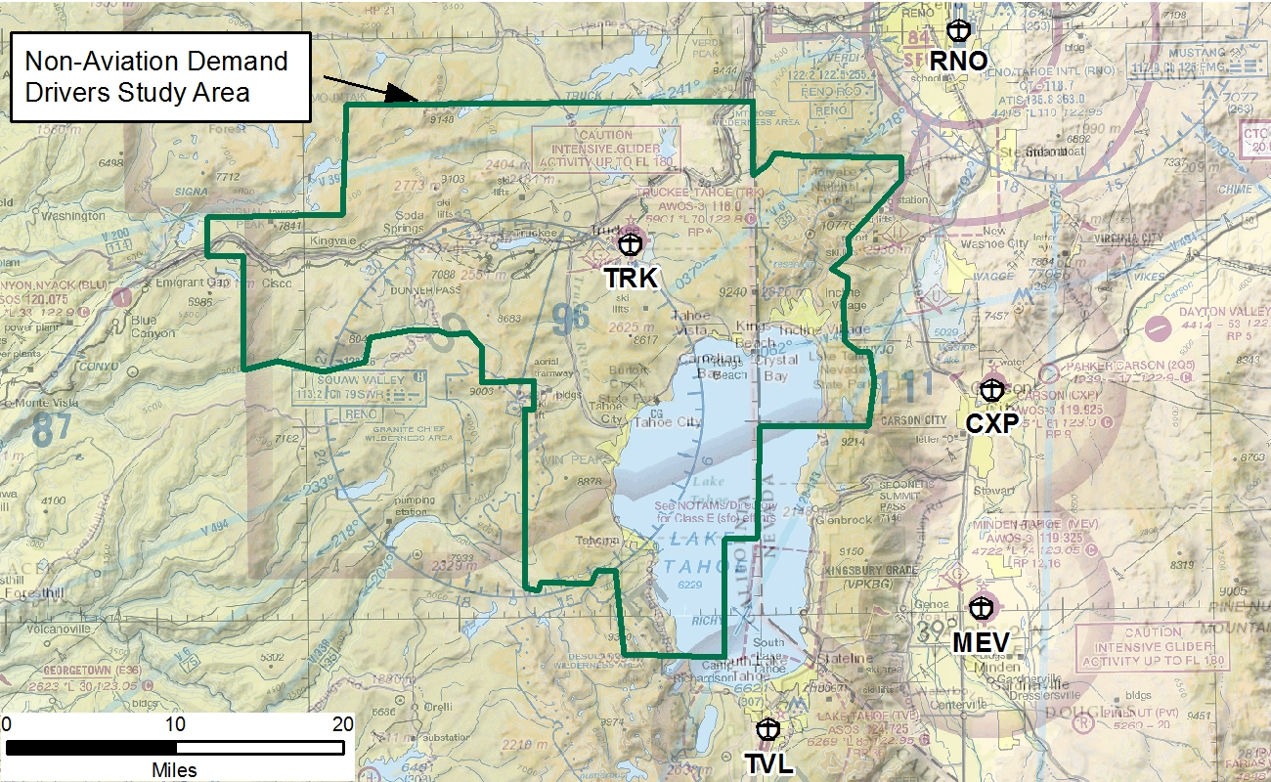
Non-Aviation Demand Drivers
Notes:
Mitch - Study area focuses on developed areas around TRK.
Amended study area based on av.DD survey responses (Incline Village)
Pulled housing and local demographic data from within this study area.

Slide 20
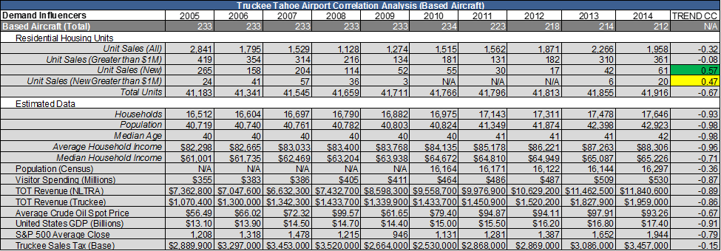
Non-Aviation Demand Drivers
Correlation Analysis: Based Aircraft
Notes:
Jeff / AMCG

Slide 21
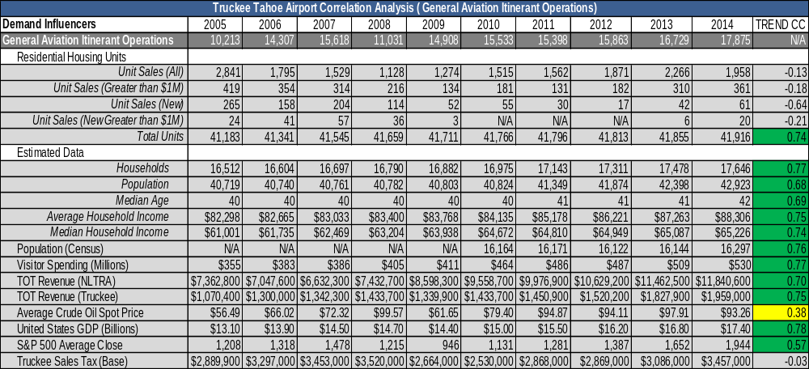
Non-Aviation Demand Drivers
Correlation Analysis: Itinerant Operations
Notes:
Jeff / AMCG

Slide 22
Non-Aviation Demand Drivers
Non-Aviation Market Assessment and Survey
Interviewees represented local business leaders and developers, plus on-the-ground TRK staff.
Questions asked:
  Who their constituency or customer base is?
  Why they visit the Truckee/Tahoe region?
  How they get to the area?
  If their constituency use TRK?
  If their constituency use TRK more or less than 10 years ago, what has driven that trend (internal or external to TTAD)
  What might drive an increase or decrease in operations at TRK in the future?
Notes:
Seana

Slide 23
Non-Aviation Demand Drivers
Non-Aviation Market Assessment and Survey
Constituency or Customer Base
  Second homeowners
  Tourists
  Primarily Bay Area
  Young families to retirees
Visitors to the Truckee-Tahoe Region
  Recreation and mountain lifestyle
  Ease of access to Bay Area (driving and flying)
Notes:
Seana
-suggest just keeping the main bullets on the pPT and using the sub bullets as your talking points

Slide 24
Non-Aviation Demand Drivers
Non-Aviation Market Assessment and Survey
Access to the Area
  Flying to TRK was a significant response,
  Some associations estimate 5%-25%, up to 40% of constituents utilize TRK to access the area
  Martis Camp estimated the completion of homes has directly resulted in an increase of activity at TRK
What has Driven Demand Recently?
  Growth in the luxury real estate product
  Improvements in the Bat Area economy
  Truckee-Tahoe Region as a destination for events
  NetJets and Surf Air
Notes:
Seana
-suggest just keeping the main bullets on the pPT and using the sub bullets as your talking points

Slide 25
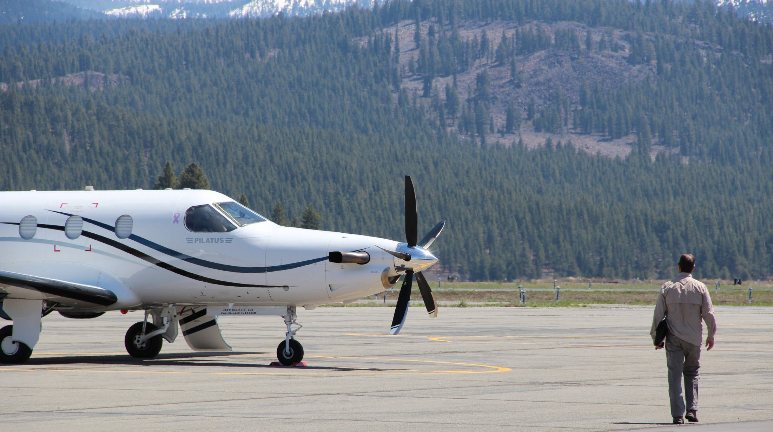
Thank you

