Slide 1
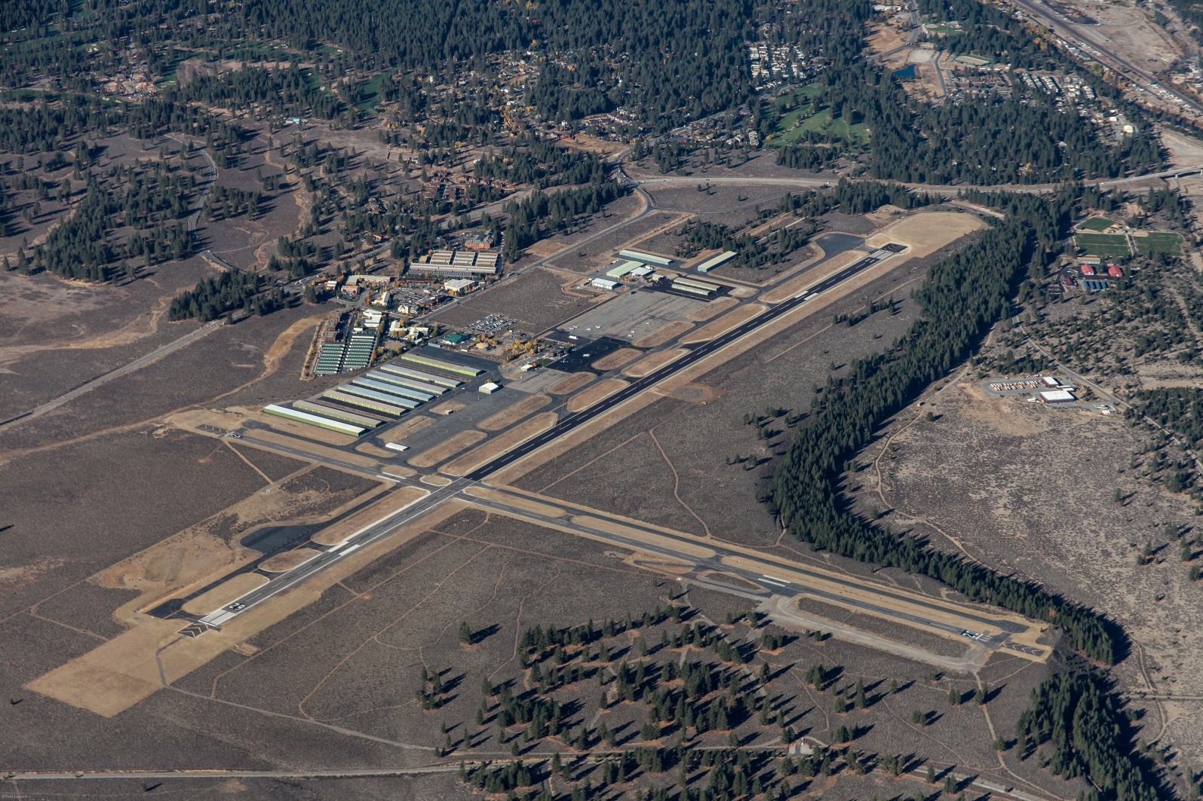
Truckee Tahoe Airport. Connected.
Truckee Tahoe Airport District
2014-2015 Budget Workshop
September 3, 2014

Slide 2
Truckee Tahoe Airport District
General Notes
Revenue estimates do not take into account any changes to the rates and fees schedule. Fee Schedule is under review.
The sale of “contract fuel” will be available in the new year, and Avfuel, our provider, is confident our sales volume will increase. As the effect is unknown, no assumption is made in the budget.
No revenues related to new land leasing projects are estimated.
A CPI adjustment factor of 1.9% is applied to the appropriate leases.

Slide 3
Truckee Tahoe Airport District
Fuel Revenues
Forecasting to sell 5% more gallons of 100LL than we estimated to be sold in FY2014.
Forecasting to sell 15% more gallons of Jet A than we estimated to be sold in FY2014.
Margins of $0.75 for self-serve 100LL, $1.30 for full-serve 100LL and $2.00 for Jet A were included. Staff plans to change margin to $2.20 for final budget. The margin on gallons sold to tenants was adjusted to reflect their discount.

Slide 4
Truckee Tahoe Airport District
Other Airside Revenues
Tiedowns and Transient Use Fees were forecasted using current rates and usage. The policy of waiving roll fees based on a minimum fuel purchase will effect the accuracy of the estimate. This is a speculative area as the contract fuel process will also impact the number of events.
Other airside revenues were based on 7/1/13 -6/30/14 activity levels and rates.
The GPU fees were estimated based on historical data since the unit went into operation in February 2013.
Notes:
We don’t have a handle on what percentage of visitors will purchase fuel and waive the roll fee.

Slide 5
Truckee Tahoe Airport District
Hangar Revenues
Revenue reflects hangars at current base rate. The incentive discounts elected by the tenants are shown as expenses.
Reduction to revenue for estimated annual prepayment discount.
A vacancy rate of 12% was factored in. Some non-aero leases are included. With all non-aero leases to date, vacancy is 9%. Future status of non-aero is uncertain.

Slide 6
Truckee Tahoe Airport District
Other Business Leasing and Warehouse Revenues
There has been a 1.9 % CPI adjustment included.
Relating to OBL Revenues:
  No revenues have been budgeted for Hangar #2.
  Auto Rental Concessions are budgeted at $70,000.
  Red Truck lease has been increased from an introductory $240 to $1200/month.
  EAA revenues are included at $1,143/month, and an offsetting expense is included in Other Public Relations-Community Outreach.

Slide 7
Truckee Tahoe Airport District

Slide 8
Truckee Tahoe Airport District
Operating Expenditures (1 of 3)
Cost of sales was budgeted based on the cost of fuel as of 7/31/14.
Total Payroll and Employee Benefits are budgeted to decrease 4% from the amount budgeted for 2013-2014. Staffing is based on 19 full-time positions, 1 full-time temporary and 1 temporary 4 month summer staff and a vacancy factor is used. The increase associated with salaries and wages is 5% over prior year budget, which includes the 1.9% COLA, performance awards and merit increases (at the discretion of the General Manager). Seasonal, snow plow help, as used in the past, is factored in.
  Items identified in “benefits” section represent 27% of total personnel costs – this is down from the prior year.
  Healthcare insurance premiums are budgeted to decrease 14% from prior year budget by changing insurance policies in August of 2014.
  Workers Comp is budgeted to decrease from prior year budget with improved experience rating.
Notes:
To put this into perspective – I reviewed a few other agency benefit ratios. A review of the Town of Truckee 2013 budget shows that their benefits range between 33% (Administrative Svcs) and 38% (Town Manager) of total payroll and benefits by department. For TDPUD the rate is 46%
Perf awards includes:
2500 cost savings
2550 safety
2400 add-on assignments
7500 certification pay for new program
5000 in regular

Slide 9
Truckee Tahoe Airport District
Operating Expenditures (2 of 3)
Operating, General and Administrative Expenses increase 25% over the prior year’s budget. Expenses have been budgeted based on:
  prior experience (12 months ended 6/30/14 adjusted for known, specific circumstances, e.g. whether or not there is an election),
  staff’s estimate of upcoming expenses - including computer purchases, potential consulting services, etc.,
  consultation with outside resources (i.e. TDPUD, SW Gas, insurance brokers).
The largest single line item line item is for Other Professional Fees, which includes the cost of the Hangar 3 design and CEQA for the Master Plan and other consulting projects summarized below:
Master Plan CEQA | Hangar 3 Design | Charted Visuals | Title Report | Other
$164,000 | $400,000 | $30,000 | $30,000 | $52,000

Slide 10
Truckee Tahoe Airport District
Operating Expenditures (3 of 3)
Repair and Maintenance Expenses were budgeted based on current expense levels, subject to the review of management, and specific projects scheduled for the upcoming year. Many of the $3,306,331 in expenses budgeted come from Facility and Equipment Maintenance and Land Management Plans.
Pavement Maintenance Program | Facilities Maintenance Plan | Forest Management Plan | Total
$2,450,000 | $452,930 | $249,600 | $3,152,530
Although the pavement maintenance expenses may be grant fundable and funding may be pursued, the expenses are shown without anticipated FAA participation.
Notes:
Note that the CFP includes funding to work on Hangar #2 – which may not be performed. Work on the beacons is not included, as the consultants report had not been received at the time.

Slide 11
Budgeted Operating Expenses
2014-2015
Truckee Tahoe Airport District

Slide 12
Truckee Tahoe Airport District
Expenditures Budgeted in FY2014 – Rolling to FY2015
Since this draft of the Budget was completed, it has become apparent that there are expenditures that had budgeted funds available in the current fiscal year will not be completed by year end and will have to be carried forward into the FY2015 budget :
  Utilities Maintenance Plan - $30,000
  Facilities Maintenance- $252,400
  When the budget is brought to the Board for approval on the September 24th, these amounts will be included in the revised version.
Notes:
Discuss cutoff-timing, etc. Issue with tree removal.

Slide 13
Truckee Tahoe Airport District
Expenditures Identified to Consider Adding to the Budget
When the budget is brought before the Board September 24, 2015, the following items will be added:
  STEM funding through the Boys and Girls Club - $45,000. This item will be flagged for future consideration.
  POS software upgrade, $40,000
Notes:
Discuss cutoff-timing, etc. Issue with tree removal.

Slide 14
Truckee Tahoe Airport District
Capital Expenditures
Three major categories:
  FAA grant eligible
  Other (non-grant eligible) – Most significant project is the purchase of Plow Truck.
  Land Purchase/Development – No additional funds were budgeted for land acquisitions as there will be $2.5 million of Unrestricted Net Assets designated for this purchase as of 9/30/14.

Slide 15
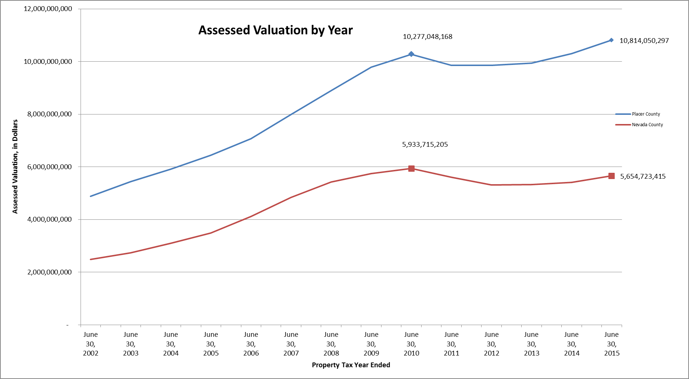
Truckee Tahoe Airport District
Property Tax Revenues
Notes:
Valuations for Placer County have reached a new high. Nevada County is still below 2009-10 levels. In total the increase in total valuation was 2.85.

