Slide 1

Summary
Public Input
Potential Multi-Use Hangar Building
Updated: 7.28.2015

Slide 2
Project Input To-Date
November 2013 May 2013 November 2014
Godbe Survey
TTAD Master Plan
Multi-Use Hangar Workshops
Sample Size:
500 residents; 65 pilots
Q19: Support for Multi-Use Hangar (residents only)
Summary:
76% support
13% against
11% undecided
Sample Size: 500+ comments
Methodology: workshops, survey, on-line comments
Qs:
Which hangar development preferred?
Summary:
Majority preferred the multi-use and executive hangar options
Sample Size: 80+
Methodology: interviews with pilots + non-profits, public workshops, online input
Q: Per proposed concepts, what do you think. Would you come if we built it. Uses?
Summary:
Multi-use support
Commercial kitchen
Regional need for events/programs
Pilots: not driver for operations
Notes:
Also on Godbe survey (p. 48):
Q12: Most important improvement (pilots)
More hangars (19%)
Deicing facilities (14%)

Slide 3
Per Board Request
Spring-Summer 2015 Input
Proposed Multiuse Hangar Project
July 22, 2015

Slide 4
Spring-Summer 2015 Input Methodology
Ad Hoc Committee Review/Planning
Non-profit/service club interviews (50)
FlashVote Survey (232) + comments (120)
On-line comments (6)
Questions: Potential Public Use
If we build a multi-use hangar will the community use it (if yes, how often)? In no, why not.
Of the three current options ($3M, $6M, $9M) which option does the community prefer? (FlashVote question only)

Slide 5
Summary of Spring-Summer 2015 Nonprofit/Service Interviews
July 22, 2015

Slide 6
Who: Organizations Interviewed
Arts & Culture Arts for the Schools For Goodness Sake Inner Rhythms Dance Moody’s Jazz Camp North Tahoe Arts Center North Tahoe Events Center Tahoe Art Haus Tahoe Flow Arts Tahoe Youth Ballet TOCCATA Wild & Scenic Film Festival | Sports Barcelona NorCal Soccer Far West Nordic Peak Volleyball / Pinnacle Tahoe Volleyball Sierra Avalanche Center Truckee Bike Park Truckee Little League | Community Improvement & Community Services Friends of Truckee Library / Early Literacy Program Girls on the Run High Fives Foundation McConkey Foundation Project MANA Rotary Senior Services Sierra Business Council Slow Food Lake Tahoe Soroptimist Tahoe Food Hub Tahoe Rim Trail Association Truckee Donner Chamber of Commerce Truckee Family Resource Center Truckee Tahoe Community Foundation Truckee Trails Foundation
Education & Youth Development Adventure Risk Challenge Alder Creek Middle School Big Brothers Big Sisters of Nevada County Excellence in Education KidZone Museum Sierra College Sierra Expeditionary Learning School Squaw Valley Institute Squaw Valley Prep/Creekside School Tahoe Expedition Academy Tahoe Truckee Unified School District | Environment & Animal Welfare Humane Society of Truckee Tahoe Mountain Area Preservation Foundation Sierra State Parks Foundation Tahoe National Forest – Truckee Ranger District Truckee Donner Land Trust Truckee River Watershed Council

Slide 7
What: Questions
Non-Profit Interview Questions
  What events/programs do you currently host?
  If TTAD built community use space, would you use it?
  If yes, what amenities would you want/need? When? For how many?
  If no, why not

Slide 8
If TTAD built an event space, would you use it?
76%=yes

Slide 9
Top Four Amenity Picks
Mentioned by over 20 organizations
  Audio/Visual (sound, light, projector, screen)
  Tables + Chairs
  Commercial Kitchen
  Stage / performance + theater space / black box theater
Notes:
Other ideas (5-10 people mentioned): dividable space, heating & A/C, Good acoustics/sound proofing, Wi-Fi, some kind of special flooring, open air + indoor/outdoor space, bar + beer/wine license, appealing interior/unique space, bathrooms, parking

Slide 10
Other Top Amenities
Mentioned by fewer than 20, but more than 5 organizations
  Dividable space
  Heating and A/C
  Good acoustics/sound proofing
  Wi-Fi
  Some kind of special flooring
  Open air + indoor/outdoor space
  Bar + beer/wine license
  Appealing interior/unique space
  Bathrooms
  Parking

Slide 11
If No, Why Not?
4 groups said no
  Have a need for office / storage space instead or no need
Why not?
  A different organization should build community events space; building a community space is not in alignment with TTAD goals and mission
  However; interviewees acknowledged a need for event space by other organizations in the community

Slide 12
What Type of Events Do They Host?
Types of events
  Dinners
  Fundraisers / auctions
  Movies / film festivals / entertainment
  Performances / visual art shows / dances
  Lectures / Speakers / Assemblies
  Science festivals / camps
  Sporting events (volleyball, baseball, hockey, etc.)
  Meetings / conferences

Slide 13
Projected Use
  Quarterly: lectures, meetings, movies/films, entertainment, arts, concerts, fundraisers, dinners
  Monthly: lectures, meetings, dinners
  Weekly: assemblies, soccer practice, food drives
  5 days/week: sports practice
  More use during winter (for inclement weather), holidays

Slide 14
Current Estimated Space Needs (Size)

Slide 15
Potential Future Needs (When)

Slide 16
Non-Profit Summary
76% support for multi-use hangar that can host events
Year-round use but greatest in winter + fall
Event size: 100-400
Top amenities: audio/visual, chairs/tables, kitchen, stage
Need for free/low cost event/meeting space
Overall, those interviewed enthusiastic

Slide 17
Current Use

Slide 18
Current Use of Airport Facilities
Notes:
2011 – Q1 2012 data only tracked events; didn’t track organizations that used airport
Q1 &Q2 2013 data missing
Data doesn’t show how many times each organization used community rooms, only how many organizations in total used them.
Events totals by year:
2011 – 19
2012 – 15
2013 – 12 (over 2 quarters – data missing)
2014 – 19
Annual use by number of organizations: (estimates)
2014: 76
2013: 52
2012: 52
2011: handful (fewer than 20)

Slide 19
FlashVote
232 survey takers
120 comments

Slide 20


Slide 21
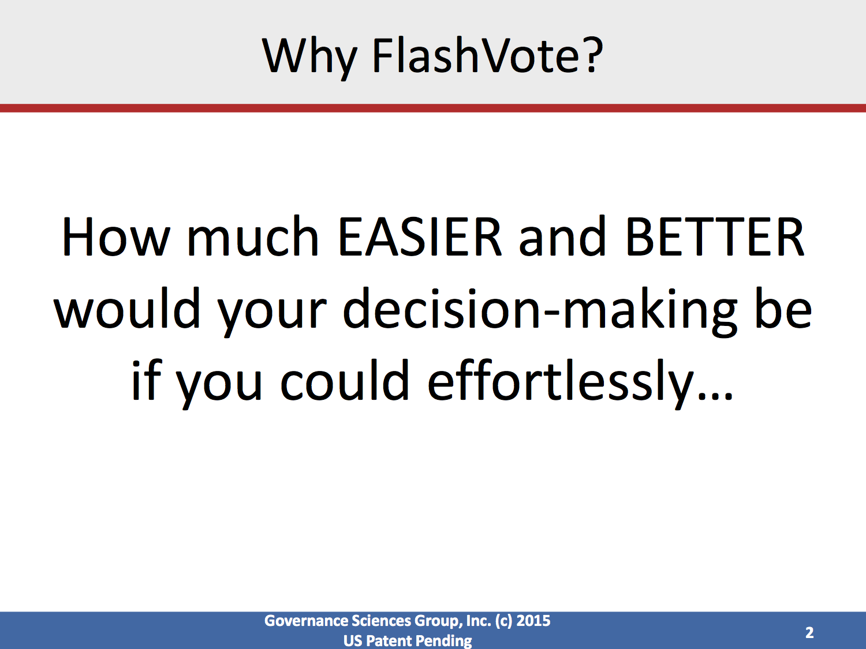

Slide 22
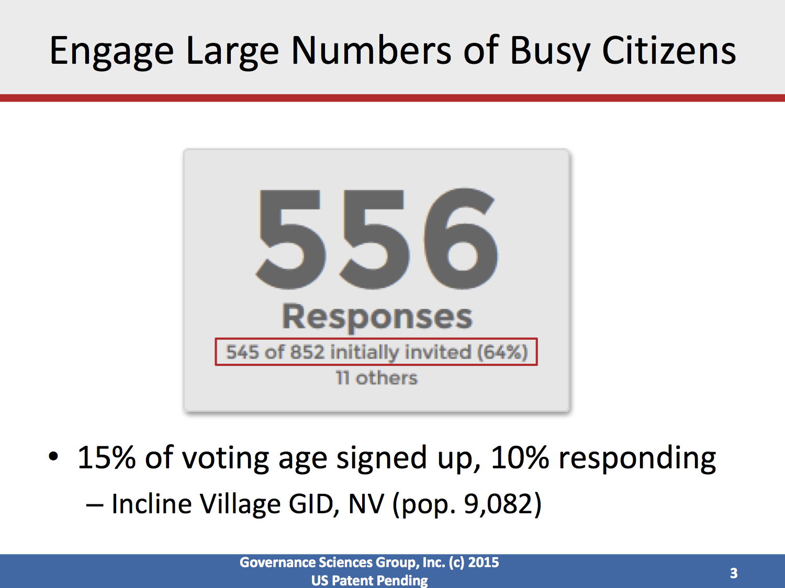

Slide 23
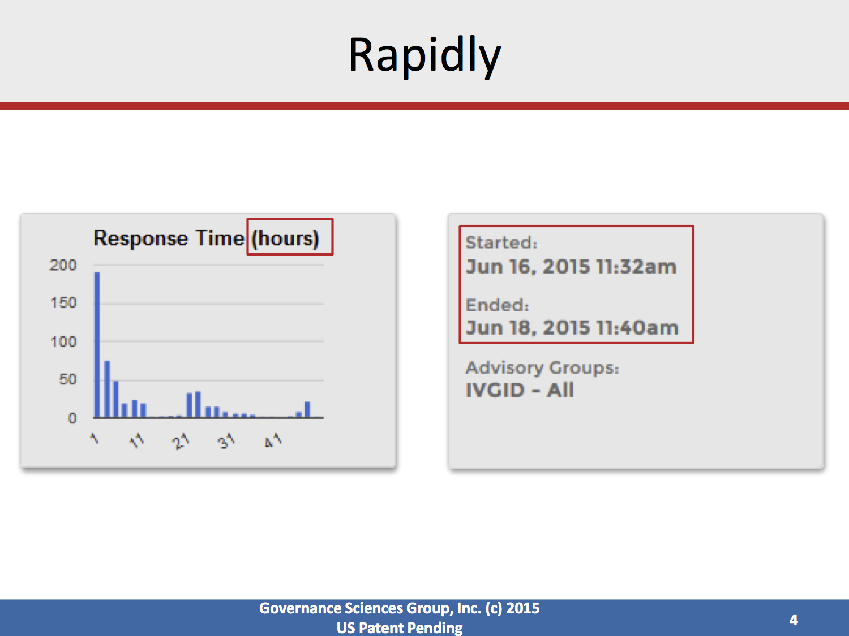

Slide 24
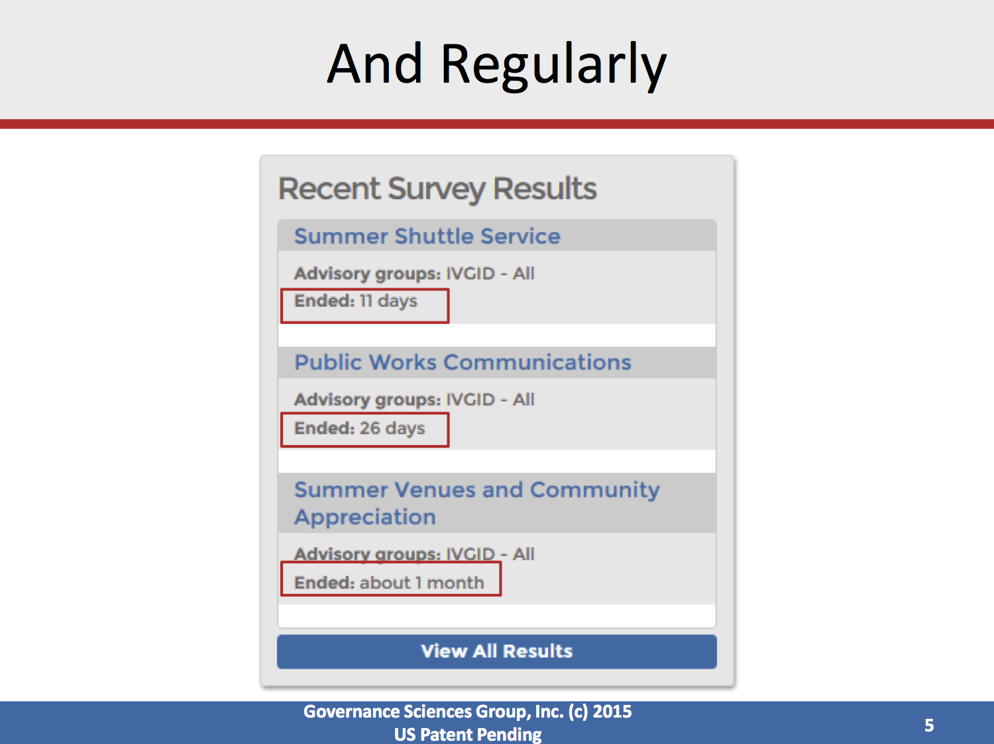

Slide 25
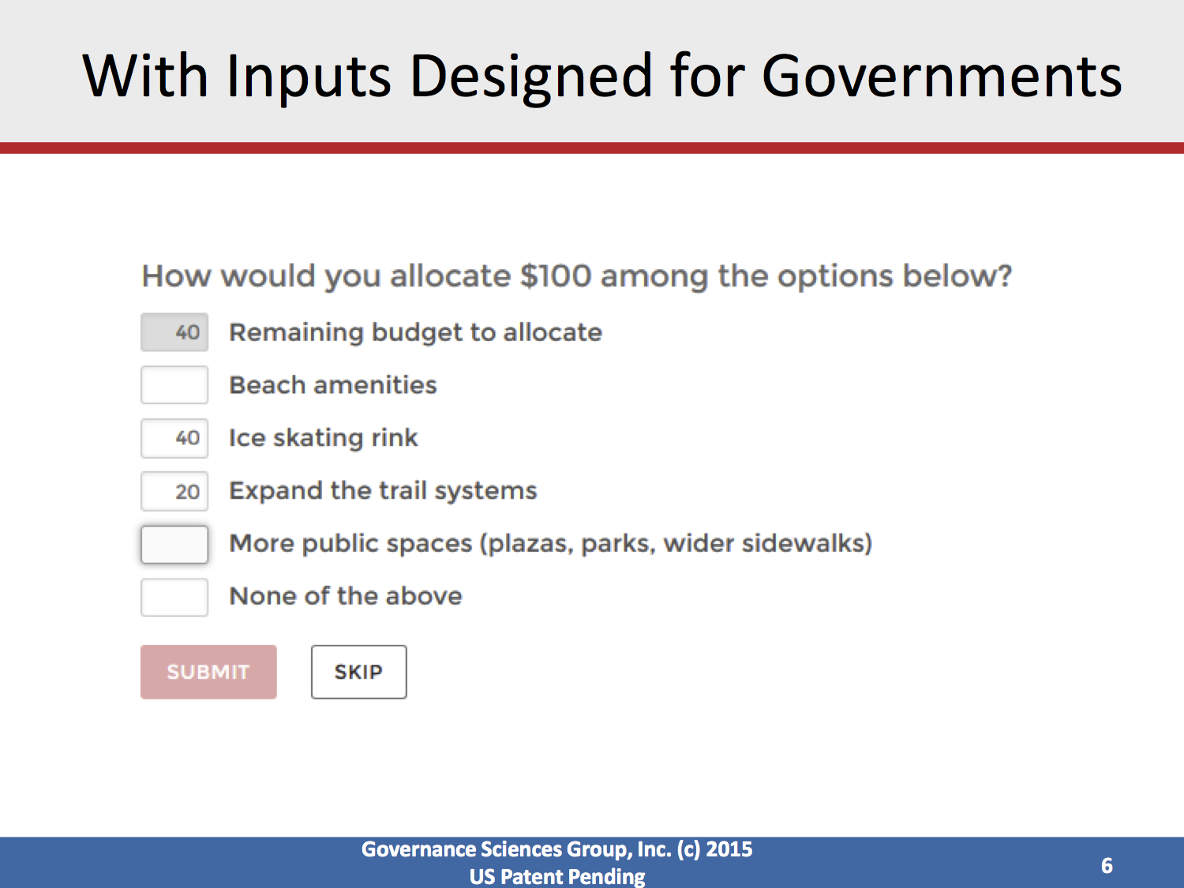

Slide 26
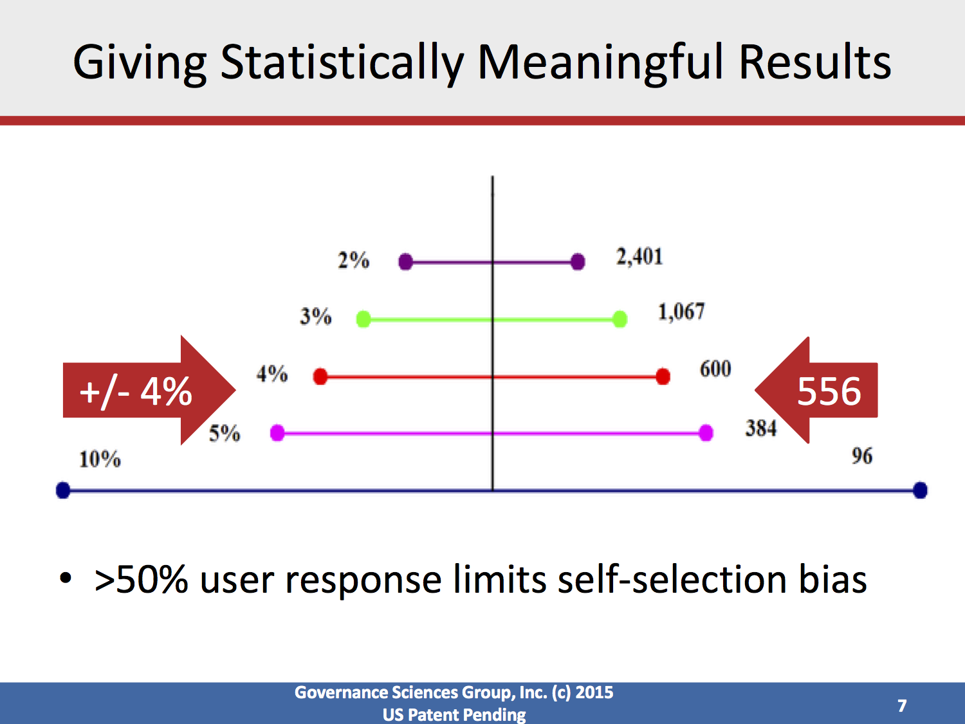

Slide 27
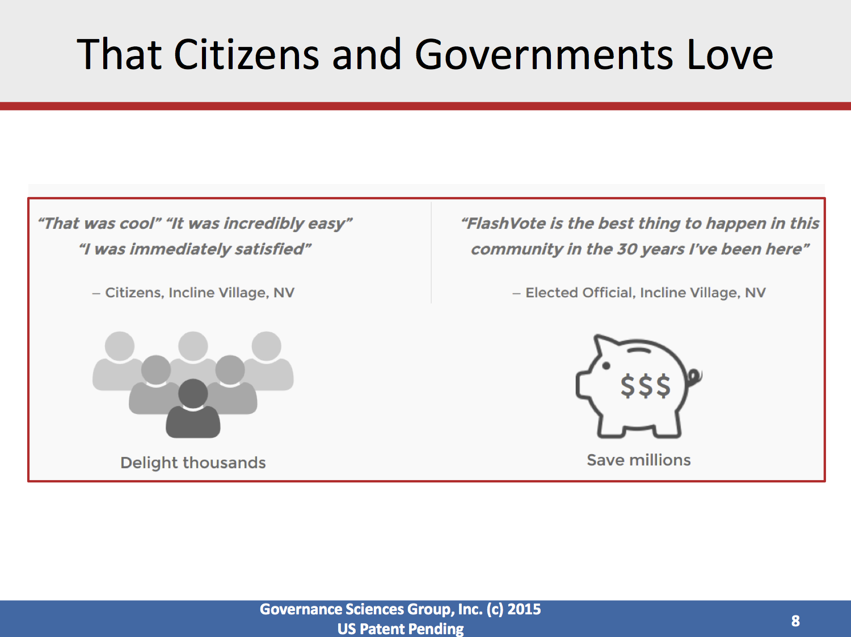

Slide 28
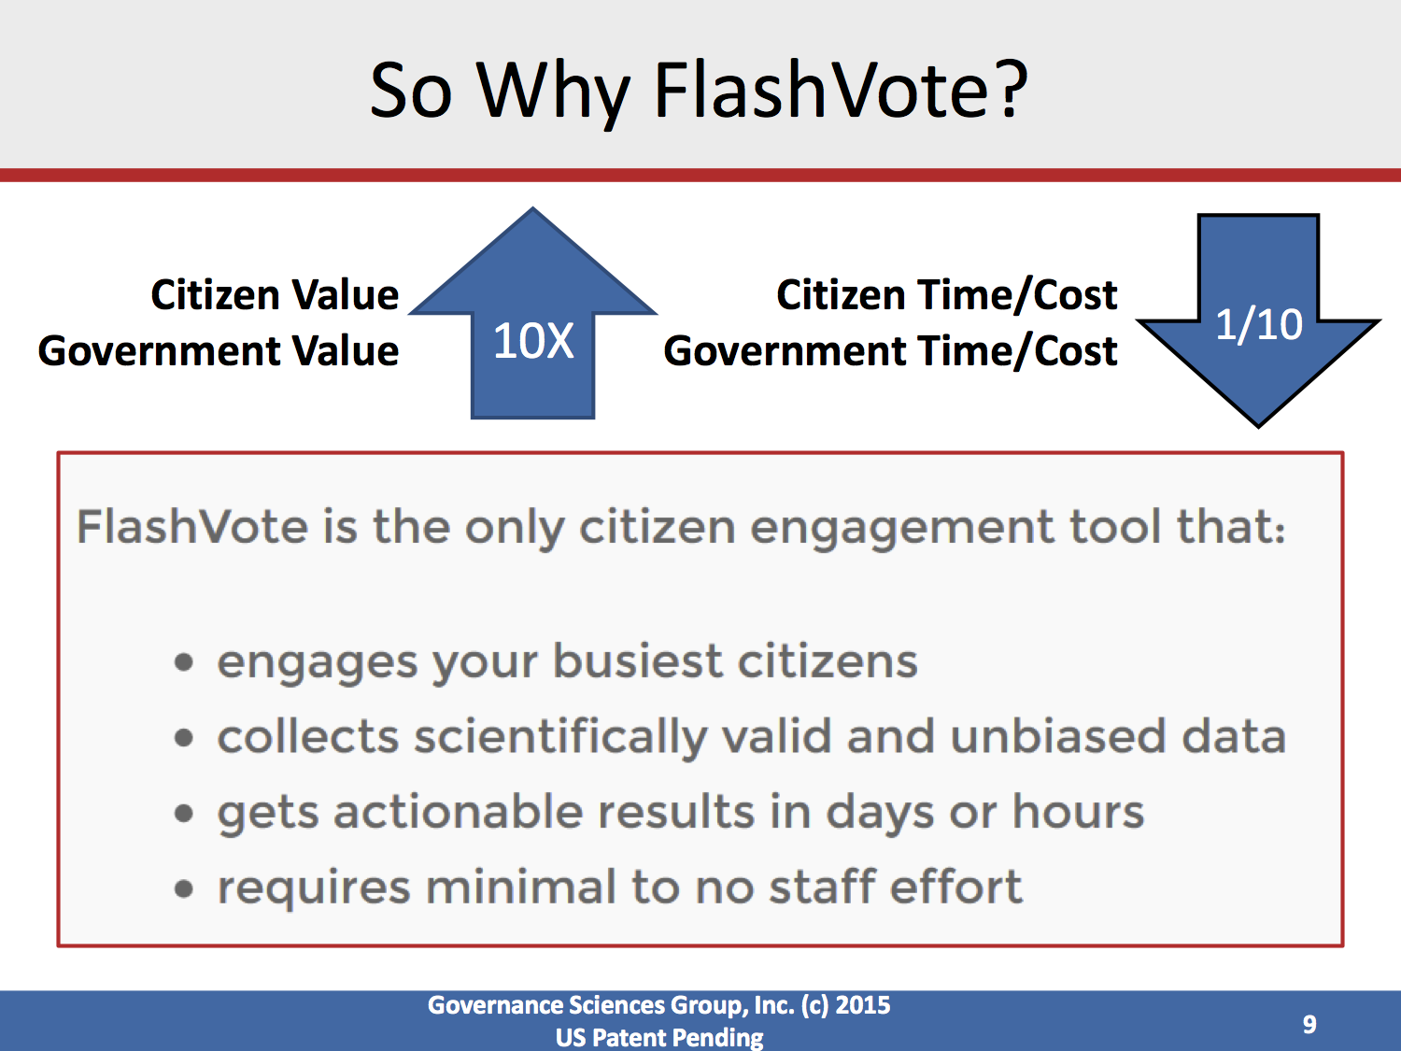

Slide 29
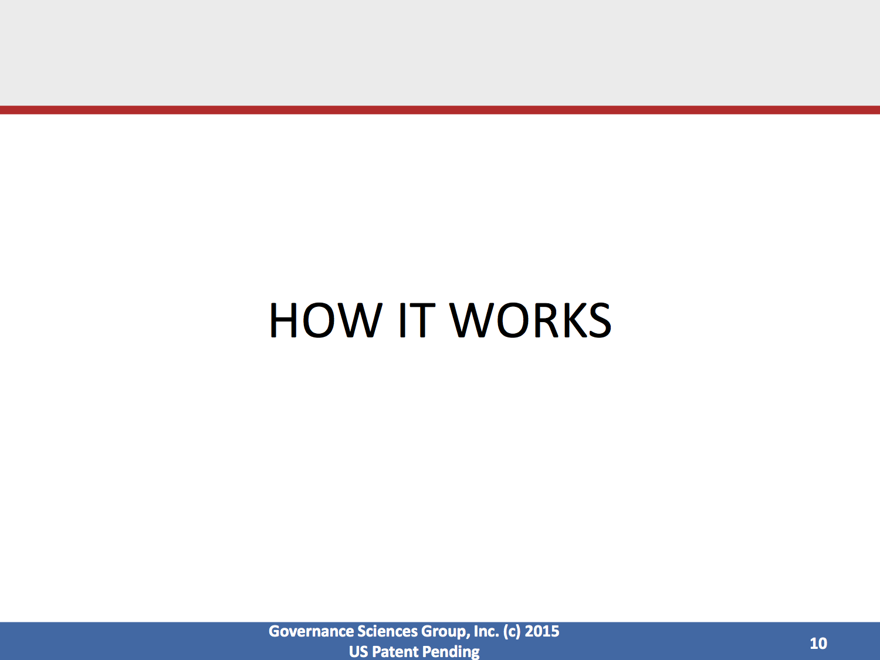

Slide 30
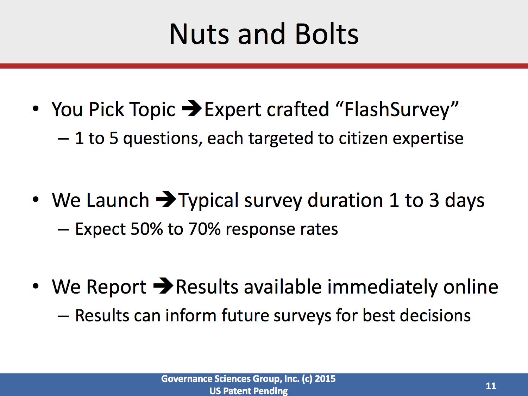

Slide 31
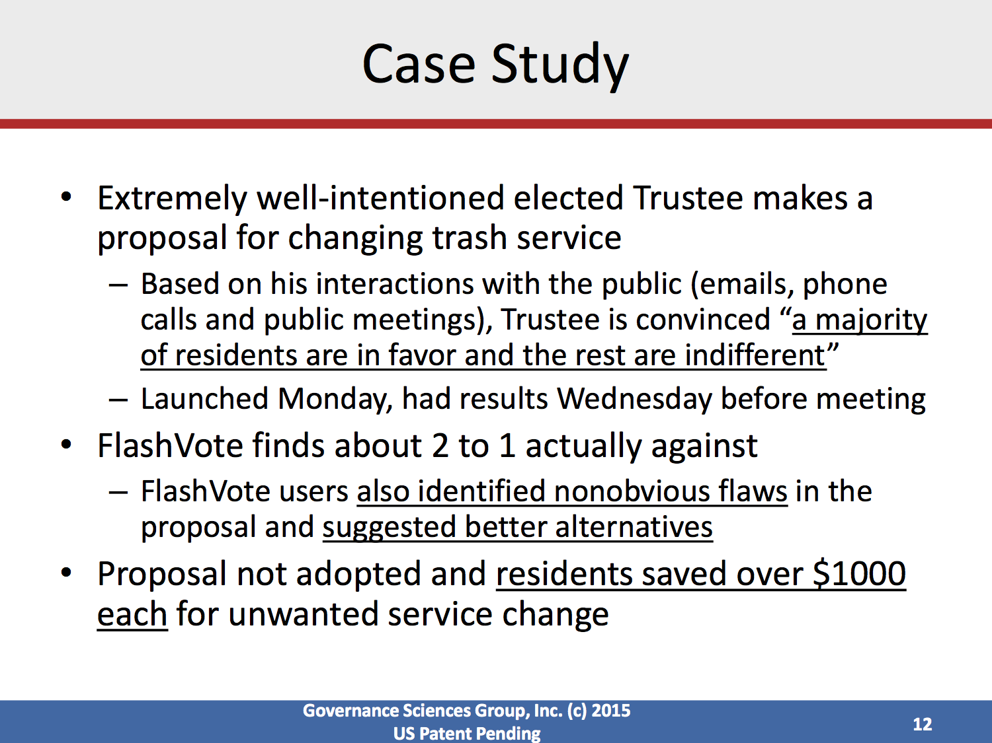

Slide 32
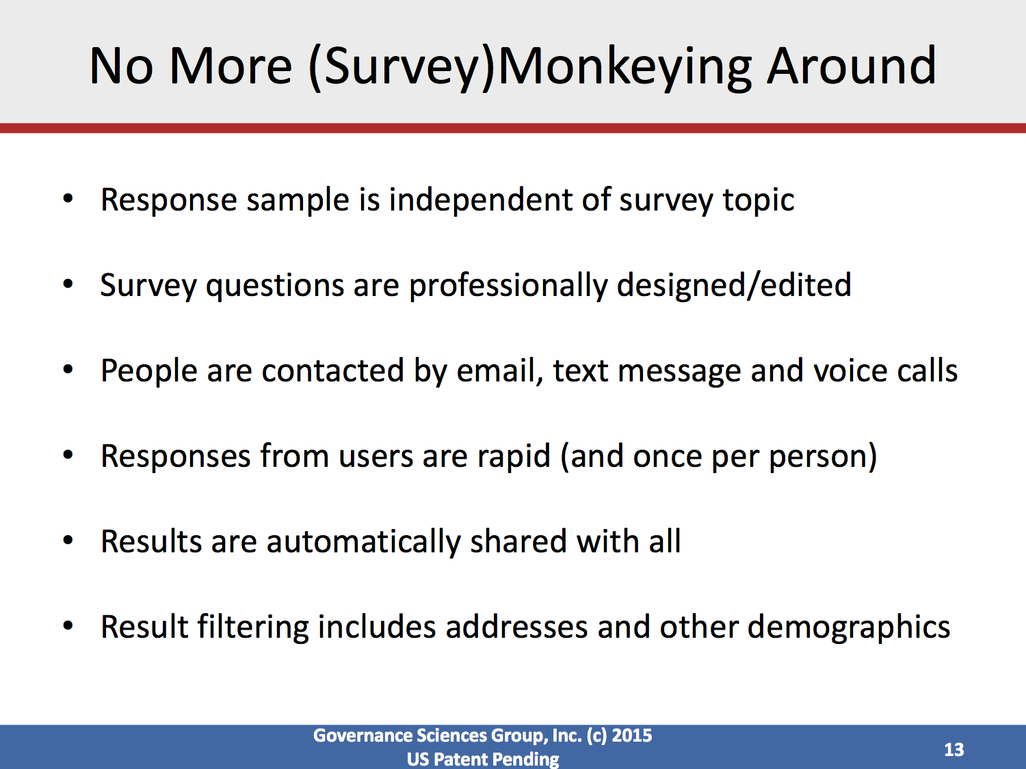

Slide 33
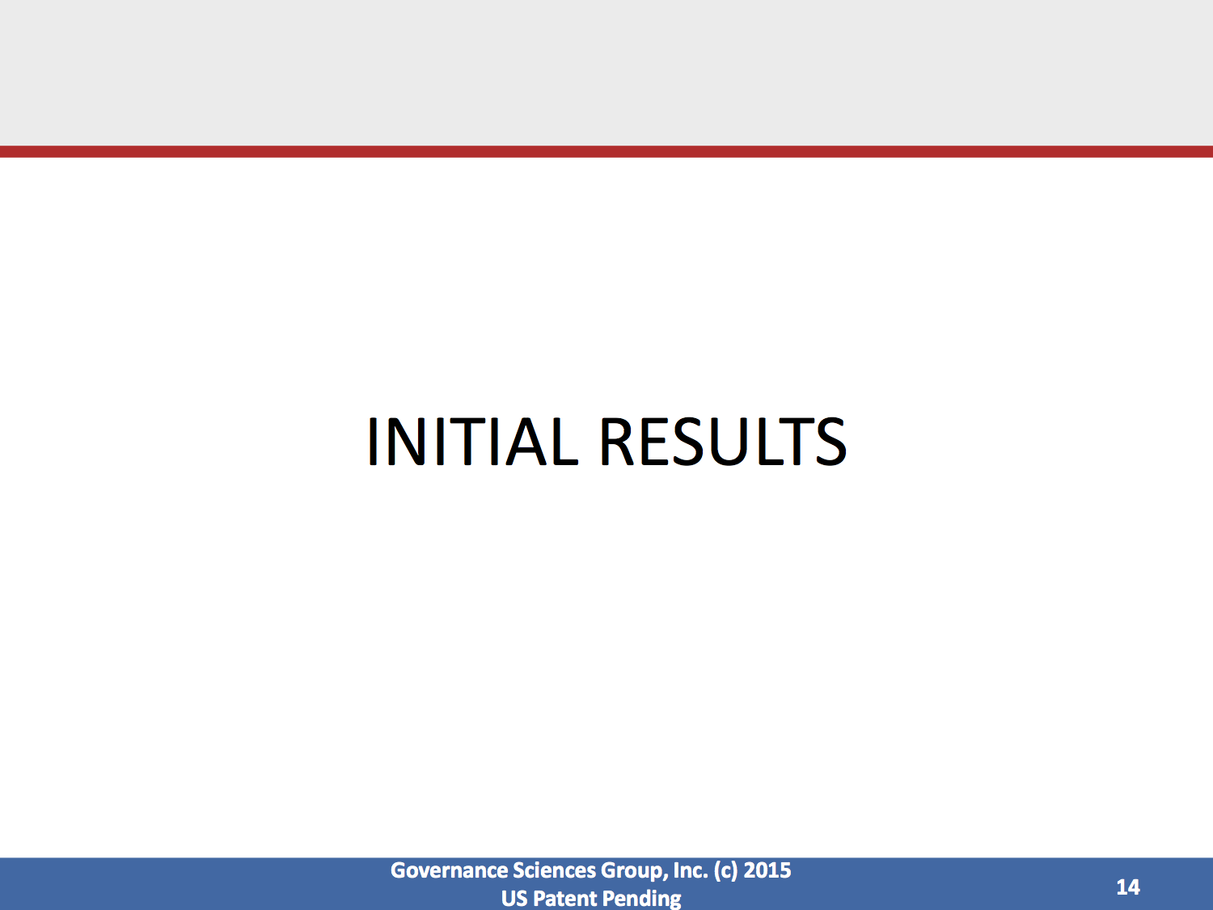

Slide 34
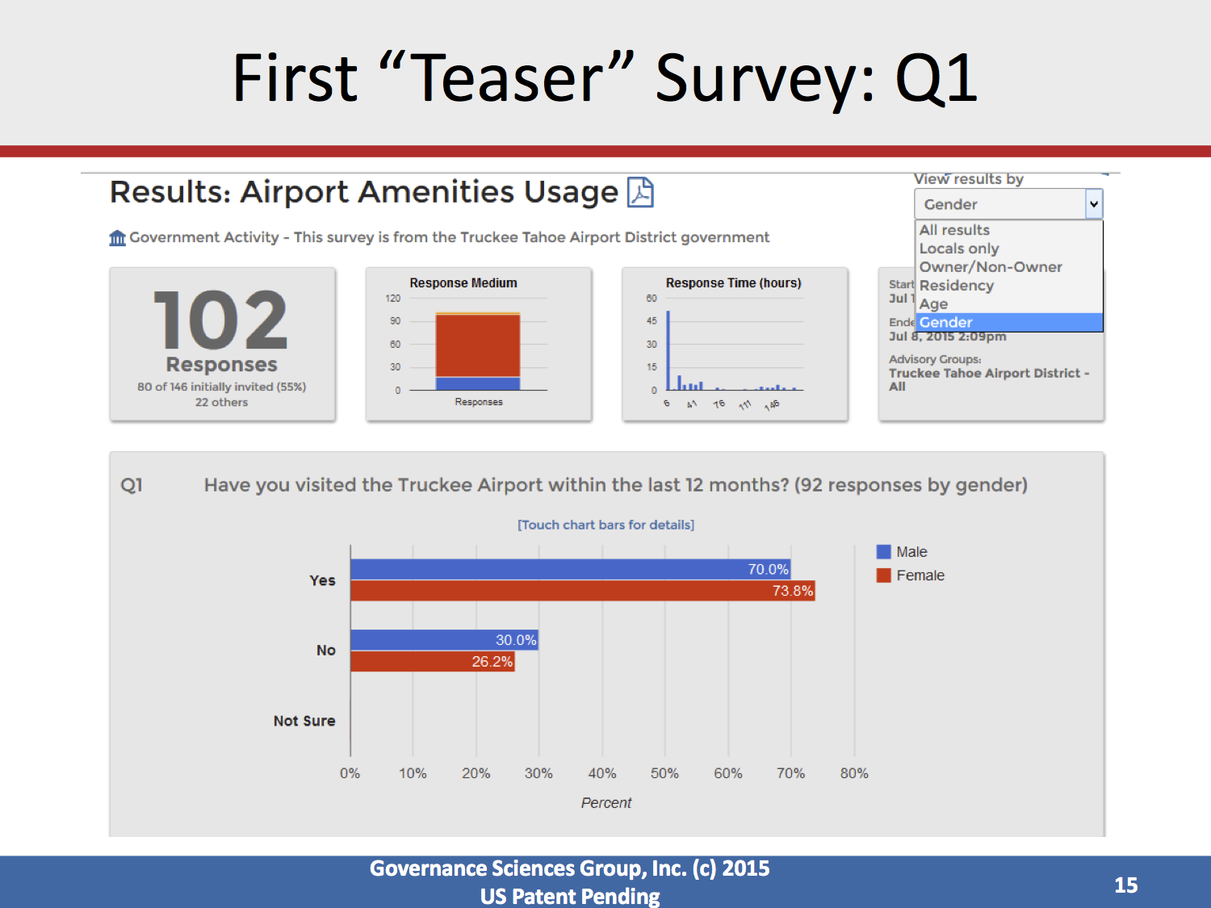

Slide 35
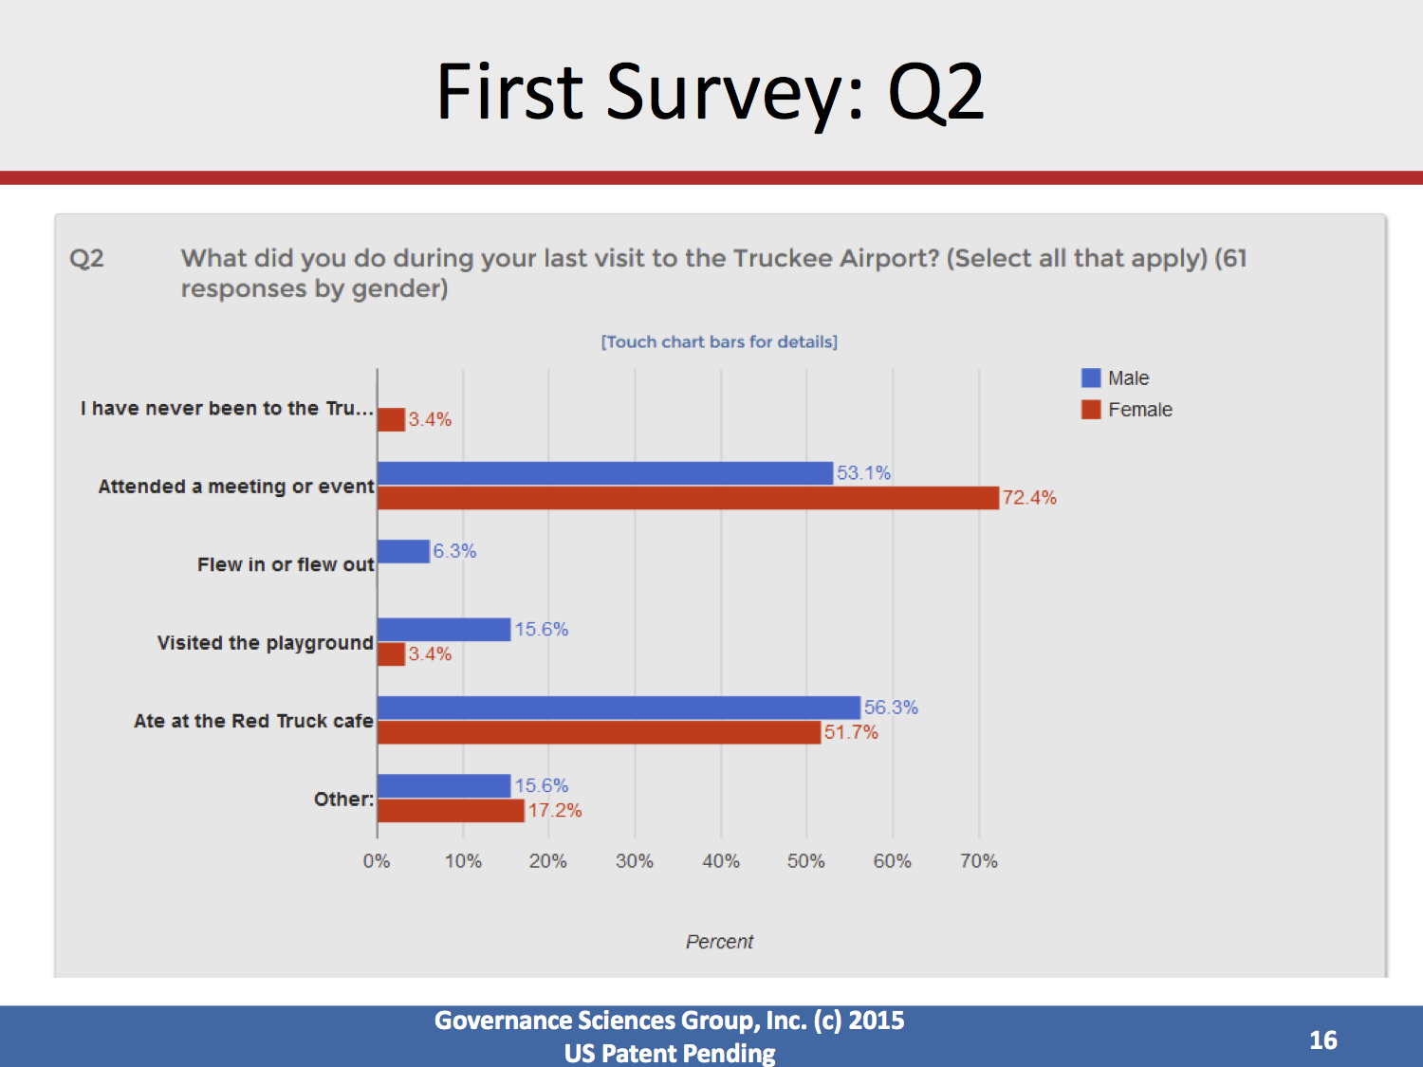

Slide 36
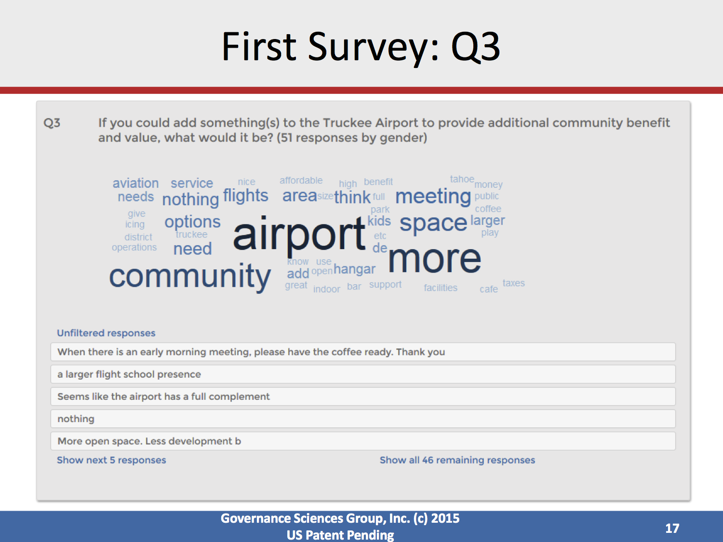

Slide 37
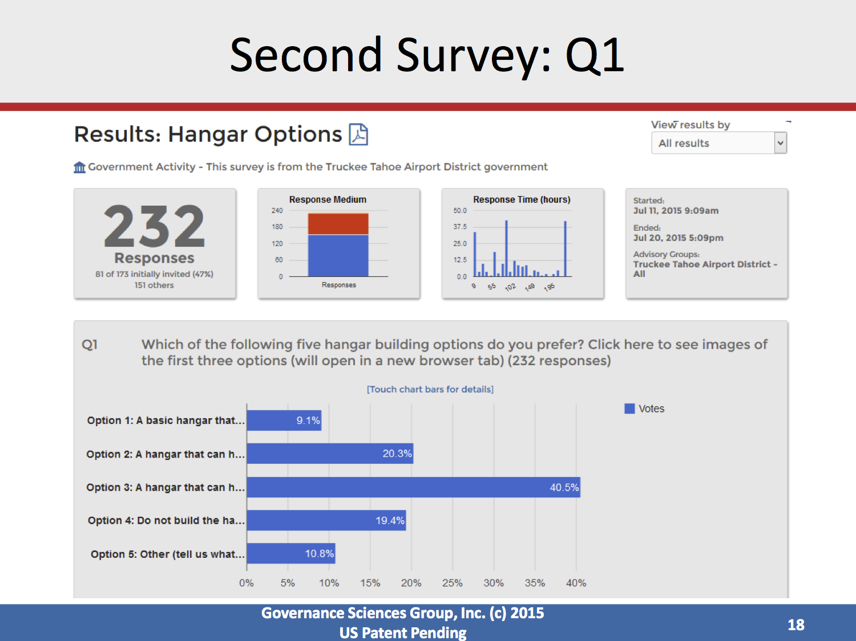

Slide 38
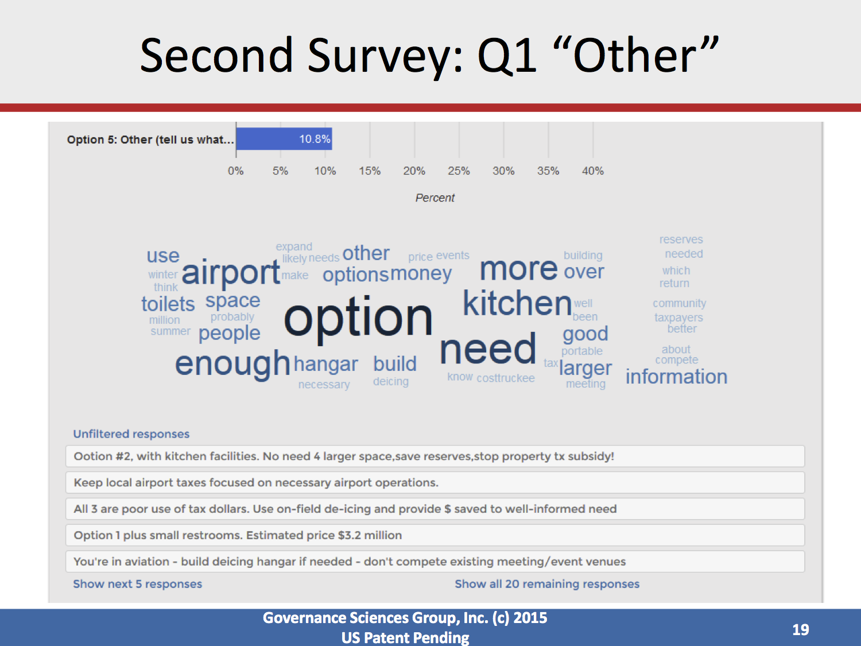

Slide 39
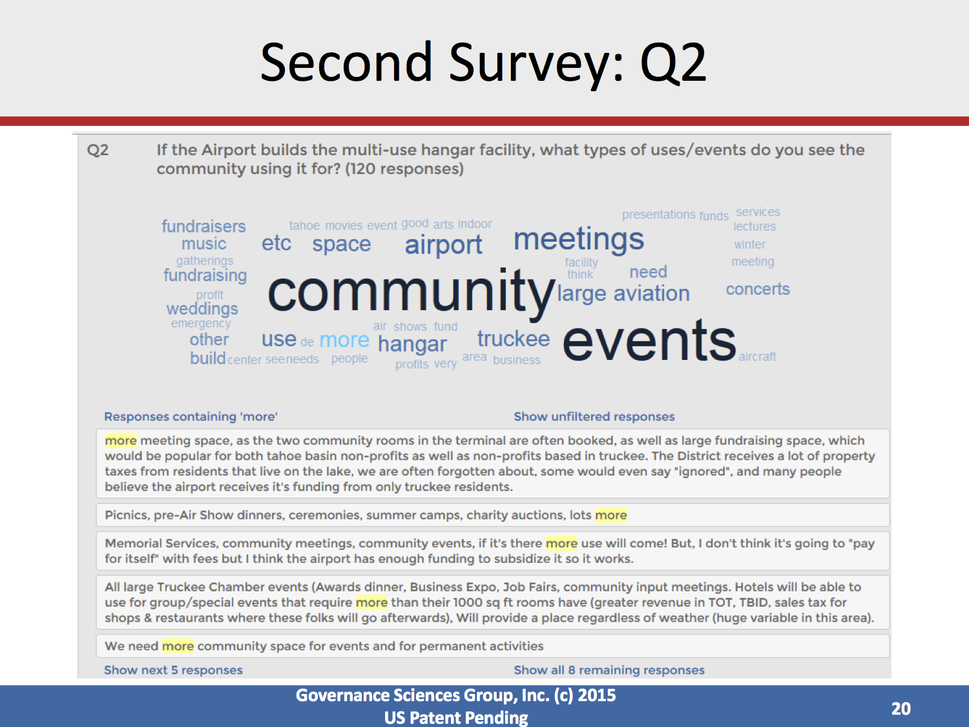

Slide 40
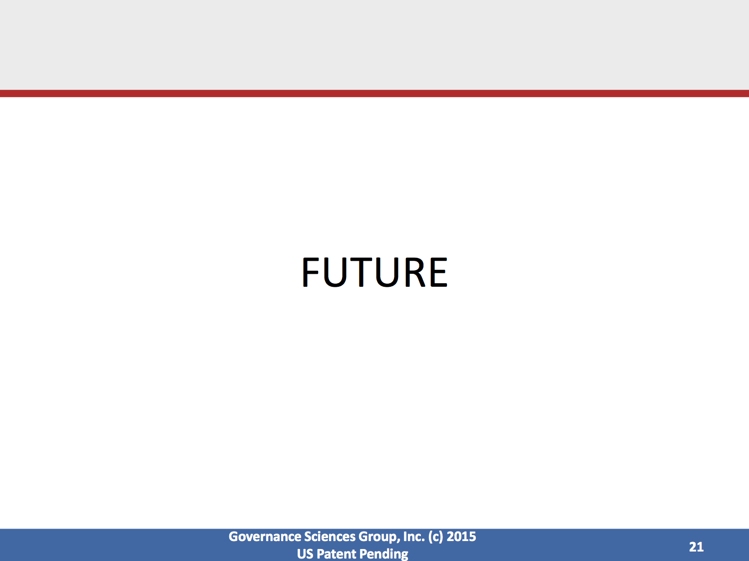

Slide 41
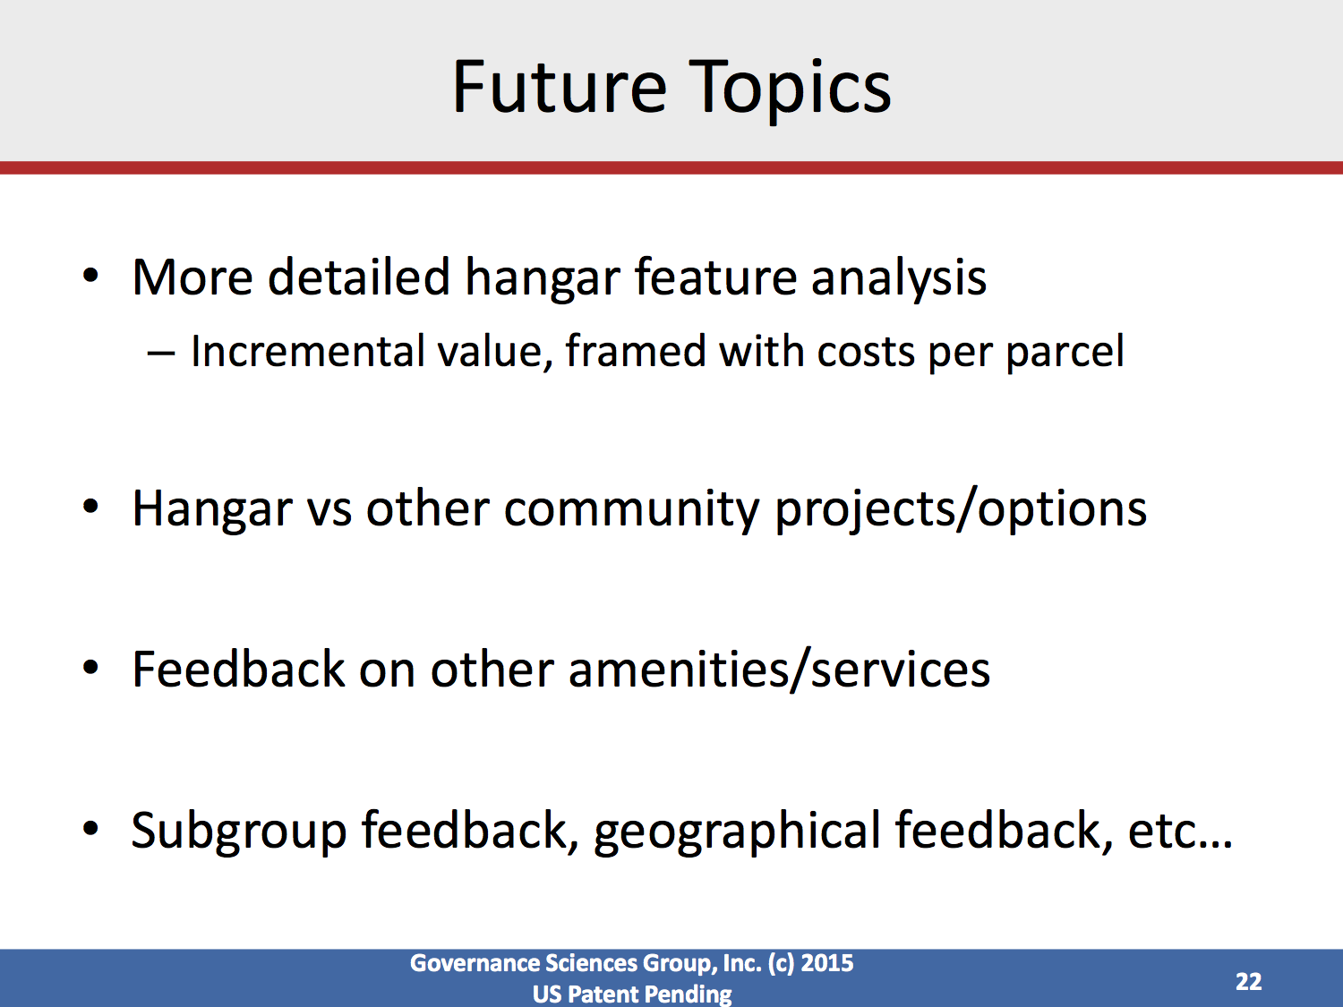

Slide 42
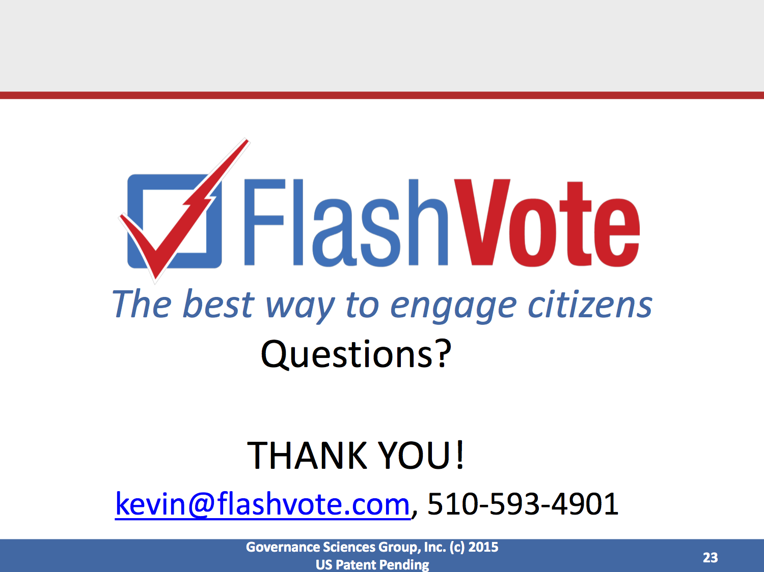

Slide 43
Publicity Efforts
Sierra Sun Ads
Biz cards at Air Faire/terminal/events
Press coverage
Website
Connected
E-blasts
Facebook

Slide 44
Conclusion
*1,427 comments on the multi-use hangar concept since 2013
(includes duplicated comments)
Godbe (November 2013):
76% support
Master Plan (May 2013):
Strong support for multiuse option
Hangar Input Process (November 2014):
Strong support for multiuse concept with amenities for community events (AV, kitchen)
Spring-Summer 2015 Input:
Non-Profits: 76% support
FlashVote: 70.3% support
  $3M option: 9.1%
  $6M option: 20.3%
  $9M option: 40.9%

