Slide 1
Pilot Outreach
Summer 2015

Slide 2
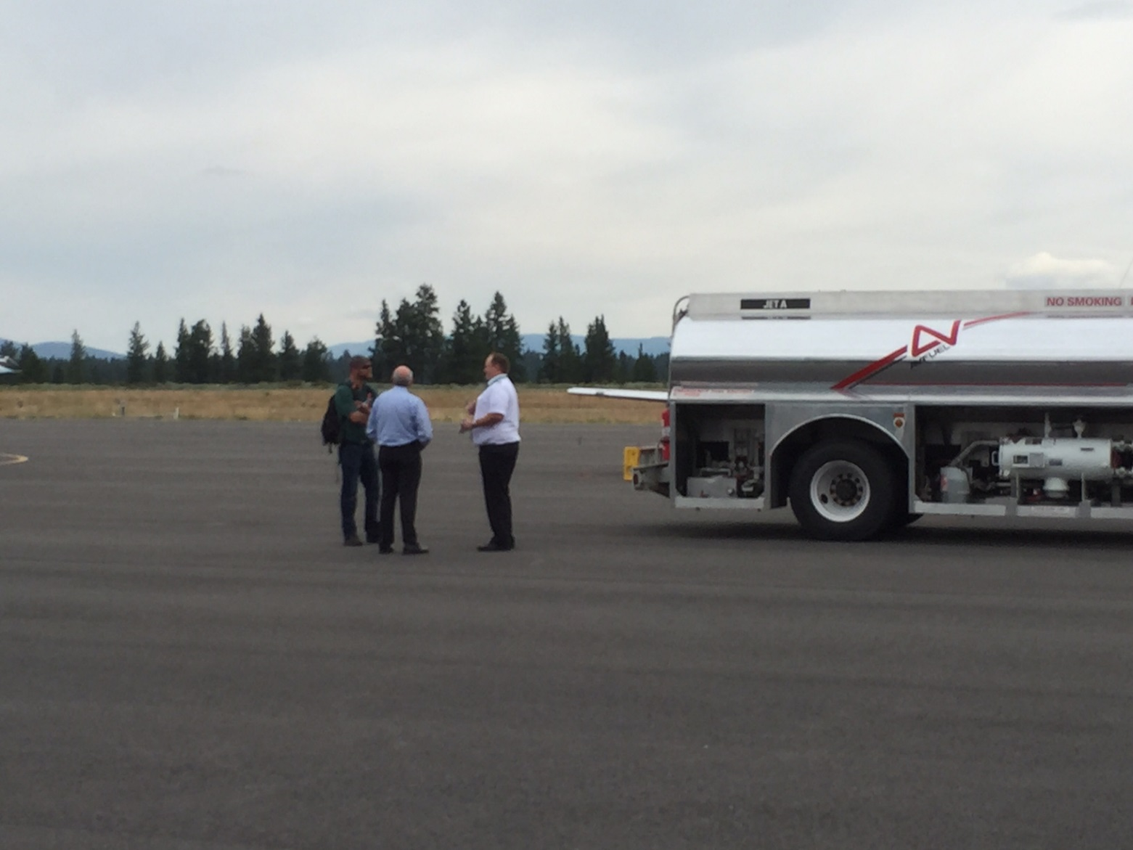
Outreach Dates
May 22nd – September 7th
Ongoing effort: Continued through UNICOM and Aviation & Community Services staff.
Over 350 pilots reached

Slide 3
Approach
Truckee Tahoe Airport water Bottles (350)- Ice Breaker, NAP info.
DATA: Pilots Name, Tail Number, Type, Operator, Contact.
Where the pilots got the Flight Planning/ Navigation & Airport Data?
How Often Do You Come To Truckee?
Is there anything we can do to make this a better/safer experience for you?
Is there anything we can do to help you reduce annoyance?

Slide 4
Finding Flight Planning & Flight Data For KTRK

Slide 5
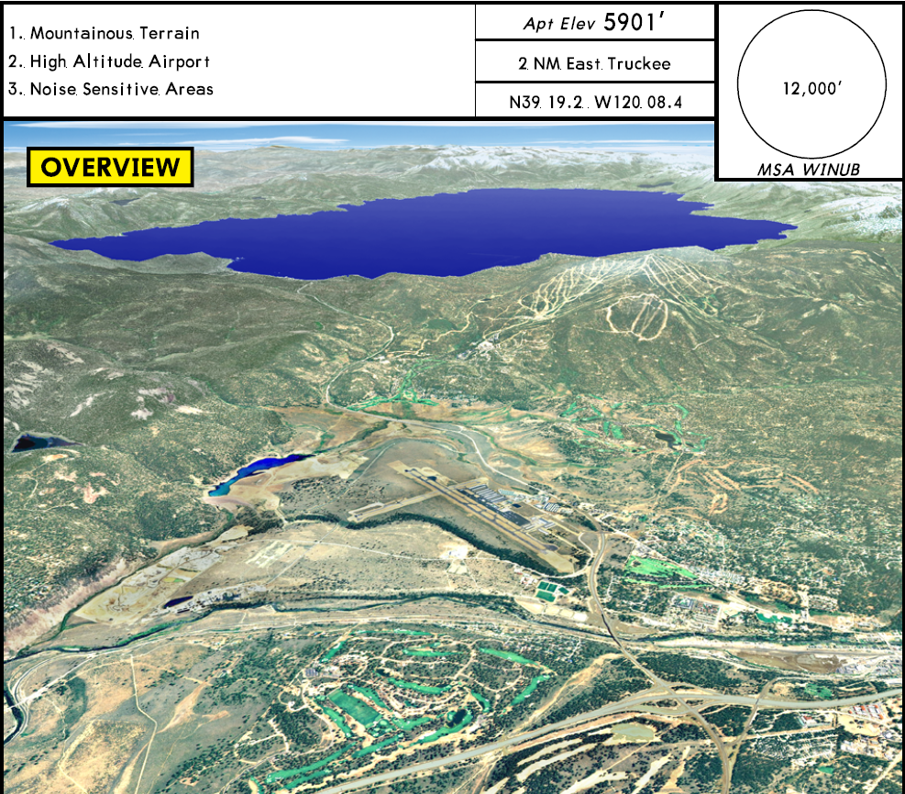
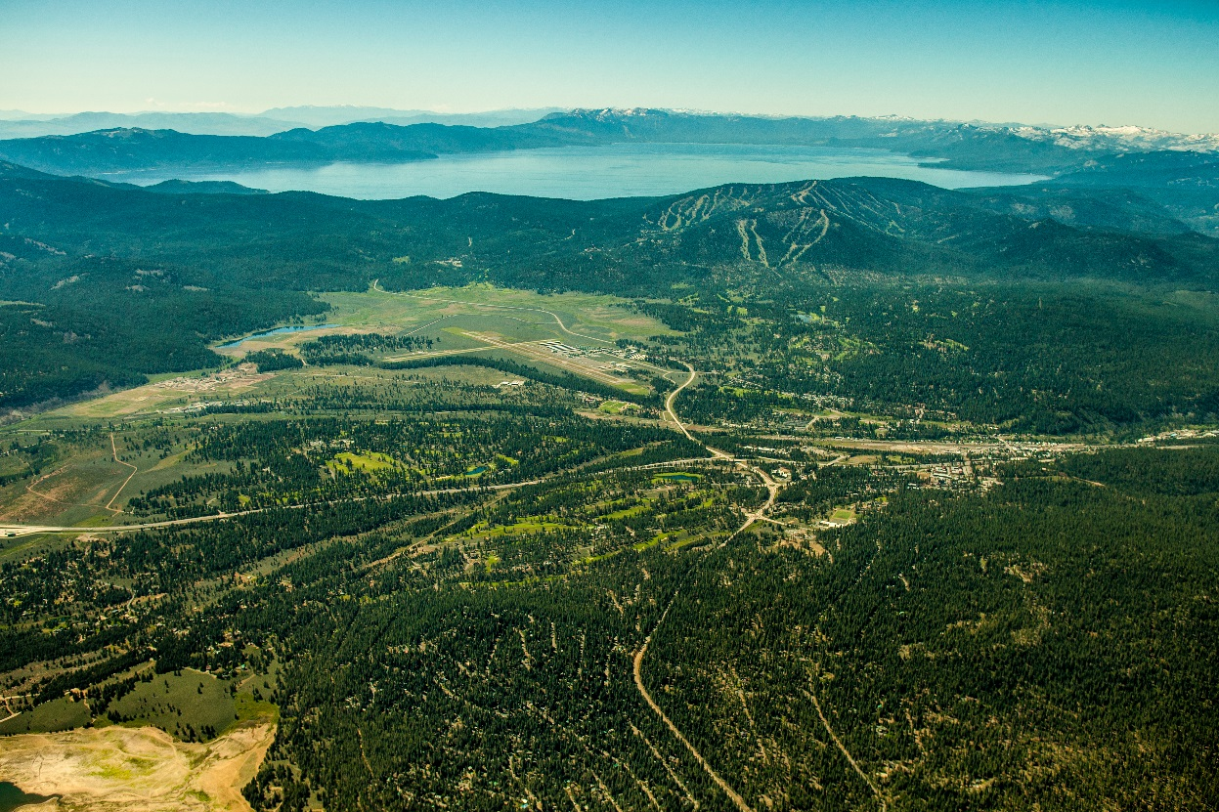
QUALS: JEPPESEN
JEPPESEN OVERVIEW
2015 UPDATED OVERVIEW PHOTO

Slide 6
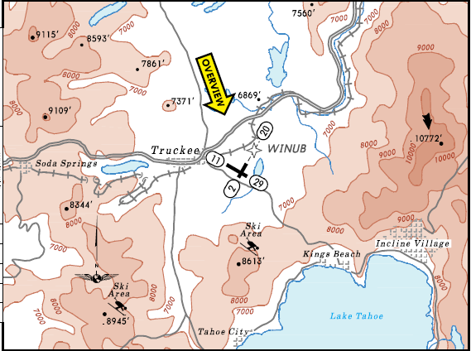
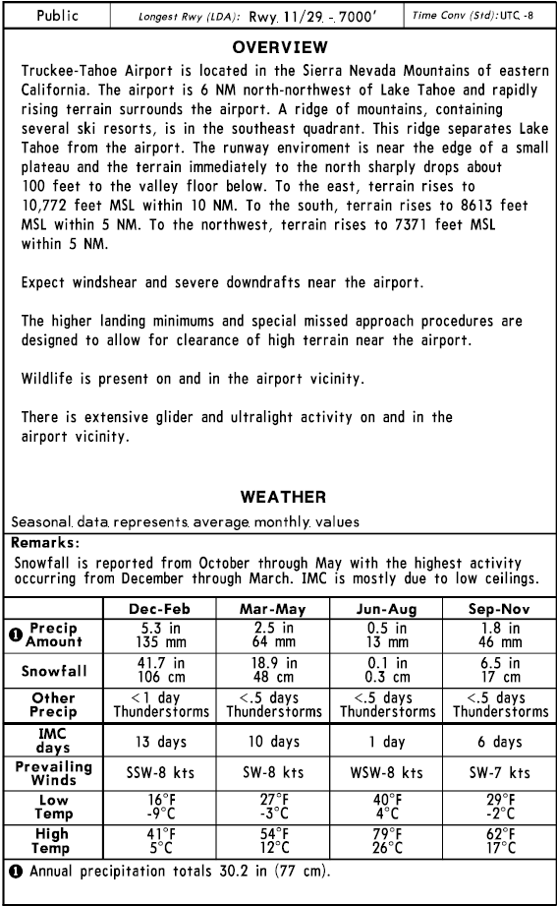
QUALS: JEPPESEN
JEPPESEN OVERVIEW
JEPPESEN OVERVIEW DATA

Slide 7
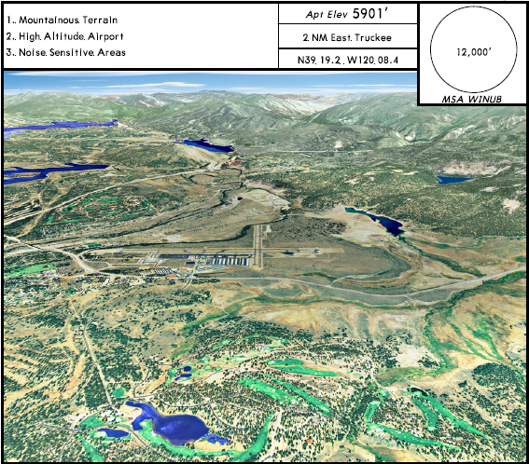
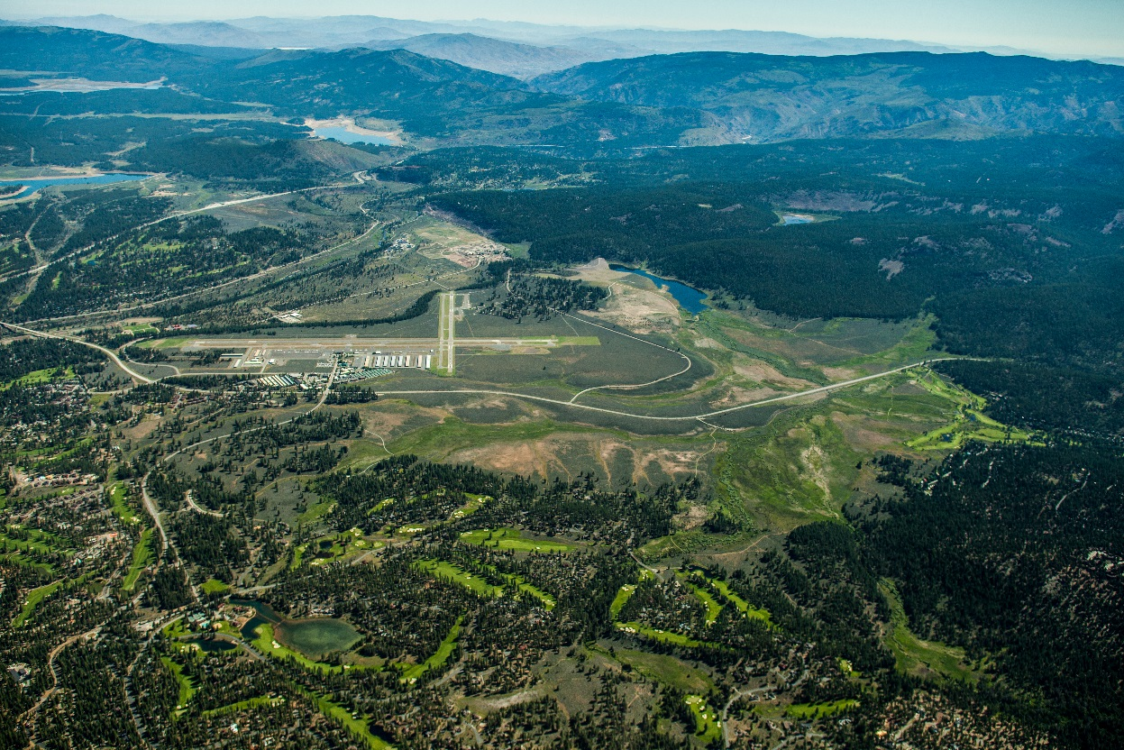
QUALS: JEPPESEN
JEPPESEN RUNWAY 02 APPROACH
UPDATED 2015 RUNWAY 02 PHOTO

Slide 8
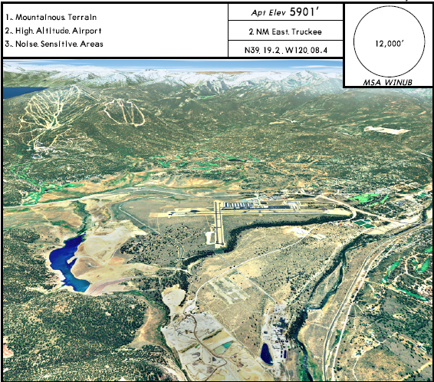
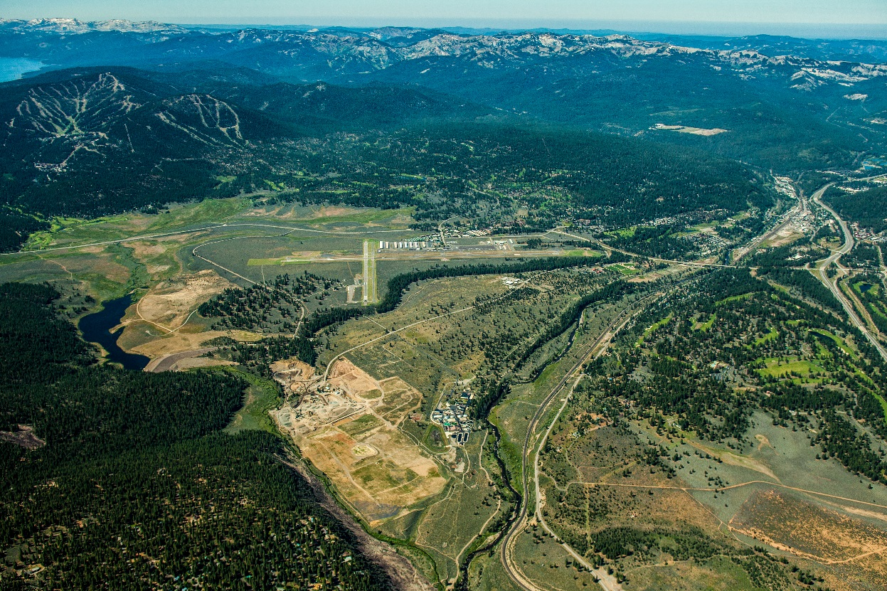
QUALS: JEPPESEN
JEPPESEN RUNWAY 20 APPROACH
UPADATED 2015 RUNWAY 20 PHOTO

Slide 9
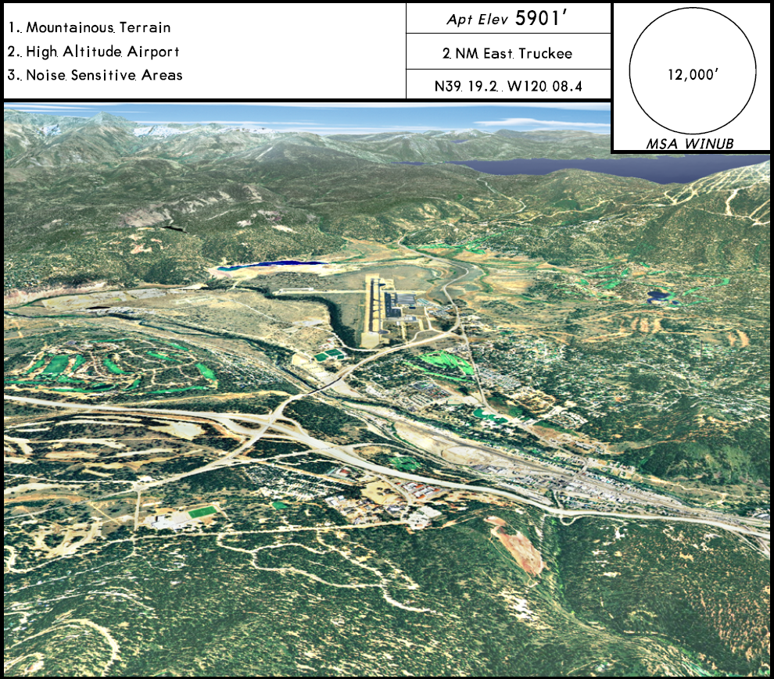
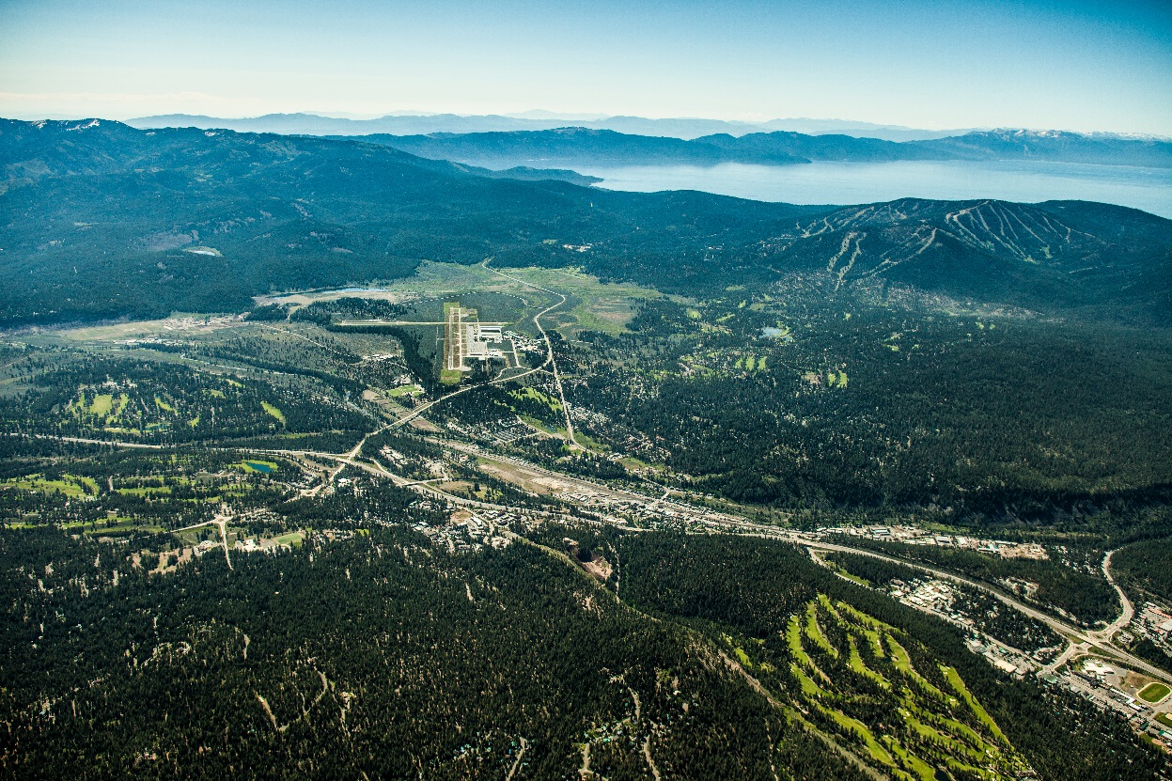
QUALS: JEPPESEN
JEPPESEN RUNWAY 11 APPROACH
UPDATED 2015 RUNWAY 11 PHOTO

Slide 10
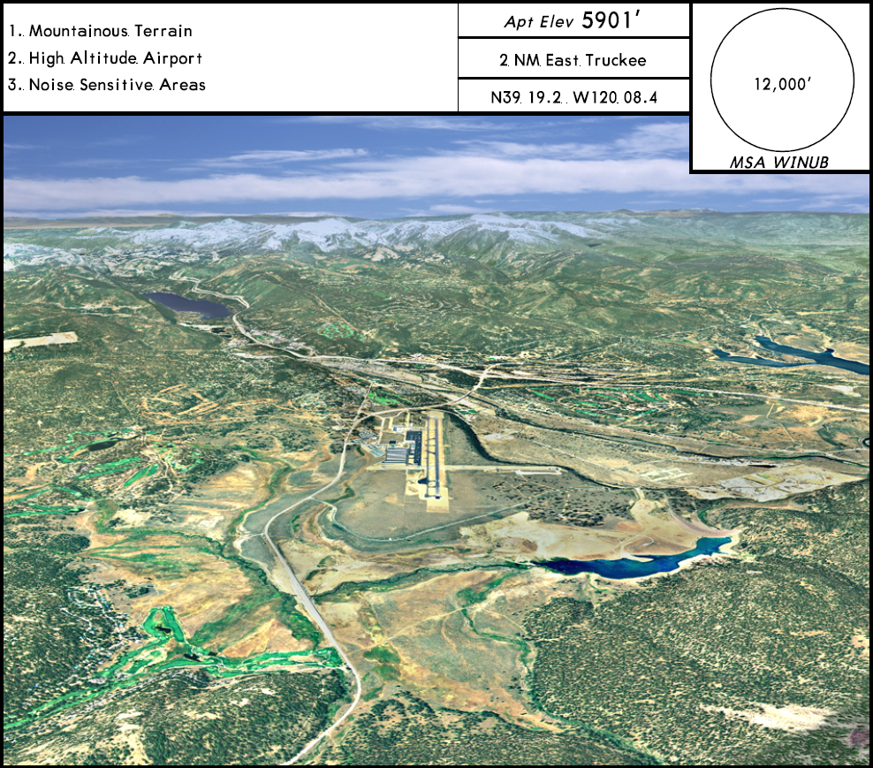
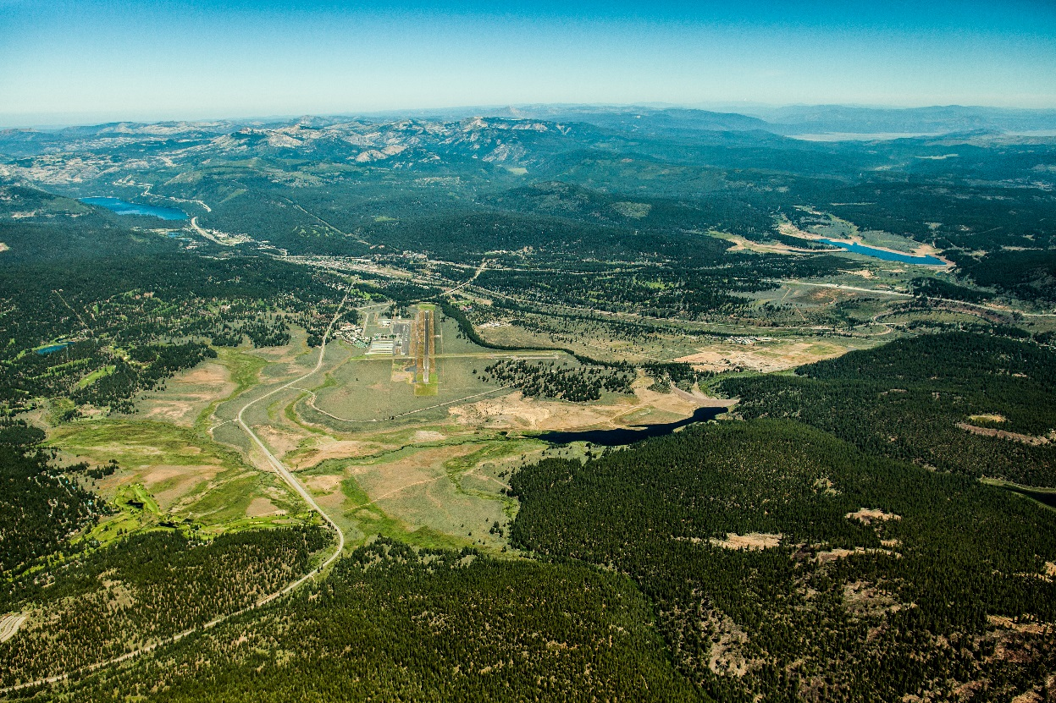
QUALS: JEPPESEN
JEPPESEN RUNWAY 29 APPROACH
UPDATED 2015 RUNWAY 29 PHOTO

Slide 11
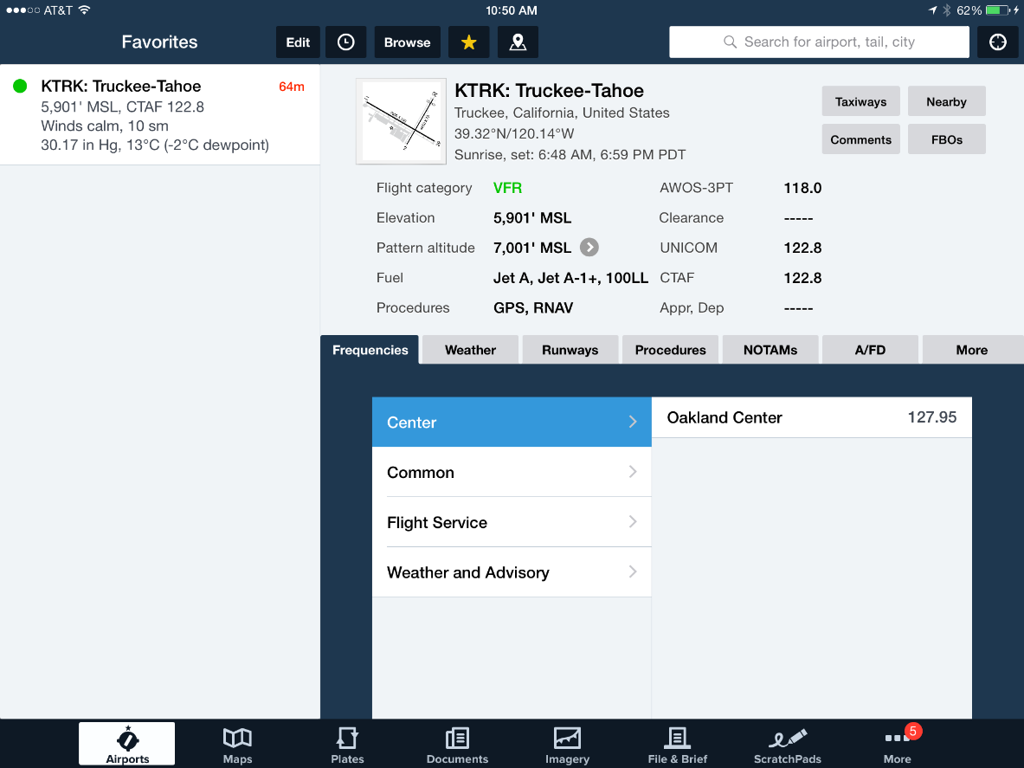
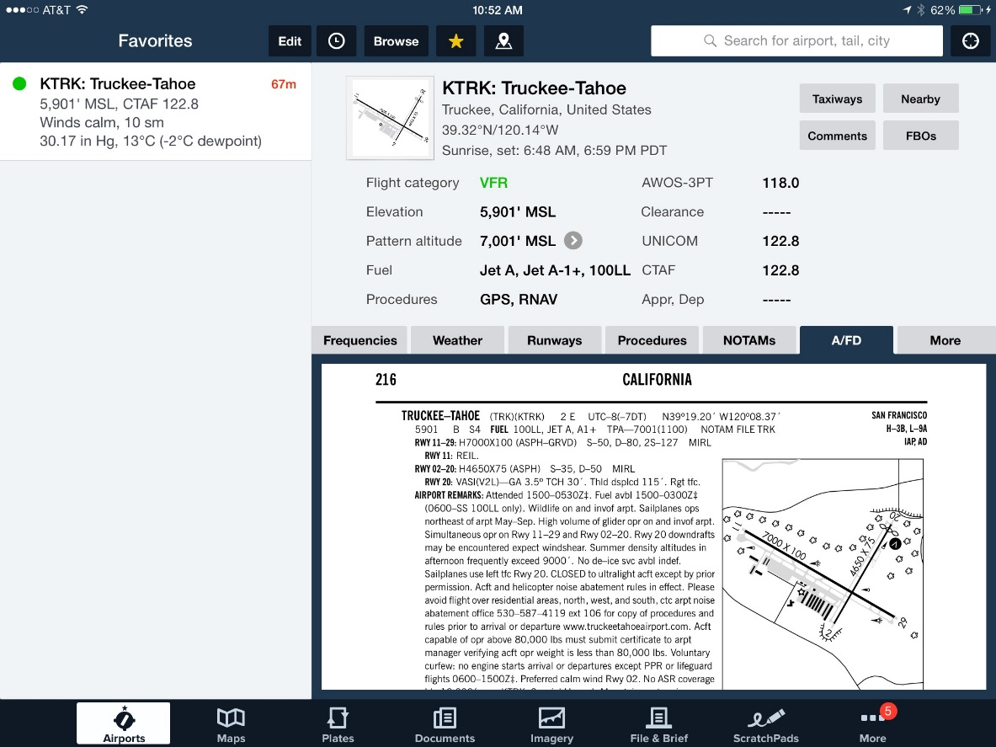
Flight Data: FOREFLIGHT

Slide 12
Travel To Truckee

Slide 13
Aircraft Outreach on the Ramp

Slide 14
Getting To Know Our Customers:
Pilot Comments & Concerns
“We need better Unicom communication between pilots.”
“Would like to see better Glider Communication over Unicom.”
“KTRK needs a deicing option.”
“KTRK needs a Tower.”
“Food option for pilots on Sunday?”
“Can we have a dedicated runway for peak traffic times?”
“Too much unnecessary chatter over Unicom, is there a possibility of a discrete frequency?”
“NOTAM for heavy glider activity?”

Slide 15
Getting To Know Our Customers:
Pilot Comments Continued.
“Liked/loved water Bottles.”
“Never seen NAP info. But will Follow.”
“Awesome Airport!”
“For services KTRK is as good as it gets.”
“ I like the webcam, helpful and friendly staff.”
“Great Website, lots of good information.”
“Follow the NAP’s religiously.” – Pilot had a copy in hand.
“I want to get this information in the hands of all of our pilots.” –Alley, Net Jets Pilot
“Great to be back in Truckee, this Airport is the best by far!”

Slide 16
The Future of Outreach:
Programs in Place.
Media Campaign- Website, Facebook, Pilot News, E Blasts, Connected, Rack Cards, Flight Chops and Tranquility Campaign.
Technology- MLAT System and Vector, AWOS, Master Record: providing pilots with the most accurate data about KTRK via Jeppesen, Foreflight, Flight Aware, etc.
Operational- Airfield Signage, Preferred Runways, Set times for services and staffing, Curfew-incentives and T.U. fees.
District Policy- Multiple channels for noise comments: Web, Phone, Email or Live Receptionist.
Attending Meetings: NBAA, AAAE, NCO, etc.
Staff: On the Ramp, Phone, Mail and Email - educating public and pilots.

Slide 17
The Future of Outreach:
Untapped Potential.
Possibility of Surveillance- designated VFR procedures.
Possibility of Seasonal Tower – ATC directing traffic during peak periods.
Continually redefining outreach positions at TTAD
    More focus on pilot outreach and Community annoyance mitigation- preventing comments before they occur, through pilot education.
    Continued reinforcement of Outreach campaign through: UNICOM, on the ramp, contacting aviation companies, handing out and discussing maps and flyers with NAP info in water bottles etc.
    Enhanced training for all TTAD staff to be knowledgeable in our Noise Abatement Procedures, having the ability to have an educated conversation with pilots about how to fly quiet.

