Slide 1
Airspace Design Review
Project Update
Hardy Bullock
Cynthia Gibbs, PMP
BridgeNet International

Slide 2
The District advertised for “Airspace Design Review” services early in 2015.
Bridge Net International, based in Southern California, was awarded the contract.
SCOPE OF WORK
Recommend procedures to reduce community annoyance, enhance safety, and promote efficiency.
Survey existing procedures and analyze results relative to current GIS data for housing and land use.
Advocate for KTRK with the FAA.
Present solutions for visual flight procedures.
Present methods for disseminating information to pilots about KTRK.
Show development paths for Special Procedures and Specific Publications that enhance airspace use at KTRK.

Slide 3
DELIVERABLES
Executive Report
Airspace Design Review
2 and 3 dimensional maps showing proposed future flight corridor and procedures
Community Outreach Plan
Creation of an airspace design working group
Biannual Airspace Design Review Plan

Slide 4
TRADITIONAL APPROACH TO AIRSPACE DEVELOPMENT
FAA
Drives Procedure Development
Safety – Capacity – Integration – NextGen
Airport
Commenter in the process at best – Victim at worst
Responsible for implementation and community response
The Airport is the final “buck stops here” no matter what the FAA does

Slide 5
KTRK APPROACH TO AIRSPACE DEVELOPMENT
Airport
Drives Procedure Development meeting Community Needs
Safety –– Environmental Integration – Next Gen
FAA
Partner in published procedures
Consumer of surveillance data
Drives Procedure Development meeting Aviation Needs
Regional efficiencies for safety, capacity, efficiency, and environmental impact

Slide 6
SWOT STRENGTHS
Airport is well funded.
Airport is progressive.
Airport is willing to adapt, change, and modify to improve the lives of the community members.
Airport is willing to adapt, change, and modify to improve flight safety, efficiency, and environment.
Airport is willing to be inclusive of other airports for broader changes beyond Truckee.

Slide 7
SWOT WEAKNESS
Airport is a regional general aviation airport not a reliever or hub.
Physical constrains limit possible options for procedure development.
Weather limits possible options.
KTRK has to show benefit to other airports or controlling authorities.

Slide 8
SWOT OPPORTUNITY
Establish the airport as a driving force in airspace utilization.
Get in front of the curve with the FAA on airspace utilization.
Establish procedures that reduce community impact and reduce environmental impact.
Establish procedures that get published to ALL aviators.
Enhance safety and act proactively to address airport operational tempo (growth) and fleet mix.
Be a regional change agent for better surveillance data, better procedures.

Slide 9
SWOT THREAT
Federal requirements are enormous.
Complex process requiring subject matter experts requires staff oversight and knowledge.
Aviation is a responder to economic influencers.
Aviation is dynamic, changing, and ever evolving.
Next Gen priorities carry weight with the FAA – Potential unintended consequences exist when technology is deployed at KTRK.
Cost of creating a procedure.
Must be a strong advocate and be vigilant to follow-up on procedure progress.

Slide 10
PROJECT GOALS
The goal of the project is to recommend how Truckee can move forward with NextGen procedures for general aviation, from single engine to large turbines.
Understand existing procedures, use, and needs of stakeholders.
Identify constraints: land use, aircraft capabilities, terrain, weather, runway use
Identify concept of operations:
  What will alleviate the constraint(s)?
  No shifting of noise or use non-compatible land uses

Slide 11
PROJECT STATUS
August 12, 2015 – Project Kickoff with Advisory Team
Advisory Team: airport, FAA, users, KTRK-based users, industry representatives, ACAT representative, consultant team
Follow-up conversations with Oakland Center
Understand existing procedures, use, and needs of stakeholders
Creating notional procedures to share with Advisory Team
Report to airport due mid-October
  Notional procedures
  Effects of procedures on noise, environment, land uses

Slide 12
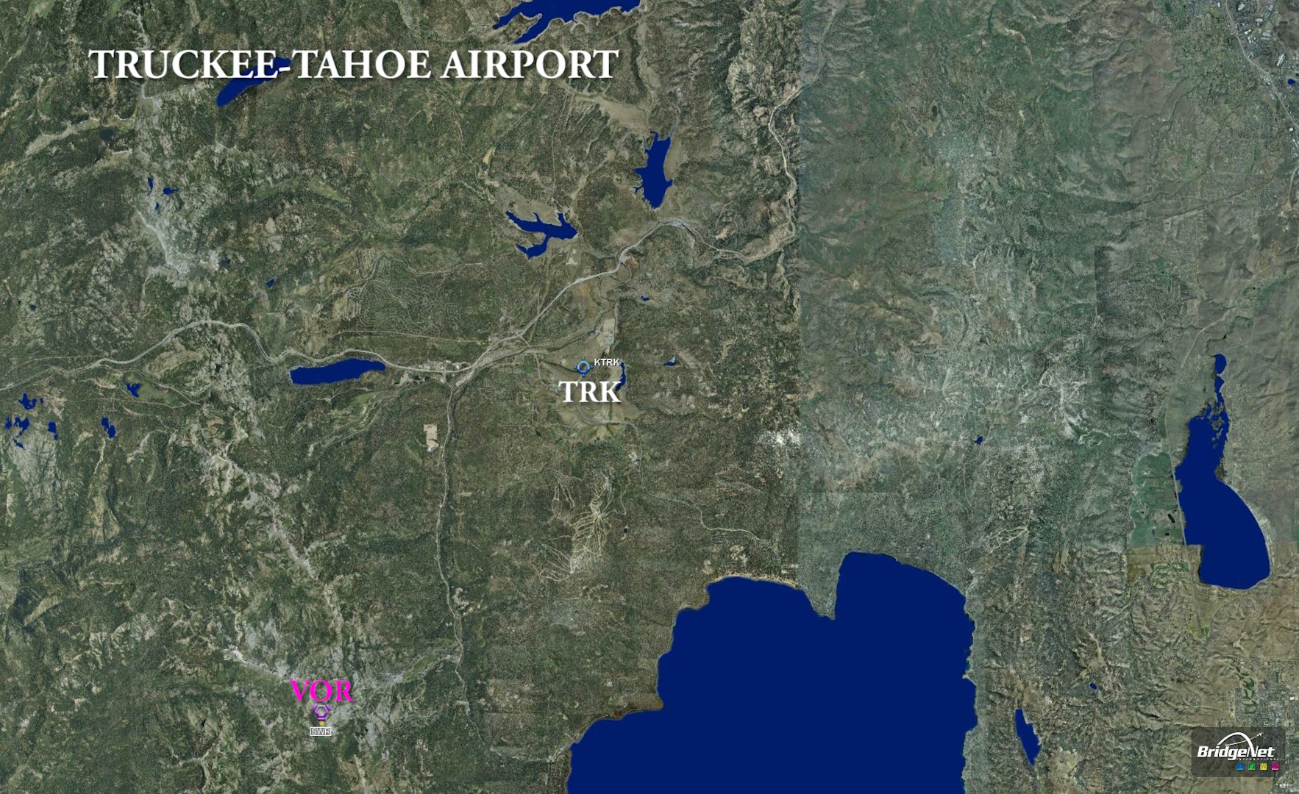
Existing Data

Slide 13
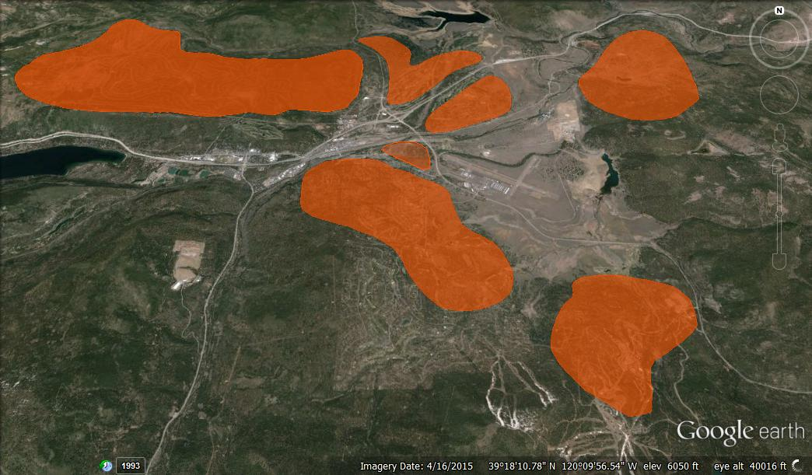
Existing Land Use - generalized

Slide 14
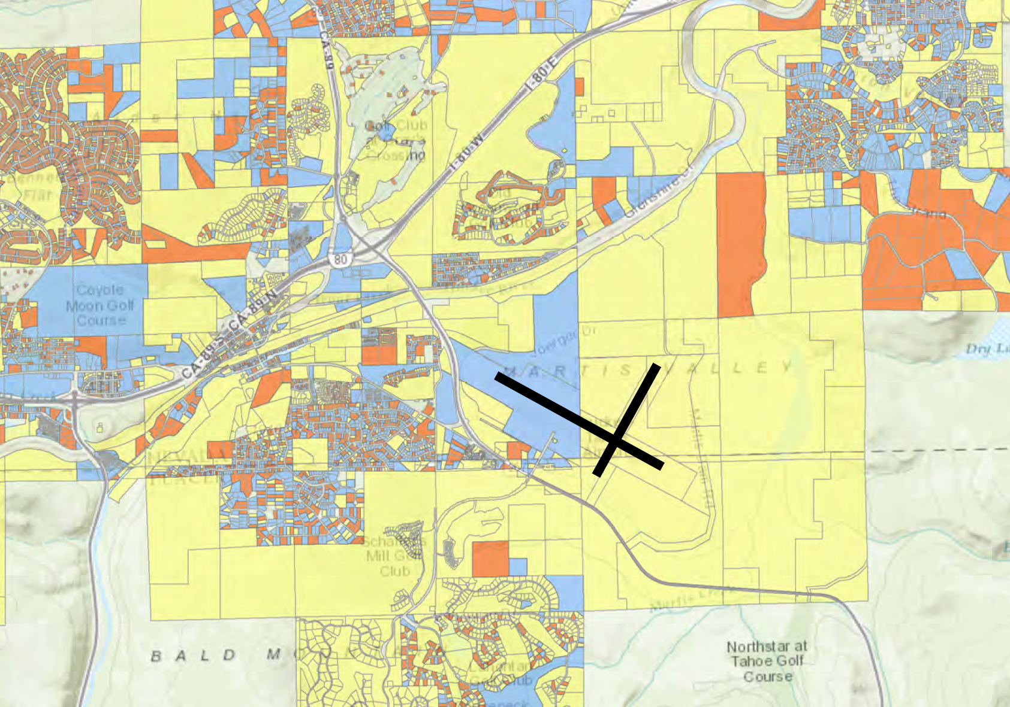
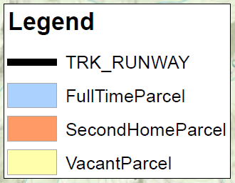
Existing Land Use – secondary vs primary

Slide 15
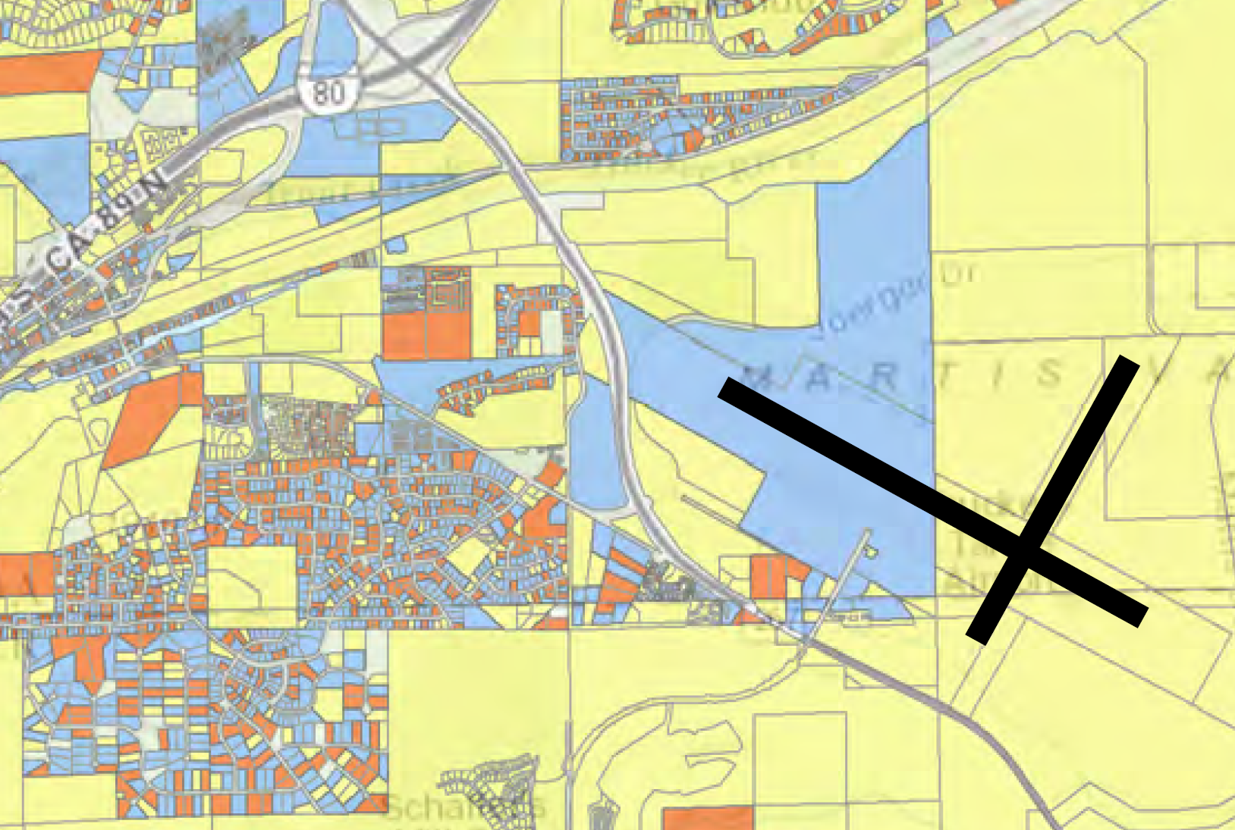
Existing Land Use – secondary vs primary

Slide 16
Next Steps
Submit notional arrival and departure concepts in October report to TTAD
Refine concepts & present them at the Advisory Team Meeting to be scheduled, TBA early December 2015.
Finalize concepts to present to TTAD in early 2016.
Create outreach plans for community (with Fresh Tracks), pilots, and FAA.

Slide 17
Questions

