Slide 1
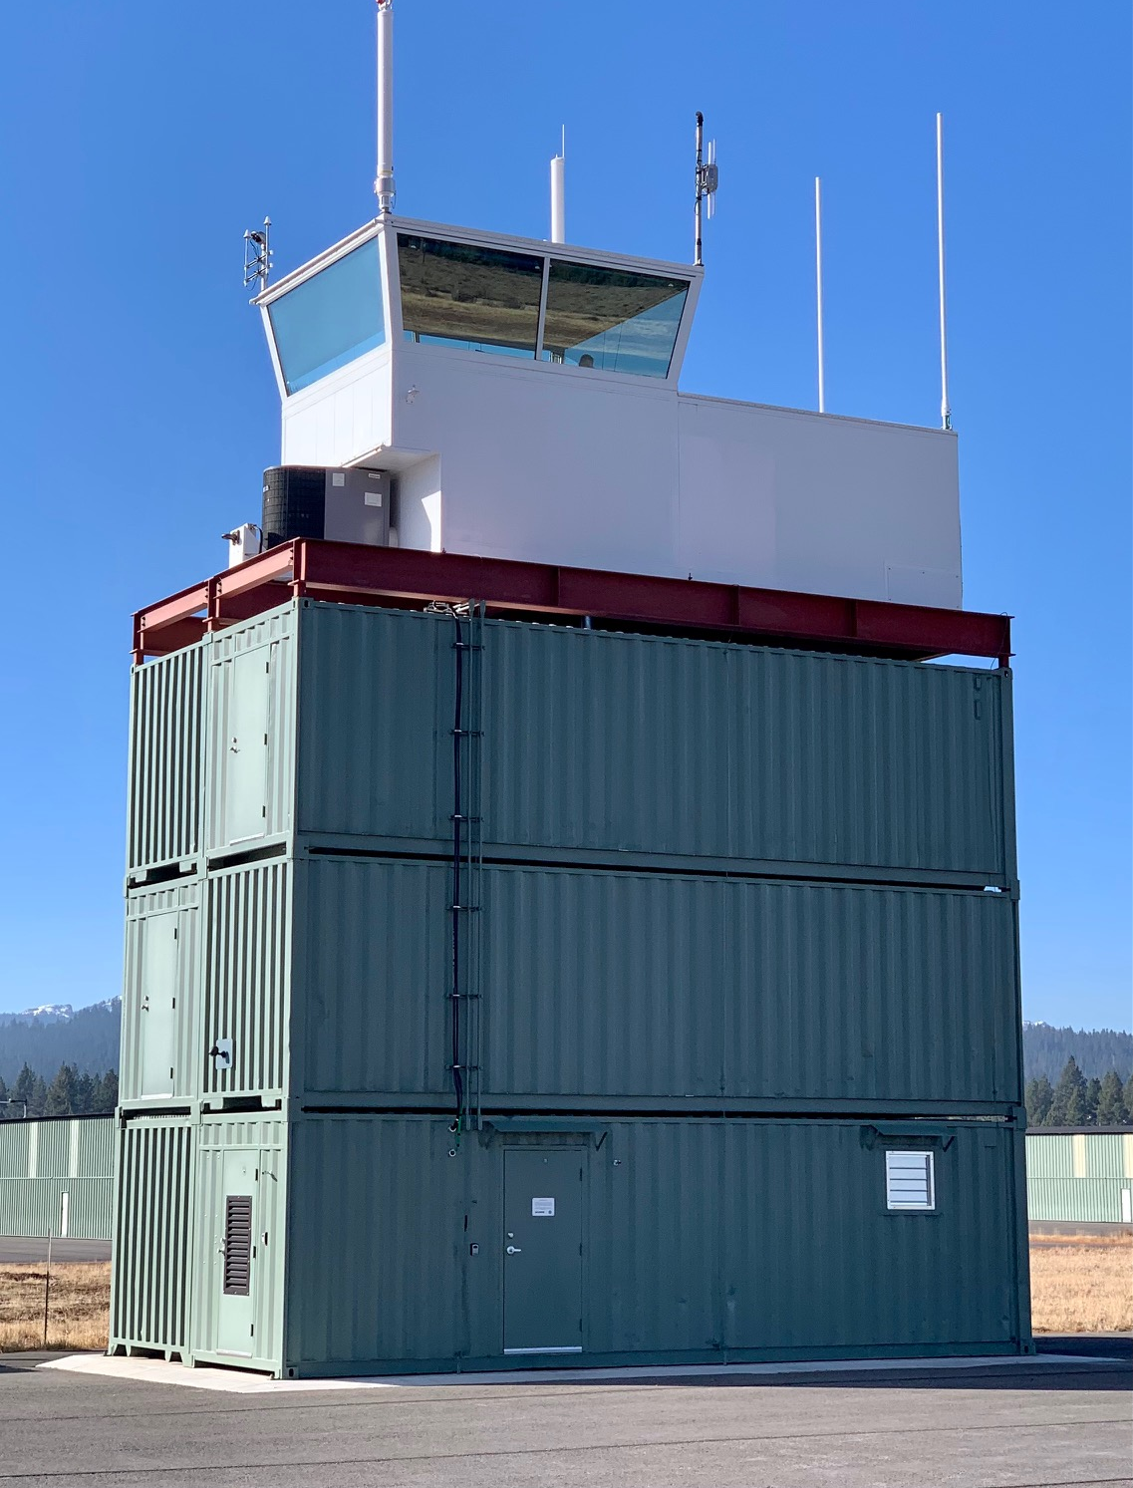
Basics of
Air Traffic Control
ATC101
Presented by Truckee Tower and Oakland Center

Slide 2

ATC101
Discussion Items
Air Traffic Control Tower Types
Local ATC Facilities
Basics of ATC
Truckee ATC
  Runway Selection
  Noise Abatement Procedures (NAP)
  ATIS Procedures and Requirements
  Tower Displays
  Runway Separation and Sequencing
  Flight Following
  Effective Communication is Key
  Summertime Ops and Gliders
  Drone Operations in the Class D
  Tower Tours
  Questions?

Slide 3
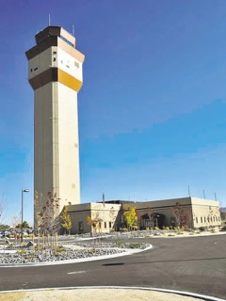
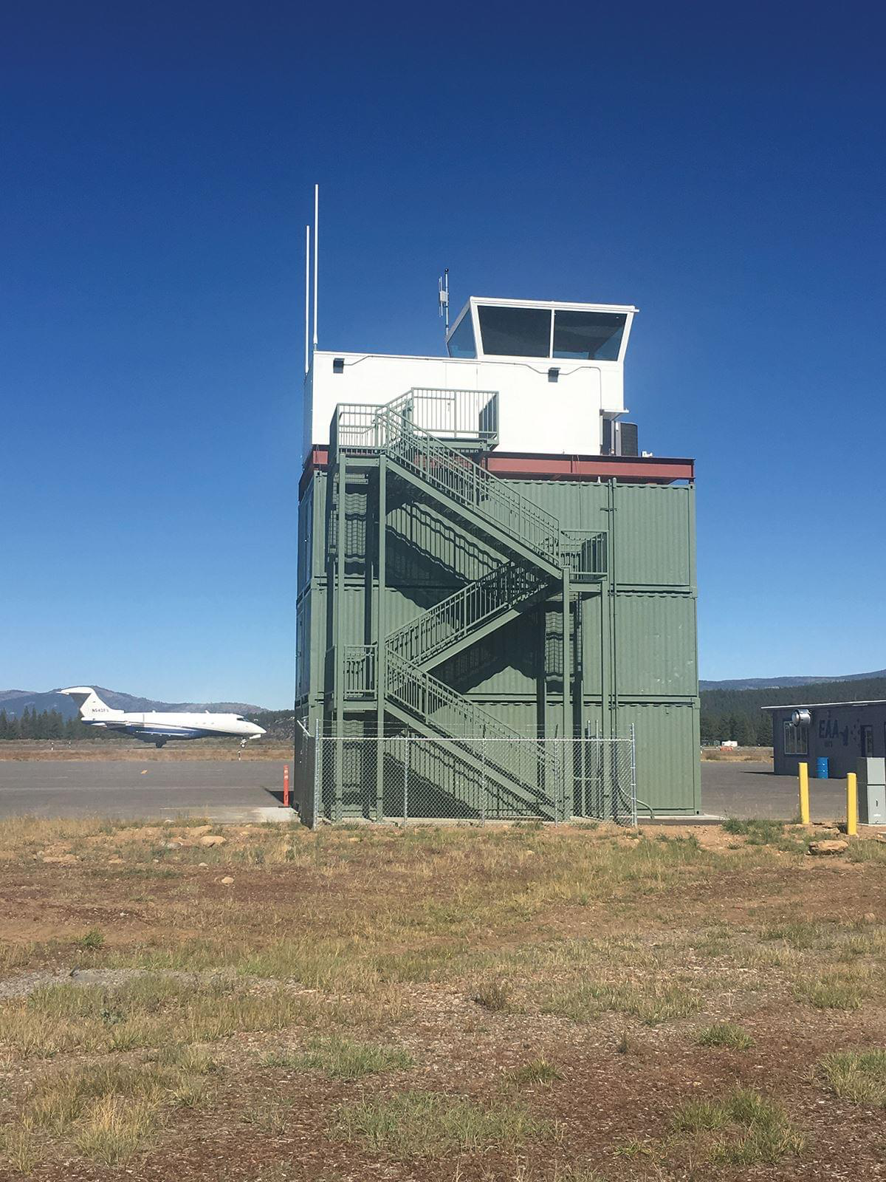
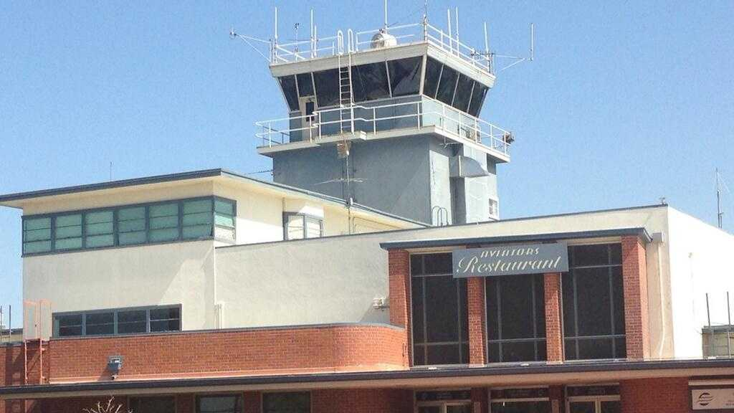
Air Traffic Control Towers
Three Types of Towers
FAA Air Traffic Control Tower
Federal Contract Tower
Non-Federal Control Tower
Controllers follow all Rules and Regulations prescribed by the FAA
Staffed by FAA Controllers
Controllers follow all Rules and Regulations prescribed by the FAA
Staffed by a Contractor
Controllers follow all Rules and Regulations prescribed by the FAA
Staffed by Midwest ATC

Slide 4
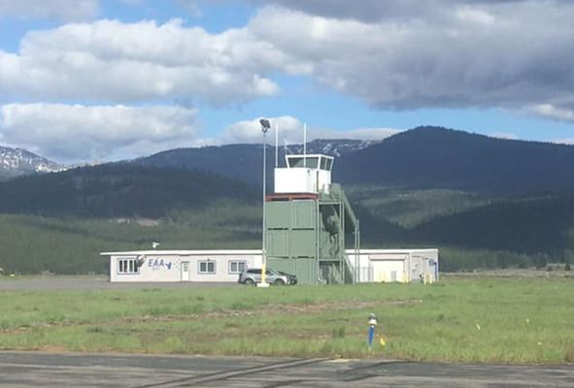
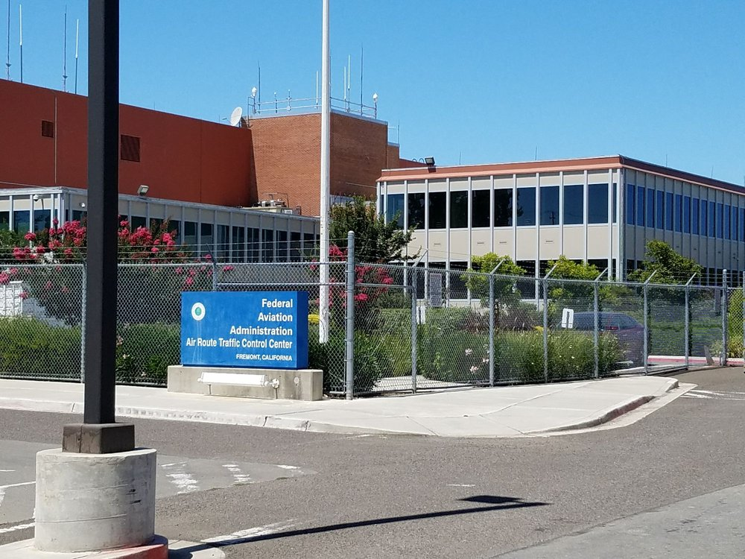
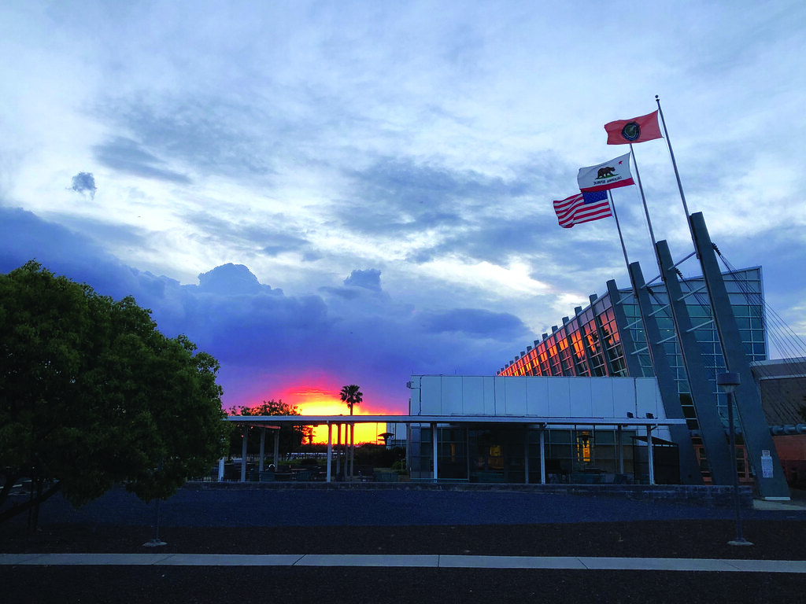
Local ATC Facilities
Truckee Tower
Oakland Center
NorCal Approach

Slide 5

Oakland Center (ZOA)
Oakland Center provides enroute air traffic control service from the surface (or above underlying approach control/tower airspace) to unlimited.
Sector 44 provides approach and departure services for the TRK airport.
ZOA provides air traffic service to a wide range of users (GA, airline, military, civilian UAS, rocket launches, law enforcement, search and rescue, photo/survey missions, MEDEVAC, etc.)
Northern CA TRACON (NorCal Approach) provides approach control service for most of Northern CA and Reno at and below FL190.

Slide 6
Technological Improvements
The addition of ADS-B ground transmitters, reduced separation minima, and improvement of procedures have greatly increased safety and the quality-of-service ZOA controllers can provide at TRK.
Airspace, terrain complexity, and volume presents many challenges for the mix of traffic in Sector 44, especially during busy summer months and poor weather during winter months.

Slide 7
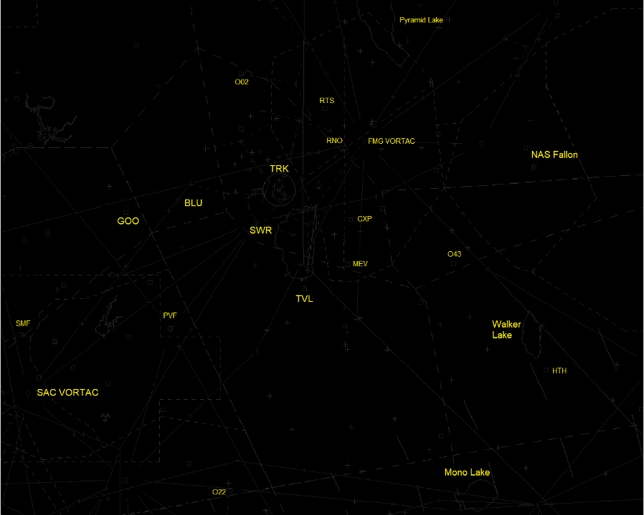
ZOA Radar Map

Slide 8
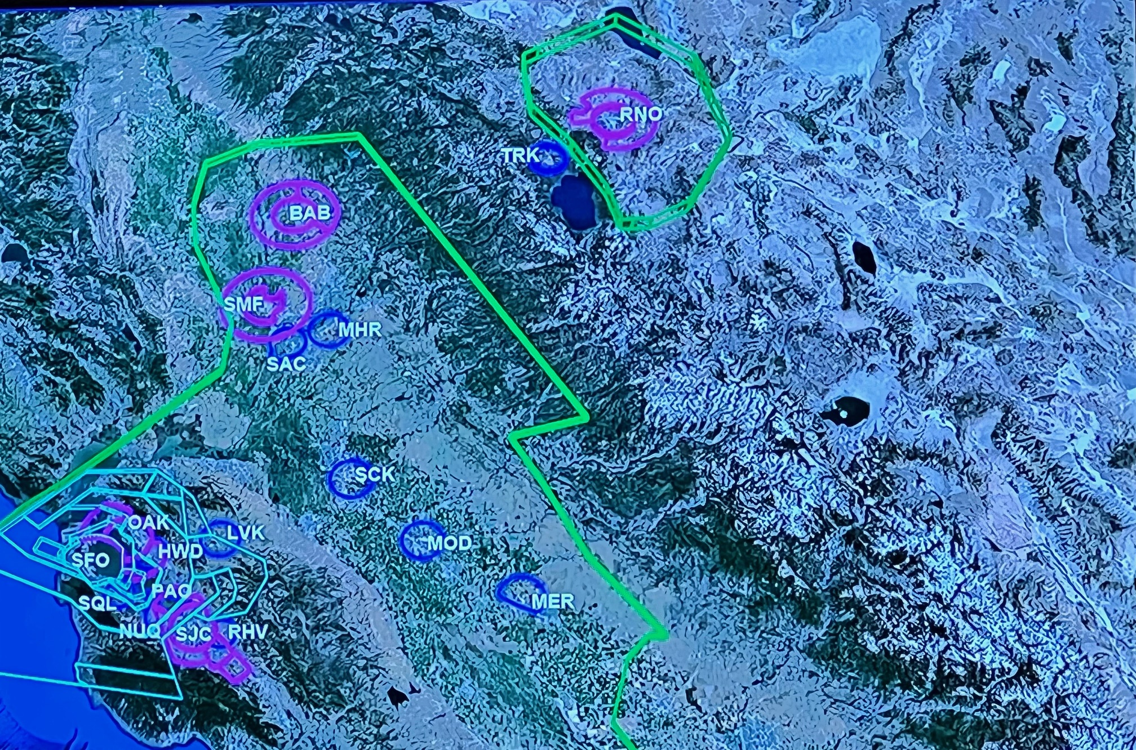
NorCal TRACON (NCT) Airspace

Slide 9
Basics of ATC
ATC Service
FAA Order 7110.65 – This Order is the main Order ALL Air Traffic Controllers are required to follow.
Provide a safe, orderly, and expeditious flow of air traffic.
Support National Security and Homeland Defense Missions.
Secondary/Additional Services.
Controllers MUST provide air traffic control service in accordance with the procedures and minima in FAA Order 7110.65.

Slide 10
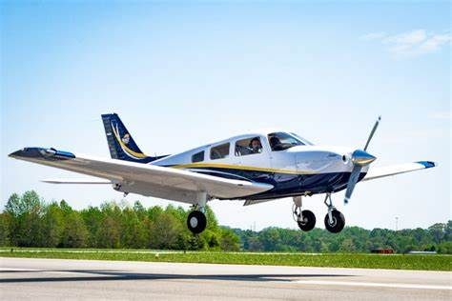
Duty Priority
The First Priority is separating aircraft and issuing safety alerts.
When more than one action is required, controllers will exercise their best judgement based on the facts known to them.
The action which is most critical from a safety standpoint is performed first.

Slide 11
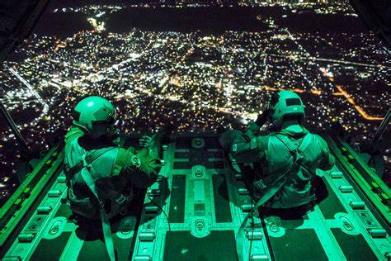

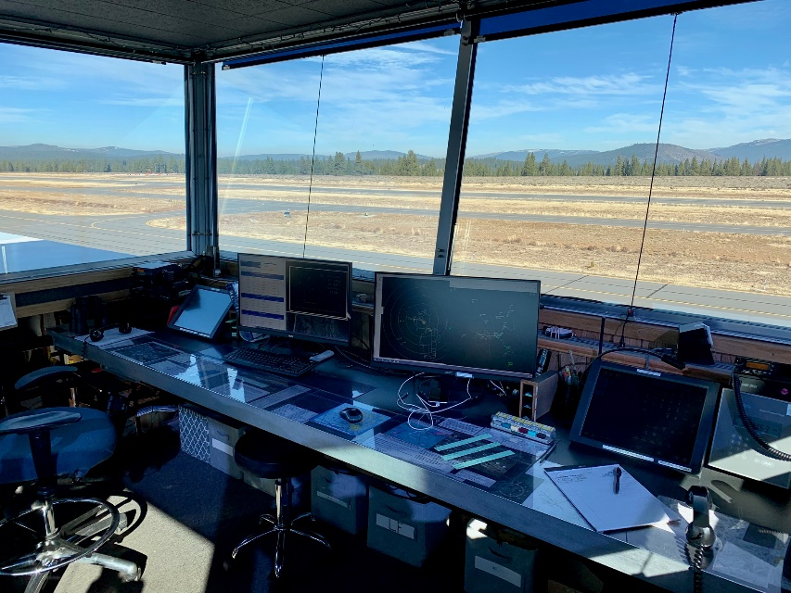
Duty Priority
Provide support to national security and homeland defense. Including reporting of suspicious and/or unusual aircraft/pilot/Drone activities.
Provide and/or solicit weather information.

Slide 12


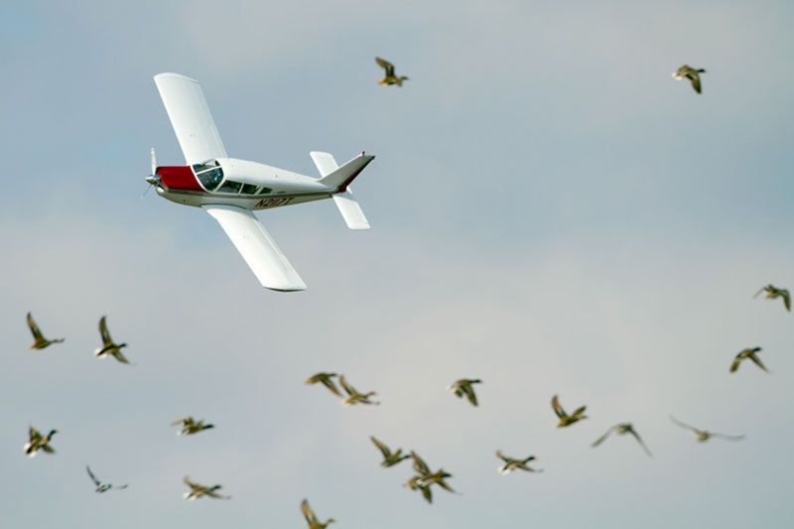
Secondary/Additional Service
Secondary/Additional services.
Traffic Advisories, weather information, and bird activity information are examples.
Flight Following (ZOA & NCT)
Contingent only upon the controller’s capability to fit them into the performance of higher priority duties and other factors/limitations.

Slide 13
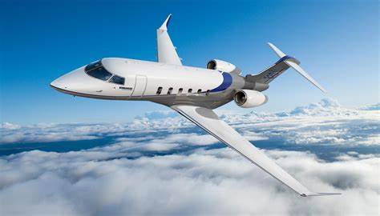
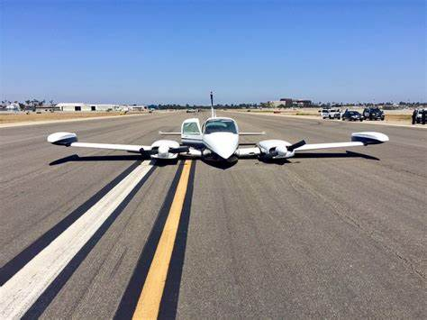
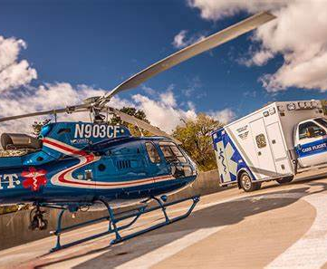
Operational Priority
“First come, first served”
  At times we will use aircraft performance to determine sequence
Exceptions –
  Emergency Aircraft
  MEDEVAC

Slide 14
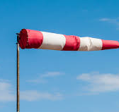
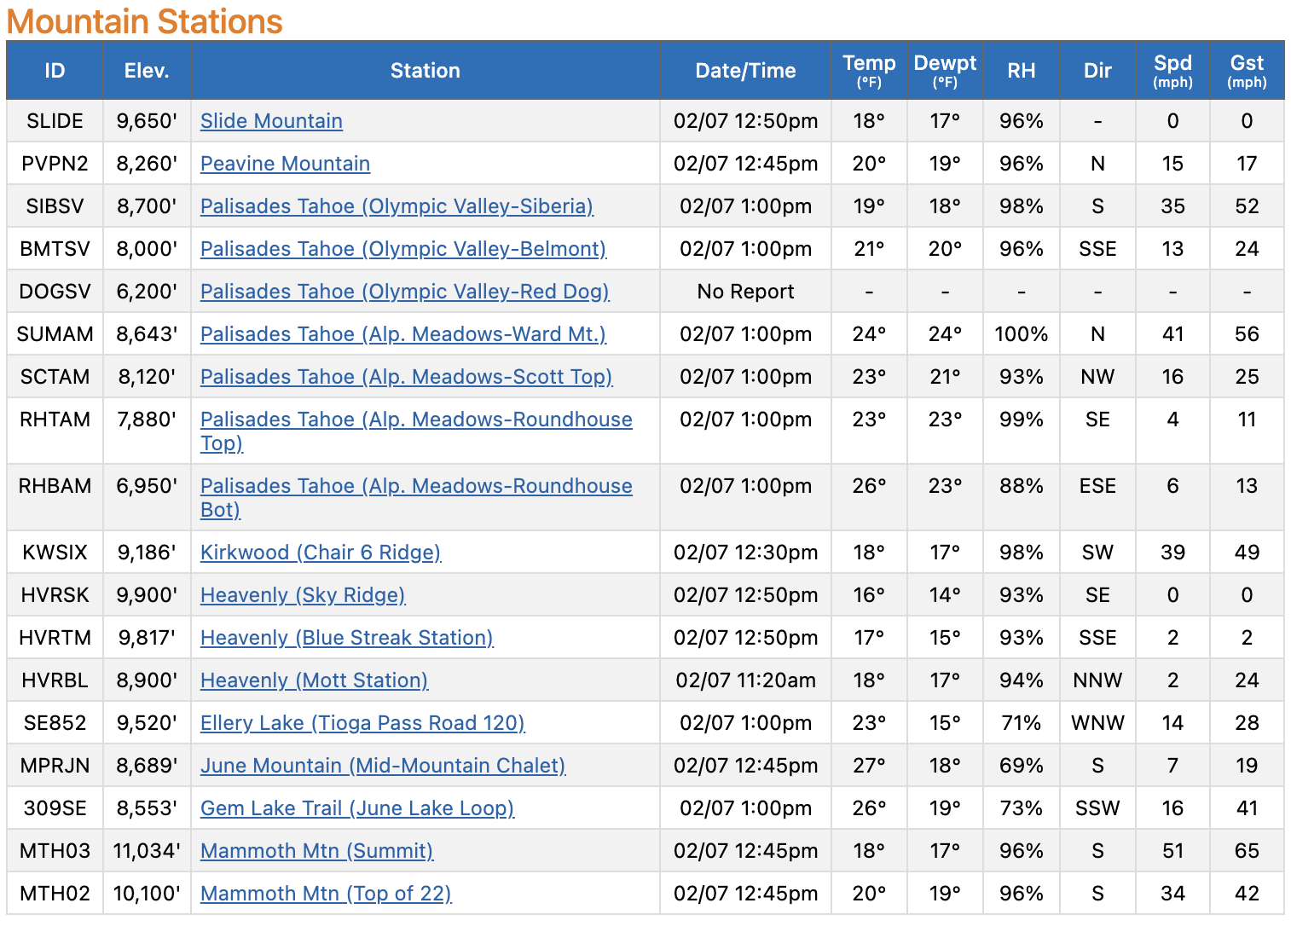
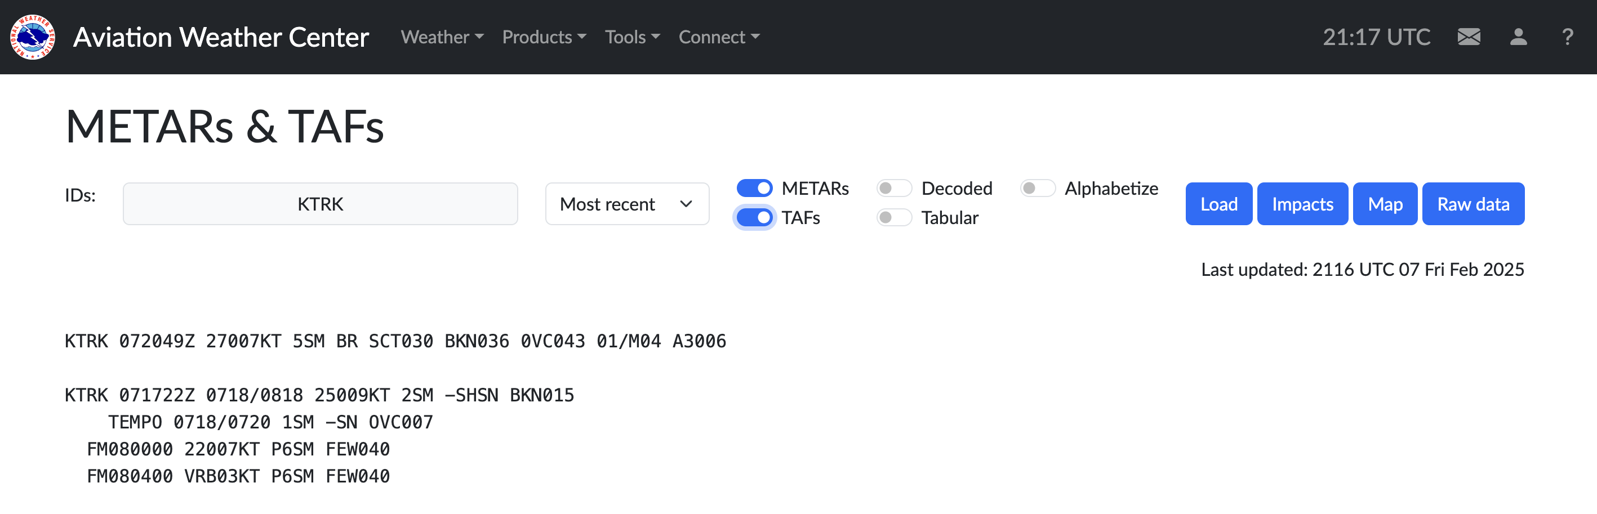
Runway Selection Process
Current Weather and Winds (surface and aloft)
Forecasted Weather and Winds
Notes:
FAA Runway Selection Requirements – updated due to the COA accident in Denver in 2008. Added crosswind and priority over NAP

Slide 15
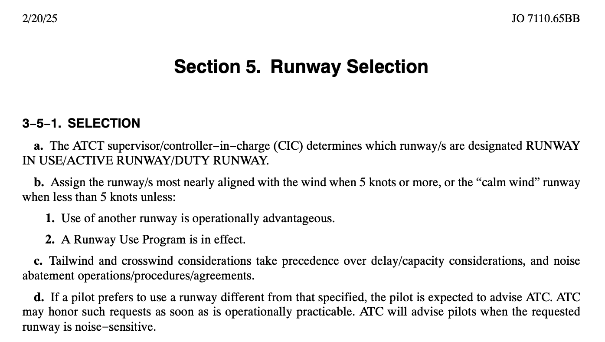
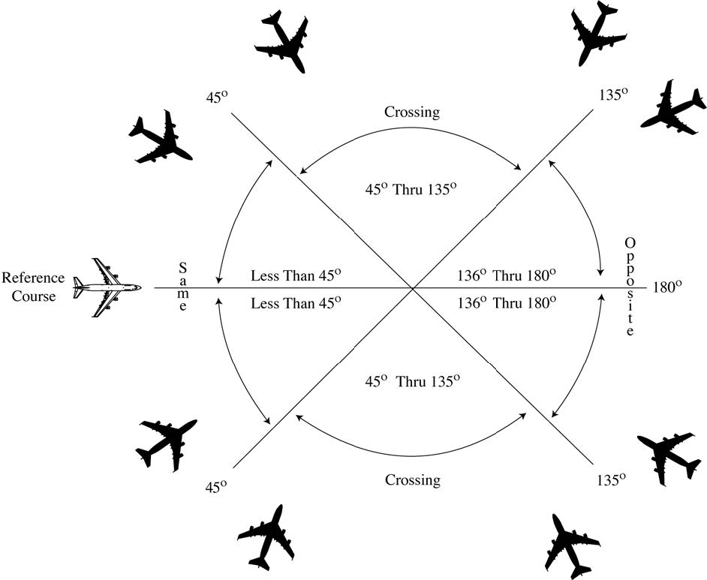
Runway Selection Process
Visual or Instrument Approach
Instrument Departure
FAA Runway Selection Requirements
Opposite Direction Operation

Slide 16
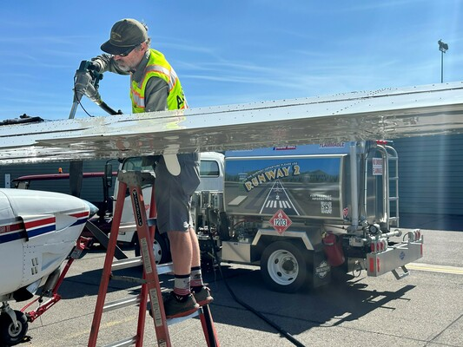
Runway Selection Process
Calm Wind Runway
Most Important - The Pilot is responsible for the safe operation of the aircraft.

Slide 17
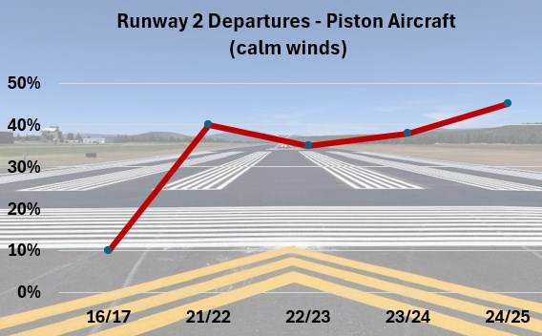
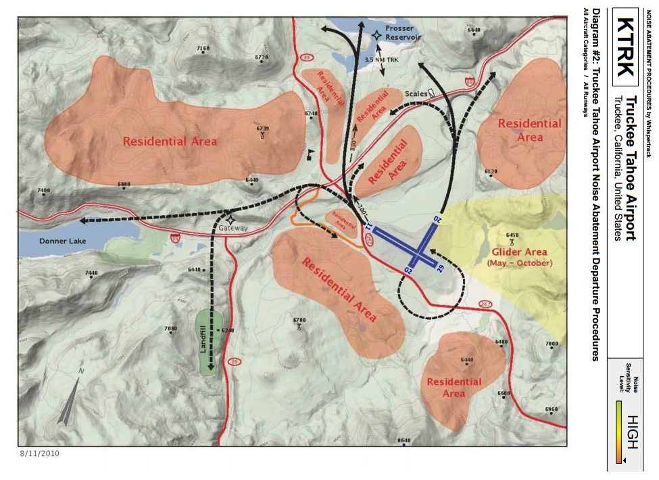
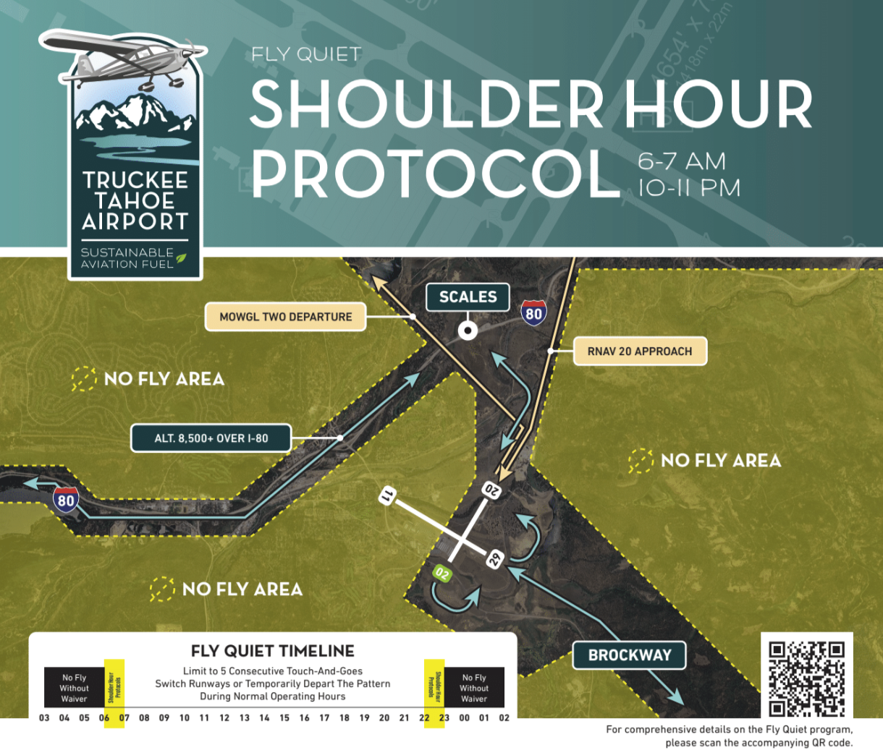
TRK Noise Abatement Procedures
Runway 2 Departure Usage (calm winds). Thank you for your efforts!
Airport Initiatives.
Stakeholder Initiatives. Mountain Lion, NetJets, and AT&T.
Monthly review of NAP by the tower team.
Safety is our number one priority.
Notes:
Meetings – review and evaluate service when requested by TTAD. Discussion with Tower controller(s) as needed when we are not in compliance with NAP. Trends. Annual review of NAPs.
Pilot education – On frequency, tower tour, or with DVQ.

Slide 18
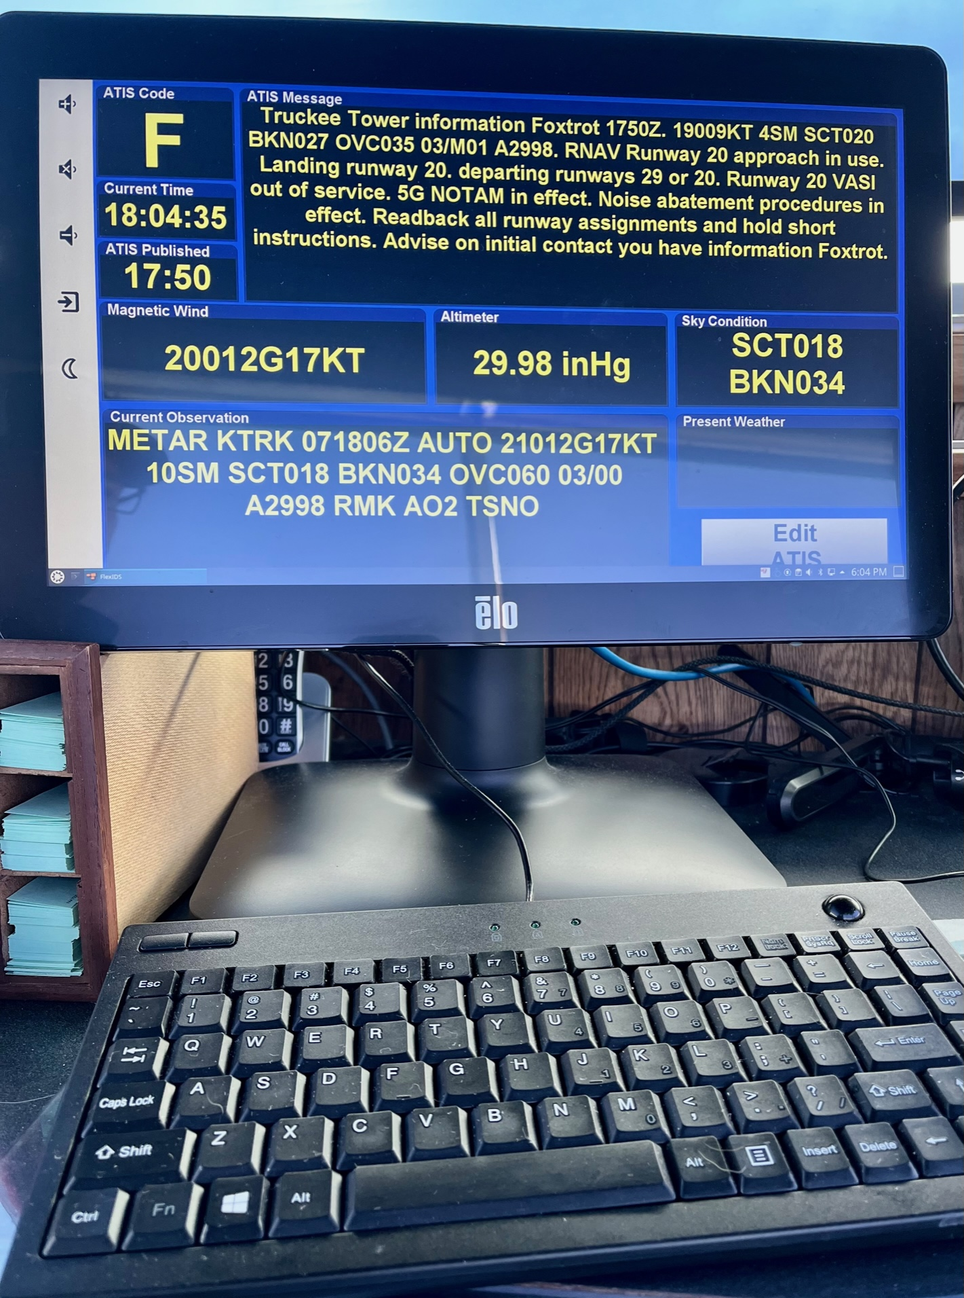
ATIS Procedures and Requirements
Content specified by FAA Orders to include:
Weather Information
Type Approach (Visual or Instrument) and Runway in Use.
Departure Runway (only if different from landing runway)
NOTAM Information
Runway Condition Codes/Braking Action Advisories
Local Items – LLWS, gliders, bird activity, Noise Abatement Procedures
Readback all runway hold short instructions
Brief and concise as possible

Slide 19
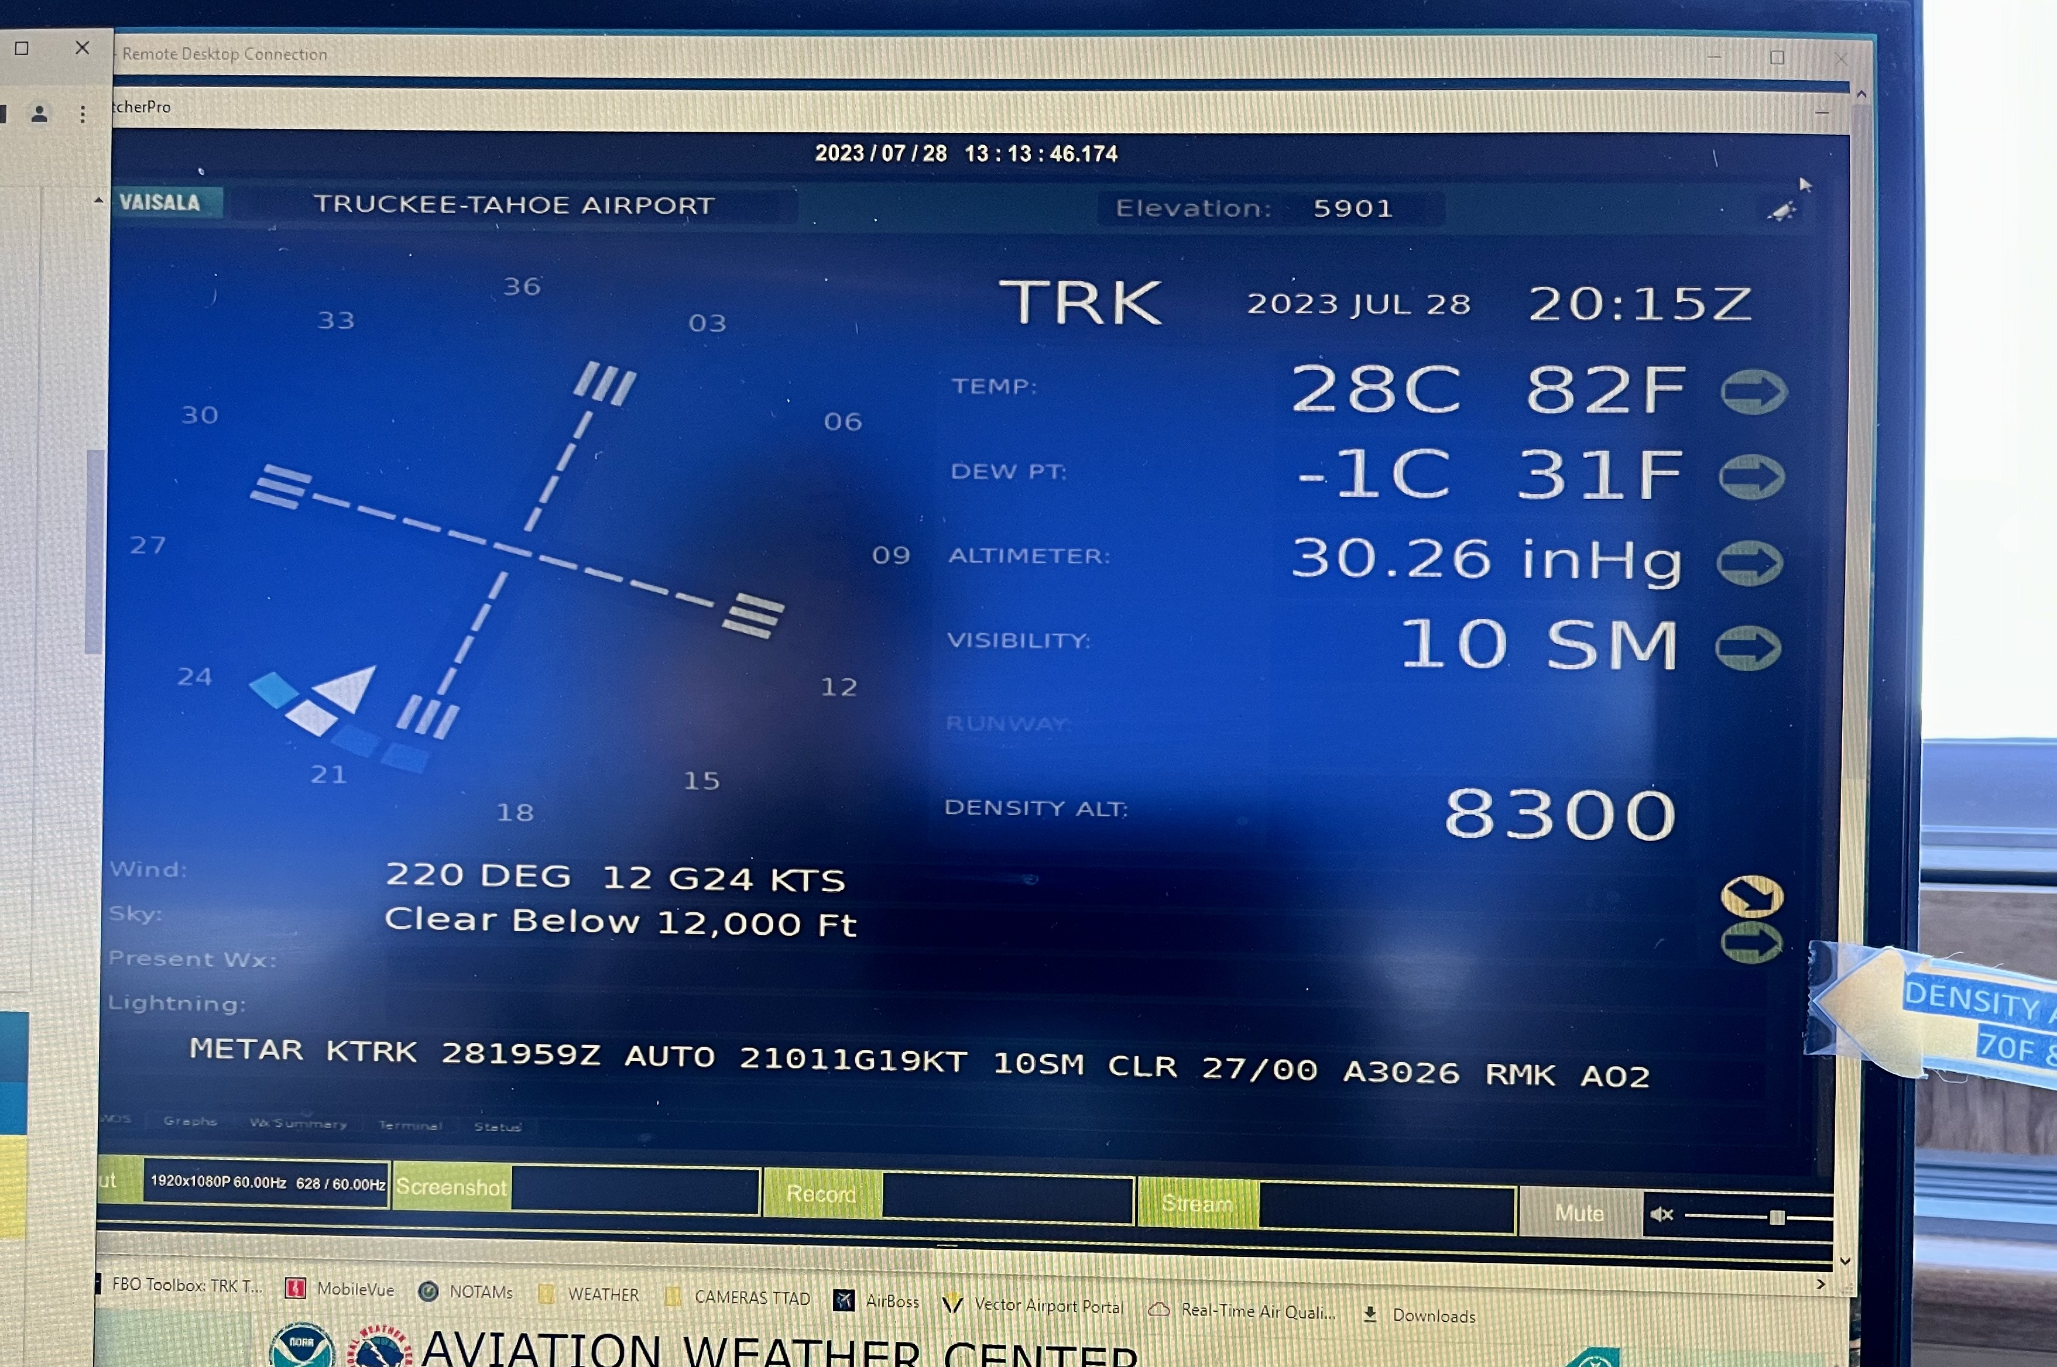
Weather Display
AWOS Data
Updated every minute
Used to assist with METAR Observation
Operational wind readout
Density Altitude

Slide 20
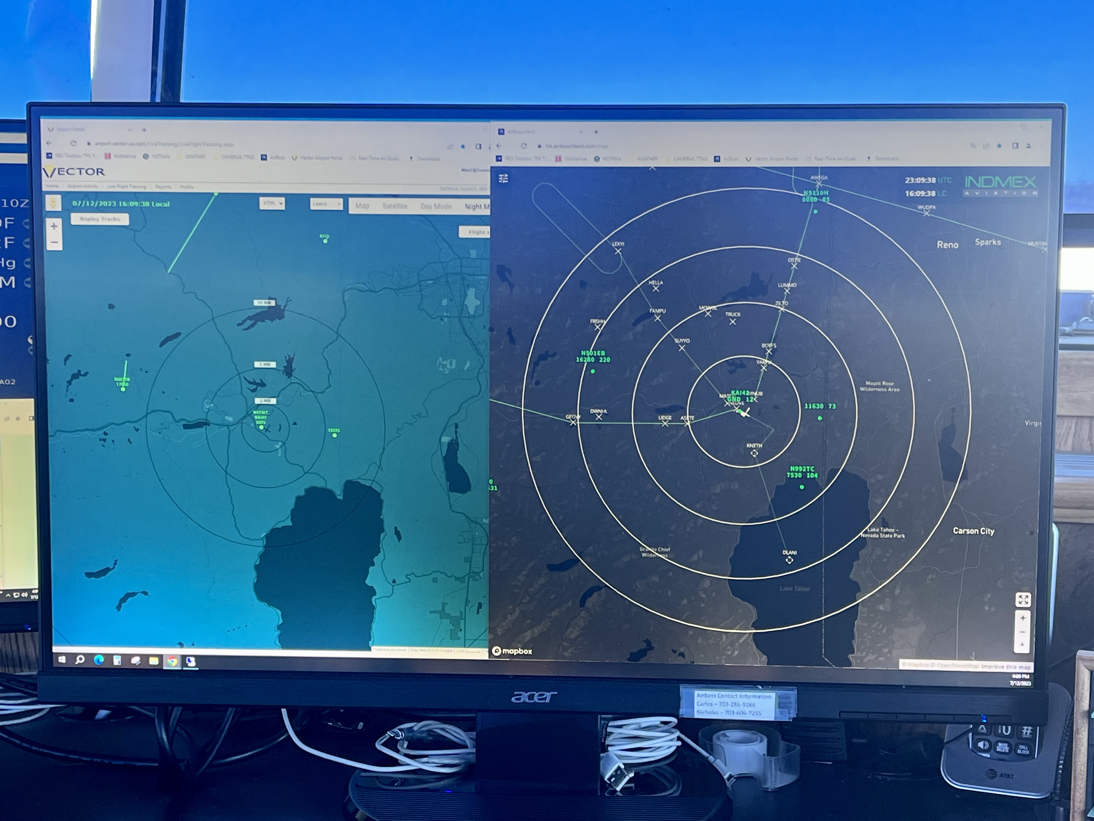
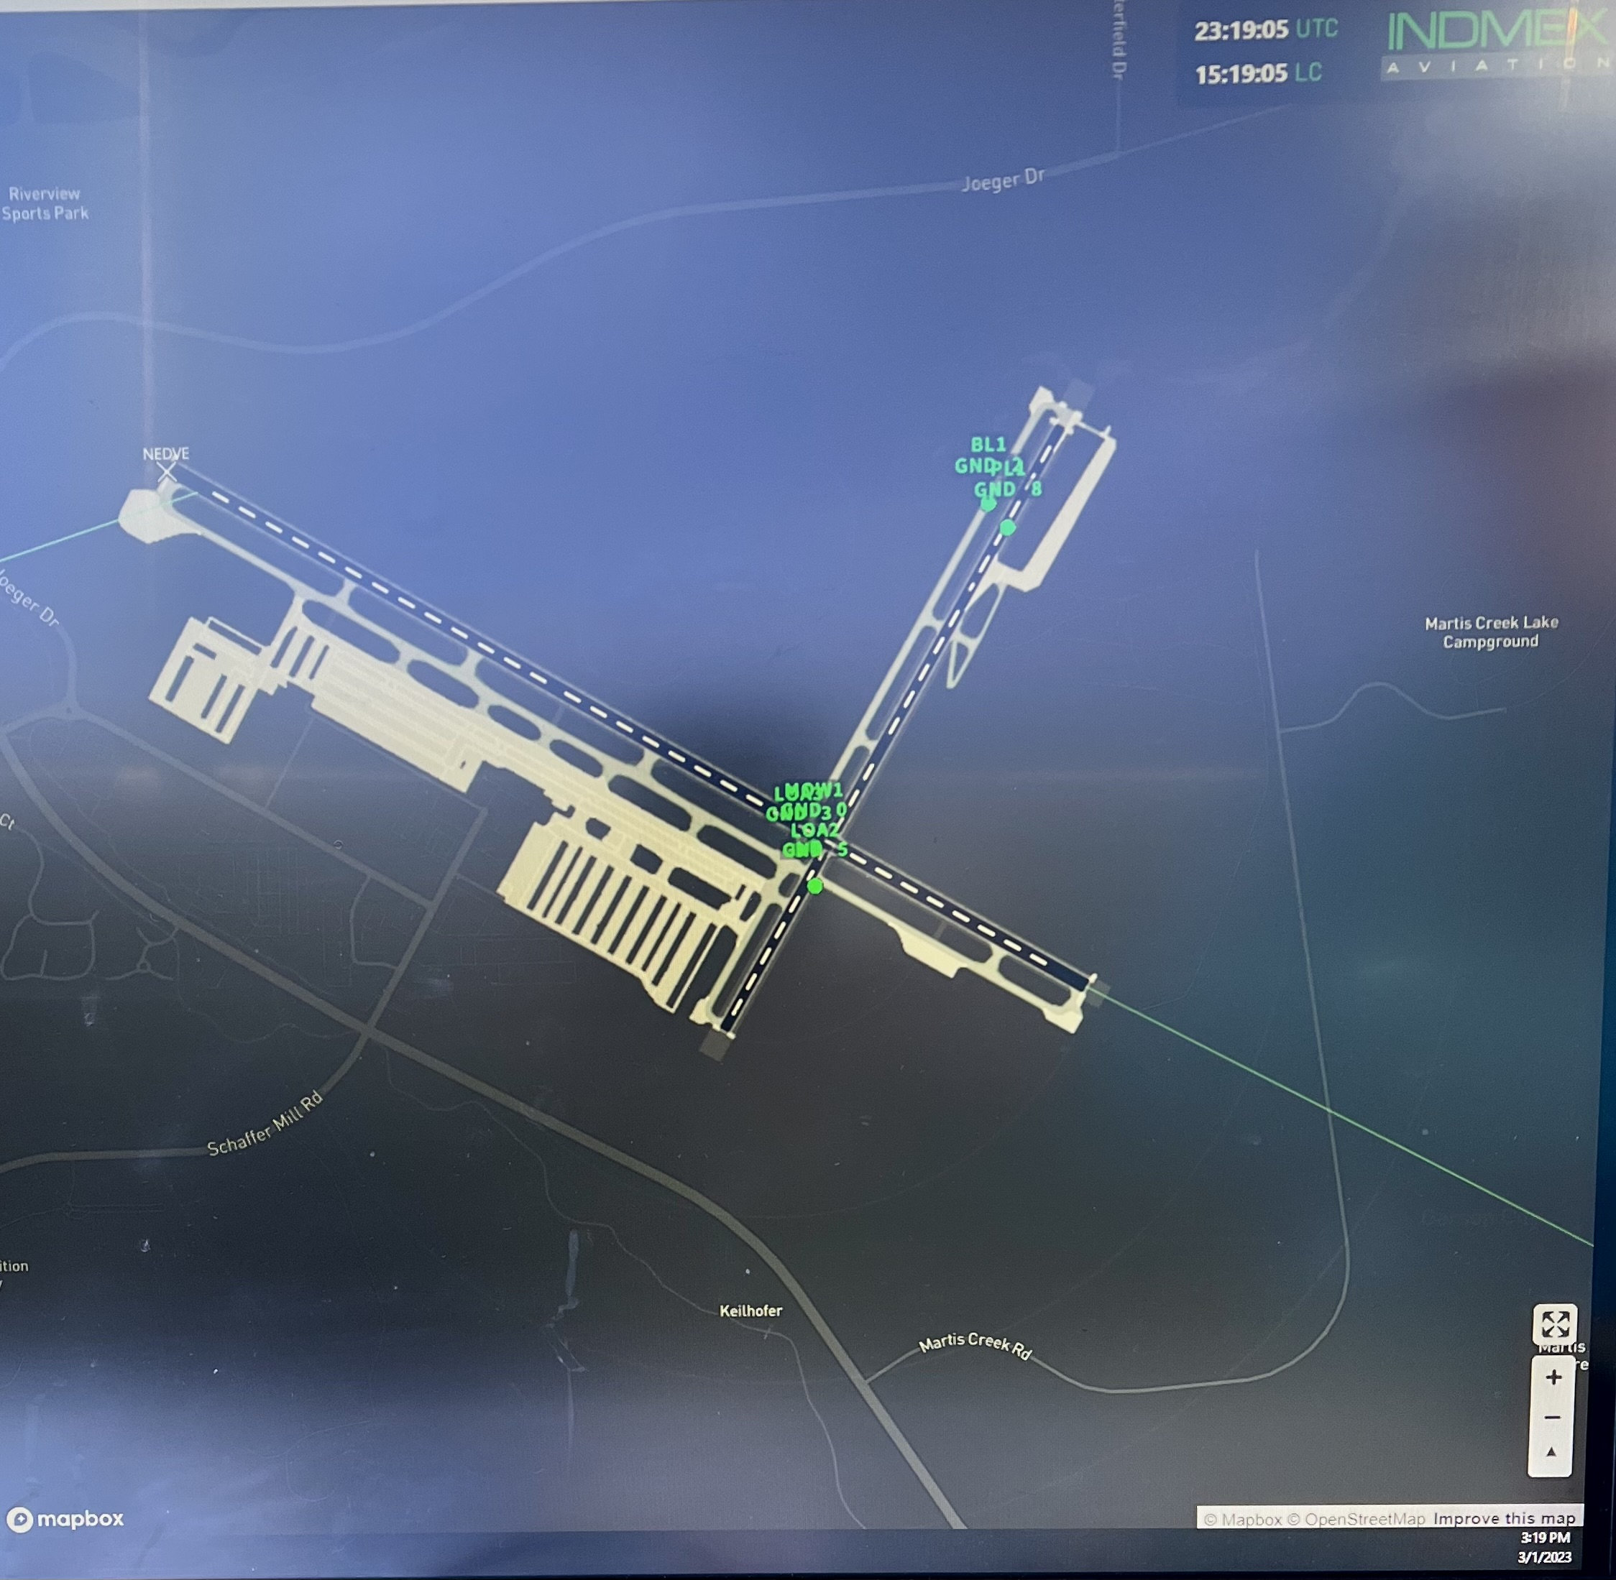
Situational Awareness Displays
Not used for separation
Tower controllers are not authorized to provide radar vectors.
AirBoss Data includes:
ACID
Indicated Altitude
Ground Speed
Instrument Approach Course and Fixes
Range Rings
Landmarks
Vehicle Tracking
Vector System
Serves as the Tower backup
Noise Tracking by the Airport

Slide 21
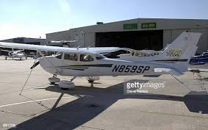
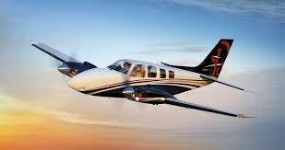
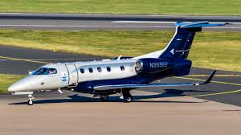
Runway Separation and Sequencing
Same Runway Separation (SRS) Category
CATEGORY I - small single-engine propeller driven aircraft weighing 12,500 lbs. or less, and all helicopters.
CATEGORY II - small twin-engine propeller driven aircraft weighing 12,500 lbs. or less.
CATEGORY III - all other aircraft.

Slide 22
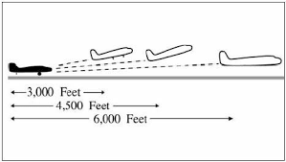
Runway Separation and Sequencing
SRS Minimum Distance – Departure - Departure
CAT I behind a CAT I or II – 3000’
CAT II behind a CAT I or II – 4500’
CAT III – 6000’

Slide 23
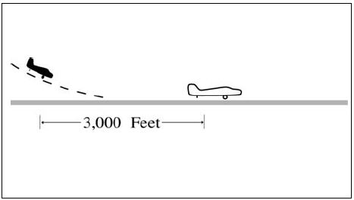
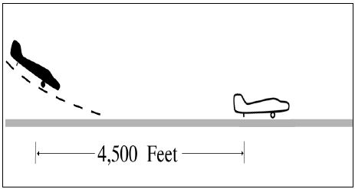
Runway Separation and Sequencing
SRS Minimum Distance – Arrival - Arrival
CAT I behind a CAT I or II – 3000’
CAT II behind a CAT I or II – 4500’
CAT III – Clear of runway

Slide 24
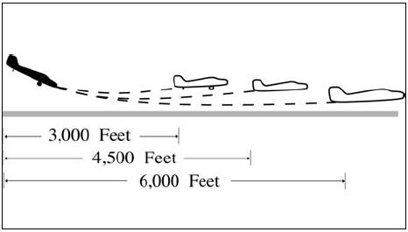
Runway Separation and Sequencing
SRS Minimum Distance – Arrival and Departure
CAT I behind a CAT I or II – 3000’
CAT II behind a CAT I or II – 4500’
CAT III – 6000’

Slide 25
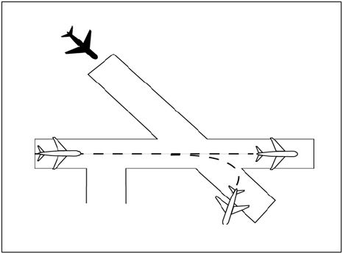
Runway Separation and Sequencing
Intersecting Runways
Departing/Arriving Aircraft must be through the intersection before a departure can be cleared for takeoff or an arrival is cleared to land.
Tower can use anticipated separation at the intersection.
Land and hold short not authorized.

Slide 26
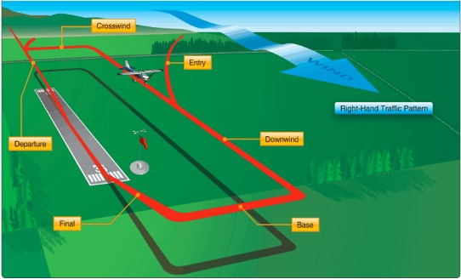
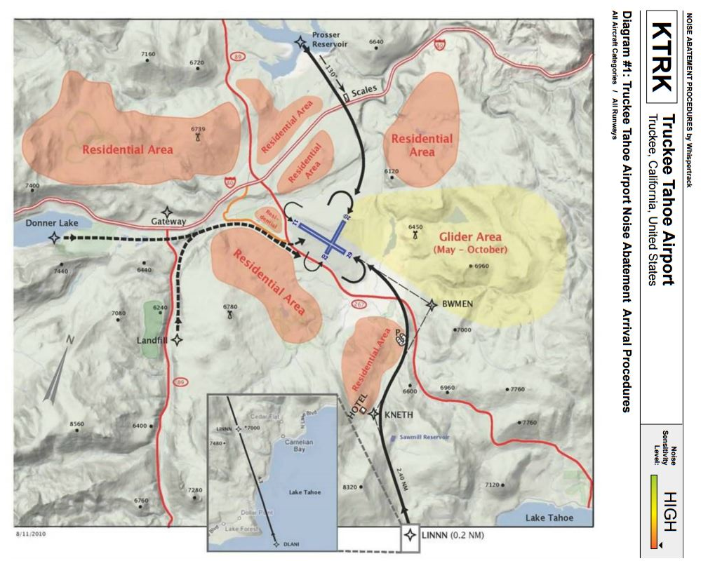
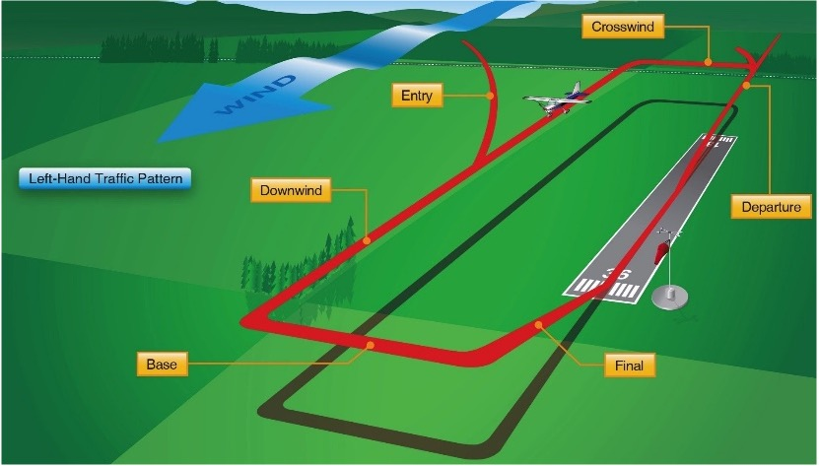
How does the tower provide runway separation?
Develop a sequence that will ensure same or intersecting runway separation
Using aircraft performance
Increase or decrease spacing by sending to geographic points. (Unable to issue headings/vector)
Assigning pattern entry instructions
Noise Abatement arrival

Slide 27
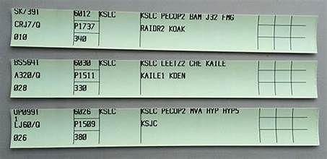
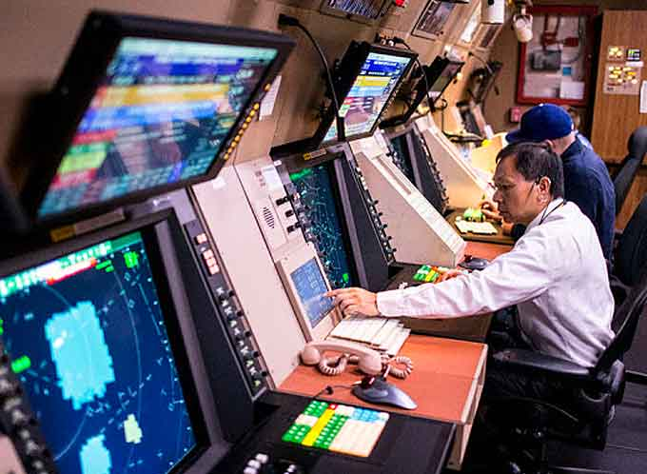

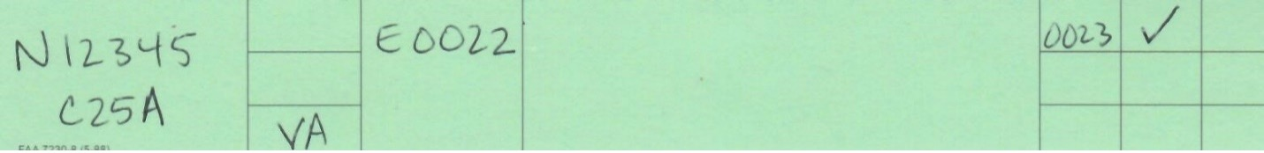
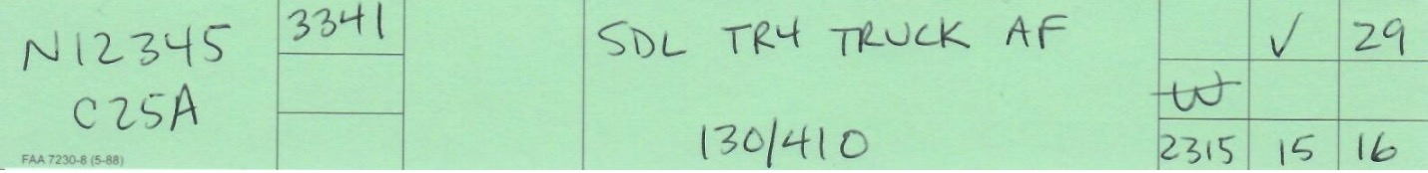
Flight Following and Handoffs
Equipment Limitations prevent both services
Flight Following and Squawk Codes - TRK does not have the required equipment. Flight Data Input Output Device (FDIO) required.
IFR/VFR Automated Hand-offs - Lack of automation interface – STARS, STARS Lite
IFR Arrival/Departure Information Transfer via Shout Line.

Slide 28
Effective Communication is Key
Notify ATC immediately if you're unable to comply with a clearance.
Pilot assigned the NAP departing runway 20 (left 270° to the Bypass) and the pilot made a left 540° to Brockway.
Pilot cleared to land runway 29 and did a touch and go.
Always read back assigned runways and any hold short instructions, as this is required by the FAA for tower controllers to verify.
If you are departing from or arriving at TRK, please confirm that you have received the ATIS.
If you miss an ATC instruction or clearance, please don’t guess—ask us to repeat or clarify the instructions.

Slide 29
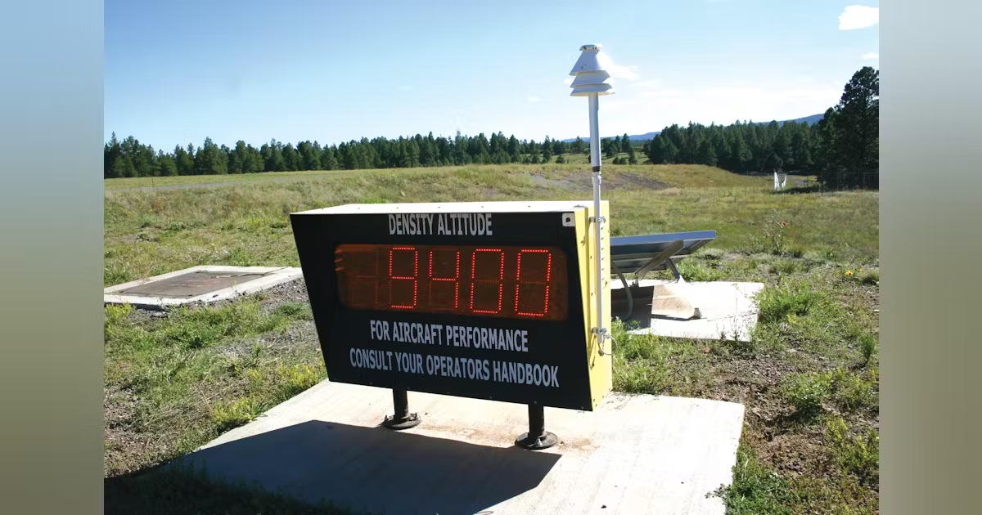
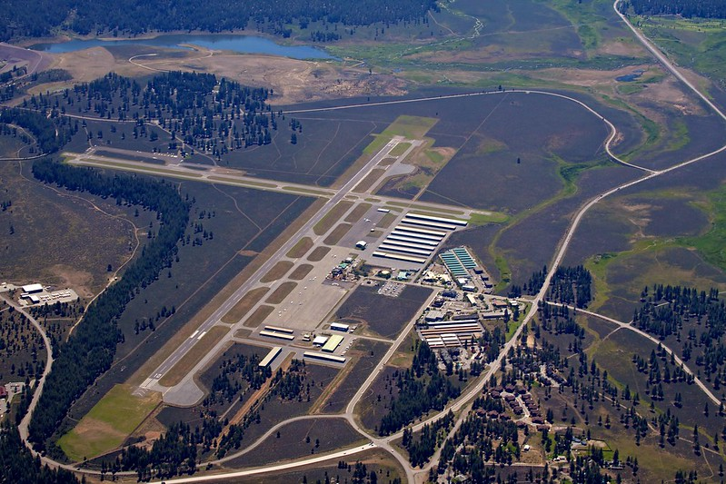
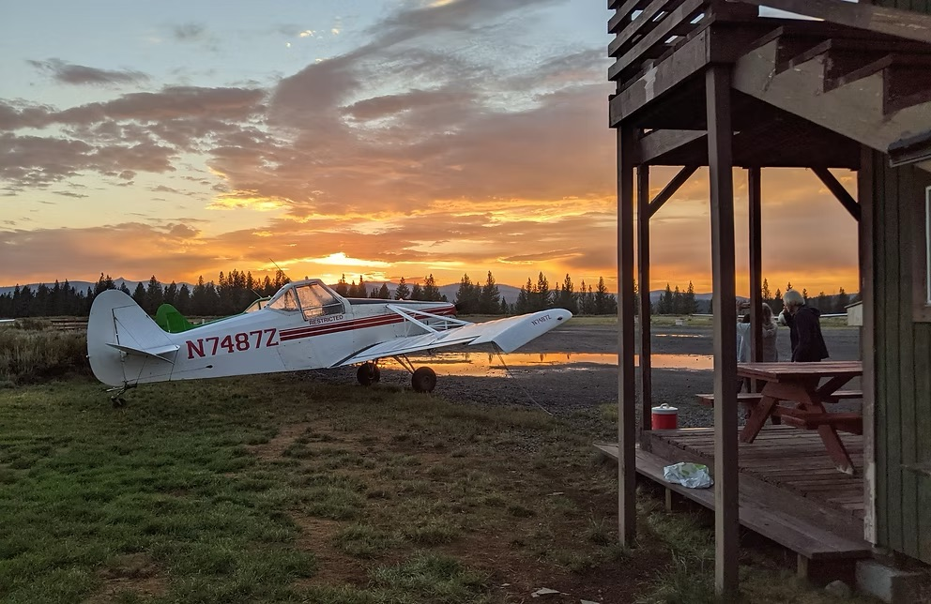
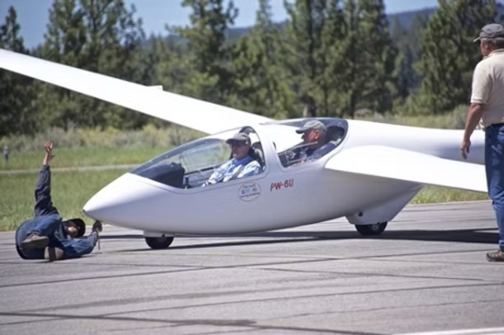
Summertime Operations and Gliders
Density Altitude
Construction – A2 Project. Tenant Meeting May 20
Intersecting Runway Operations
Thunderstorms
Runway 20 approach. Downdrafts, updrafts, and LLWS.
Glider Operations

Slide 30
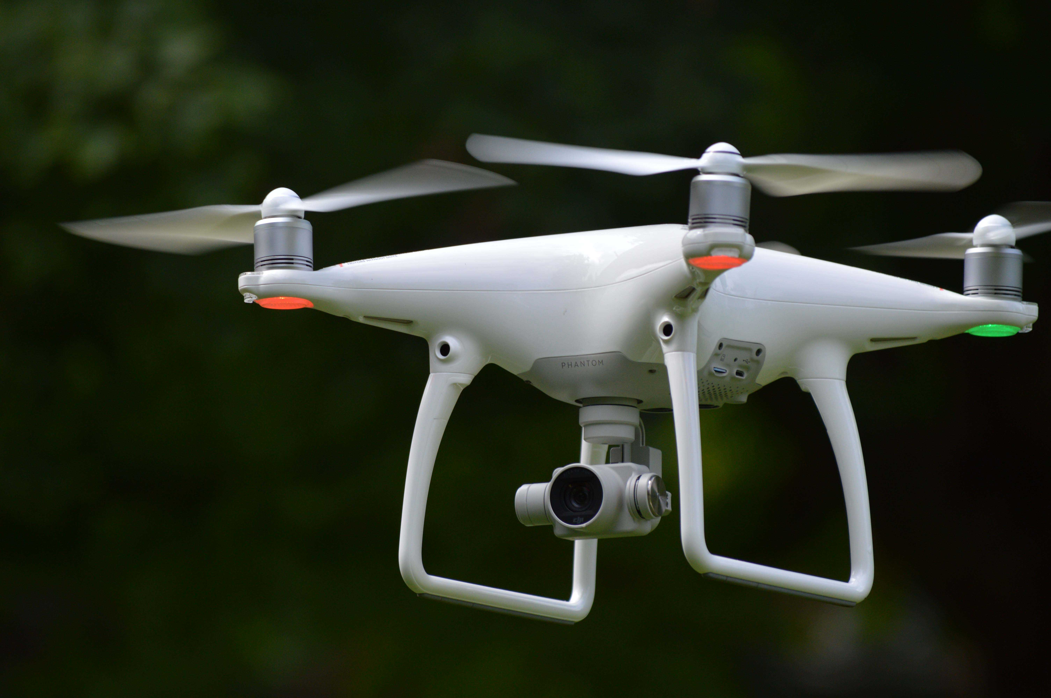

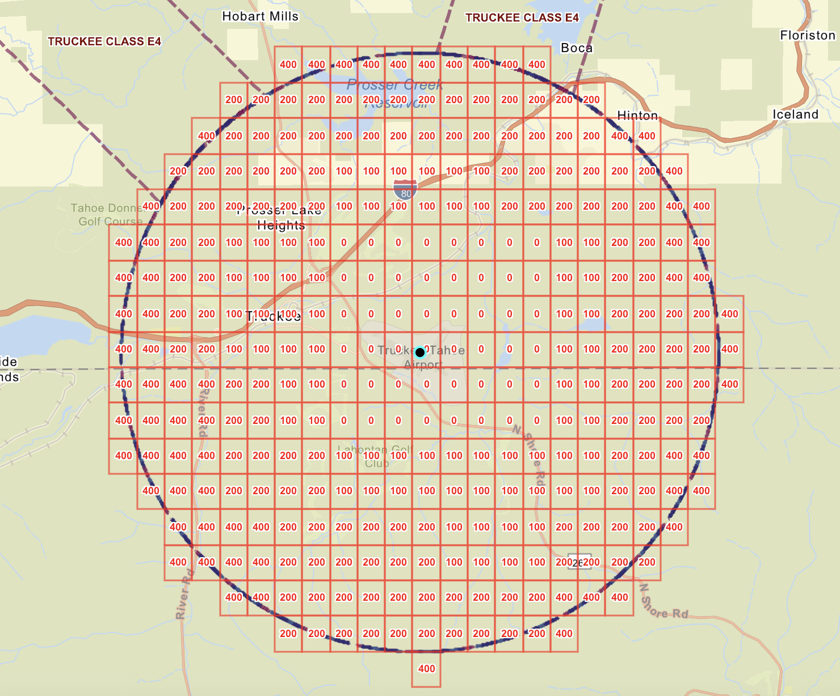

Drone Operations in the Truckee Class D Airspace
DroneZone not LAANC
UAS Facility Map
FAA Approval – At or Below Grid Altitudes
TRK Tower Approval – Above Grid Altitudes
Unauthorized Drone Activity

Slide 31

Tower Tours
Monday-Friday: 10:00am-3:00pm
Saturday-Sunday: 11:00am-3:00pm
Email tour requests to trknfct@midwestatcs.com
ZOA Tours – jmartin@natca.net

Slide 32

Question?
Thank you for coming!
Photo Credit: Tom Lippert

