Slide 1
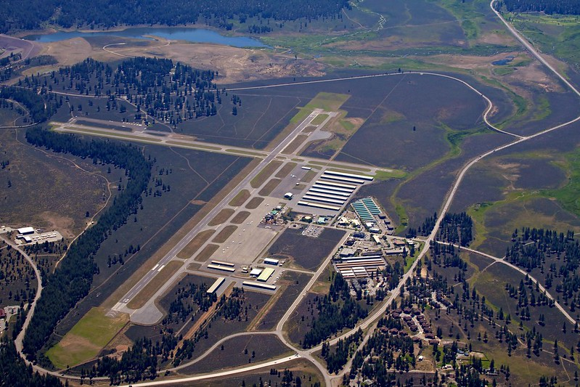

Air Traffic Manager
Steven Ingebretson
Air Traffic Services Manager
Amy St. Pierre
Director of Aviation
Jeff Menasco
Safety, Security, and Community Engagement Manager - Larry Finney
Attendees, please introduce yourselves
Notes:
PRESENTER NOTES
Be aware of key people attending and introduce them when possible.
Talking Points:
Begin the meeting by welcoming the group and introducing the Air Traffic Manager, Airport Manager, and NATCA representative.
Ask attendees to introduce themselves by stating their full name and the organization they represent.
Remind the group to add their information to the sign-in sheet, chat box if virtual or to send an email to you for the meeting records required for the RSAP.
Presenter Tip:
Virtual Option – Ask attendees to write name, title & email in chat box for attendance
In Person - A blank sign-in sheet is available in the Tool Kit if needed.
Remember, everyone in the meeting is a part of your Team.

Slide 2
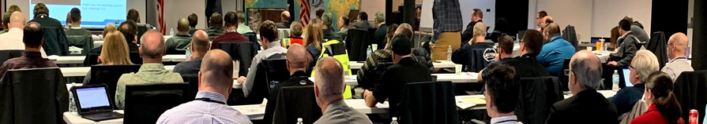
THIS RSAT MEETING
is an Open Discussion Safety Forum
PURPOSE TAKEAWAYS
Surface risks
Risk mitigations
Best practices
Safety resources
Local safety trend awareness
Safety resource availability
Action Item identification
Runway Safety Action Plan
(RSAP) update
Notes:
PRESENTER NOTES
Talking Points:
Local RSAT meetings are required once per fiscal year and result in better communication as well as safer operating environment.
You all are an integral part of the team.
The purpose of the RSAT meeting is to openly discuss:
local surface risks.
objectively determine ways to improve surface safety.
encourage active participation through use of best practices.
Learn about available resources.
Takeaways should include:
Local safety trend awareness. All participants are encouraged to freely discuss local safety concerns objectively without assigning blame.
Become aware of possible best practices and resources to implement and improve safety for everyone at your airport.
Identify actions that can be pursued by the airport operator, users and stakeholders to facilitate positive change.
Update the local Runway Safety Action Plan (RSAP) to promote partnerships, accountability and success.

Slide 3
TODAY, WE ARE DISCUSSING SAFETY WITHIN THE
AIRFIELD OPERATING AREAS
The Non-Movement Area
The Movement Area
The Protected Area and
The Runway Environment
Notes:
PRESENTER NOTES
Talking Points:
Airfield Operating Surfaces include the
Non-Movement Area,
Movement Area,
Protected Area, and
Runway Environment.
Let’s watch this video to learn more about these surfaces.

Slide 4
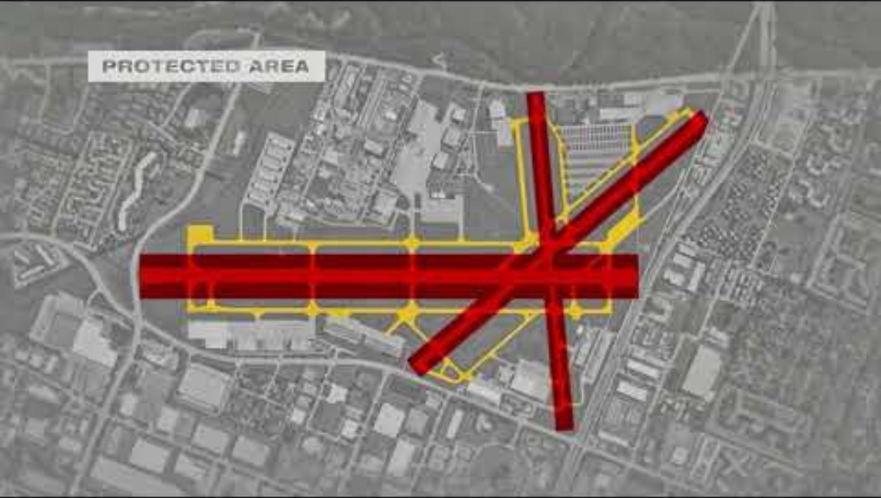
Notes:
PRESENTER NOTES
Mandatory to watch the Airfield Operating Surfaces video.
If inoperable from slide, cut and paste link to internet browser to share, be sure to click button for audio sharing:
https://youtube.com/watch?v=9ICtpfJicds
Presenter Tips:
CLICK ON the icon in the center of the slide to play the video. Or go to XXX link to stream the video live online.

Slide 5
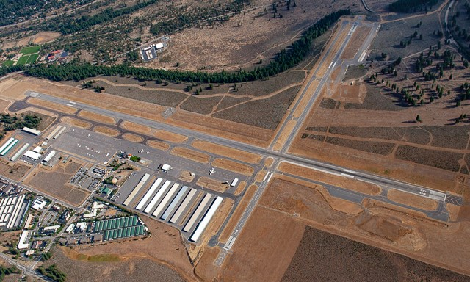
Truckee-Tahoe Airport
Movement Area
Runways
Taxiways
Photo Credit: Tom Lippert
Notes:
Runways
All Taxiways, including the runway exits and ramp exits.

Slide 6
Truckee-Tahoe Airport
Main Ramp
South Ramp
West Ramp
East Ramp
Jet Ramp
“Taxiway Q”
“Taxiway R”
Fuel Island
All Hangar Rows
Non-movement Areas
TWY Q
TWY R
Photo Credit: Tom Lippert
Notes:
ATC clearance not required on the non-movement area.
Controllers do like to know about movement in this area. It helps with the sequencing of aircraft on and off the non-movement area.
ATC will issue a clearance to use TWY Q and R even though it is a non-movement area.
Areas of non-visibility.

Slide 7
AIRFIELD OPERATING AREAS
What did you learn from the video and airfield review?
Notes:
PRESENTER NOTES
Talking Points:
Discuss with your audience what they learned form this video.
Did it clarify any imaginary surface that were previously misunderstood or confusing?
Discuss any unique airfield areas or operational expectations. (move these notes to later if needed.)
Does your airport have Non-Movement Area Boundary Markings?
If not, how do pilots and drivers access movement areas with proper authorization?
Presenter Tip:
This is a good opportunity to review the movement and non-movement areas at your airport.

Slide 8
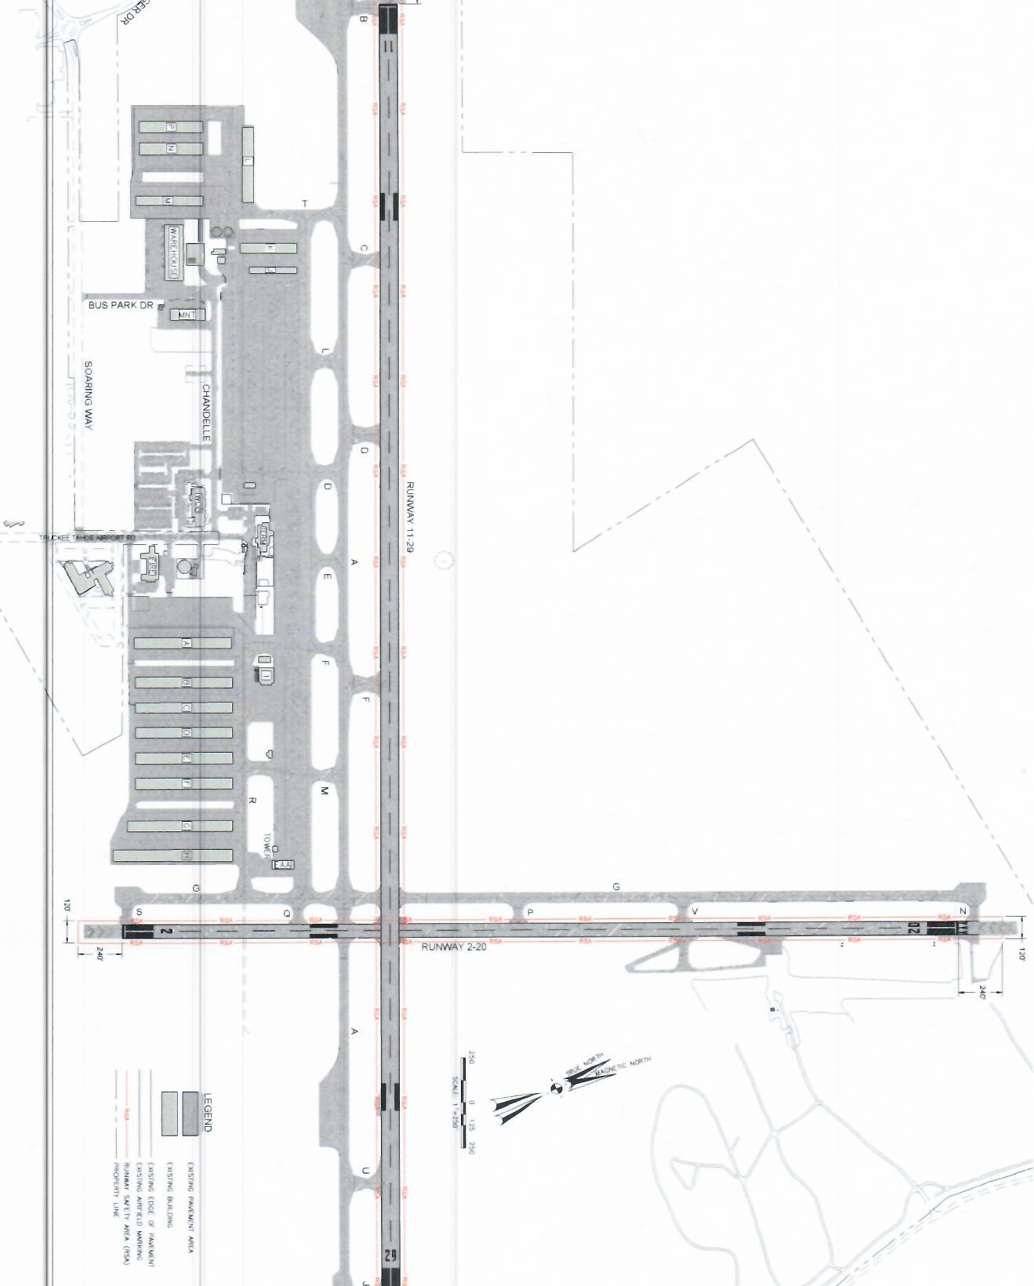
KNOW YOUR LOCAL PROTECTED AREAS
TRK RUNWAY SAFETY AREA ^{(RSA)}
Discuss RSA dimensions for each runway at your airport
      Runway 11/29 RSA 150’ wide or 75’ either side of CL or 25’ from edge of runway
      Runway 11/29 Blast pad/Overrun RSA 300’ from end of runway
      Runway 2/20 RSA 120’ wide or 60’ either side of CL or 22 ½’ from edge of runway
      Runway 2/20 Blast pad/Overrun 240’ from end of runway
Notes:
PRESENTER NOTES
Editing Instructions:
XXX insert your 3 letter airport id
Insert local visual depiction and RSA dimensions for each runway at your facility
Contact your local airport manager or local ADO for assistance in obtaining your airport's approved ALP for individual RSA dimensions. They should also be depicted and/ or listed in your RSA LOA.
Talking points:
Discuss the actual RSA dimensions for each runway at your airport.
The RSA dimensions can be found on the FAA approved Airport Layout Plan (ALP) or in your local RSA Letter of Agreement (LOA.)
We will discuss facility RSA LOA later in presentation

Slide 9
LET’S REVIEW ...
operational safety at Truckee-Tahoe airport...
Notes:
PRESENTER NOTES
Talking Points:
Let’s review operational safety at your local airport in the following slides

Slide 10
RUNWAY INCURSION (RI) & SURFACE INCIDENT (SI)
CLASSIFICATIONS
are based on these attributed actions:
Pilot Deviations (PD) are attributed to pilots operating an aircraft under its own power
Vehicle or Pedestrian Deviations (V/PD) are attributed to a vehicle driver or non-pilot operating an aircraft under its own power, a vehicle driver towing an aircraft, or a pedestrian
Operational Incidents (OI) are attributed to Air Traffic Control action or inaction
Others (OTH) are events
not clearly attributed as determined above. This can include events caused by equipment failure or
other factors
Notes:
PRESENTER NOTES -
Talking Points:
Pilot Deviations (PD) are attributed to pilots operating an aircraft under its own power.
Vehicle or Pedestrian Deviations (V/PD) are attributed to a vehicle driver or non-pilot operating an aircraft under its
own power, a vehicle driver towing an aircraft, or a pedestrian.
Operational Incidents (OI) are attributed to Air Traffic Control action or inaction.
Others (OTH) are events not clearly attributed as determined above. This can include events caused by equipment failure or
other factors.

Slide 11
SURFACE INCIDENTS ^{(SI)}
An unauthorized
movement of an
aircraft, vehicle or
pedestrian within
the designated movement area, but outside of the RSA
Notes:
PRESENTER NOTES
Talking Points:
According to ICAO, a Surface Incident (SI) is an unauthorized or unapproved movement within the designated movement area (excluding runway incursions) or an occurrence in that same area associated with the operation of an aircraft that affects or could affect the safety of flight.
An example of a SI is entering a movement area without ATC approval.
An SI occurs outside the RSA and is NOT an RI.
Presenter Tip:
Discuss examples of surface incidents with the group.

Slide 12
54.3M
567
3
16
51%
7%
28%
14%
Notes:
PRESENTER NOTES
Talking Points:
In FY2023, there were 54.3 million take-offs and landings in the NAS.
Of these, 567 were Surface Incidents.
Surface incidents (SI) may include wrong taxiway surface operations. There were 3 aircraft that departed from a taxiway and 16 that aligned with and landed on a taxiway.
Overall, 51% were PDs, 7% were OIs, 28% were VPDs and 14 % were OTHs.

Slide 13
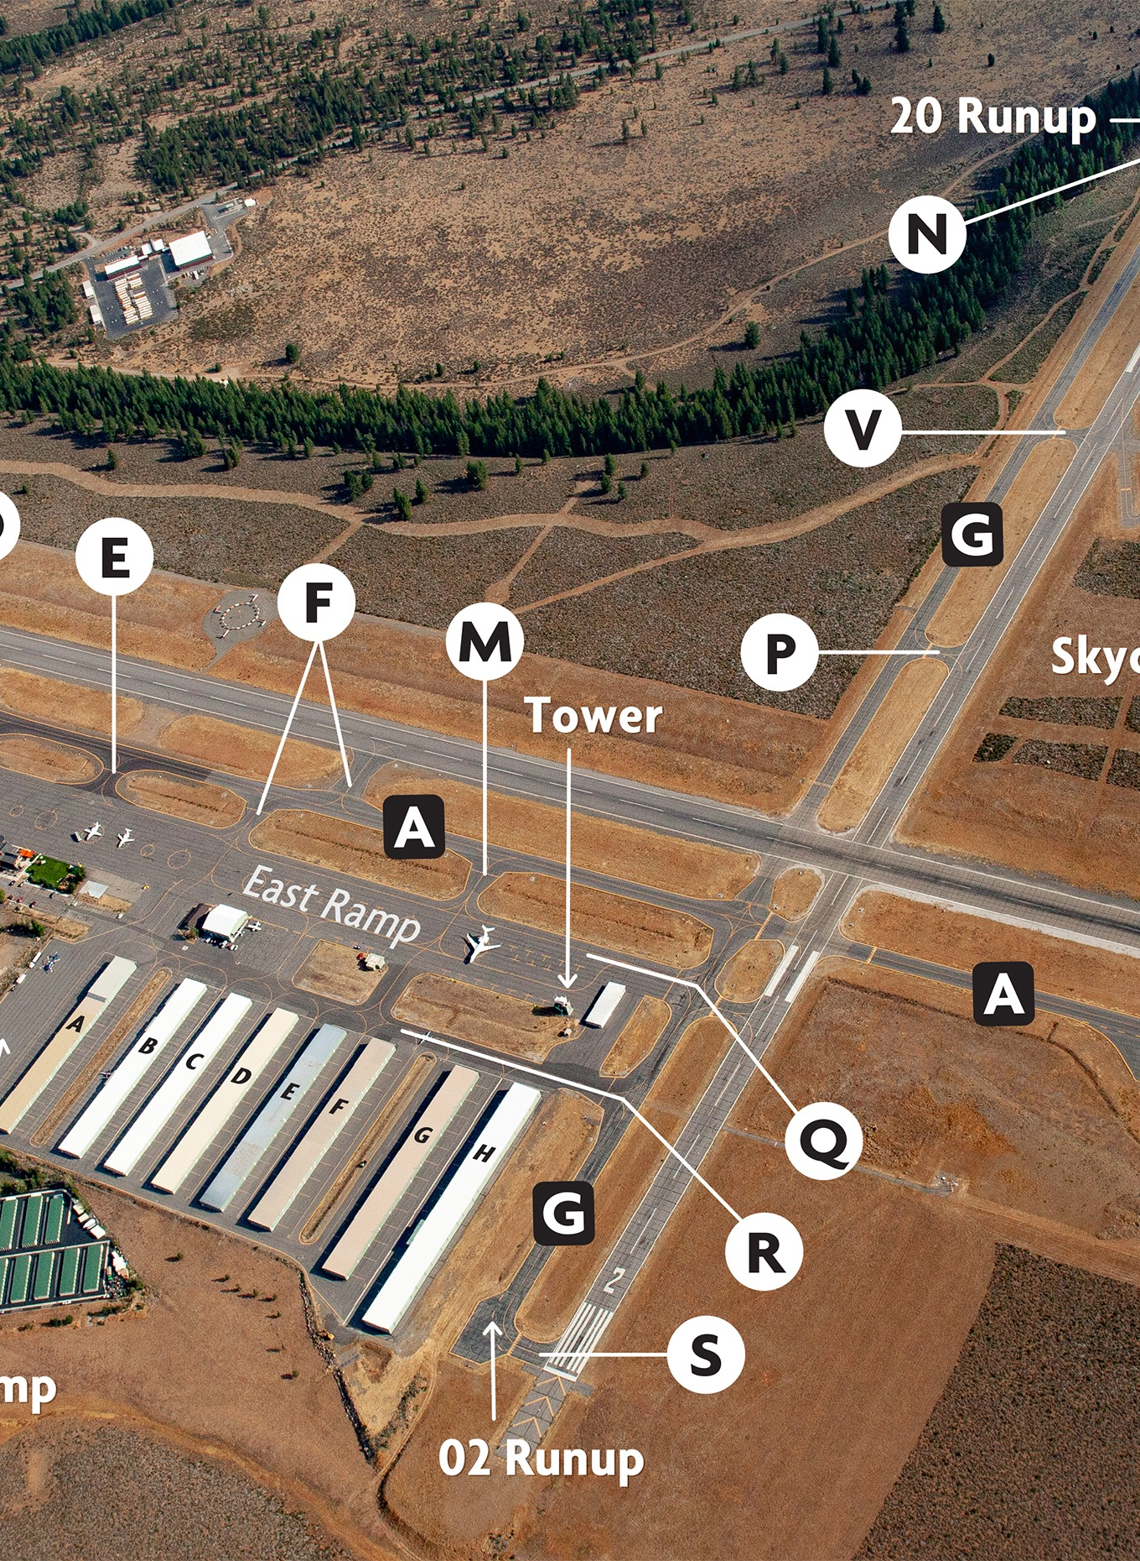

LOCAL SURFACE EVENT REVIEW
SURFACE INCIDENTS ^{(SI)}
XXX-M-YYYY/MM/DD-000#-XXX-00X
No Reported Surface Incidents
Group Discussion:
What can be learned from this event?
Notes:
PRESENTER NOTES
Editing Instructions:
If applicable, modify this slide with local SI events that have occurred since the last RSAT using the RSAT WebTool at www.rsatevents.com
(If inaccessible, contact your assigned Runway Safety Program Manager (RSPM) found at https://www.faa.gov/airports/runway_safety/contact)
Cut and paste (use Snipping Tool if available) the RI event graphic(s), MOR # and narrative from the RSAT WebTool to this slide for discussion at your meeting.
Duplicate this slide to review multiple local events at your RSAT.
Delete example slide if not applicable.
Talking Points/ Presenter Tip:
Review the event and discuss the following:
Is this a recurring trend?
What are lessons learned?
Ask/discuss what could be done to reduce this risk or what has been done to reduce risk?
If an SSR was complete on this event, add lessons learned, new procedures/mitigations, etc. from SSR.

Slide 14

SAFETY
KNOWLEDGE POINT
You are preparing to depart and are ready for taxi. As you approach the Movement Area, you may come upon these markings.
What must you do?
When can you cross these lines without authorization?
Notes:
PRESENTER NOTES
Talking Points/ Presenter Tip:
Ask the question and let the audience answer.
Discuss Non-Movement Area Boundary markings at your facility.
Do you have them?
Are they consistent across the airfield?
If not, what procedures should pilots follow with air traffic to ensure safe operations?

Slide 15
RUNWAY INCURSION ^{(RI)}
Incorrect presence of an aircraft, vehicle or person on the protected area of a surface designated for the landing and take-off of aircraft
Notes:
PRESENTER NOTES
Example of RI: Crossing the Hold short line without ATC approval
Talking Points:
According to ICAO, Runway Incursions (RIs) are any occurrence at an aerodrome involving the incorrect presence of an aircraft, vehicle or person on the protected area of a surface designated for the landing and take-off of aircraft.
When you cross this line, you have entered the ‘runway environment’ and are too close to the runway for aircraft to safely take-off or land.
An example of a violation of the RSA would be crossing the marking such as the one in the image without permission from Air Traffic.
If you get any part of your aircraft or vehicle across this line without permission to do so, even if there are no other aircraft or vehicles involved, it is still a RI.
Presenter tip
Briefly review this RI definition covered in the previous video.
Discuss other examples of runway incursions with the group.

Slide 16
Notes:
PRESENTER NOTES
Talking Points:
All Runway Incursions (RI) are assessed by the Runway Incursion Assessment Team (RIAT.)
RIs are classified by the severity of the event.
The Severity Classifications are:
Accident - An incursion that results in a collision. For the purposes of tracking incursion performance, an accident will be treated as a Category A runway incursion.
Categories A through E, with A being the most serious incident
Categories are assigned based on the proximity, speed and closure rates of the events.
Category E. An incident in which insufficient or conflicting evidence of the event precludes assigning another category
Presenter Tip:
Encourage the group to discuss severity classifications and what characterizes these categories.

Slide 17
54.3M
61%
1,760
19%
18%
2%
Notes:
PRESENTER NOTES
Talking Points:
Of the 54.3 million take-offs and landings in the NAS in FY2023,
There were 1,760 Runway Incursions (RIs).
Of those RIs, 61% were PDs, 19% were OIs, 18% were VPDs and 2% were OTHs.
This kind of data helps the FAA, airports and stakeholders understand how to identify risks, mitigation measures and effective outreach efforts.

Slide 18
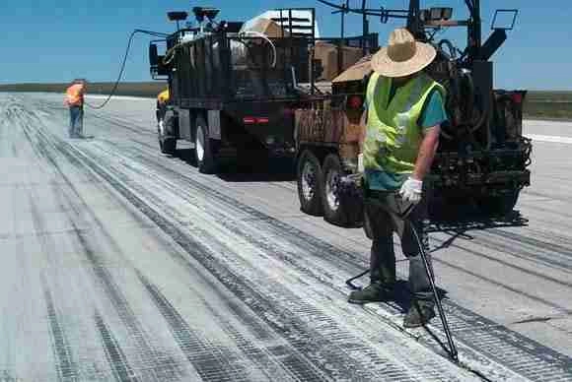
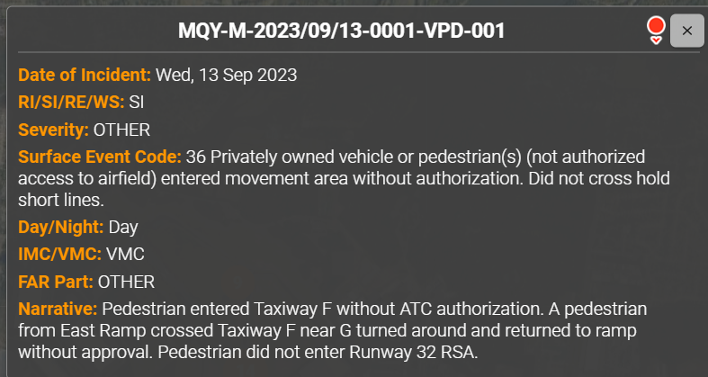
LOCAL SURFACE EVENT REVIEW
RUNWAY INCURSIONS ^{(RI)}
XXX-M-YYYY/MM/DD-000#-XXX-00X
Category C – Aircraft executed a go-around after seeing the vehicle on the runway. (2024)
Notes:
PRESENTER NOTES
Editing Instructions:
If applicable, modify this slide with local RI events that have occurred since the last RSAT using the RSAT WebTool at www.rsatevents.com
(If inaccessible, contact your assigned Runway Safety Program Manager (RSPM) found at https://www.faa.gov/airports/runway_safety/contact)
Cut and paste (use Snipping Tool if available) the RI event graphic(s), MOR # and narrative from the RSAT WebTool to this slide for discussion at your meeting.
Duplicate this slide to review multiple local events at your RSAT.
Delete example slide if not applicable.
Talking Points/ Presenter Tip:
Review the event and discuss the following:
Is this a recurring trend?
What are lessons learned?
Ask/discuss what could be done to reduce this risk or what has been done to reduce risk?
If an SSR was complete on this event, add lessons learned, new procedures/mitigations, etc. from SSR.

Slide 19
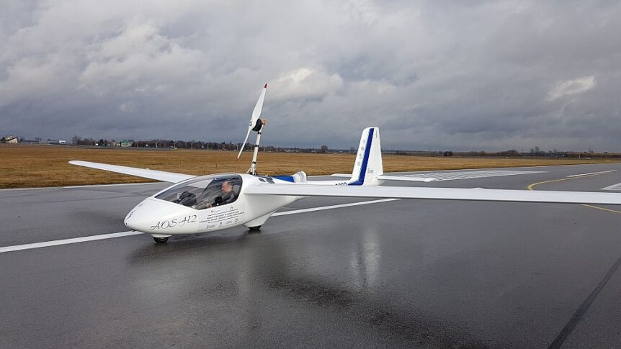
LOCAL SURFACE EVENT REVIEW
RUNWAY INCURSIONS ^{(RI)}
XXX-M-YYYY/MM/DD-000#-XXX-00X
Category D – Pilot did not inform ATC that ground support was needed. Personnel entered the runway without authorization. (2025)
Notes:
PRESENTER NOTES
Editing Instructions:
If applicable, modify this slide with local RI events that have occurred since the last RSAT using the RSAT WebTool at www.rsatevents.com
(If inaccessible, contact your assigned Runway Safety Program Manager (RSPM) found at https://www.faa.gov/airports/runway_safety/contact)
Cut and paste (use Snipping Tool if available) the RI event graphic(s), MOR # and narrative from the RSAT WebTool to this slide for discussion at your meeting.
Duplicate this slide to review multiple local events at your RSAT.
Delete example slide if not applicable.
Talking Points/ Presenter Tip:
Review the event and discuss the following:
Is this a recurring trend?
What are lessons learned?
Ask/discuss what could be done to reduce this risk or what has been done to reduce risk?
If an SSR was complete on this event, add lessons learned, new procedures/mitigations, etc. from SSR.

Slide 20
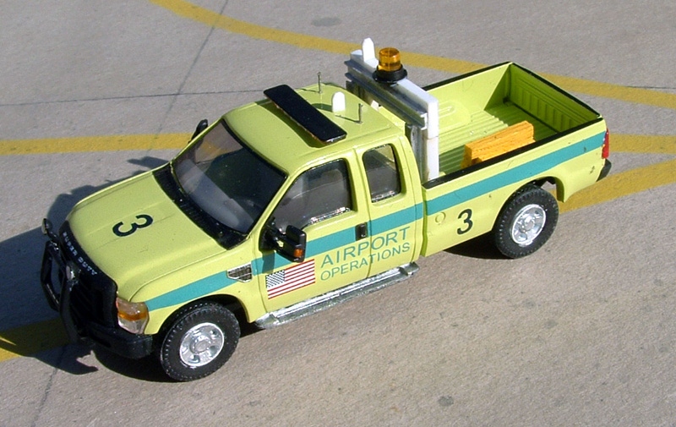
LOCAL SURFACE EVENT REVIEW
RUNWAY INCURSIONS ^{(RI)}
XXX-M-YYYY/MM/DD-000#-XXX-00X
Category D – Vehicle entered runway without ATC approval. (2025)
Notes:
PRESENTER NOTES
Editing Instructions:
If applicable, modify this slide with local RI events that have occurred since the last RSAT using the RSAT WebTool at www.rsatevents.com
(If inaccessible, contact your assigned Runway Safety Program Manager (RSPM) found at https://www.faa.gov/airports/runway_safety/contact)
Cut and paste (use Snipping Tool if available) the RI event graphic(s), MOR # and narrative from the RSAT WebTool to this slide for discussion at your meeting.
Duplicate this slide to review multiple local events at your RSAT.
Delete example slide if not applicable.
Talking Points/ Presenter Tip:
Review the event and discuss the following:
Is this a recurring trend?
What are lessons learned?
Ask/discuss what could be done to reduce this risk or what has been done to reduce risk?
If an SSR was complete on this event, add lessons learned, new procedures/mitigations, etc. from SSR.

Slide 21



SAFETY
KNOWLEDGE POINT
When instructed to “exit the runway” by ATC,
what markings do you seek to cross to ensure
you are safely clear of
“the runway environment?”
Notes:
Left to Right signage defined:
Non-Movement Area Boundary Marking, dashed line first
Instrument Landing System (ILS) Marking
Runway Position Hold Marking, dashed lines first
PRESENTERS NOTES
Safety Knowledge Point: When told to “clear the runway” by ATC, what markings do you seek to cross to ensure you are safely out of “the runway environment?”
Non-Movement Area Boundary Marking, dashed line first
Instrument Landing System (ILS) Marking, or
Runway Position and Hold Marking, dashed lines first
Let audience answer and explain their answers
Answer: Runway Position and Hold Marking, you will meet the dashed lines first as you EXIT the runway.
Note: The majority of losses of runway separation, go-arounds, and other types of RIs are attributable to not completely crossing these double lines when exiting a runway or crossing them without permission. If we resolve this, we improve Runway Safety dramatically across the NAS. “

Slide 22
RUNWAY EXCURSIONS ^{(RE)}
A veer off or overrun from
the runway surface during take-off or landing
Contributing factors may include:
Unstable Approaches
Cross Wind Component
Tailwind
Mechanical
Runway Conditions
Notes:
PRESENTER NOTES
Talking Points:
According to ICAO, a Runway Excursion (RE) is a veer off or overrun from the runway surface during a take-off or landing.
An example of a RE is an aircraft leaving the runway surface due to pilot loss of control, unstable approach or mechanical failure.
Presenter Tip:
Discuss examples of Runway Excursions with the group.

Slide 23
492
458
27
4
3
Notes:
PRESENTER NOTES
Talking Points:
In FY2023, there were 492 Runway Excursions in the NAS.
There were 458 general aviation, 17 commercial, 4 foreign and 3 military aircraft involved in a runway excursion.
The main contributing factors are aircraft problems, loss of control, and unstable approaches.
(Note: Commercial aircraft excursions include Part 121 and Part 135 operations.)
Presenter Tip:
Encourage the group to discuss surface safety best practices and lessons learned.

Slide 24

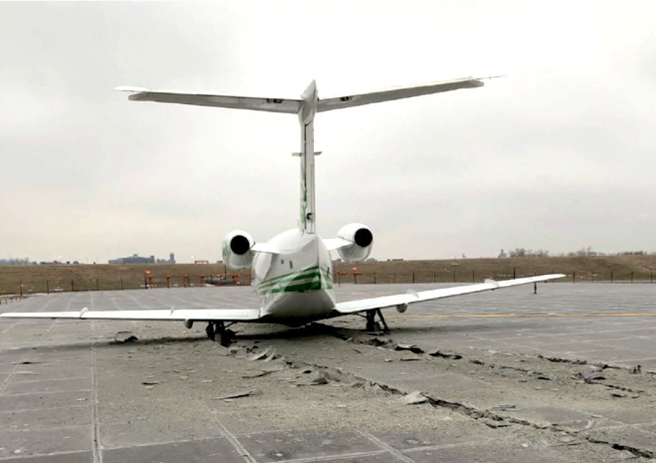
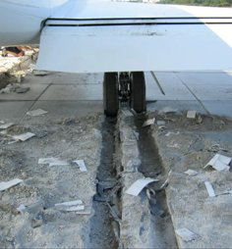
EMAS (Engineered Material Arresting System)
SINCE 1996 | BY THE NUMBERS
21
runway excursions have been stopped safely by EMAS,
protecting 430 souls on board
70
knots
or less
The speed at which standard EMAS is designed to stop the most demanding, regular-use aircraft
125
EMAS beds are installed
at 72 airports across the
NAS as of October 27, 2023.
Notes:
PRESENTER NOTES
Talking Points:
To help reduce the impact of Runway Excursions that overrun the runway ends, EMAS can be installed.
EMAS is installed to meet RSA standards beyond the ends of the runway when it can not otherwise be reasonably accomplished.
The purpose of an EMAS is to stop an aircraft overrun by the loss of energy required to crush the EMAS material with no human injury and minimal aircraft damage.
21 runway excursions have been stopped safely by EMAS protecting 430 crew and passengers.
125 EMAS MAX beds are installed at 72 airport across the NAS as of October 27, 2023.
70 knots or less is the speed at which standard EMAS is designed to stop the most demanding, regular–use aircraft.
Additional EMAS information: https://www.faa.gov/airports/engineering/incursions_excursions/emas. Listed on the weblink page at the end of the presentation.

Slide 25
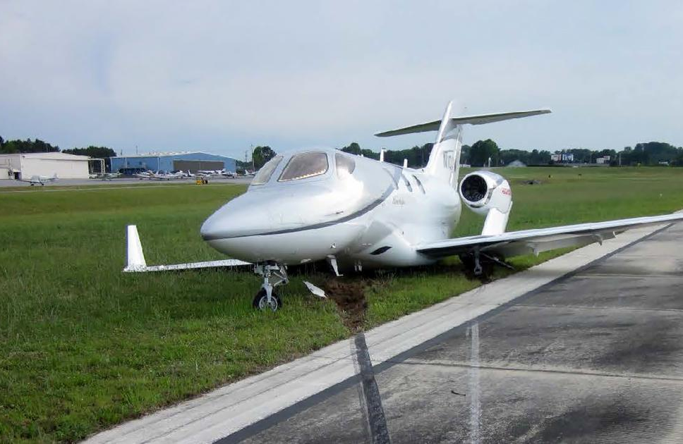
LOCAL SURFACE EVENT REVIEW
RUNWAY EXCURSIONS ^{(RE)}
XXX-M-YYYY/MM/DD-000#-XXX-00X
No REs in FY2024
Notes:
PRESENTER NOTES
Editing Instructions:
If applicable, modify this slide with local RE events that have occurred since the last RSAT using the RSAT WebTool at www.rsatevents.com
(If inaccessible, contact your assigned Runway Safety Program Manager (RSPM) found at https://www.faa.gov/airports/runway_safety/contact)
Cut and paste (use Snipping Tool if available) the RI event graphic(s), MOR # and narrative from the RSAT WebTool to this slide for discussion at your meeting.
Duplicate this slide to review multiple local events at your RSAT.
Delete example slide if not applicable.
Talking Points/ Presenter Tip:
Review the event and discuss the following:
Is this a recurring trend?
What are lessons learned?
Ask/discuss what could be done to reduce this risk or what has been done to reduce risk?
If an SSR was complete on this event, add lessons learned, new procedures/mitigations, etc. from SSR.

Slide 26
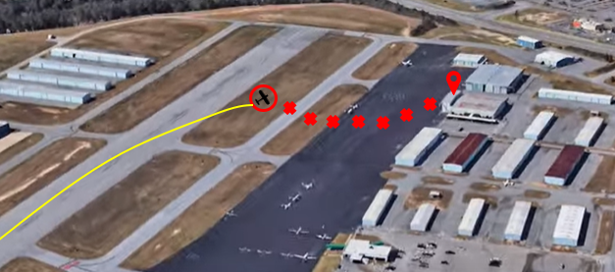
SAFETY
KNOWLEDGE POINT
You have touched down on the runway but leave the runway unintentionally.
What should you do?
Notes:
PRESENTER NOTES
Talking Points/ Presenter Tip:
You have touched down on the runway, but leave the runway unintentionally.
What should you do?
Let the audience answer.
Discuss this scenario and the proper responses: what procedures should pilots follow with air traffic to ensure safe operations?
Also discuss what NOT to do.
Proper Answer for Pilots: Call tower if able. Await local operations for assistance, tow, emergency responses as per local requirements.
Proper Answer for Tower: Tower should call emergency response, airport operations, etc. for assistance as per local requirements.

Slide 27
WSO
WRONG SURFACE OPERATIONS
WSOs involve landing on or taking off from a taxiway, wrong runway, or landing at a wrong airport. Risk factors include:
Parallel runways, particular offset thresholds, or irregular spacing
Closely aligned runway ends
Parallel taxiways
Close airports with similar configurations
Notes:
PRESENTER NOTES
Editing Instructions:
Replace picture with your facility highlighting wrong surface issues if applicable
Talking Points:
In the past few years, Wrong Surface Operations have come to light as one of the higher-risk errors being made in the NAS.
Landing risks include landing on the wrong runway, landing on a taxiway or landing at the wrong airport.
Takeoff risks include departing from the wrong runway to include the wrong direction from an intersection or from a taxiway.
The FAA is working to mitigate Wrong Surface Operations and all surface risk via the From the Flight Deck videos, Arrival Alert Notices, Pilot Information Booklets, and the Runway Incursion Mitigation programs.
Presenter Tip:
Encourage the group to discuss best practices and lessons learned.

Slide 28
Notes:
PRESENTERS NOTES:
Talking Points:
WSO arrivals by operator type include General Aviation at 82%, Commercial at 17% and Military at 1%.
WSO departures by operator type include General aviation at 92%, Commercial at 7% and Military at 2%.
WS arrivals occur 87% of the time during daylight hours while WS departures occur 90% of the time during daylight hours.
WS arrivals involve other aircraft 18% of the time and WS departures involve other aircraft 17% of the time. Luckily, the majority of these types of WSOs occur without involving others.
WS arrivals and departures by Surface Type include wrong runways, taxiways, other surfaces and wrong airports as shown in the lower right corner of the slide.

Slide 29
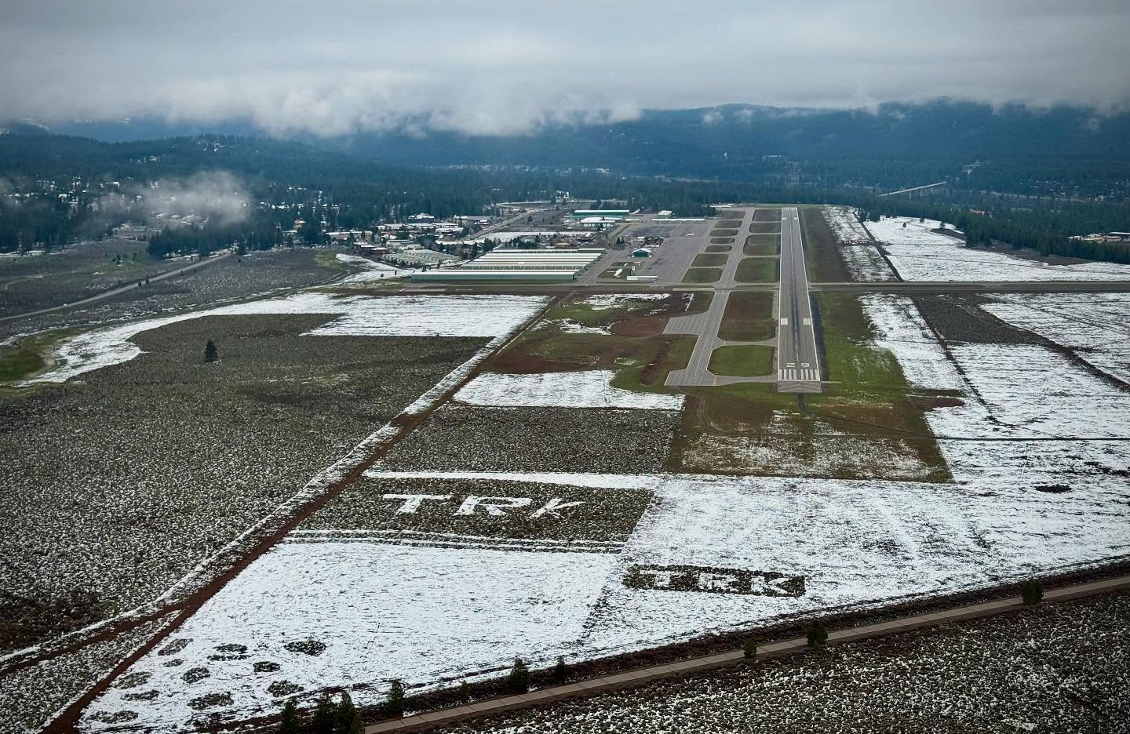
LOCAL SURFACE EVENT REVIEW
WRONG SURFACE OPERATIONS ^{(WS)}
XXX-M-YYYY/MM/DD-000#-XXX-00X
No WSOs in 2024
Notes:
PRESENTER NOTES
Editing Instructions:
If applicable, modify this slide with local WSO events that have occurred since the last RSAT using the RSAT WebTool at www.rsatevents.com
(If inaccessible, contact your assigned Runway Safety Program Manager (RSPM) found at https://www.faa.gov/airports/runway_safety/contact)
Cut and paste (use Snipping Tool if available) the RI event graphic(s), MOR # and narrative from the RSAT WebTool to this slide for discussion at your meeting.
Duplicate this slide to review multiple local events at your RSAT.
Delete example slide if not applicable.
Talking Points/ Presenter Tip:
Review the event and discuss the following:
Is this a recurring trend?
What are lessons learned?
Ask/discuss what could be done to reduce this risk or what has been done to reduce risk?
If an SSR was complete on this event, add lessons learned, new procedures/mitigations, etc. from SSR.

Slide 30
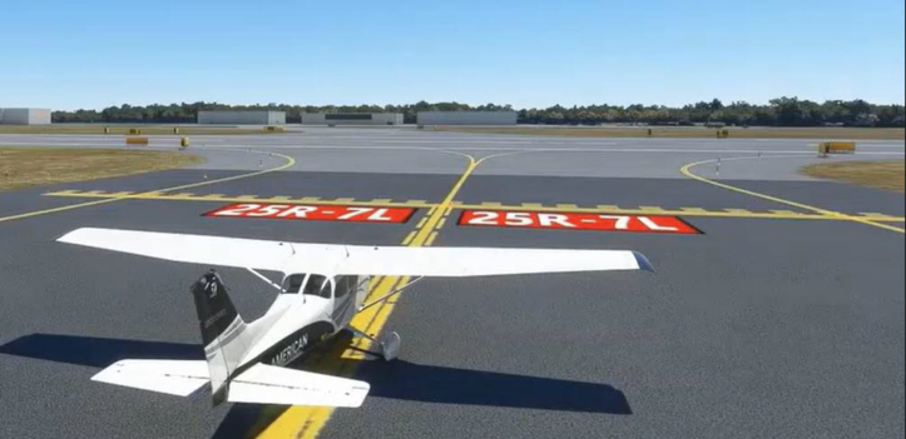
SAFETY
KNOWLEDGE POINT
You are holding short at Runway 7L at intersection R awaiting departure clearance.
Which direction will you turn to depart?
How can you be sure?
Notes:
PRESENTERS NOTES
Safety Knowledge Point:
You are holding and awaiting an intersection departure clearance for Runway 7L.
Which direction will you turn to depart?
How can you be sure?
Answer: You will turn the aircraft to the left to depart Runway 7L.
Ensure your compass heading is aligned with the 070 departure heading.
NO INTERSECTION DEPARTURES AT TRK

Slide 31
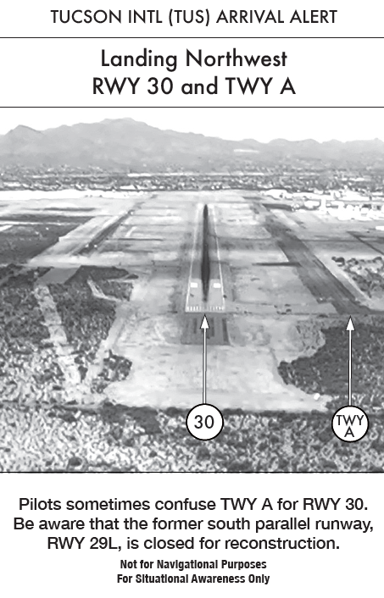
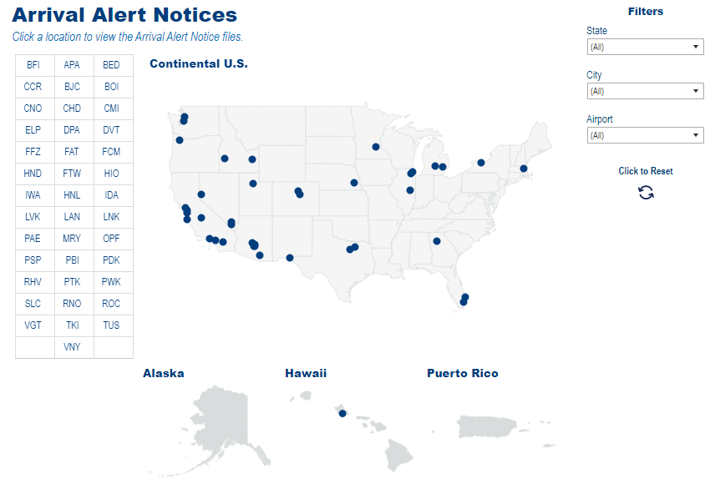
APA IWA
BED LAN
BFI LNK
BJC LVK
BOI MRY
CCR OPF
CHD PAE
CMI PBI
CNO PDK
DPA PSP
DVT PTK
ELP PWK
FAT RHV
FCM RNO
FFZ ROC
FTW SLC
HIO TKI
HND TUS
HNL VGT
IDA VNY
Help identify where aircraft line up to or land on a:
Taxiway, Incorrect Runway or Wrong Airport
Available at
Continental U.S.
New “Click to View” & “Drop Down Filter” features enabled.
https://www.faa.gov/airports/runway_safety/hotspots/aan
Notes:
PRESENTER NOTES
Talking Points:
To aid in reducing wrong surface operations in the NAS, Arrival Alert Notices (AAN) were created at airports with a history of misalignment risk.
These alert notices help increase pilot awareness at these 40 listed airports across the NAS.
The new “click to view” and “drop down” features on our Runway Safety website will help get you to a specific location and notice.
A QR code and weblink are provided at the end of the presentation that lead to the new Runway Safety Arrival Alert Notice website.

Slide 32
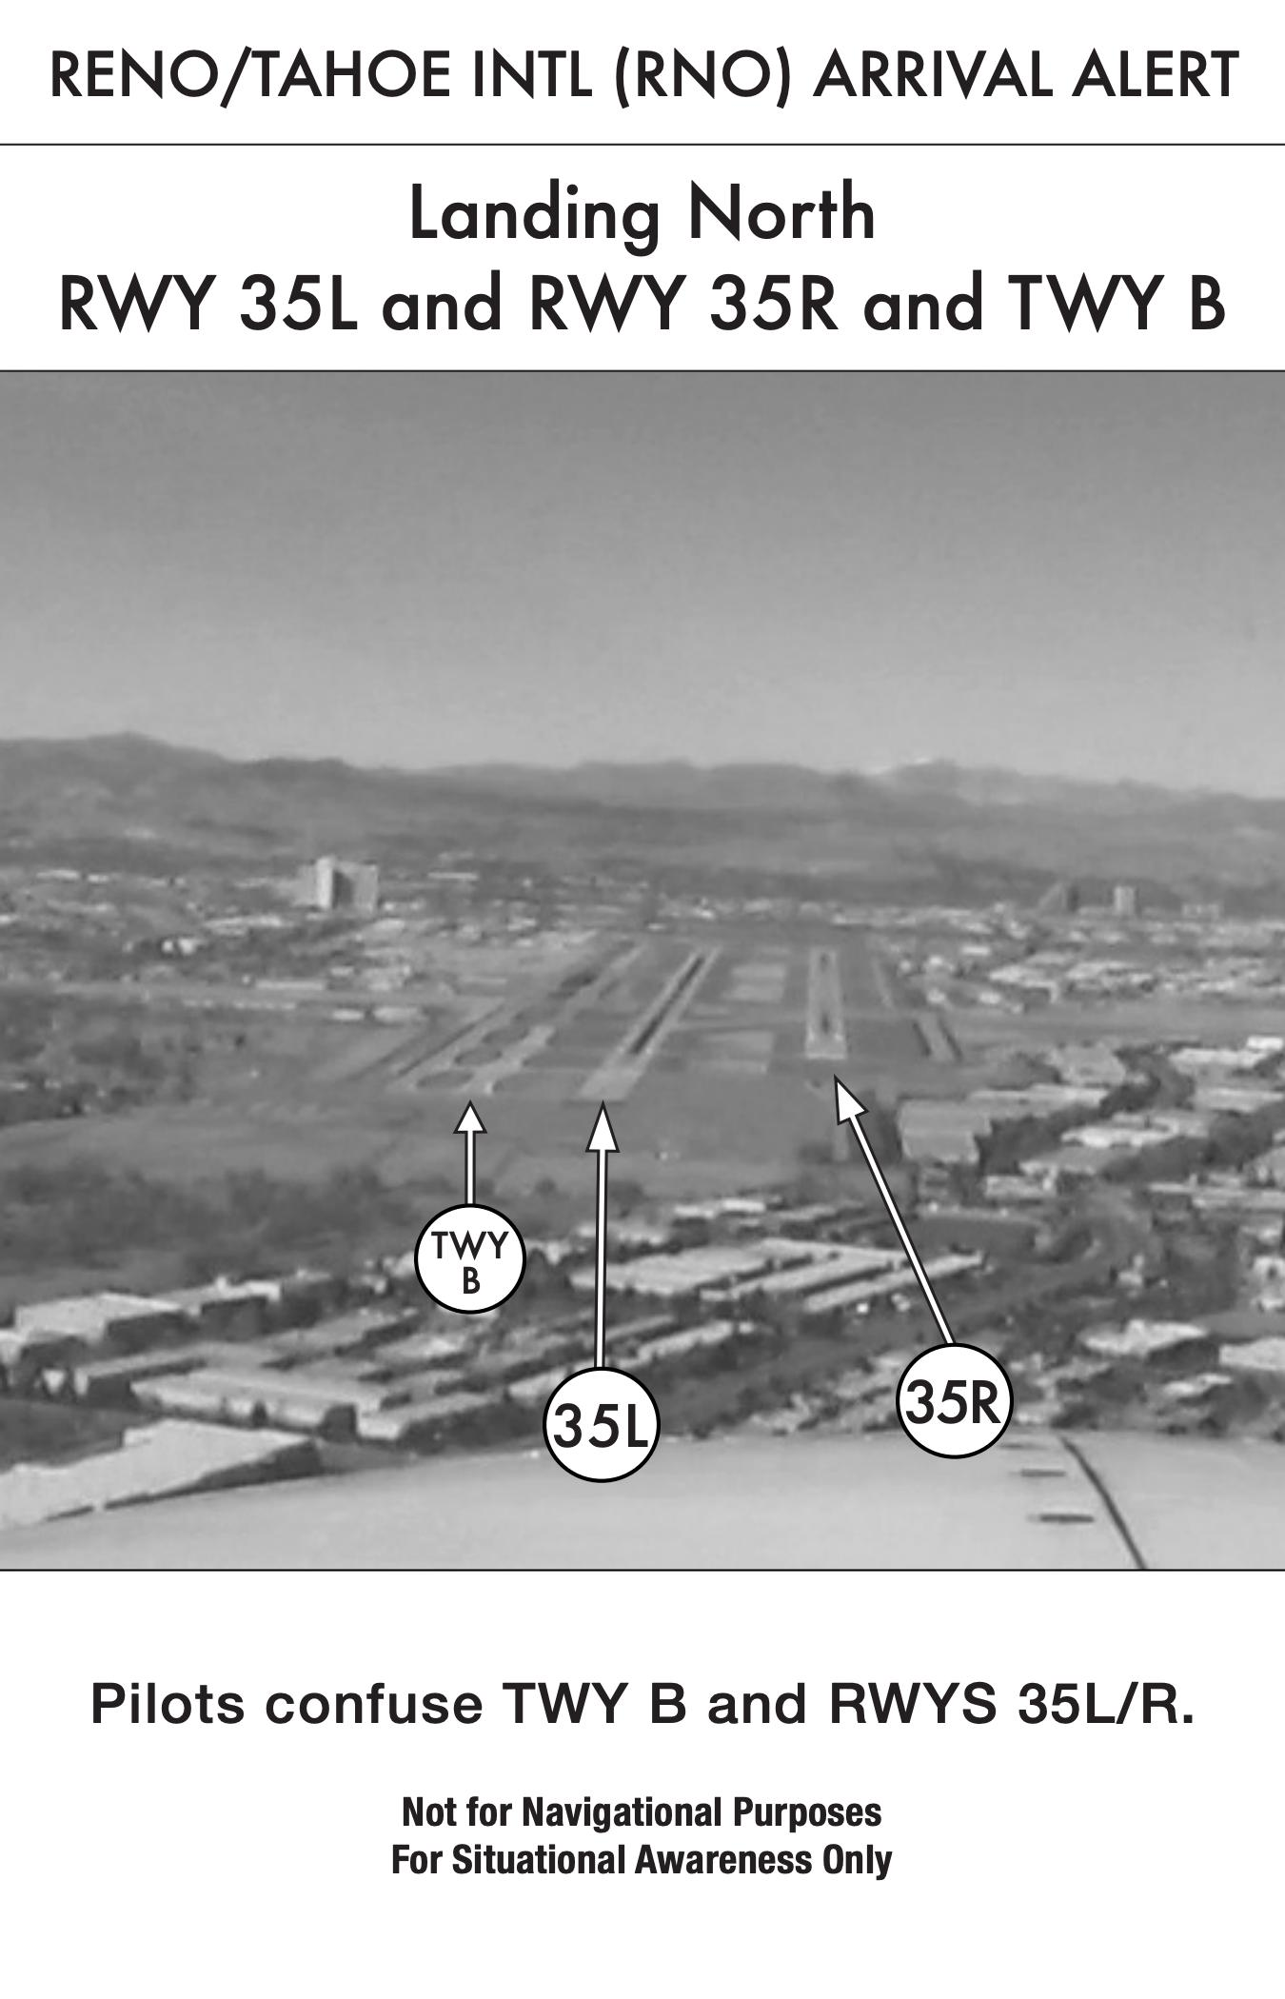
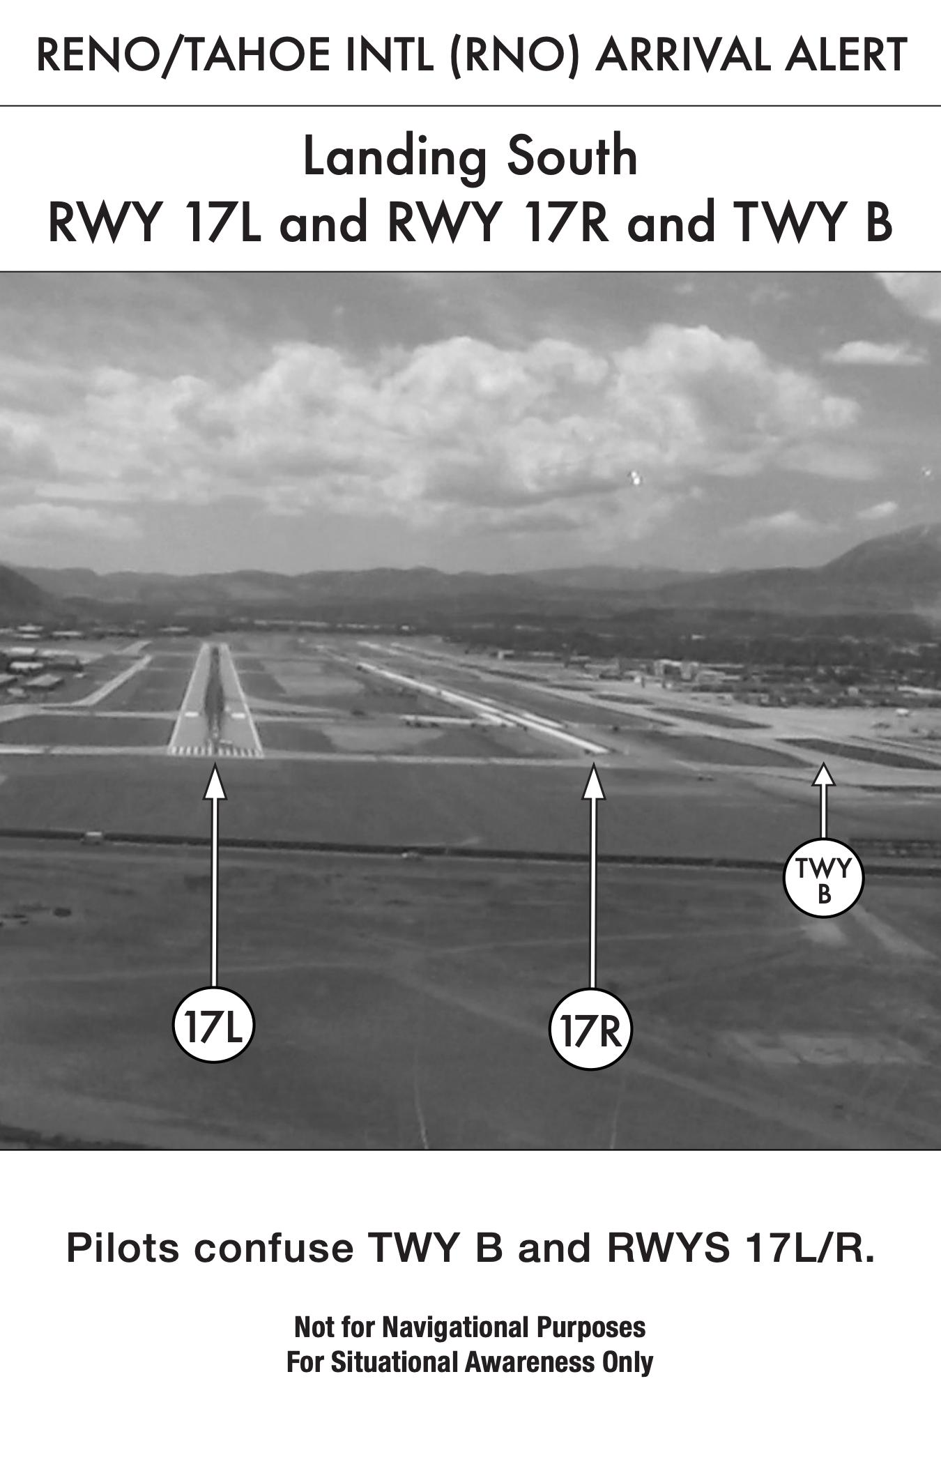
Notes:
PRESENTER NOTES​
The QR code leads to the Runway Safety Arrival Alert Notice website with links for each facility: https://www.faa.gov/airports/runway_safety/hotspots/aan
Even though TRK is not on the list of the 12 airports, continued diligence is still needed

Slide 33
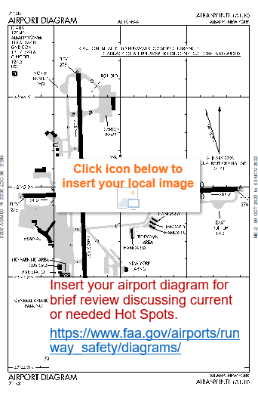

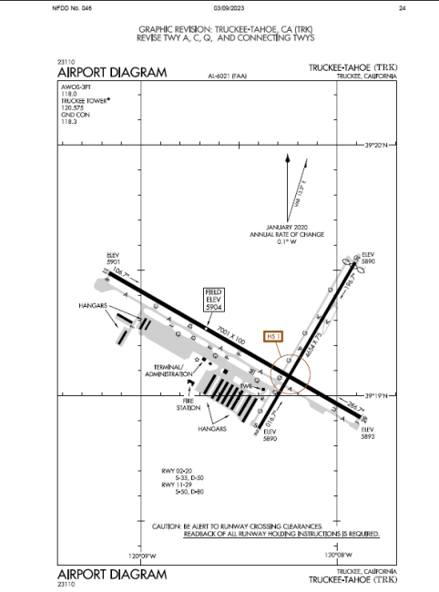
AIRPORT DIAGRAM & HOT SPOTS
Airport Diagrams provide situational awareness for pilots, airport staff, and airport ground vehicle operators in navigating runways, taxiways, and aprons.
  Hot Spots are a location on an aerodrome movement area with a history or potential risk of collision or RI, where heightened attention by pilots and drivers is necessary.
https://www.faa.gov/airports/runway_safety/diagrams/
Notes:
PRESENTER NOTES
Editing Instructions:
Use this slide for portrait shaped Airport Diagrams. Use the next slide for landscape shaped Airport Diagrams. Delete the unused slide.
Use FAA Airport Diagrams website at: https://www.faa.gov/airports/runway_safety/diagrams/ to access your diagram.
Insert an image of your Airport Diagram and any additional image or graphic that describes your airport.
Include additional information, if necessary.
Talking Points:
Review the FAA Airport Diagram with the group and any additional graphics or images you may have included.
Discuss any Hot Spots currently published at your airport and make sure everyone understands the risks they are addressing.
Are the Hot Spots effective? Are they still necessary? Are you working on ways to mitigate them? Are there any areas you think a Hot Spot might be needed?
Do the hotspot descriptions need to be updated? See if there are any ideas for addressing the risks in these locations (i.e.: procedural, signage, construction).
Are there any locations that may benefit from the heightened awareness of publishing a Hot Spot.
If construction/geometry changes are proposed, the Airport Operator and Airports Division (ADO) will need to be in agreement before entering as an action item.
Discuss movement and non-movement areas at your airport.
Discuss typical traffic flow that describe your airport – air carriers, GA, Airport Rescue Fire Fighter (ARFF) routes, etc.
Discuss any needed action to update your diagram with recent development or other airfield changes to reflect current conditions.
Applicable QR codes and weblinks can be found at the end of the presentation.
Presenter Tips:
Use a diagram that illustrates your hot spots, etc. Insert additional graphics as necessary to describe your airport.
To delineate movement and non-movement areas, reference local LOAs and current airfield maps.
Utilize construction notice diagrams to discuss construction, if applicable: https://www.faa.gov/air_traffic/flight_info/aeronav/aero_data/Apt_Constr_Notices/

Slide 34
Notes:
PRESENTER NOTES
Talking points:
The Airport Construction Advisory Council (ACAC) is a collaborative work group comprised of industry representatives (FAA, ATO, NATCA, ACI-NA, ALPA, AOPA, Airline Dispatchers, IATA, ICAO, NBAA) who help identify potentially dangerous situations during airport construction projects and work to implement ways to significantly mitigate accompanying risks.
ACAC is also responsible for creating graphical airport Construction Notice Diagrams (CND) that reflect certain runway and taxiway closures and restrictions for increased operational awareness and improved safety.
Additional Information:

Slide 35
AIRPORT CONSTRUCTION AWARENESS
NOTAMS
Are notices filed to alert airfield users of potential hazards or airfield conditions.
Are added and changed by the Airport Operator based on current conditions.
Are coordinated with ATC for awareness.
Can be further used to produce Construction Notice Diagrams known as CNDs.
https://notams.aim.faa.gov/notamSearch/
Notes:
PRESENTER NOTES
Talking points:
NOTAMS are notices filed by an Airport Operator to alert airfield users of potential hazards or airfield conditions.
NOTAMS are added or changed by the Airport Operator and should be coordinated with ATC.
Early construction coordination must include the ACAC and is verified during External Compliance Verification (ECV) inspections.
NOTAMs can be used to produce Construction Notice Diagrams known as CNDs.
The QR code and weblink at the end of this presentation directs you to the NOTAM search page.

Slide 36
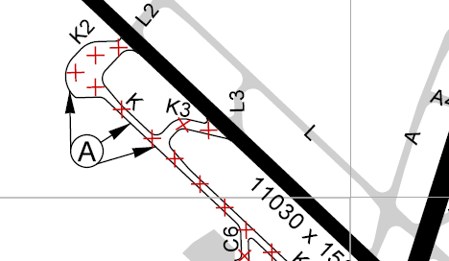
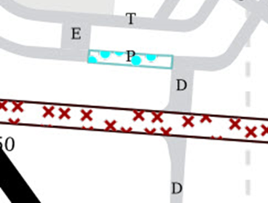
CONSTRUCTION NOTICE DIAGRAMS
CNDs . . .
Give airport users a visual depiction of runway & taxiway closures as well as operational restrictions lasting >24 hours
Do not replace traditional Airport Diagrams or other non-closure NOTAMs
Are updated daily based on issued NOTAMs
Can be found on ForeFlight
KEY:
Closures
Temporary restriction
Notes:
PRESENTER NOTES
Talking Points:
In general, CNDs illustrate on an airport diagram current runway and taxiway closures and restrictions lasting over 24 hours.
Partial runway closures, declared distances and restricted operating areas are also depicted visually for improved awareness as shown here.
Utilize Construction Notice Diagrams to discuss construction, if applicable:
https://www.faa.gov/air_traffic/flight_info/aeronav/aero_data/Apt_Constr_Notices/

Slide 37

CONSTRUCTION NOTICE DIAGRAMS
CNDs
Can be found on the NOTAM website at applicable airports.
Open to search for your airport NOTAMs.
Look for this construction symbol , on the left of the top row
If available, under Condition, click on "ON AIRPORT – SEE CONSTRUCTION GRAPHIC" on the right of the top row to download your airport’s CND
https://notams.aim.faa.gov/notamSearch/
https://notams.aim.faa.gov/notamSearch/
Notes:
PRESENTER NOTES
Talking Points:
FAA is transitioning to an automated CND process using NOTAM Manager to streamline coordination.
The yellow and black construction symbol shown here along with "ON AIRPORT – SEE CONSTRUCTION GRAPHIC" are found at the top of airport specific NOTAMs when applicable.
Under "Condition", Click "ON AIRPORT – SEE CONSTRUCTION GRAPHIC" in the NOTAM Search to download the airport CND for closed and/ or restricted airfield surface viewing.
Actually click on the link and show the participants what the CNDs look like.
NOTAM Search is found at: https://notams.aim.faa.gov/notamSearch
The current and automated CNDs website: https://notams.aim.faa.gov/fnsprintservice/cndServlet
Automated CNDs may be slow in loading, be patient.

Slide 38
AIRPORT CONSTRUCTION
BEST PRACTICES
Coordinate construction plans early among the Airport Operator, ATCT and Airport Construction Advisory Council (ACAC.)
Email Plans to ACAC
at: ConstructionCouncil@faa.gov
Provide briefings
& training for controllers and tenants.
Meet with your Local Safety Council (LSC) to discuss alternate procedures/ taxi routes.
Coordinate with Quality Control Group (QCG) for Safety Management System (SMS) requirements.
Use resources & checklists found on the Runway Safety Webpage under the Runway Construction Section.
Set up an after-action review to determine what worked and what did not.
Use NOTAM Manager
when available at your airport for Automated CNDs.
Notes:
PRESENTER NOTES
Talking Points:
Coordinate construction plans early among the Airport Operator, ATCT and ACAC.
Email ACAC at: ConstructionCouncil@faa.gov.
Provide briefings & training for controllers and tenants.
Meet with your Local Safety Council (LSC) to discuss alternate procedures/taxi routes.
Coordinate with Quality Control Group (QCG) for Safety Management System (SMS) requirements.
Use resources & checklists found on Runway Safety Webpage under the Runway Construction Section.
Set up an after-action review to determine what worked and what did not.
Use NOTAM Manager when available at your airport for Automated CNDs.

Slide 39
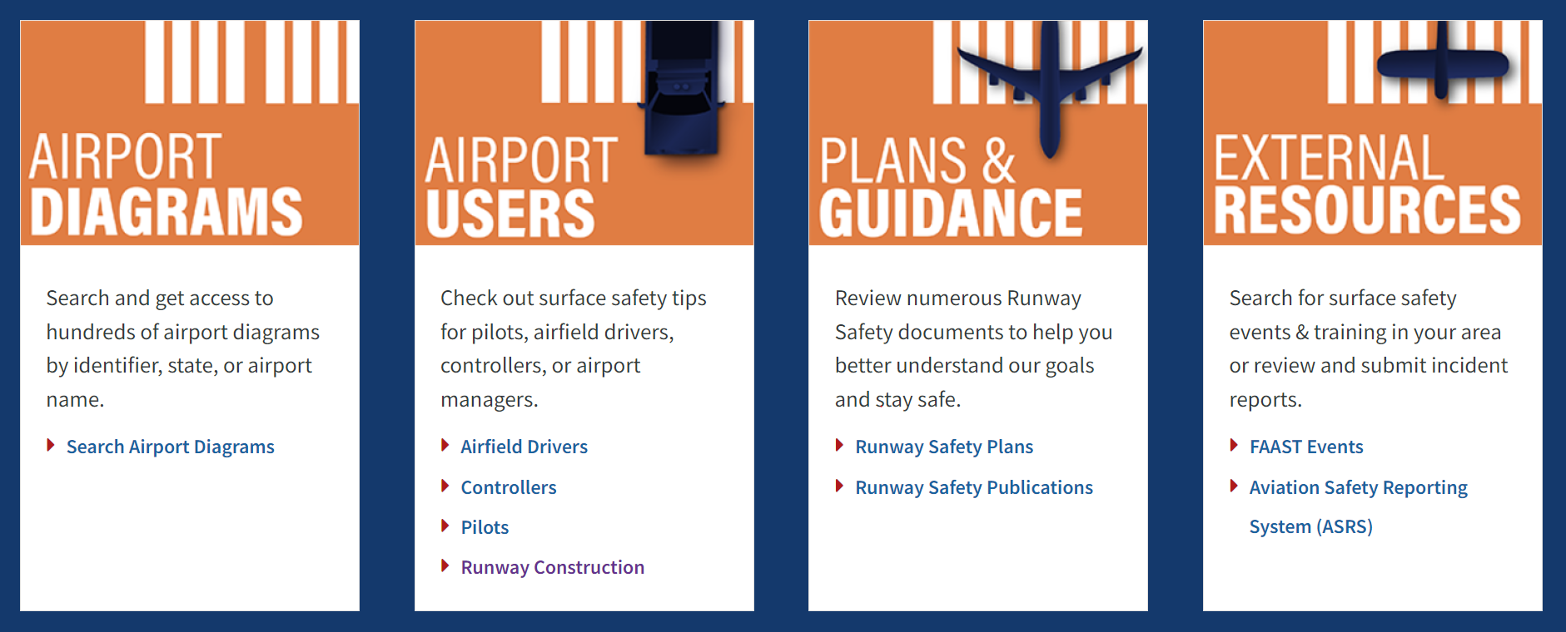
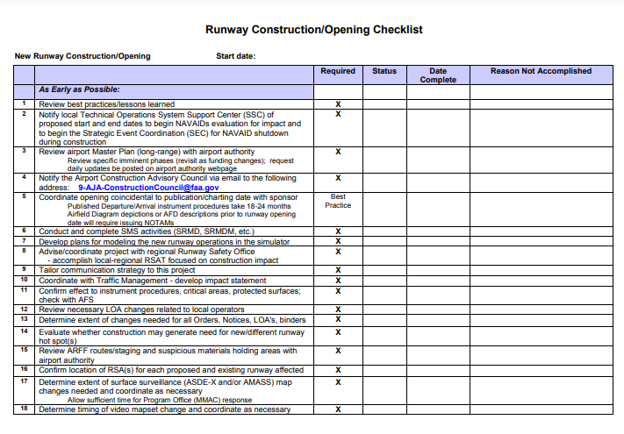
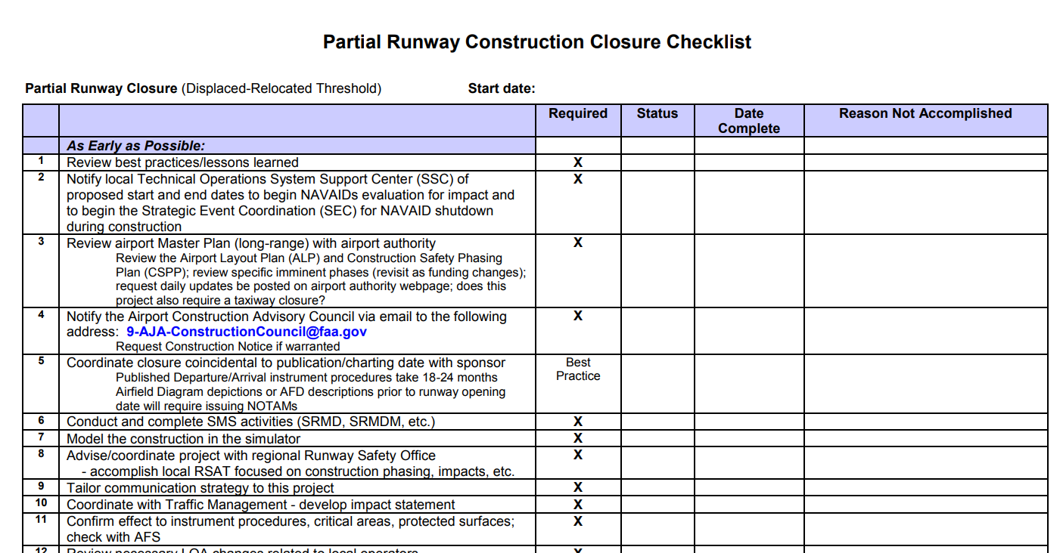
RUNWAY SAFETY
RESOURCES
Airfield Construction Checklists
Complete Runway Closure Checklist
New Runway Construction/ Opening Checklist
Runway/ Taxiway Opening (Re-Opening) Checklist
Taxiway Construction Checklist
Partial Runway Construction Closure Checklist
Taxiway Re-Labeling Checklist
Runway Decomissioning Checklist
https://www.faa.gov/airports/runway_safety
Notes:
PRESENTER NOTES
Talking Points:
Many resources are available on the Runway Safety Web site.
Under Airport Users, click "Runway Construction" to access airfield construction checklists
Per Order 7210.3 (paragraph 10-3-2, Airport Construction) early construction coordination with ACAC is required by the Air Traffic Manager (ATM.)
Each project update must also be coordinated with ACAC to properly reflect varying surface closures on your CND.

Slide 40
SAFETY MANAGEMENT & SAFETY RISK SYSTEMS
SMS & SRM
Safety Management Systems (SMS) is the formal, top-down, FAA-wide approach to managing safety risk and assuring the effectiveness of safety risk controls that include systematic procedures, practices, and policies for the management of safety risk.
Safety Risk Management (SRM) is one of the four components of SMS that enables the FAA to manage safety within the National Airspace System (NAS) helping to identify hazards, analyze and assess safety risk, and develop controls to reduce safety risk to an acceptable level.
Both, Office of Airports (ARP) and Air Traffic Organization (ATO) require SRM, but each have separate procedures. In short, when a triggering change is made to that could affect safety of the NAS, some level of SRM needs to occur.
Airport Managers/ Operators
can find more ARP SRM information via your Airports Regional or District or at:
https://www.faa.gov/airports/airport_safety/safety_management_systems
Air Traffic Managers
can find more ATO SRM information through your Service Area Quality Control Group at:
https://my.faa.gov/org/linebusiness/ato/safety/sms/srm/pre-panel (for internal FAA use)
Notes:
PRESENTER NOTES
Talking points:
Safety Management Systems (SMS) is the formal, top-down, FAA-wide approach to managing safety risk and assuring the effectiveness of safety risk controls that include systematic procedures, practices, and policies for the management of safety risk.
Safety Risk Management (SRM) is one of the four components of SMS that enables the FAA to manage safety within the National Airspace System (NAS) helping to identify hazards, analyze and assess safety risk, and develop controls to reduce safety risk to an acceptable level.
Both, Office of Airports (ARP) and Air Traffic Organization (ATO) require SRM, but each have separate procedures. In short, when a triggering change is made to that could affect safety of the NAS, some level of SRM needs to occur.
ARP and ATO SMS info and contact data is on the slide and on the weblink list at the end of the presentation.

Slide 41
LOCAL CURRENT AND PLANNED
CONSTRUCTION
A brief overview of any construction projects planned for the upcoming year.
      Apron A2 – Estimated completion Fall 2025
      Reconstruct RY11/29 east of RY2/20
Notes:
PRESENTER NOTES​
​Editing Instructions:
XXXXX Modify this slide with current and/ or planned construction information, pictures or graphics.
Duplicate this slide as needed to add diagrams or images, if applicable. Blank slides are available for use at the end of the presentation for use to maintain presentation formatting.
Delete any unnecessary content before presenting.
Talking Points:​
​Provide information on Current and Planned Construction at your airport.​
Discuss changes in traffic flow that will be impacted by the upcoming construction project(s). ​
​
Presenter Tip:​
If your airport operator is willing, this may be a good section for them to present to the team. ​
If changes need to be made, you can capture that as an action item.​
Ensure you have contacted the ACAC for best practices to your construction project(s). ACAC can be contacted via constructioncouncil@faa.gov ​
​

Slide 42
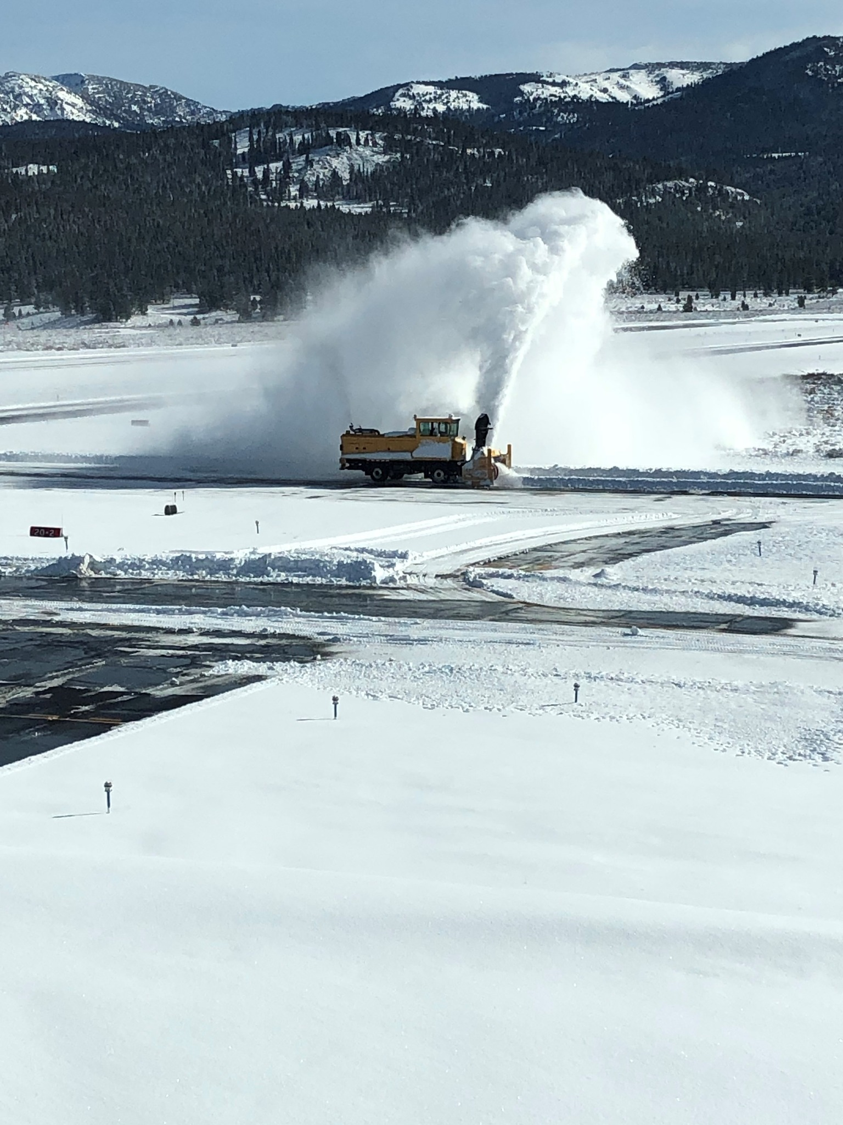
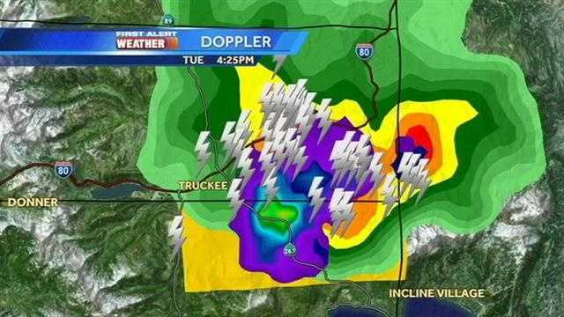
LOCAL AREA
WEATHER
Discuss weather conditions that affect safety on your airfield.
      Is sun glare a safety factor?
      Are there areas where ponding/ standing water impacts surface safety?
      How is cumulating snow/ ice addressed to minimize sign/ marking obscurity?
      Do you utilize Take-Off and Landing Performance Assessment (TALPA) practices at your facility?
(You may add photos of weather-related issues at your airport.)
      Thunderstorms, snow, fog, and wind.
      Airfield visibility from the tower.
Notes:
PRESENTER NOTES​
Talking Points:​
​Discuss challenges and the mitigations you use to counteract local weather challenges.​
Are there any specific weather-related issues that affect surface safety? Glare, Ponding, Snow, Fog, Visibility from the tower, etc.​
Discuss how to raise awareness and possibly identify mitigations.​
Does your facility participate in TALPA? Takeoff and landing Performance Assessment
TALPA is a method used by airport operators to determine runway conditions for take-off and landing. It produces a Field Condition report which allows pilots to determine braking action when the runway is not dry.
TALPA assessment produces a Runway Condition Code (RWYCC) from 6 to 0, where 6 is Dry, and 0 is Nil, meaning braking action is minimal to non-existent.
Separate runway condition codes are published for each third of a runway, and pilots use a Runway Condition Assessment Matrix (RCAM) to calculate their aircraft performance.[1]
TALPA was introduced by the United States Federal Aviation Authority (FAA) in 2016.[1] The TALPA matrix was superseded by the ICAO Global Reporting Format (GRF), which was based on TALPA and was adopted on 4 November 2021.
Presenter Tip:​
If you have any weather-related issues at your airport, please insert actual photos, if possible. This is a good place to insert pictures of your airport that can illustrate the challenge.​
Ask your airport operator or Tech Ops counterparts if they have pictures or can help you obtain them.​

Slide 43
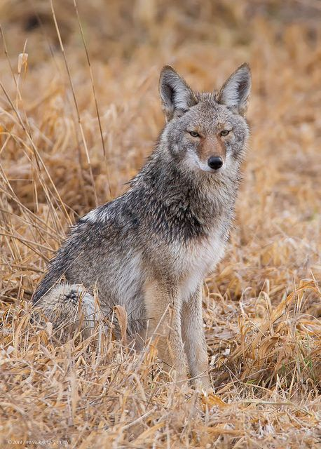
LOCAL AREA
WILDLIFE HAZARDS
The following are wildlife hazards specific to this airport:
Deer, bears, coyotes
Migratory birds, coyotes
Grasshoppers, coyotes
(You may add photos of wildlife-related issues at your airport. Discuss the process for reporting wildlife and/or bird strikes at your facility)
Describe movement controls, and procedures for the responsible airport drivers involved in active or preventative wildlife mitigation measures.
Notes:
PRESENTER NOTES​
Talking Points:​
Who conducts wildlife mitigation at your airport?
What does the training consist of for the persons given authority to operate on the movement area for the purpose of wildlife mitigation?
Discuss what it looks like in real life when wildlife is reported at the airport?
What directive (LOA or Order) governs the control of vehicles or personnel operating on the airport to mitigate wildlife hazards.
Discuss wildlife hazards specific to your airport: waterfowl, migratory birds, deer, coyotes, etc. ​
Discuss specific times of the year or other conditions that precipitate the risk and what you currently do to mitigate and spread awareness:​
Do you have a wildlife mitigation plan in place?​
Personnel dedicated to those efforts (USDA)?​
Point of contact for reports?​
​
Presenter Tip:​
If you have any wildlife issues at your airport, please insert photos, if possible. This is a good place to insert pictures of your airport that can illustrate the challenge.​
Ask other members of your team if they have pictures or can help you obtain them.​
If changes need to be made, you can capture that as an action item.​

Slide 44
TRAINING AND OPERATIONS
AIRFIELD DRIVERS
      Review of driver policies, procedures, and training
      Who can access the airfield?
      How is training conducted for various airfield users, i.e. police/ security, fire fighters/ emergency responders, wildlife agents?
      Who do you contact if someone accesses the airfield without permission?
Notes:
PRESENTER NOTES
Talking points:
Review local airfield driver training requirements, best practices and concerns from the slide.
Discuss vehicle equipment enhancements or electronic tracking devices or "apps" that can offer improved driver situational awareness. Speak to your local ADO for possible funding.
The QR codes shown here lead to videos that can be viewed for improved driver awareness among local airfield drivers and tenants.
If you choose, click one and download to view at your RSAT if you choose:
Situational Awareness: https://youtube.com/watch?v=gTc-SZi9nk8&feature=share
Phraseology: https://www.youtube.com/watch?v=lLHsgz3aWZY
Winter Ops: https://youtube.com/watch?v=FNgAN1tHJUE&feature=share

Slide 45
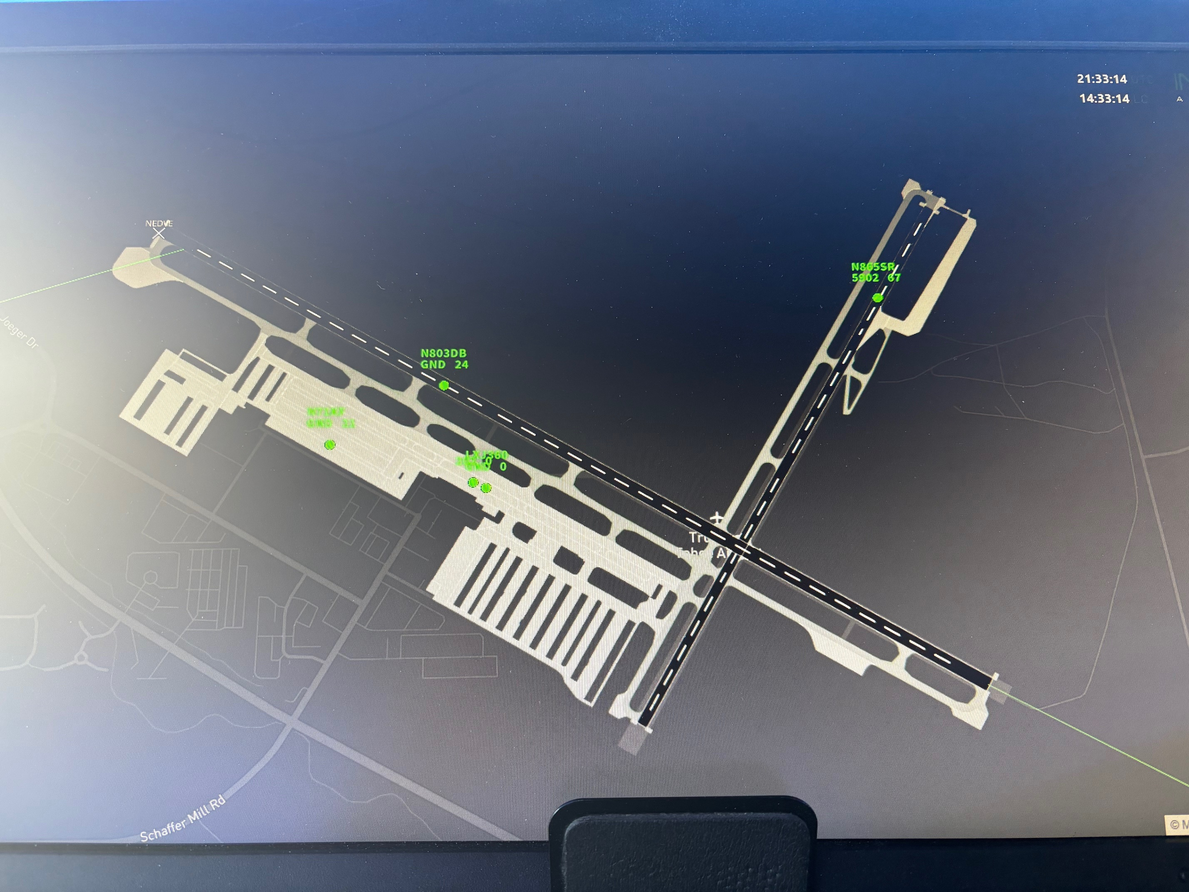
TRAINING AND OPERATIONS
AIRFIELD DRIVERS
      Review of driver policies,
      procedures, and training
Do vehicles have tracking devices?
Tower display

Slide 46
LETTERS OF AGREEMENT
AFFECTING SURFACE OPERATIONS
      Have LOAs been reviewed and updated annually as required?
      Do you have a stand-alone RSA LOA on file per 7210.3, 3-4-1?
TRK/TTAD Movement and Non-Movement Areas and Control of Vehicles
TRK/TTAD Reporting Airport Conditions
TRK/TTAD Requirements for Operating in Runway Safety Areas
Airport Emergency Services
      Other LOAs
Notes:
PRESENTER NOTES
Talking points:
Discuss pertinent information about LOAs or published notices relating to surface operations.
Have your LOAs been reviewed/ updated as required annually? - When were they last updated?
If review or update is needed, include as an Action Item. - Are they current and accurate?
Do you have a current RSA LOA addressing Personnel and Equipment in the RSA as required by 7210.941?
Your RSA LOA should:
Be stand alone,
Include training of responsible parties,
Outline communication procedures among parties,
Have minimum signatures by Operator, ATCT and Tech Ops (where Tech Ops operations occur on airport),
Include RSA dimensions for each runway on an airfield map

Slide 47
LOCAL UPCOMING
SPECIAL EVENTS
The following are events scheduled at this airport:
Fly Safe Clinics. Next month Juan Browne
American Century Celebrity Golf Tournament
Truckee Tahoe Soaring Association Contests
Notes:
PRESENTER NOTES​
Talking Points:​
​Discuss any Special Events happening in the upcoming year.
Examples: air shows, fly-ins, sporting events, etc.
Anything that might disrupt normal operations at the airport. ​
​
Presenter Tip:​
Make sure tenants and users are aware of any special procedures or surface closures that may occur as a part of the event. ​
Discuss participation in the events. Talk about how these events benefit the airport and the community.​
Discuss if any of these events are linked to outreach efforts.​

Slide 48
      Enter reported safety issues from local pilots, tenants,
      stakeholders, Pilot-Controller Forums, etc. for discussion
      Any known areas of non-visibility in movement areas from the tower?
      Any known areas of intermittent communication/technology/frequency
      interruption? (ATIS)
      Taxiway Romeo and Quebec markings
      Runway assignments not being readback
Notes:
PRESENTER NOTES
Talking points:
XXXXX Note local issues carried forward from local pilots, stakeholder, tenant, Pilot-Controller Forums, etc. meetings.
(Some possible topics are shown to initiate the discussion.)
Encourage discussion of previously noted or known issues that may require an action item or local follow up.
Include these discussion notes and decisions in the RSAP.
Are there any user concerns? this is your opportunity to share your observations and questions about operations on this airport
All Runway Safety concerns brought up and discussed will be reviewed again near the end of the meeting at the time of creating Action Items.

Slide 49
LOCAL RUNWAY SAFETY BEST PRACTICES
FOR PILOTS
      Enter best practices at your facility for discussion
      Please readback assigned runways and hold short instructions
      Ask for progressive taxi instructions
Notes:
PRESENTER NOTES
Editing Instructions:
XXXXX add LOCAL best practices for PILOTS.
Talking points:
Discuss local best practices for PILOTS.
Are there any user concerns?” “this is your opportunity to share your observations and questions about operations on this airport”
All Runway safety concerns brought up and discussed will be reviewed again near the end of the meeting at the time of creating Action Items.

Slide 50
LOCAL RUNWAY SAFETY BEST PRACTICES
FOR CONTROLLERS
      Enter best practices at your facility for discussion
      Open Ground Control before it gets busy.
      Use checklist and memory aids.
      Have vehicles use tower frequency when conducting runway checks.
Notes:
PRESENTER NOTES
Editing Instructions:
XXXXX add LOCAL best practices for CONTROLLERS
Talking points:
Discuss local best practices for CONTROLLERS
Are there any user concerns?” “this is your opportunity to share your observations and questions about controller operations on this airport”
All Runway Safety concerns brought up and discussed will be reviewed again near the end of the meeting at the time of creating Action Items.

Slide 51
LOCAL RUNWAY SAFETY BEST PRACTICES
FOR DRIVERS
      Enter best practices at your facility for discussion
      Wait to start runway checks until the tower is open, if possible.
      For other than runway crossings, use tower frequency while on the runway.
Notes:
PRESENTER NOTES
Editing Instructions:
XXXXX add LOCAL best practices for DRIVERS
Talking points:
Discuss local best practices for DRIVERS
Are there any user concerns?” “this is your opportunity to share your observations and questions about driver operations on this airport”
All Runway Safety concerns brought up and discussed will be reviewed again near the end of the meeting at the time of creating Action Items.

Slide 52
RUNWAY SAFETY ACTION PLAN
RSAP
      Action items are non-regulatory, voluntary, and flexible.
      The responsible parties for implementing and/or funding the Action Item must be in agreement with the Action Item.
      Your RSAP is due to your RSPM within 45 days from today for review and acceptance.
      Report Action Item updates & closures to your RSPM as completed.
Notes:
​PRESENTERS NOTES
Talking Points: ​
​Discuss any Actions you intend to take in the coming year(s) to improve surface safety at your airport.​
Capture these in your Runway Safety Action Plan (RSAP) either as discussion items, recommendations or Action Items. ​
Action Items require agreement from the responsible party, and should be Specific, Measurable, Attainable, Relevant, and Time-bound (SMART). ​
Has the discussion today highlighted local surface safety issues to be addressed?
What opportunities to improve surface safety at your airport have been identified? Review notes and any items in the “holding pattern.”​
​
Presenter Tip:
What makes a good action item?
It must be clear
It must be reasonable & "doable"
It should identify a potential runway incursion risk or safety problem/concern and provide a mitigation strategy
It must be accepted by the organization responsible for accomplishing the action
Action Items may include (but not limited to):
Potential Hot Spots
Training
Procedure
Airport Markings, Signage or Lighting
Airport Geometry
New Technology
Action Items should NOT include:
Projects associated with any improvements/change already in place for future implementation
Any ongoing or continuous process without a feasibility study
Discrepancies identified during PART 139 inspections
Technology already approved for your airport
Upgrade to FBOs, Hangars, storage buildings, fuel farms and Terminals
Note: If you need help coordinating action items across lines of business, contact your Regional Runway Safety Program Manager. Coordination should occur before submitting your RSAP, or it should be noted that the action item is contingent upon coordination with the appropriate party.​

Slide 53
Enter Open Action Items below.
Discuss progress updates and
review planned completion.
Assigned Action Item Code:
Action Item Description: XXX
Status: XXX
Completion Date: XXX
Assigned Action Item Code: XXX-YYYY-00#
Action Item Description: XXX
Status: XXX
Completion Date: XXX
Notes:
PRESENTER NOTES​
​
Editing Instructions:
Modify this slide with information on current OPEN Action Items for your airport.
The current action items will be uploaded as an attachment to your RSAT meeting date in the KSN Calendar or provided by your RSPM.
Delete any unnecessary content before you modify the slide.
Talking Points:​​
Discuss current OPEN Action Items for your airport.​
Encourage a discussion that includes current progress.
Provide a status update as part of your Runway Safety Action Plan (RSAP).​
​
Presenter Tip:​
Your current action items should also be uploaded as an attachment to your RSAT meeting date in the KSN Calendar. ​

Slide 54
Enter New Action Items here.
Discuss project details, responsibilities
and planned completion.
Action Item Description: Describe item
Action Item Rationale: Issue/concern
Estimated Completion Date: Month/Day/Year
POC Organization: Operator/ ATCT
POC name: First & Last Name
POC phone: xxx.xxx.xxxx
POC email: xxxxxx.xxxx@xxx.xxx
Notes:
PRESENTER NOTES​
Editing Instructions:
Modify this slide with information on the NEW Action Items for your airport.
Delete unnecessary notes before you modify the slide.
Talking Points: ​
Discuss concerns shared at the meeting that you want to make an action item.
Each action item MUST include the details shown here and be included in your RSAP.
Presenter Tip:
If you need help coordinating action items across lines of business, contact your Regional Runway Safety Program Manager. Coordination should occur before submitting your RSAP, or it should be noted that the action item is contingent upon coordination with the appropriate party.
Policy guidance and reference notes: From FAA Order 7050.1B Runway Safety Program:​
Specific Action Items. Action items should be airport specific and linked to a runway safety concern, issue, or problem at the airport. Consensus is desirable for assignment of an action item, and at a minimum the organization responsible for accomplishing the action must agree to accept the action. Proposed action items where consensus is not reached and/or the action office is not willing to accept the item may be documented as recommendations at the discretion of the RRSPM or ATCT manager. Action items should fall within the authority of the local, regional, or service area level. The RRSPM will forward action items that require national implementation to the Manager, Runway Safety Group, through the Service Area Team Manager. Action items for nonstandard facilities or procedures will be investigative only (i.e., investigate use of) until approval is obtained from the FAA regional or service area office organization that has the authority to grant waivers or modifications to the standard. Action items may include, but are not limited to: ​
(a) Changes in physical features/facilities of the airfield. ​
(b) Air traffic control procedures. ​
(c) Airfield access requirements. ​
(d) Pilot/vehicle operator awareness. ​
(5) A proposed implementation schedule for each action item. ​
(6) The party/parties responsible for implementing each action item. ​
(7) A review of open action items and any completed since the last RSAT meeting. ​
(8) A current airport diagram.
What makes a good action item?
It must be clear
It must be reasonable & "doable"
It should identify a potential runway incursion risk or safety problem/concern and provide a mitigation strategy
It must be accepted by the organization responsible for accomplishing the action
Action Items may include (but not limited to):
Potential Hot Spots
Training
Procedure
Airport Markings, Signage or Lighting
Airport Geometry
New Technology
Action Items should NOT include:
Projects associated with any improvements/change already in place for future implementation
Any ongoing or continuous process without a feasibility study
Discrepencies identified during PART 139 inspections
Technology already approved for your airport
Upgrade to FBOs, Hangars, storage buildings, fuel farms and Terminals
Note: If you need help coordinating action items across lines of business, contact your Regional Runway Safety Program Manager. Coordination should occur before submitting your RSAP, or it should be noted that the action item is contingent upon coordination with the appropriate party.

Slide 56
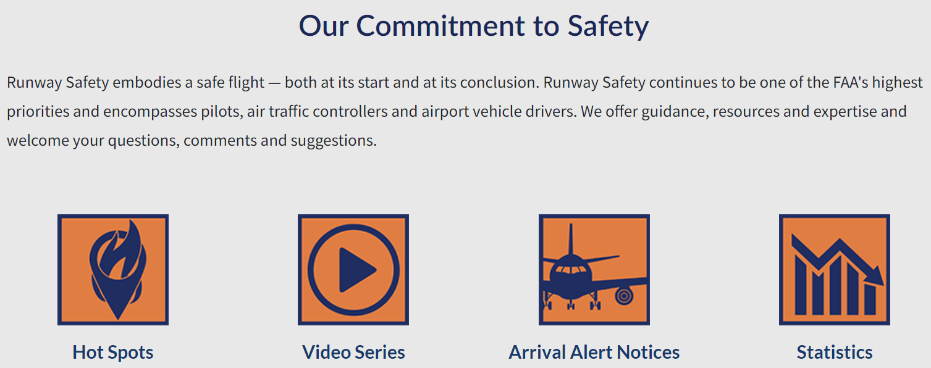
RUNWAY SAFETY PROGRAM WEBSITE
OUR COMMITMENT TO SAFETY
Runway Safety embodies a safe flight – both at its start and at its conclusion. Runway Safety continues to be one of the FAA’s highest priorities and encompasses pilots, air traffic controllers and airport vehicle drivers.
https://www.faa.gov/airports/runway_safety
Notes:
Runway Safety Website Links to:
Hot Spots
From the Flight Deck Videos and Pilot Handbooks
Arrival Alert Notice (AAN)
Statistics
Link and qr code found on the weblink list at the end of the presentation.

Slide 57
RUNWAY SAFETY PROGRAM WEBSITE
RUNWAY SAFETY RESOURCES
https://www.faa.gov/airports/runway_safety
Notes:
Runway Safety Website Links to:
Airport Diagrams
Airport Users (construction, info for Airfield Drivers, Pilots and Controllers)
Plans & Guidance
External Resources
Link and qr code also found on the weblink list at the end of the presentation.

Slide 58
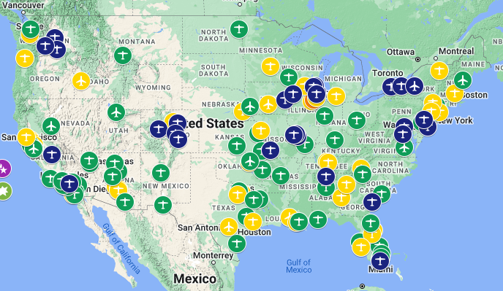
FROM THE FLIGHT DECK VIDEOS & PILOT HANDBOOKS
SAFETY RESOURCES
Over 125 From the Flight Deck Videos Available
Search for
Pilot Handbooks
using the
3-letter ID at:
www.faa.gov/XXX
From the Flight Deck Video Available
From the Flight Deck Video In Progress
From the Flight Deck Video &
Pilot Handbook Available
Pilot Handbook Available
Notes:
PRESENTER NOTES
Talking points:
Pilot Information Booklets aim to compile pilot information discussed in From the Flight Deck airport specific videos and various aviation sources into one digital, compact resource for pilots.
These are a few of the pilot information booklets already published.
Other airports are being produced and released as completed.
Newly released information booklets can be found online by using the primary link above and adding the 3-letter identifier.
Link also found on the weblink list at the end of the presentation.

Slide 59
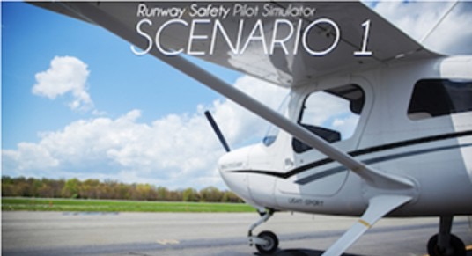


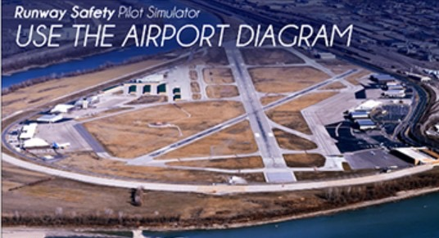
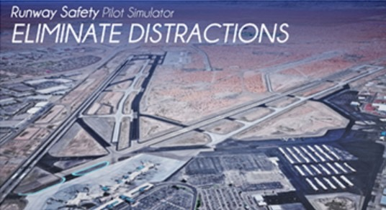
RUNWAY SAFETY
PILOT SIMULATOR
An interactive safety simulator based on actual surface events
Notes:
PRESENTER NOTES
Talking points:
The FAA Pilot Simulator is an interactive safety simulator based on actual surface events.
This animated video series is a self-guided resource to assist student pilots in surface safety best practices.
It allows student pilots (and even drivers) to navigate on airport surfaces while communicating with air traffic control and following instructions provided.
Encourage others to view on their own.
The QR code goes to the various interactive videos: http://faarunwaysafetysimulator.com/
QR code and Link also found on the resource lists at the end of the presentation.

Slide 60
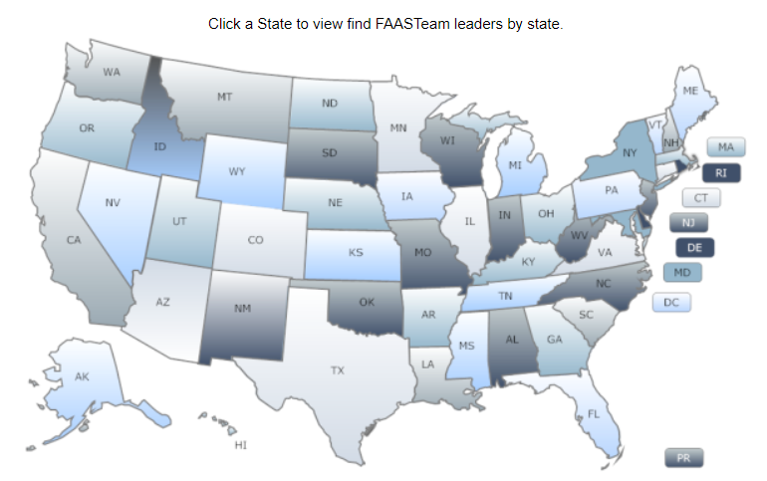
FAA FLIGHT STANDARDS SAFETY TEAM
FAASTeam
Develops standardized safety interventions for General
Aviation, and may support other safety initiatives such as:
UAS, NextGen, Runway Safety, The General Aviation Joint Steering Committee (GAJSC) Safety Enhancements
FAASTeam Program Mgr (FPM) responds to localized safety issues through:
Accident/incident reports involving airmen from the area
Hazards identified by FAA Inspectors at local Flight Standards District Offices
Information from the local aviation community
Local Pilot/ Controller Forums
Notes:
PRESENTER NOTES
Ask the FAASTeam rep to attend and review this and the following slide.
If no attending FAASTeam Rep, review the slide content for them.

Slide 61
FAA FLIGHT STANDARDS SAFETY TEAM
FAASTeam
A FAASTeam Member is anyone who promotes aviation safety and becomes part of the shift in safety culture
To become a member:
Sign-up – https://www.faasafety.gov/
Participate in our new WINGS Program (Pilots)
Participate in the new automated AMT Awards Program (Mechanics)
Attend live FAASTeam webinars or events in your area
Notes:
PRESENTER NOTES
Ask the FAASTeam rep to attend and review this and the following slide.
If no attending FAASTeam Rep, review the slide content for them.

Slide 62
Coffee with a Controller and ATC101
NEXT RSAT
When: TBD
When: August 2026
Location:
Truckee-Tahoe Airport
Location:
Truckee-Tahoe Airport
Notes:
PRESENTER NOTES
Talking points:
Consider future plans to conduct a Pilot-Controller Forum (PCF) to reach local and regional pilots operating at your airport.
Coordinate with your local FAASTeam Rep to plan and conduct these meetings.
Carry forward local issues for discussion at your PCF and annual RSAT.

Slide 63
CLOSING
YOUR OPPORTUNITY TO SAY SOMETHING
Notes:
PRESENTER NOTES
Talking points:
Offer a moment to share any last comments from participants.
Remind attendees to sign in for you in the chat, email, etc. to include in your RSAP.

Slide 64
CONSTRUCTION:
NOTAMs: https://notams.aim.faa.gov/notam
Search/disclaimer.html
CND: https://www.faa.gov/air_traffic/flight_
info/aeronav/aero_data/Apt_Constr_Notices/
Checklist: https://www.faa.gov/airports/
runway_safety/runway_Construction/
ACAC mailbox: 9-AJA-ConstructionCouncil@faa.gov
FAA WEBSITES/ LINKS:
Airport Diagram: https://www.faa.gov/airports/
runway_safety/diagrams/
Pilot Simulator: http://faarunwaysafetysimulator.com/
AAN: https://www.faa.gov/airports/runway_safety/hotspots/aan
EMAS/ RIM: https://www.faa.gov/airports/engineering/
incursions_excursions
FAAST: https://www.faasafety.gov/
Hot Spot Description: https://www.faa.gov/air_traffic/
flight_info/aeronav/digital_products/dtpp/search/
ARP SMS: https://www.faa.gov/airports/airport_safety/
safety_management_systems
ATO SMS: https://my.faa.gov/org/linebusiness/ato/safety/sms/srm/pre-panel
(for internal FAA use)
LINKS
FROM THE FLIGHT DECK VIDEOS:
FAA: https://www.faa.gov/airports/
runway_safety/videos/
YouTube: https://www.youtube.com/
watch?v=FCfONL2r7C4
AIRFIELD DRIVERS:
Situational Awareness: https://youtube.com/
watch?v=gTc-SZi9nk8&feature=share
Phraseology: https://www.youtube.com/
watch?v=lLHsgz3aWZY
Winter Ops: https://youtube.com/watch
?v=FNgAN1tHJUE&feature=share
RUNWAY SAFETY HOME PAGE:
https://www.faa.gov/airports/runway_safety
AIRFIELD OPERATING SURFACES VIDEO: https://www.youtube.com/watch?v=9ICtpfJicds
Notes:
PRESENTERS NOTES – UPDATE AAN VIDEO LINK WHEN APPROVED.
Print out and distribute or share via email with your RSAT attendees this and the previous slide with key presentation links.
FROM THE FLIGHT DECK VIDEOS:
FAA: https://www.faa.gov/airports/runway_safety/videos/
YouTube: https://www.youtube.com/watch?v=FCfONL2r7C4
AIRFIELD DRIVERS:
Situational Awareness: https://youtube.com/watch?v=gTc-SZi9nk8&feature=share
Phraseology: https://www.youtube.com/watch?v=lLHsgz3aWZY
Winter Ops: https://youtube.com/watch?v=FNgAN1tHJUE&feature=share
CONSTRUCTION:
NOTAMs: https://notams.aim.faa.gov/notamSearch/disclaimer.html
CND: https://www.faa.gov/air_traffic/flight_info/aeronav/aero_data/Apt_Constr_Notices/
Checklist: https://www.faa.gov/airports/runway_safety/runway_Construction/
ACAC mailbox: 9-AJA-ConstructionCouncil@faa.gov
FAA WEBSITES/LINKS:
Airport Diagram: https://www.faa.gov/airports/runway_safety/diagrams/
Pilot Simulator: http://faarunwaysafetysimulator.com/
AAN: https://www.faa.gov/airports/runway_safety/hotspots/aan
EMAS: https://www.faa.gov/airports/engineering/incursions_excursions/emas
FAAST: https://www.faasafety.gov/
Hot Spot Description: https://www.faa.gov/air_traffic/flight_info/aeronav/digital_products/dtpp/search/
ARP Mitigations: https://www.faa.gov/airports/engineering/incursions_excursions
ARP SMS: https://my.faa.gov/org/linebusiness/arp/programs/sms
ATO SMS: https://my.faa.gov/org/linebusiness/ato/safety/sms/srm/pre-panel

Slide 65












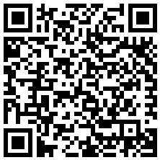




QR CODES
FROM THE FLIGHT DECK VIDEOS:
CONSTRUCTION:
FAA
YouTube
NOTAMs
CND
Checklist
ACAC mailbox
AIRFIELD DRIVERS:
FAA WEBSITES/ LINKS:
Situational
Awareness
Phraseology
Winter Ops
Airport
Diagram
Pilot
Simulator
AAN
EMAS/ RIM
Runway Safety
Home Page
Airfield Operating Surfaces Video
FAAST
Hot Spot Description
ARP SMS
ATO SMS
Notes:
PRESENTER NOTES
Print out and distribute or share via email with your RSAT attendees this and the following slide with key presentation links.
This is a QR Code library that includes those included in the presentation today.
Additional Instructions:
This page can be paused for folks to get codes they missed or it can be printed, emailed or posted to participants.

Slide 66
Air Traffic Manager
Steve Ingebretson
530-414-1641 | trknfct@midwestatcs.com
Air Traffic Services Manager
Amy St. Pierre
913-787-5461
amy.st.pierre@midwestatc.com
Director of Aviation
Jeff Menasco
530-587-4119 x106 | jeff.menasco@truckeetahoeairport.com
Notes:
PRESENTER NOTES​
​
Talking Points:​
Thank the group for their participation. ​
​
Presenter Tip:​
Ensure everyone has signed in so they can be included in the follow-up process.
Follow up by sharing a draft of your Runway Safety Action Plan (RSAP) with key parties before sending for Runway Safety acceptance.
Once accepted, share a final, signed copy with primary stakeholders.
Save final copy electronically to a local place for reference and record keeping and/ or upload to your repository for safe keeping. ​

