Slide 1

Preventative Maintenance by owner or operator
By Doug Lee & Bjorn Anderson
Notes:
-Title
-Intro
-Literature References - Bulletins, FARs, Logbooks, Maintenance Manuals
-Preventative Maintenance
-Who Performs
-Reference Material
-Logbook Entries
-Owner Assisted Annual
-Spreadsheet (inspection schedule)
-Benefits of Preventative Maintenance
-Questions.

Slide 2
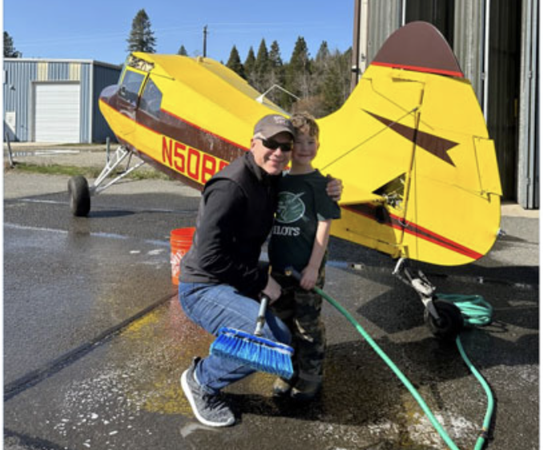
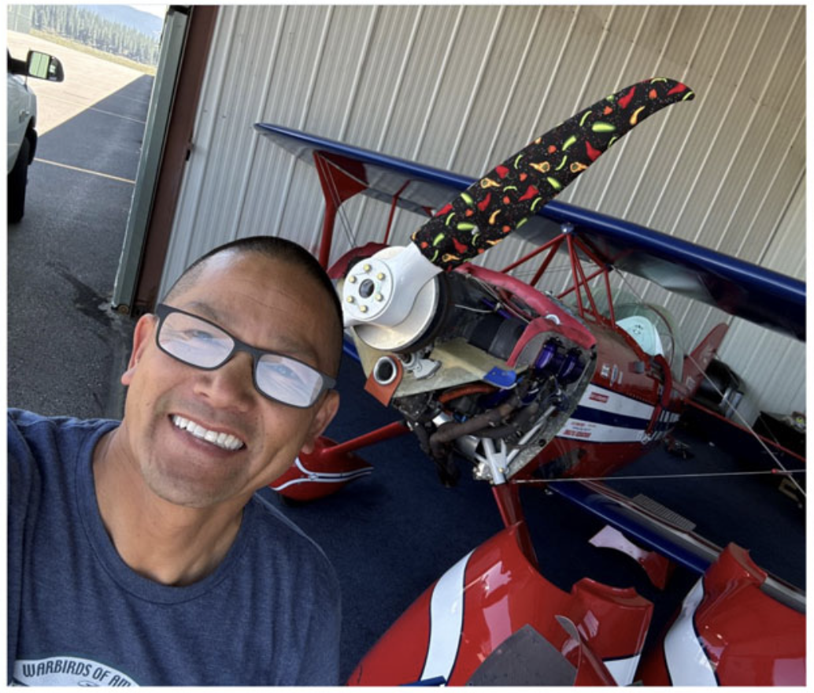
A little about Us….
Rated pilot since 1990, >15,000 hours
ATP, CFI, A&P, IA
Captain for Alaska Airlines, Gatekeeper on FOQA (flight operations, quality assurance) team.
Participated on NTSB investigation as a party member.
Have owned several aircraft including twin engine Cessna and Beechcraft
Rated pilot since 1988, >15,000 hours
ATP, Commercial Helicopter, CFI
A&P, IA,
Captain for Alaska Airlines, Performing Functional Check Flight (post heavy maintenance test flight) FCF.
Owner of several aircraft including a Pitts Special

Slide 3
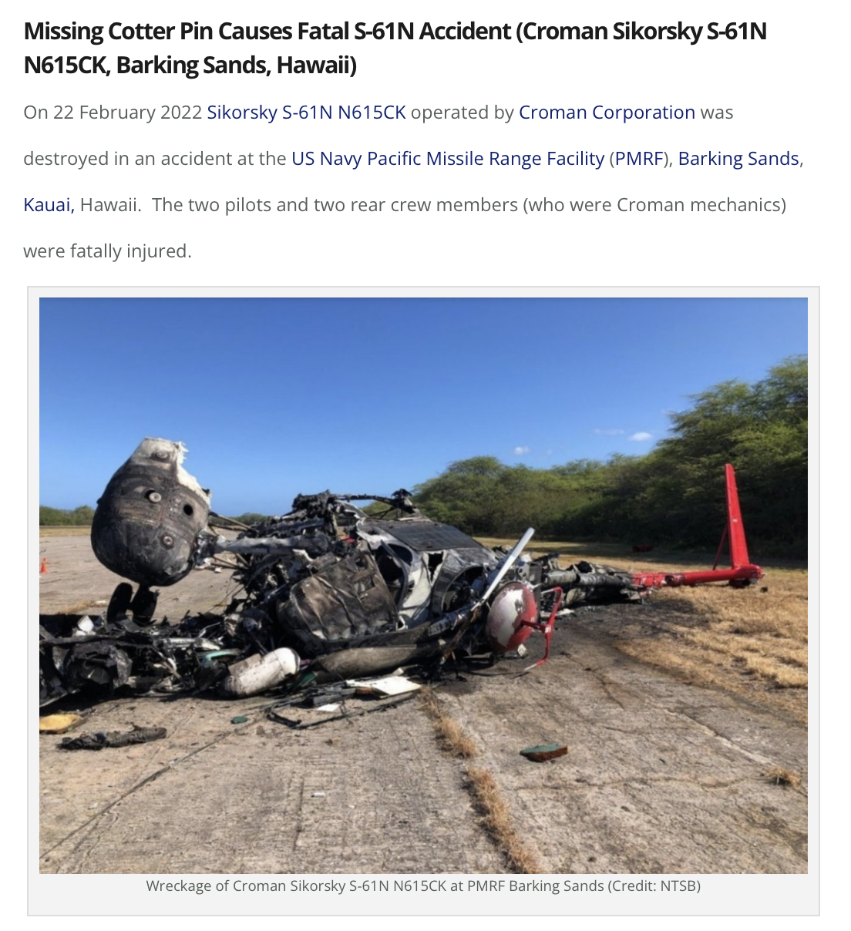

Why are we here?
Missing chain Cessna fuel cap

Slide 4

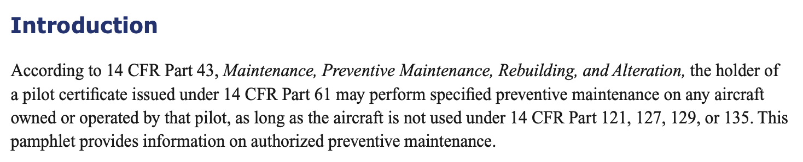
What is allowed by the FAA?
43.17 Appendix A(c)
FAA allows owner or operator of the airplane not being used for part 121, 129, or 135 operations
They must hold at least a private pilot certificate issued under part 61

Slide 5
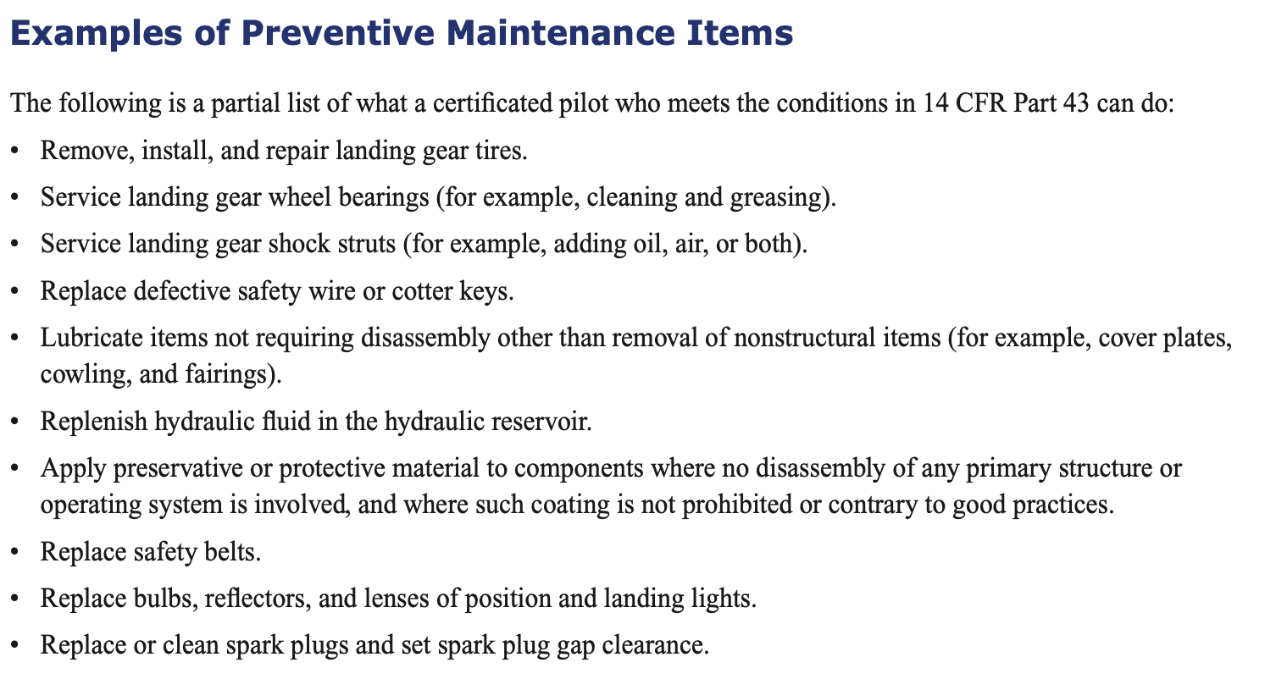
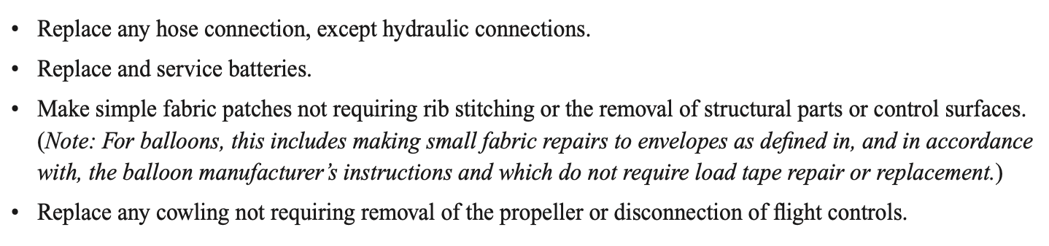
Authorized preventative maintenance tasks
Tasks must not involve “complex assembly operations”.

Slide 6
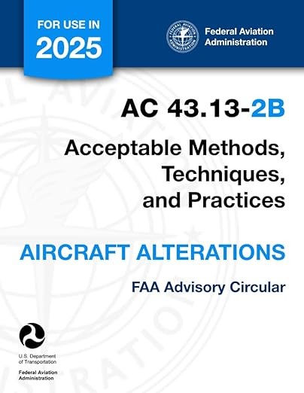
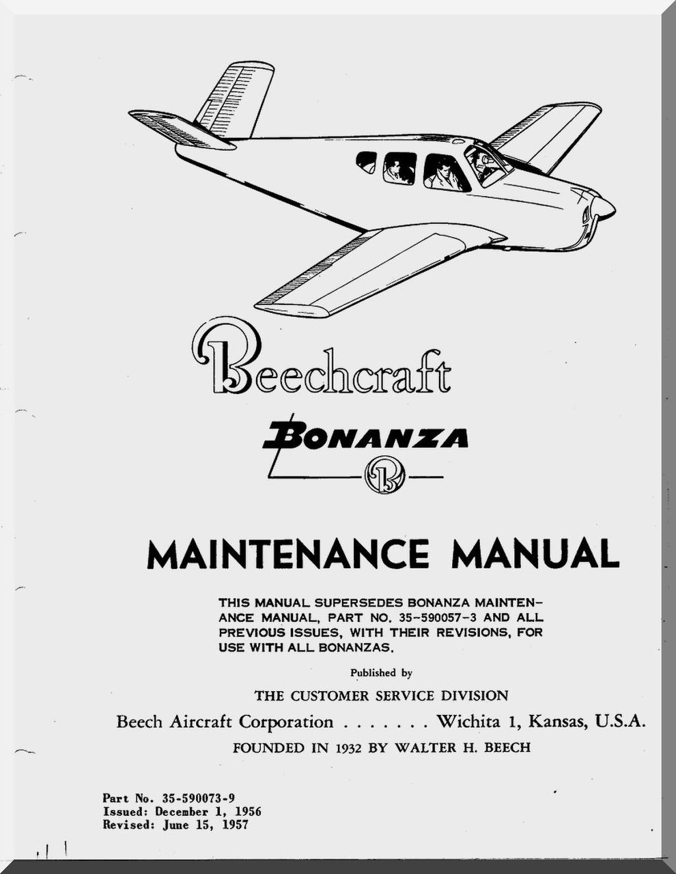
Procedures and standards
Maintenance must follow manufacturer instructions or FAA-accepted practices.
Must use appropriate tools.
Must use appropriate parts.
Only the pilot who performed the work can approve the aircraft for return to service, requiring at least a private pilot certificate.

Slide 7
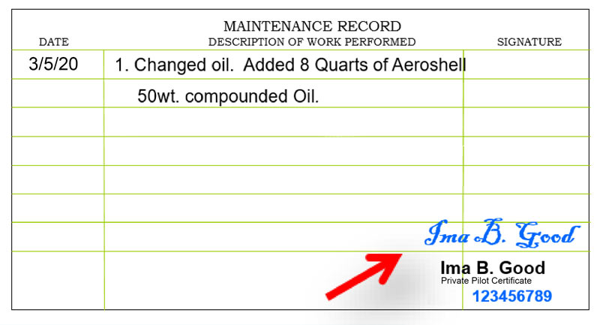
Documentation
Maintenance record entry is legally required per 14 CFR 43.9.
The entry must describe the work, date, name and signature of the person who performed the work, their certificate number, and the type of certificate. The signature signifies responsibility for the work.

Slide 8

Post maintenance flight check
In depth and thorough pre-flight, tool count.
Conduct operational check.
Confirm proper function.

Slide 9
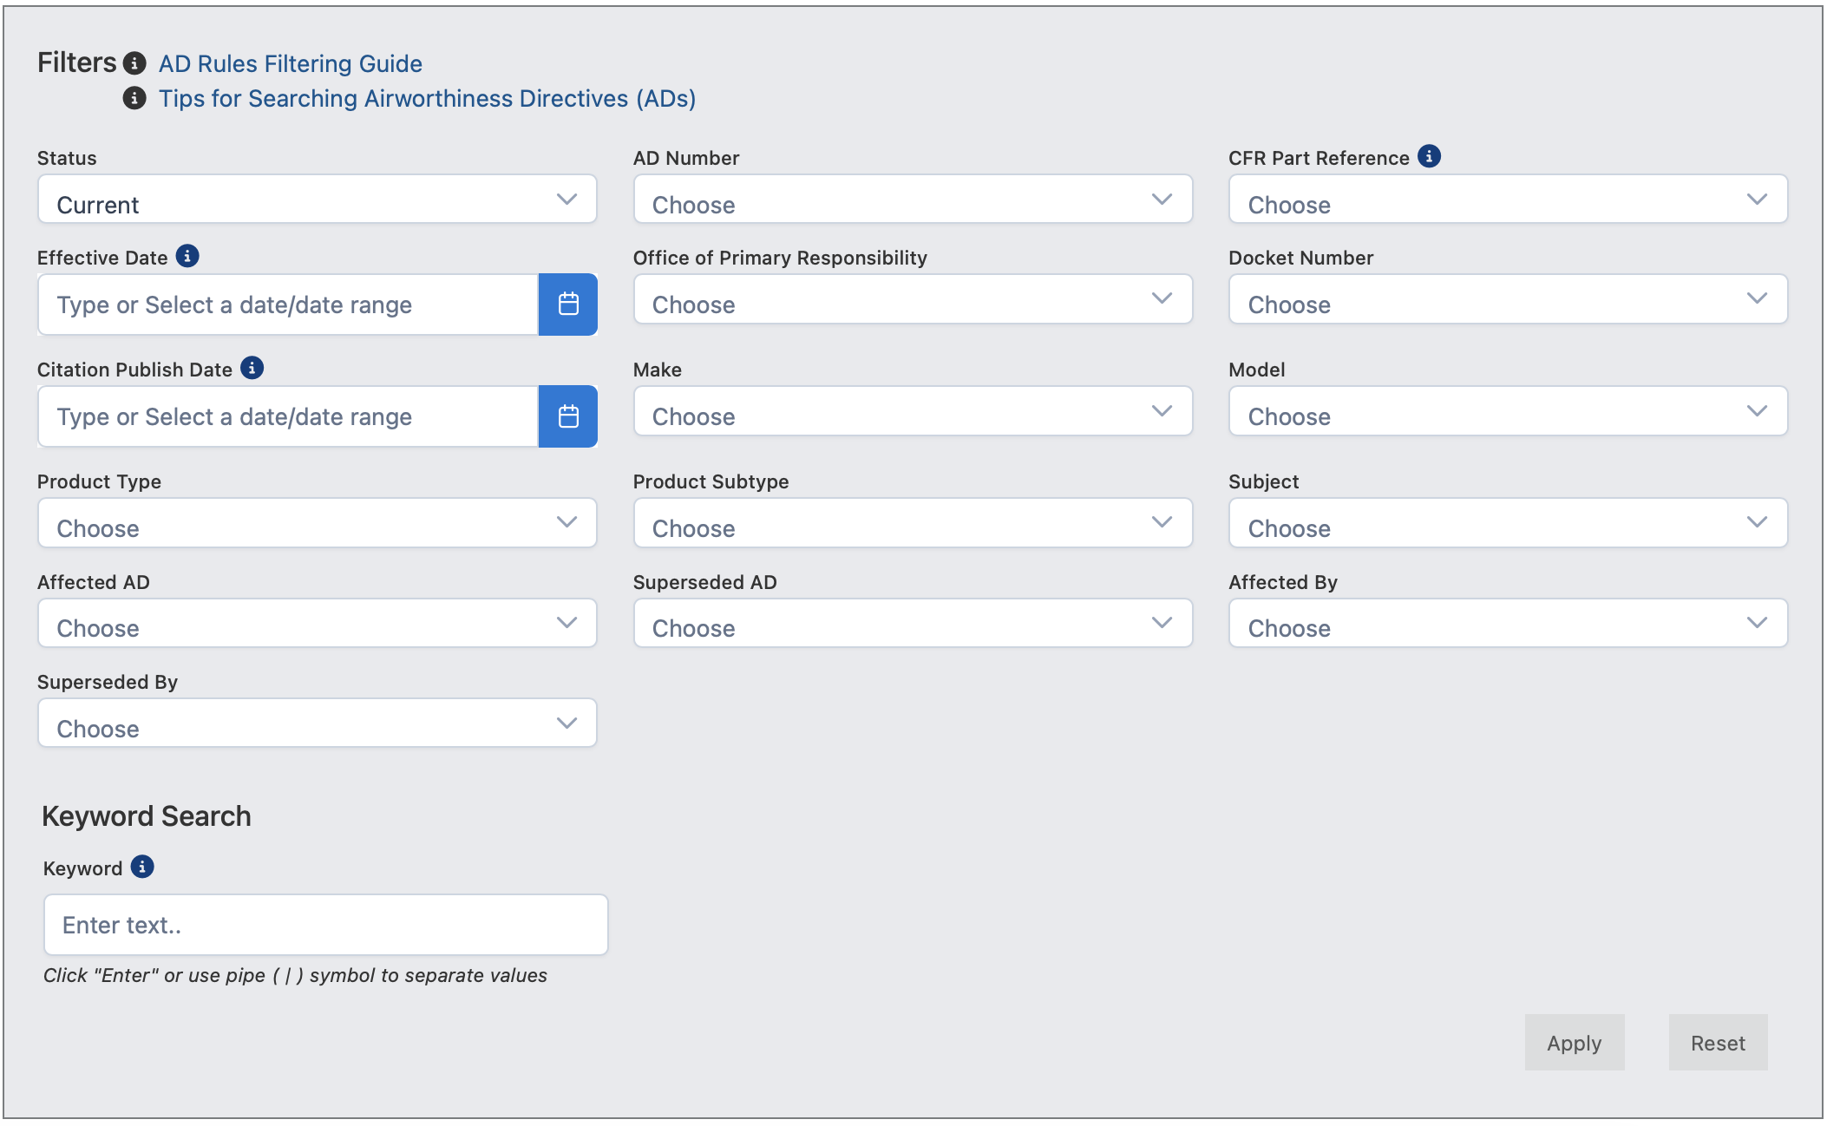
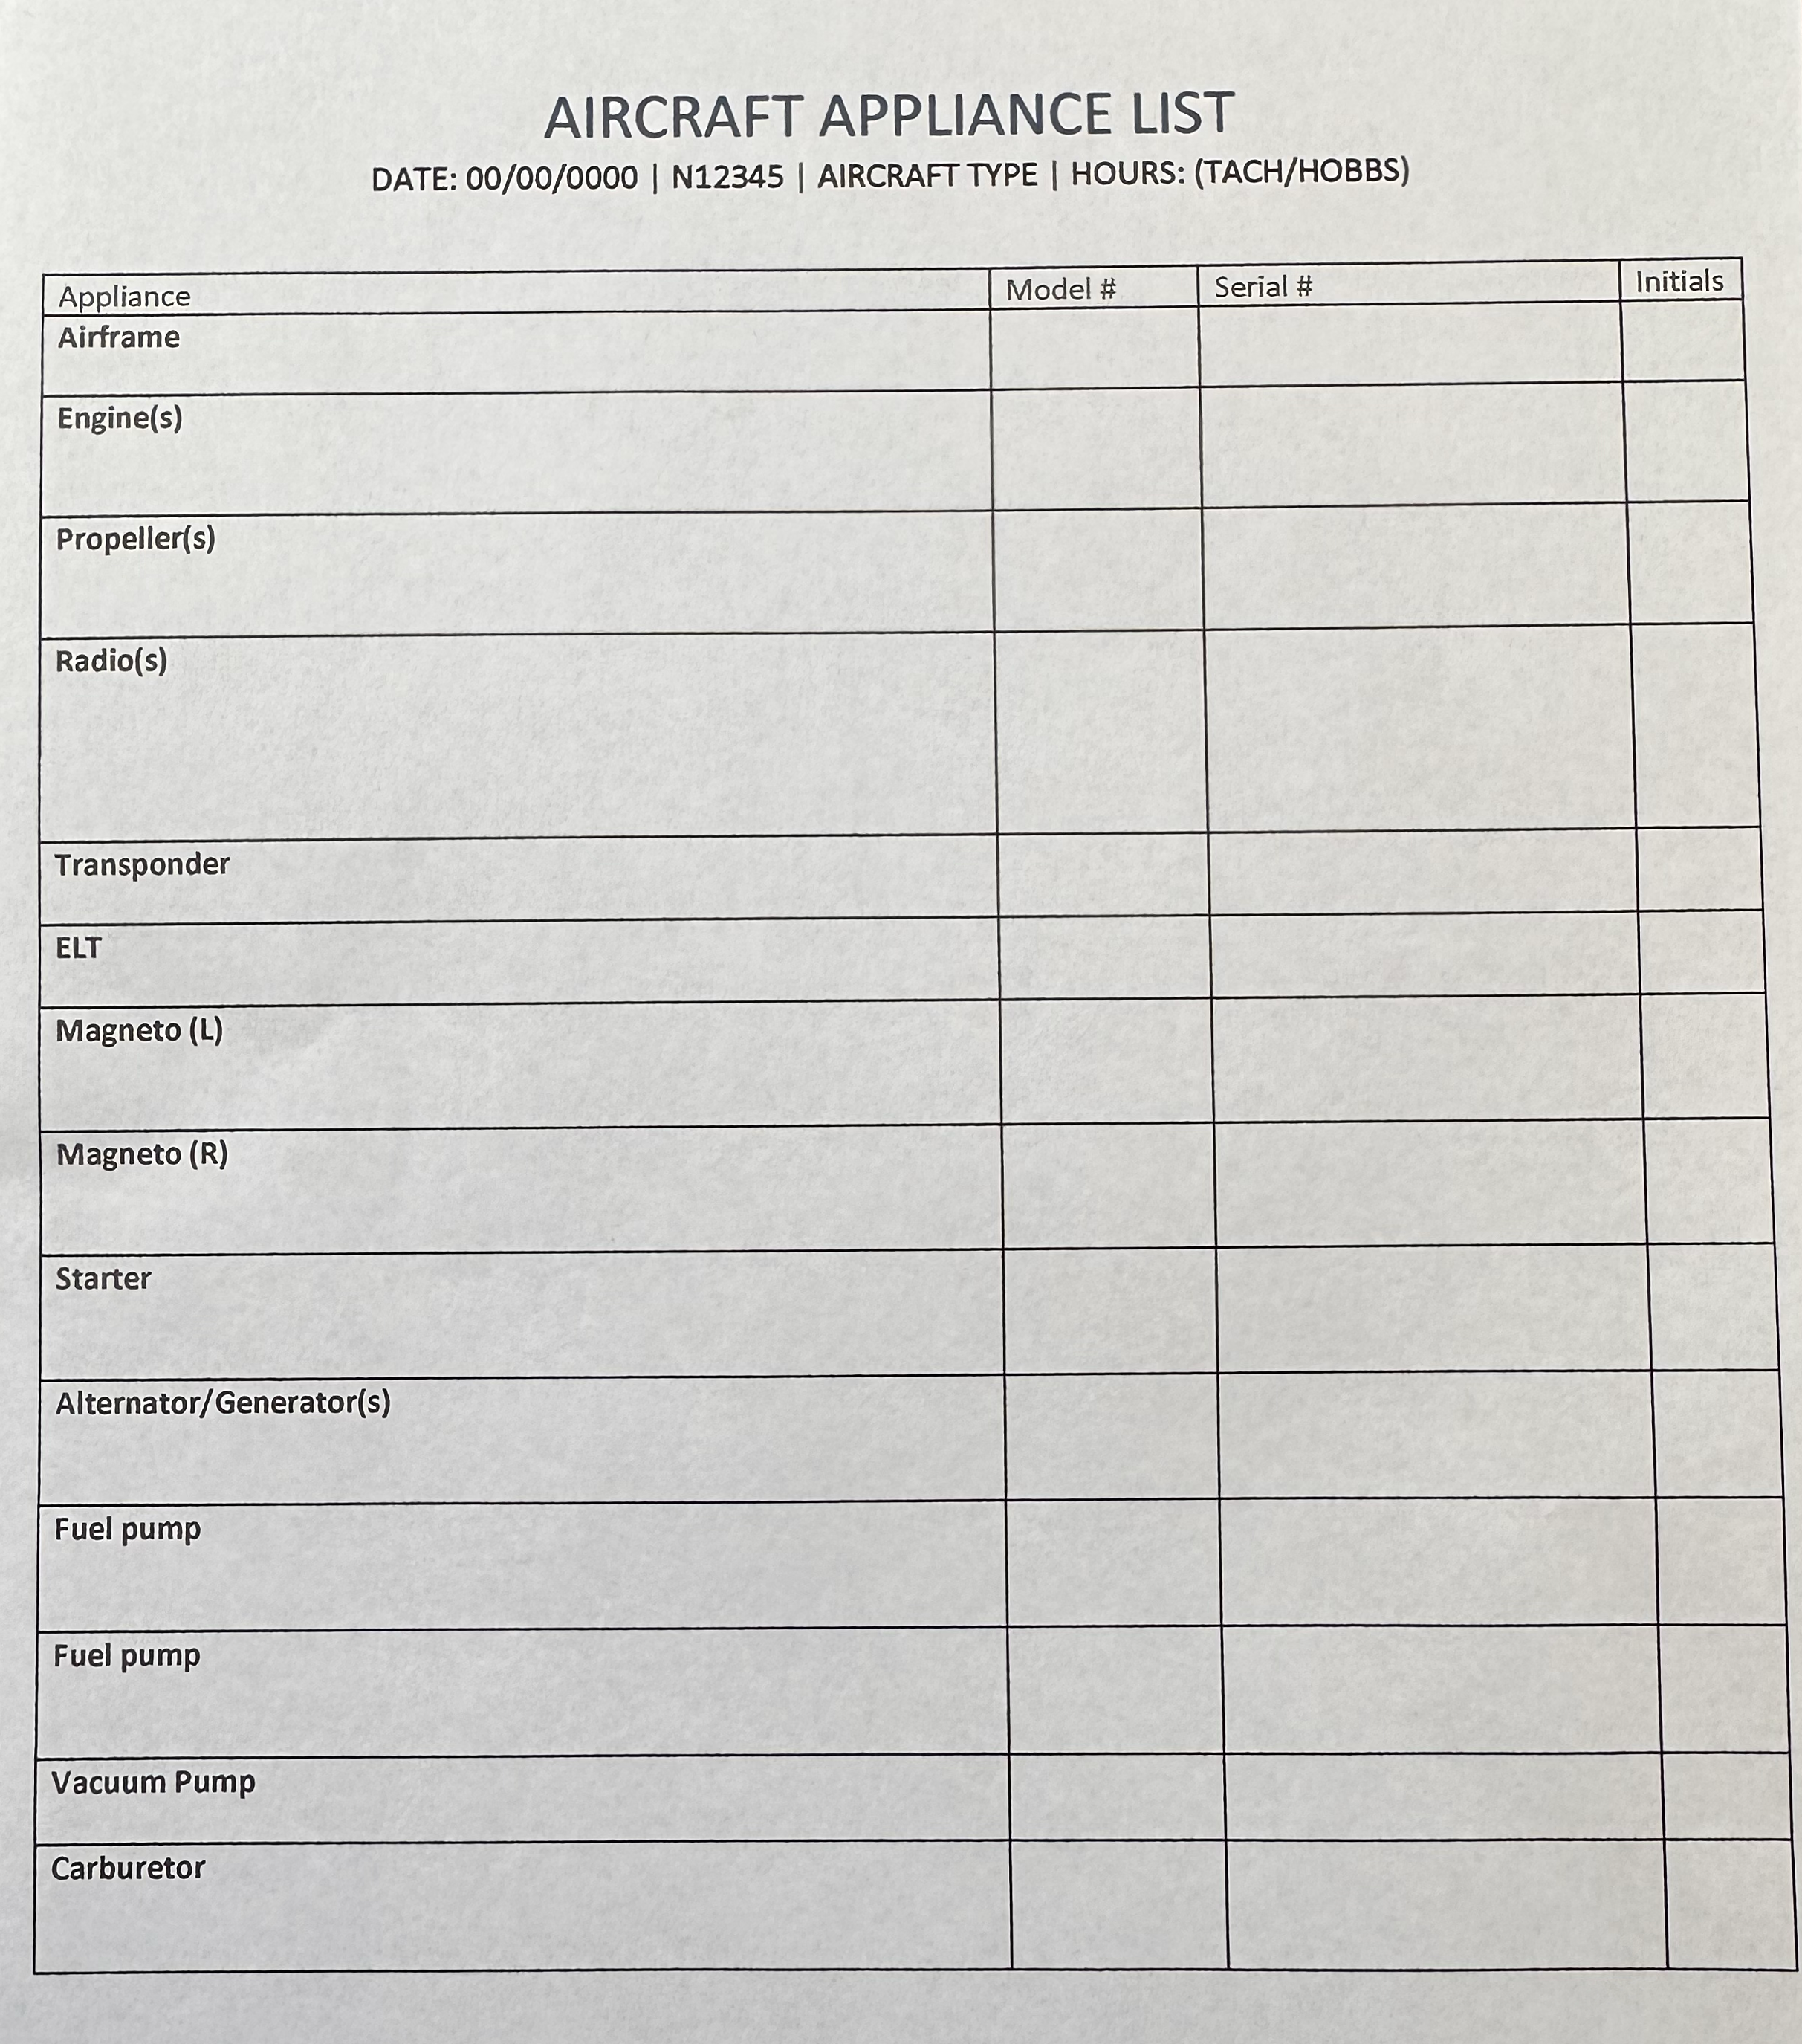
Aircraft AD search
Airworthiness Directive Search (FAA website)
Aircraft Appliance List

Slide 10
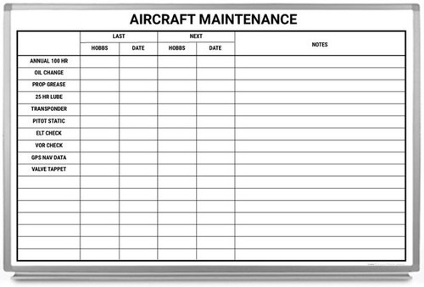
Are you legal to fly?
Aircraft annual
Registration
Insurance
Taxes
PST
ELT
Oil change
Engine TSMO
AD’s
Life limited parts
Medical
Flight review

Slide 11

conclusion
Legal authority (14 CFR 43 Appendix A, Subpart C)
Specific tasks NOT to include “complex assembly operations”
Procedures → tools, parts, and reference material
Documentation → logbook entry

Slide 12
Q&A

