Slide 1
Automatic Dependent Surveillance Broadcast (ADS-B)
101 Information | History |Definitions | Rules | Outlook
KTRK Surveillance | MLAT | Missing Data | NAS
Unintended consequences | Basics | Survey | Outreach
Next Steps | Contract | Off ramps | Roadblocks

Slide 2
Staff Role in the ADS-B Initiative
To provide the Board and Community unbiased, relevant, and factual information from informed sources regarding ADS-B.
Use industry accepted guidance to understand what benefits ADS-B will bring to pilots, passengers, and the airport.
Use regulatory guidance to understand how our airport will function with or without the pending mandatory ADS-B implementation.
Understand the positive or negative safety implications of ADS-B.
Exhaustively search for potential unintended consequences of an ADS-B installation at Truckee Tahoe Airport.

Slide 4
History: https://www.youtube.com/watch?v=BDLFHdq540g

Slide 5
Definitions
Radar: Existing technology that provides guidance and separation for aircraft by a tower or center controller.
Traffic: Pilot views other planes, altitude, heading, speed, distance.
Weather: Pilot views radar, clouds, precipitation, icing reports, PIREPS.
Flight Information: NOTAMS, runway closures, flight restrictions, hazards.
Situational Awareness: Collective understanding of disparate information: traffic, weather, flight info, etc. that allows a pilot or air traffic controller to be fully informed regarding safety of flight.
IFR: Flight under instrument flight rules or low visibility.
Cockpit Display: A screen that provides info to the pilot from ADS-B.
MLAT: Multi Lateration Tracking. Existing KTRK system, closed loop.
Flight Procedure: A system of points the aircraft follows (lat./lon./vert.) to find the airport and transition from the enroute phase to the approach.
Terrain: Hills: Mountains and obstructions that restrict aircraft operation.

Slide 6
ADS-B System Points
“Out”: Technology that transmits information about an aircraft and its location and altitude. (FAA mandate requirements explained next.)
“In”: Technology that displays for pilots ADS-B information (Traffic, weather, etc.) (Not required by FAA mandate.)
Ground station: Collects ADS-B data from nearby planes, adds weather, transmits a “complete picture” for all aircraft in the service area. (Not required by FAA mandate.)
Note – Without the Ground Station, pilots in the Truckee area will NOT SEE ADS-B “IN” information reliably until they are above 10,900 feet, because of terrain that blocks ADS-B ground stations in Reno and the Bay Area. Likewise, air traffic controllers (and our own tower personnel) will also be “blind” to aircraft below 10,900 feet in the area. The ground station eliminates this ADS-B “blind spot” in our area.

Slide 7
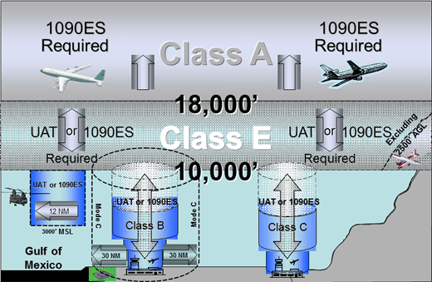
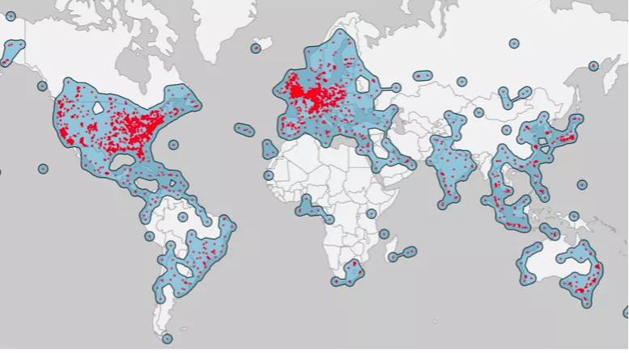
Rules for ADS-B “Out” on Aircraft
All aircraft 10,000’ or higher above sea level and 2,500’ or higher above ground level
All aircraft above or in Class C (Reno, Sac, Oakland, SJC); or above, in or within 30 miles of Class B (SFO)
Some exemptions: balloons, gliders, experimental, etc.
Most aircraft arriving/departing KTRK over terrain will require ADS-B
Most of the world is covered
ADS-B “Out” mandate takes effect 1/1/2020

Slide 8
Outlook:https://www.faa.gov/nextgen/how_nextgen_works/new_technology/adsb/ FAA sees a connected, integrated and efficient system.

Slide 9
KTRK Surveillance (Multi-Lateration)
MLAT built by the District and ERA Systems; installed in 2007; became operational in 2009 and has a service life of 15 years.
Annual maintenance budget approximately $250,000, including software, tech, ground leases, contractors and licenses.
MLAT is closed loop, non-integrated, designed for annoyance reduction only, but safety benefits abound.
KTRK MLAT is not/will never be accepted by the FAA.
MLAT is approaching end of life.
Tower controllers use MLAT as advisory guidance only.
MLAT doesn’t allow planes to see planes, weather, traffic or terrain.

Slide 10
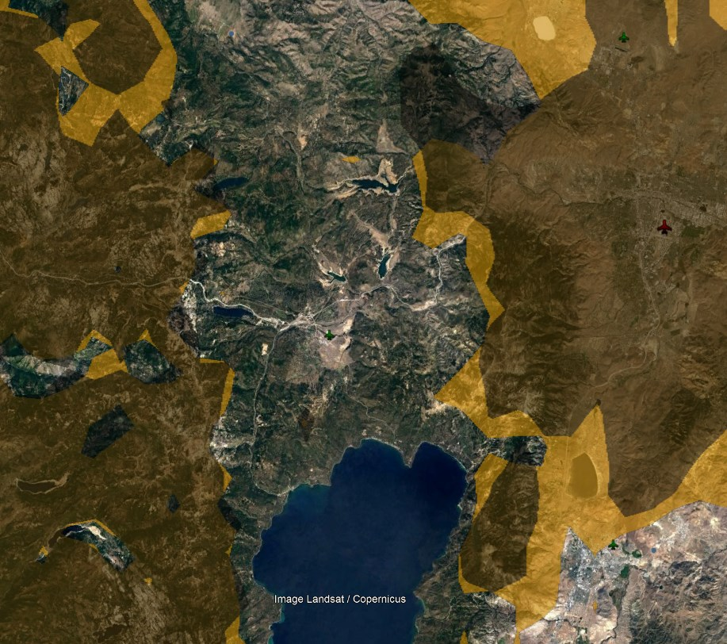
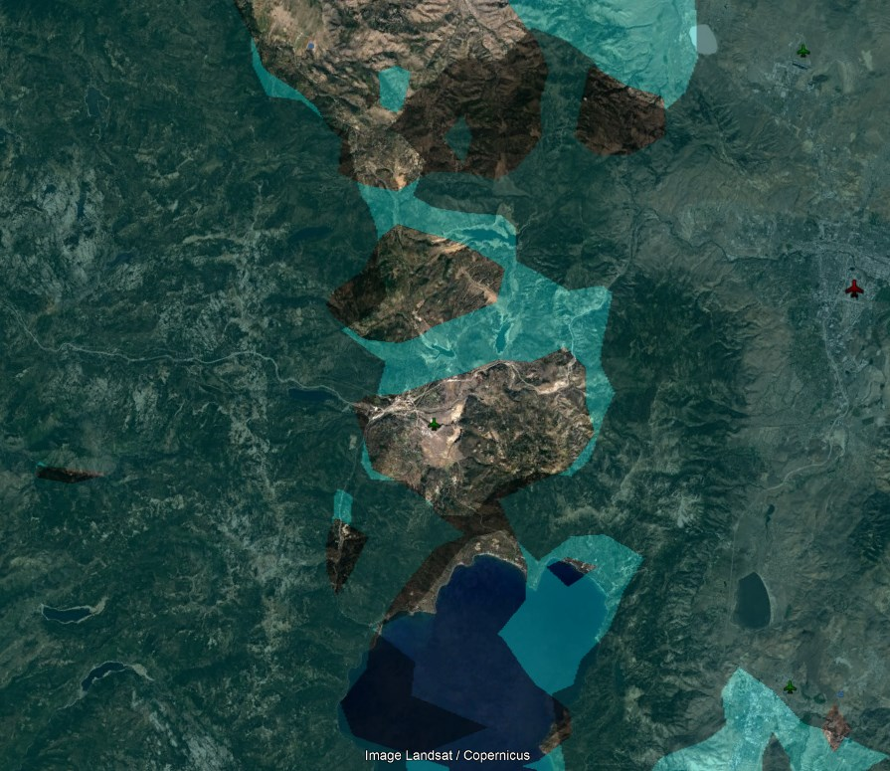
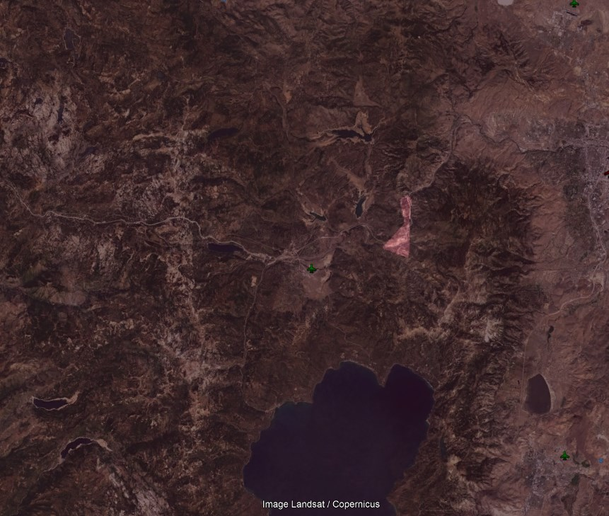
Missing Data KTRK is a black hole…
1500 AGL or 7400 MSL
500 AGL or 6400 MSL
3000 AGL or 8900 MSL
5000 AGL or 10,900 MSL

Slide 11
EXISITING CONDITION 500 AGL or 6400 MSL
GREEN indicates ADS-B Coverage
KTRK

Slide 12
EXISITING CONDITION 1500 AGL or 7400 MSL
YELLOW indicates ADS-B Coverage
KTRK

Slide 13
EXISITING CONDITION 3000 AGL or 8900 MSL
GREEN indicates ADS-B Coverage
KTRK

Slide 14
EXISITING CONDITION 5000 AGL or 10,900 MSL
BROWN indicates ADS-B Coverage
KTRK

Slide 15
National Airspace System (NAS)
HOW Airspace Capacity Reduces Annoyance & Emissions
Reduces Hold Times
Reduces Ground Delays
Allows less maneuvering prior to landing
Allows straightened paths
Enroute Controllers can’t see KTRK
Aircraft sent to KTRK with 1 in 1 out
Aircraft held overhead or maneuver
Aircraft wait on the ground idling
ADS-B allows controllers to keep traffic moving
Permits takeoffs without ground delays
Reduces time over Truckee by straightening tracks
Reduces holding
Gives controllers and pilots awareness
Allows for faster arrival/departure sequences

Slide 16
Unintended Consequences
Will ADS-B drive additional traffic? Demand Drivers Study 2015 states two major findings:
(1) Drivers of airport activity are largely outside the airport’s control.
(2) Current drivers are the location of the airport and the strong national and regional economy.
Will ADS-B drive night demand? Aircraft can currently land and depart at KTRK 24 hours/day using GPS guidance and lighting in inclement weather to a height of 526’. Surveys indicate there is little demand for night operations.
Will ADS-B enable aircraft to operate in bad weather? The weather criteria for KTRK will not change based on ADS-B. But pilots will have better weather data, which might affect a pilot’s go/no-go decision.
Will ADS-B make our community unsafe? All data indicates the contrary.

Slide 17
Aircraft Pilot & Operator Survey
Who: NetJets, SurfAir, Wheels Up, Mt. Lion, Charter, Fractional, Part 91, turbo prop, jet, piston, home based, itinerant, hangar tenant et. all.
Why: To identify potential changes in airport activity and demand, and to understand potential downsides or unintended consequences.
Other Sources: What other sources provide information on ADS-B that Staff has investigated.
The FAA
The Airline Industry
Pilot Groups such as AOPA, EAA, NBAA, NATA, GAMA
National Academy of Science ACRP NextGen for Airports
Manufacturers of technology Harris Corp

Slide 18
Survey Results

Slide 19
Survey Results

Slide 20
Survey Results

Slide 21
Survey Results

Slide 22
Survey Results

Slide 23
Expert Testimony: Chris Balle, Program Manger, Harris Corp. 650+ Site Installations across America. Paul Freeman, Deputy Program Manager, ADSB Liaison (Garmin, AOPA, NATA, GAMA etc.).
Has any airport or community, city, or system reported negative impacts from ADS-B installation or coverage? No, not to date, unaware of anything like that.
Has ADS-B been linked to an increase in airport traffic, flight congestion, or demand? No correlation to additional flights, the opposite it allows balancing and avoids “one in/out”.
Has ADS-B emboldened pilots to behave unsafely in any way? No not that we know of.
Has ADS-B promoted flying at night or is there any benefit that ADS-B offers to a night flying pilot that isn’t available during the daytime? No.
“Symphony and other flight tracking products using ADS-B technology are helping communities track flights and actually reduce annoyance”.
“11 years of ADSB operation, not one single example of more noise, or more traffic, or anything”.
“I’m deeply imbedded in the industry, I have never seen, anywhere in the industry that ADS-B does anything except enhance safety”.

Slide 24
Expert Testimony: David Gray, Surveillance & Broadcast Services Program Manager FAA
Has any airport or community, city, or system reported negative impacts from ADS-B installation or coverage? No, not to date, unaware of anything like that.
Has ADS-B been linked to an increase in airport traffic, flight congestion, or demand? I don’t know how ADS-B would increase traffic…it will increase capacity and enhance through put but not demand.
ADS-B may prevent holding, loitering, and delays by allowing aircraft to see each other while controlled by the tower and the center controllers with more accurate flexibility.
Colorado mountain airports used Wide Area Multi Lateration and had fears of additional impacts. What it provided was visibility and ultimately a more timely arrival and departure sequence.

Slide 25
Outreach to Date
Connected – Winter 2018 mass mailer: feature article and graphic on ADS-B
Pilot News - Fall 2018 edition: “Business of the Airport is Your Business” (~150 words)
TTAD “Community Open House” – 6/13 & 7/9/2018: staffed station for public discussion of ADS-B with printed information available
Connected – Summer 2018 mass mailer: radar surveillance mention in “Business of the Airport is Your Business”
Pilot News – Spring 2018 edition: ½ page featured article and graphic about ADS-B
TTAD Website – May, 07, 2018: ADS-B posting in Airport Community News “Airport Board looking at bringing ADS-B to KTRK”
TTAD Facebook – March 1, 2018: ADS-B feature post
E-Blast – December 2017: ADS-B 2020 mandate mentioned in “Enhanced MLAT Display at KTRK”
TTAD “Community Open House” June and July 2016: Six meetings held throughout Truckee

Slide 26
Outreach in the Cue
Splainers video: https://vimeo.com/300875793
Weekly micro meetings
“Go Flying and See for Yourself!” commercial operator flights
Abby Agency outreach: social media, sponsored content
News print, e-blast, Connected News, website, radio

Slide 27
Next Steps… A lot of Work
Complete a service contract with Harris for design and construction. $60K.
Final Cost and Scope (Contract). Final cost estimates unknown.
Approve final contract for service with Harris.
Complete an integration plan with the FAA.
Complete land leases and site agreements with Squaw and Northstar.
Build a sensor array of 1, 2 or 3 sites on top of the mountain(s).
Complete System Acceptance Testing and Flight Testing.
Integrate tech and service agreements allowing towers use of the data.
Integrate Oakland Center.
Retrain airport users and the flying public on KTRK protocol.

Slide 28
Offramps
Now, before $60K for service contract design and construction
After service contract, prior to final contract
Prior to construction, by phase

Slide 29
Roadblocks
Cost
FAA cooperation
FAA political climate, leadership, delays, etc.
Oakland Center funding
Tower contract and integration of data
Tower certification
Site and land leasing agreements, construction delays and environmental impact

Slide 30
Impacts from Technology and Airfield Infrastructure

